Slide 1
Determining Disulfide Linkage Patterns in Protein by Utilizing Tandem Mass Spectrometric Data and Applying a Perfect Matching Algorithm
Timothy Lee
San Francisco State University
Notes:
I’m Timothy Lee. Dr. Singh is my Thesis Advisor, a professor in the Computer Science Department at SFSU. Dr. Macher is a professor in the Department of Chemistry and Biochemistry there, and Dr. Yen runs the Mass Spectrometry lab for SFSU.
The MS2 part comes from a notation used for tandem mass spectrometry, and the DB part stands for disulfide bond.

Slide 2
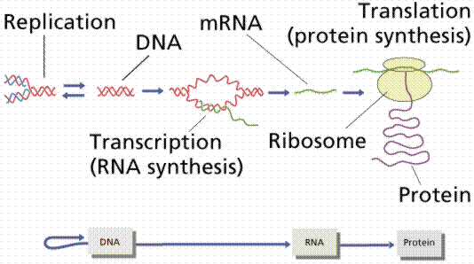
Central Dogma of Molecular Biology
Notes:
The Central Dogma of Molecular Biology can be viewed as a description of the mechanism by which information stored as genes in DNA is ultimately transmitted to a protein. DNA sequencing technology is giving us large amounts of data on genes, which leads to a relatively straightforward mapping to the amino acid chains which make up the primary structure of the protein. However at this point, things become complicated…

Slide 3
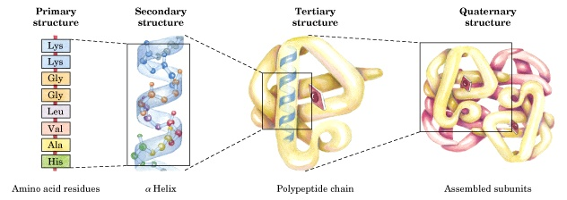
Conformational Space Problem
Notes:
…because, as we know, this chain of amino acids promptly folds up into the protein. And it is a protein’s three dimensional, or tertiary, structure that determines its biological function. But for all its importance, the determination of the tertiary structure of a protein is not straightforward, a tedious process at best and sometimes not even possible with currently available methods.
In computational terms, the mapping of a one dimensional structure into a three dimensional structure is called the conformational space problem. At this level of abstraction, with no other modeling constraints, this space grows exponentially with the number of amino acid residues. The goal of this work is to identify some constraints to reduce this conformational space.

Slide 4
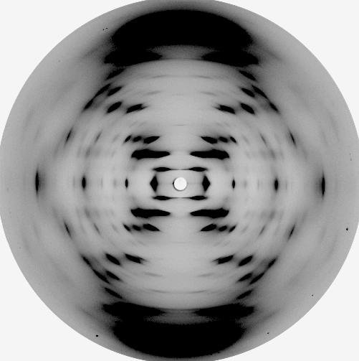

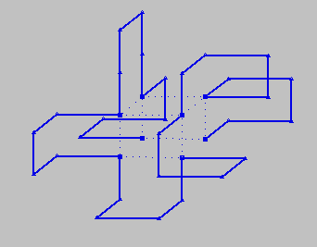
Determining the Tertiary Structure of a Protein
Two methods are common:
  X-ray crystallography
  Nuclear Magnetic Resonance (NMR)
Limitations to both:
  Requires relatively large amounts (10 to 100 mg) of pure analyte
  Can take months/years to generate a molecular structure
  Risk of model bias
Ab initio structure prediction
  Not yet practically relevant

Slide 5
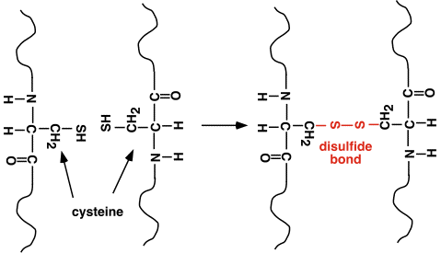

Formation of Disulfide Bonds
Notes:
Disulfide bonds form when the sulfhydryl (--SH) groups of cysteine residues come together and become oxidized. As a result, residues that are far apart in the primary structure of the protein may in fact be joined in its tertiary structure. Thus the importance of knowing the location of these bonds, as they significantly constrain the conformational space of possible ways the protein can fold.

Slide 6
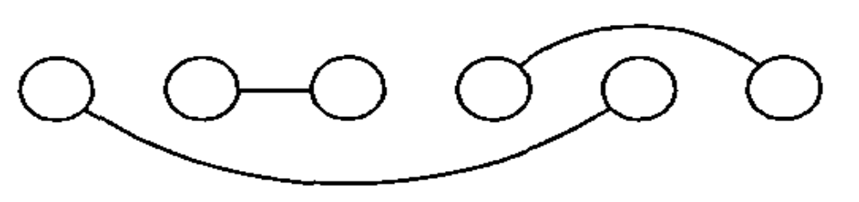
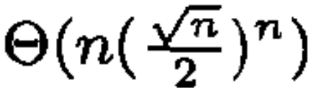
Disulfide Bond Prediction
Model as undirected graph (disulfide connectivity graph)
  Vertexes = bonded cysteines, edges = disulfide bond
  For |V| = n cysteines, time complexity of prediction algorithm is bounded by
Notes:
Quite a bit of recent research has gone into attempting to predict the disulfide bonding patterns in a protein based solely on its primary structure. This study showed that there is a theoretical upper limit to how well a prediction algorithm will scale, concluding that five cysteine pairs is a practical upper limit. In addition, the algorithms that have been implemented have prediction accuracies of only around 50%.
A disulfide connectivity pattern has a simple representation in terms of an undirected graph G = (V, E). The vertex set V represents the set of bonded cysteines and an edge eE corresponds to a disulfide bridge between its adjacent cysteines. Admissible vertex and edge sets are constrained because an even number of intra-chain bonded cysteines is required and a cysteine can only be bridged to one and only one different cysteine. Thus, we have |V| = 2B, |E| = B and degree(v) = 1 for any v V (perfect matching), where B denotes the number of disulfide bonds in a chain.

Slide 7
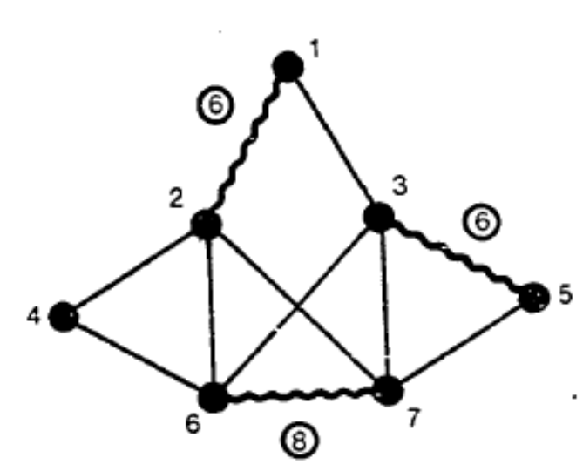
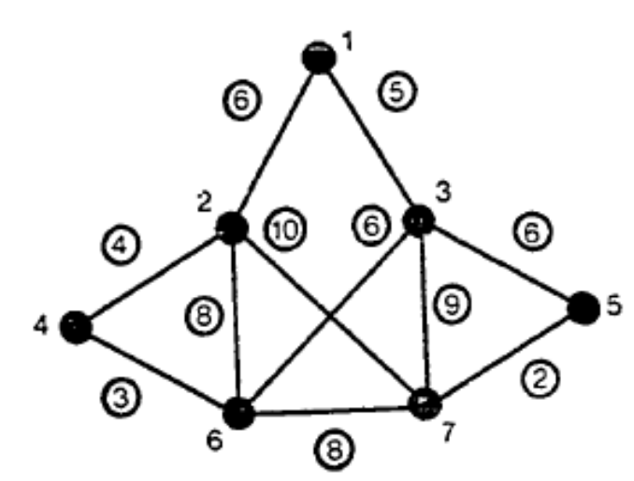
Equivalence to Maximum-weight Matching Problem
Algorithmic solution (Gabow 1973) is O(n³)
  Improved (Gabow 1990) to O(n²m+ n² log n)
    Equivalent for complete graph
How to assign edge weights?

Slide 8
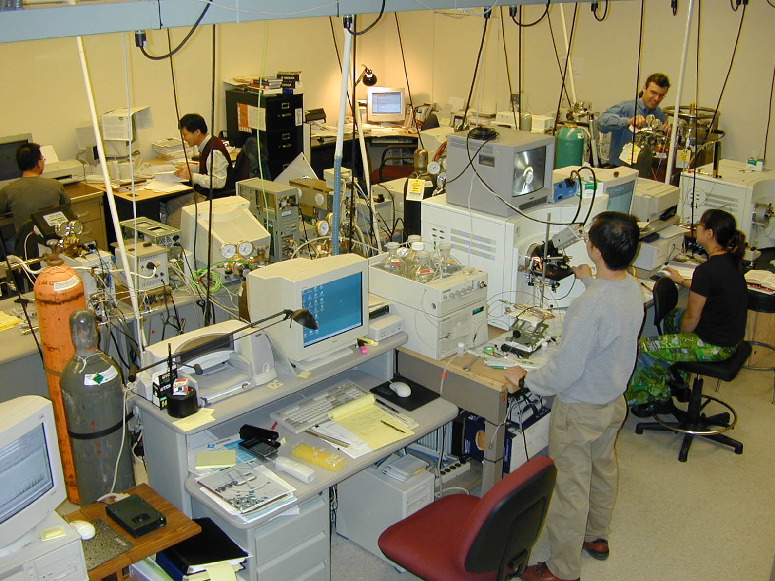

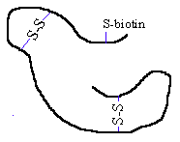
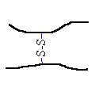

LC/ESI-MS/MS Method
Protein
Label Cys with
N-ethylmaleimide-biotin
Digest with Trypsin or Chymotrypsin
Analyze Digested Peptides by LC/ESI-MS/MS
Identify Cys-peptides and
Disulfide Bonded-peptides
Using
MS2DB to match MS/MS
Methods
Denatured with
8M Urea
Notes:
To assign the edge weights, we utilize data obtained from liquid chromatography electrospray ionization tandem mass spectrometry (LC/ESI-MS/MS) experiments. This methodology yields highly specific structural fragments derived from the disulfide bonded pair of peptides. The identification of the disulfide linkage pattern utilizes mass spectrometry (MS) data to make an initial identification of which peptides are involved in a disulfide bond. These bonded peptides are then fragmented, and a tandem mass spectrum (MS/MS) of these fragments is generated. The MS/MS data is analyzed to confirm the initial identification of a disulfide bond.
Our approach to determining disulfide linkage patterns utilizes data obtained from performing mass spectrometry analysis on the protein in addition to knowing its primary structure. First, free Cys residues are alkylated with a reagent. Otherwise, artifact disulfide linkages may occur after the digestion step. Trypsin breaks up the protein into peptides by breaking the amino acid chain along its arginine or lysine residues.

Slide 9
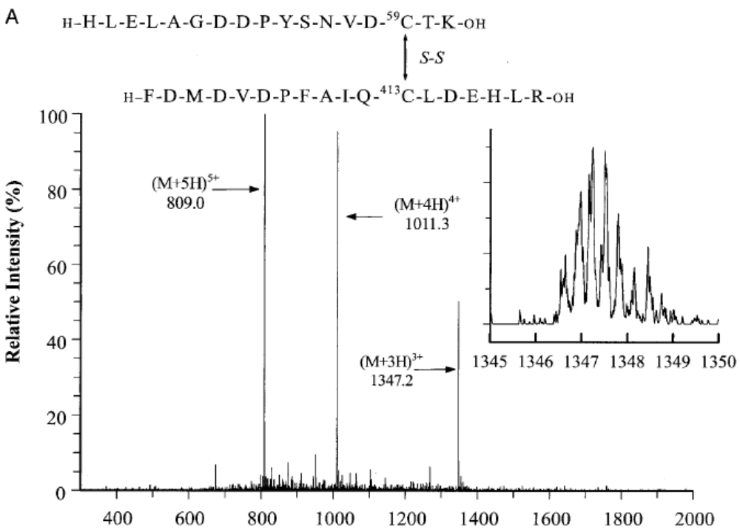
Peptide MS
Notes:
Let A denote the set of amino acid residues, each with mass m(a), a A. A peptide p = {ai} is a string of amino acids with mass m(p) = ∑m(ai) + 18 Daltons. The 18 Da. is included in this formula to account for the masses of H and OH of the the N- and C-termini of the peptide, respectively. A protein P = {pi} denotes the set of all peptides. A cysteine-containing peptide c is a peptide that has at least one if its ai identified as a cysteine residue. Thus if C = {ci} is the set of all cysteine-containing peptides, then C P. In practice, it is very rare that C = P.
A disulfide bonded peptide D12 is a pair of cysteine-containing peptides c1 and c2, with mass m(C12) = m(c1) + m(c2) – 2m(H). The disulfide bond mass space D = {di} of a protein is the set of every possible pair of cysteine-containing peptides. A mass spectrum MS = {msj} is the set of numbers obtained from a mass spectroscopy experiment that represent the masses of peptides, as well as chemical noise. A match mk between D and MS occurs between di and sj when |di - sj| < msmt, where mt is defined as the MS mass tolerance, the ± amount of experimental uncertainty that msj is allowed to have to determine the match. A MS spectrum match is the set of matches M = {mk} between MS and D. The existence of a MS spectrum mass indicates that the edge in G* connecting the cysteines contained in c1 and c2 may have a nonzero weight.

Slide 10
How Does a Peptide Fragment?
y3
y2
y1
A₁
A₂
A₃
A₄
H₂N
COOH
N-terminal
C-terminal
b1
b2
b3
m(b₁)=1+m(A₁)
m(b₂)=1+m(A₁)+m(A₂)
m(b₃)=1+m(A₁)+m(A₂)+m(A₃)
m(y₁)=19+m(A₄)
m(y₂)=19+m(A₄)+m(A₃)
m(y₃)=19+m(A₄)+m(A₃)+m(A₂)
Notes:
This slide explains how a peptide fragments, using a length four peptide as an example. Each ellipse is an amino acid.
The fragmentation most often occurs at the boundary of two amino acids. If it occurs between the first and second amino acids, then the resulting fragment ions are called b1 ion, because there is one amino acid in the ion; or y3 ion, because there are three amino acids in the ion. For the same reason, we can a b2 + y2 combination of ions, or a b3 + y1 combination.
The mass for each amino acid is known very precisely. Therefore, if the sequence is known, we can compute the mass of each fragment ions. For example, m(b1) = 1+m(A1), where A1 is the first amino acid, and the extra 1 is because the extra hydrogen in the unbonded amino group at the left end of the peptide. For the same reason, m(y2) = 19+m(A4)+m(A3), and 19 is because of the unbonded carboxylic acid group at the right end of the peptide.

Slide 11
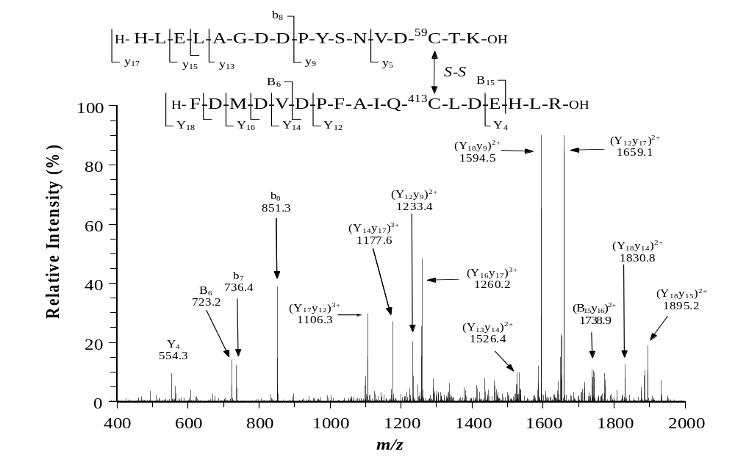
Fragment MS/MS
Notes:
For each MS spectrum match, a MS/MS mass spectrum TMS = {tmsi} of the fragmented peptides is obtained. A peptide fragment FrsP is a substring of P with mass m(Frs) = ∑r≤i≤s m(pi). A disulfide bonded fragment F12 is a pair of peptide fragments F1 and F2, with mass m(F12) = m(F1) + m(F2) – 2m(H). For there to be a disulfide bond between F1 and F2, each fragment must contain at least one cysteine. The disulfide bonded fragment mass space DF = {dfij} for two cysteine-containing peptides Pi and Pj is the set of every disulfide bonded fragment mass that can be obtained from these two peptides. A match mk between DF and TMS occurs between di and tmsj when |dfij - sj| < msmt, where mt is defined as the MS/MS mass tolerance, the ± amount of experimental uncertainty that tmsj is allowed to have to determine the match. A MS/MS spectrum match is the set of matches M = {mk} between TMS and DF. The match ratio r is then defined as the number of matches divided by the size of the tandem mass spectrum, i.e. r = ||M||/||TMS||. Finally, the match ratio is assigned to the weight we for the edge e of G* that was initially identified by the MS spectrum match.
In this tandem mass spectrum, each peak represents a fragment of this bonded pair of peptides.
The matches between the tandem mass spectrum and the mass tables are labeled in this slide. The mass-to-charge ratio of a peak that is identified as doubly ionized must be doubled in order to obtain the mass of a singly charged fragment pair.
Weight of bond between C59 and C413 is the number of peaks that are correlated with the disulfide bonded peptides divided by the total number of peaks in the spectrum.

Slide 12
Determining Disulfide Linkage Pattern
Define match ratio = number of matches divided by the size of the tandem mass spectrum
Compute match ratios for many MS/MS spectra
Construct disulfide connectivity graph, assigning match ratio as edge weight.
Maximum weight matching is disulfide linkage pattern best supported by data.

Slide 13
Results: Protein C2GnT-I
8
8
8
.96
1
1
1
1
.72
.84
.84
.84
7
2
7
.76
9
.86
.72
.86
.72
6
6
3
10
3
.72
.72
.72
.72
.98
.96
5
5
4

Slide 14
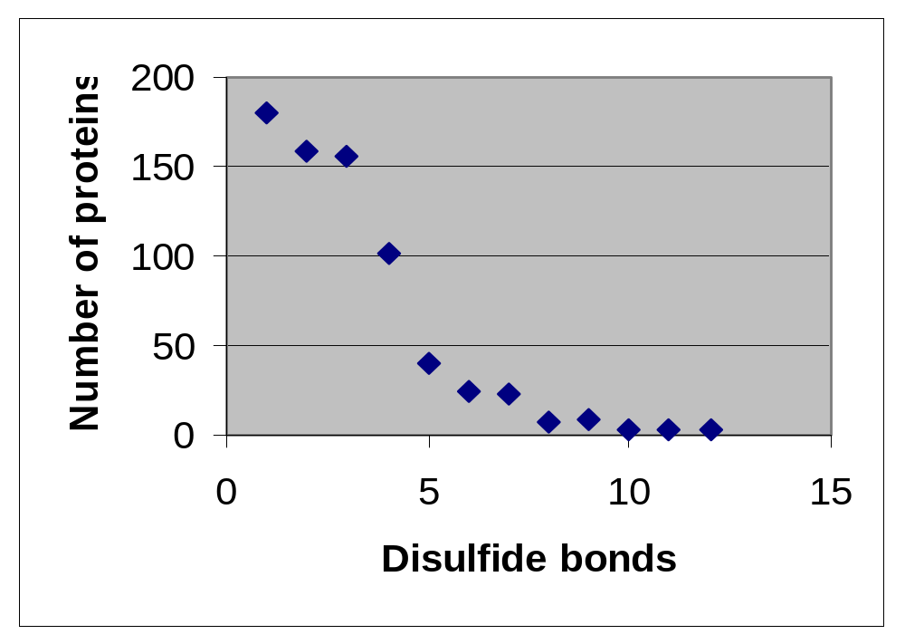
Observations (Mistaken Assumptions)
Number of cysteines in a protein not large

Slide 15
Observations (cont.)
Graphs are not complete!
  Sparse graph = m << n² (m = # edges, n = # vertices)
Brute force method is OK!
  Number of possible matchings = (n – 1)!!
  Compute weight of each, take max

Slide 16
An Idea
8
8
8
.96
1
1
1
1
.72
.84
7
2
7
.76
9
.86
.72
.86
6
6
3
10
3
.72
.98
.96
5
5
4

Slide 17
Protein ST8sia IV
1
1
1
2
2
.56
2
.66
5
.86
4
4
4
3
3
.56
3

Slide 18
A Matching Algorithm for Sparse Graphs
sparse-matching(G, w)
Obtain all v of minimum degree
M <- null
Obtain edge (u, v) of maximum weight
M <- M + (u, v)
Remove u, v, and all edges incident to them
Go to Step 3

Slide 19
A Counter-example
W_{algo} = 101, but W_{opt} = 198
Worst case scenario.
1
1
1
2
2
99
2
1
100
4
4
4
3
3
99
3

Slide 20
Approximation Algorithms
Need to be very fast (low time complexity)
Need to give “good” results, even if not optimal
Performance ratio c = W_{algo}/ W_{opt}

Slide 21
A Greedy Algorithm
greedy-matching(G,w)
sort the edges in decreasing weight w
M <- null
for (u, v) elements of E in order
do if u and v are free
then M <- M + (u, v)
return M
Theorem 1. The performance ratio for this algorithm is c = 0.5.
The algorithm runs in O(m log(n)) time.

Slide 22
Maximal matching
A maximal matching is a matching M of a graph G with the property that if any edge not in M is added to M, it is no longer a matching.
  Note: not the same as maximum matching!
Can compute by starting with an empty matching and extending it in each step by an arbitrary edge in such a way that it remains a matching.
Advantage: O(m)
Disadvantage: c = 0!

Slide 23
Combining Greedy and Maximal Algorithms
Preis (1999) replaced the heaviest edge used in the greedy algorithm by a locally heaviest edge.
  An edge is locally optimal if all other eligible edges e of the form (x, u) or (v, x) such that x is free have weight w(e) ≤ w(u, v).
Theorem 2. A maximal matching M made of locally optimal choices has c = 0.5
Refined version of this algorithm (Drake and Hougardy, 2003) runs in O(m) time.

Slide 24
Drake and Hougardy (2005) Algorithm
Main idea: start with a maximal matching M and increase its weight by short augmentations.
  Augmentation: replace one matching by another of larger weight.
  Short augmentation: an augmentation s.t. all edges in the augmenting set are adjacent to some edge e ∈ E.
  e is called a center of this short augmentation.

Slide 25
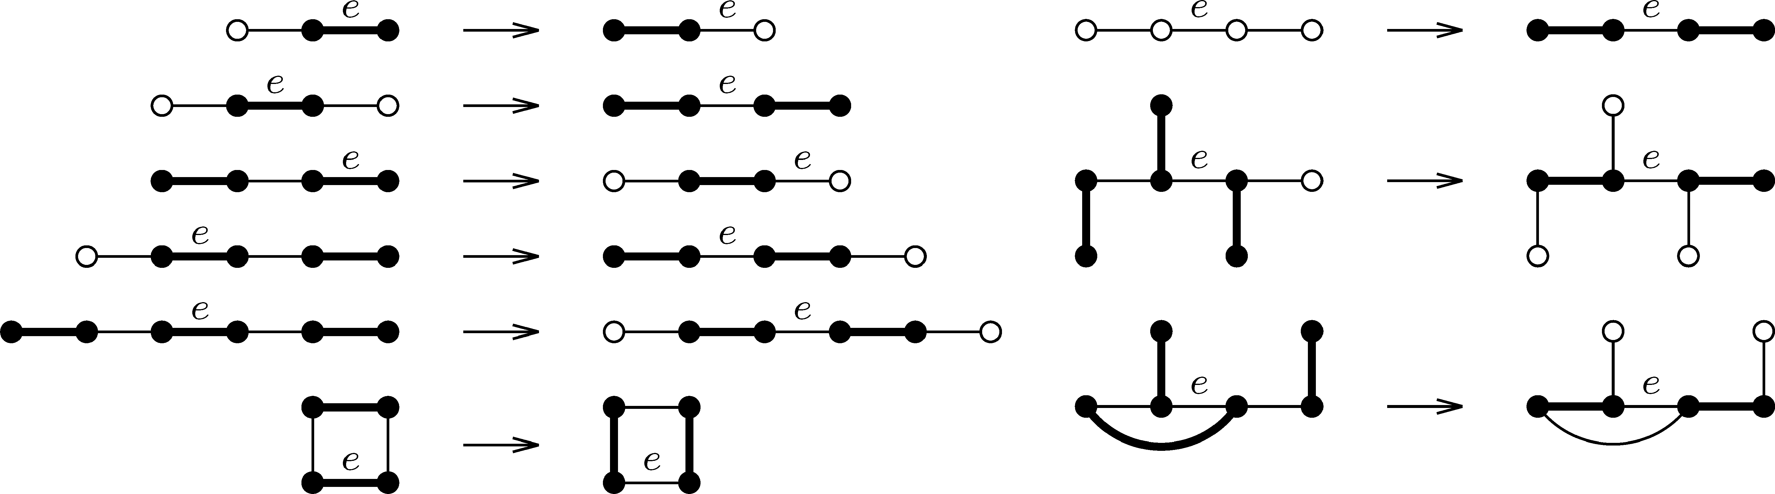
Examples of short augmentations
A center of each augmentation is labeled e.
Edges belonging to the matching are shown in bold.
Hollow vertices are vertices not contained in any matching edge.

Slide 26
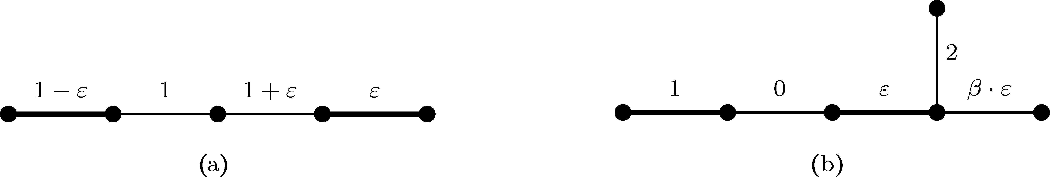
β-augmentations
In (a), the short augmentation replaces edge of weight 1 − ε as by the neighboring edge of weight 1.
  After performing this short augmentation there is no short augmentation that has the edge of weight ε as its center.
  Thus, the total weight of the matching has increased by only ε, which may be arbitrarily small.
For a constant β > 1, a β-augmentation is a short augmentation the total weight of the matching by a factor of β.
(b) shows that it is not enough to perform any β-augmentation.
  A good β-augmentation achieves at least a (β − 1)/(β − ½) fraction of the gain that a best β-augmentation with center e can achieve.

Slide 27
DH Algorithm
improve-matching(G,w, M)
Make M maximal
M ‘ <- M
for e ∈ M do begin
  if there exists a β –augmentation in M’ with center e
  then augment M’ by a good β–augmentation with center e
  end
return M
Theorem 3. A weighted matching algorithm exists that runs in linear time, and has a performance ratio arbitrarily close to ⅔.

Slide 28
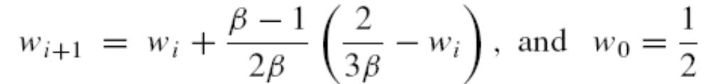
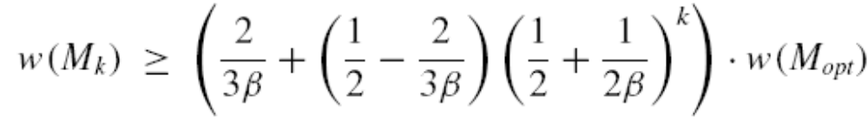
Outline of Proof of Theorem 3
Lemma 1: Let M₀ be a matching of weight at least ½w(M_{opt}). Applying improve_matching to matching M_{i} (i = 0, …, k – 1) results in a matching M_{i+1} in linear time s.t. w(M_{i +1}) ≥ w_{i+1} · w(M_{opt}), where w_{i+1} is
Solving this linear recurrence relation yields

Slide 29
Outline of Proof (cont.)
For large enough k, and β arbitrarily close to 1, this relation gives a performance ratio arbitrarily close to ⅔.
Since M₀ can be found in linear time (Drake and Hougardy 2003), and Lemma 1 is in linear time, so the overall weighted matching algorithm runs in linear time. □

Slide 30
Protein FucT VII
1
2
.89
6
3
.64
.67
5
4

Slide 31
References
A. Vullo, P. Frasconi. "A Recursive Connectionist Approach for Predicting Disulfide Connectivity in Proteins". Proc. 18th ACM Symposium on Applied Computing (SAC 2003), pp. 66-71, 2003.
H. Gabow, “Implementation of Algorithms for Maximum Matching on Nonbipartite Graphs”, Ph.D. thesis, Stanford University, 1973.
Robert Preis. “Linear Time 1/2-Approximation Algorithm for Maximum Weighted Matching in General Graphs” (STACS 1999)
D. E. Drake, S. Hougardy, “A simple approximation algorithm for the weighted matching problem” Inf. Proc. Lett. 85, 211–213, 2003.
D. E. Drake, S. Hougardy, “A linear-time approximation algorithm for weighted matchings in graphs” ACM Transactions on Algorithms (TALG 2005), 107 - 122 .

Slide 32
Questions?

Slide 33
Supplementary slides

Slide 34
Steps to Take
Study the maximum-weight perfect matching problem
  Study Gabow’s (1975) algorithmic solution
Implement Gabow’s algorithm
Develop software to process MS and MS/MS data to generate edge weights
Apply data to software and interpret results

Slide 35
Matchings in Graphs (Tarjan)
Let G = (V,E) be an undirected graph. A matching M of G is a set of edges, no two of which are incident to a common vertex.
The object of the unweighted matching problem is to find a matching of maximum size.
In a weighted graph, the weight of a matching M is defined to be the sum of the (positive) weights of the edges in M. The object of the weighted matching problem is to find a matching of maximum weight.

Slide 36
Alternating Paths
Let M be a matching of G = (V,E).
  A matching edge is any edge in M; all other edges are free
  A vertex is matched if it is incident to a matching edge and free otherwise
  An alternating path or cycle is a simple path or cycle in which every other edge is matching
  an alternating path is an augmenting path if its end points are free
If G contains an augmenting path P (with respect to M), then we can obtain a larger matching by removing from M the matching edges in P and adding to M the non-matching edges.

Slide 37
Augmenting Path Method
Theorem 9.1. Let M be a matching of G, M ' be a maximum matching and k = |M ' | − |M |. Then G has k vertex disjoint augmenting paths with respect to M.
Proof. Let N be the set of edges in M or in M ' but not in both. Every vertex is adjacent to at most two edges of N, so the subgraph induced by N consists of paths and even length cycles that are alternating with respect to M. N contains exactly k more edges from M ' than from M. So at least k paths in N must begin and end with edges from M '. These paths are vertex disjoint and augmenting (with respect to M). 
Augmenting path method for finding a matching. Given a graph G, let M = { } and repeat the following step until there are no more augmenting paths.
  Augmenting Step. Let P be an augmenting path with respect to M. Remove from M the matching edges in P and add to M the non-matching edges in P.
Complexity: n times the time required to find an augmenting path.

Slide 38
Blossoms
If {v,w} is an edge joining two even vertices in the same tree, the cycle induced by the tree path connecting v and w together with {v,w} is called a blossom.
This problem is handled by shrinking the blossom, that is, condensing all the vertices of the blossom into a single vertex.
Note that a blossom consists of an odd-length cycle and that the one vertex in the cycle that is incident to two non-matching edges in the cycle is an ancestor of all other vertices in the cycle (in the forest defined by the parent pointers).
  this vertex is called the base of the blossom
+
a
−
b
+
c
−
d
e
−
+
u
v
+

Slide 39
Implementation of Gabow’s algorithm
WMATCH : Solver for the Maximum Weight Matching Problem
  http://elib.zib.de/pub/Packages/mathprog/matching/weighted/
Used by several other disulfide linkage pattern finding programs
C source code
  Ported to Java by TTL

Slide 40
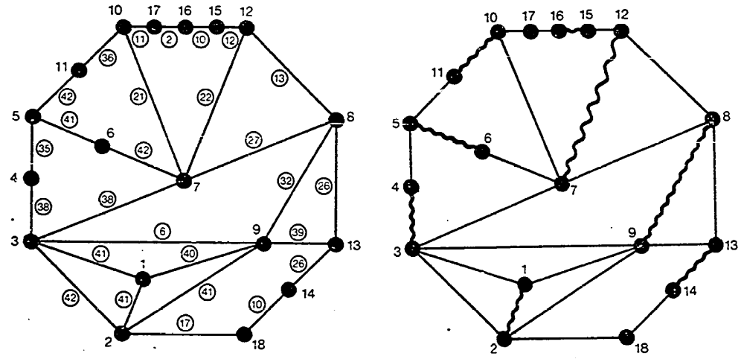
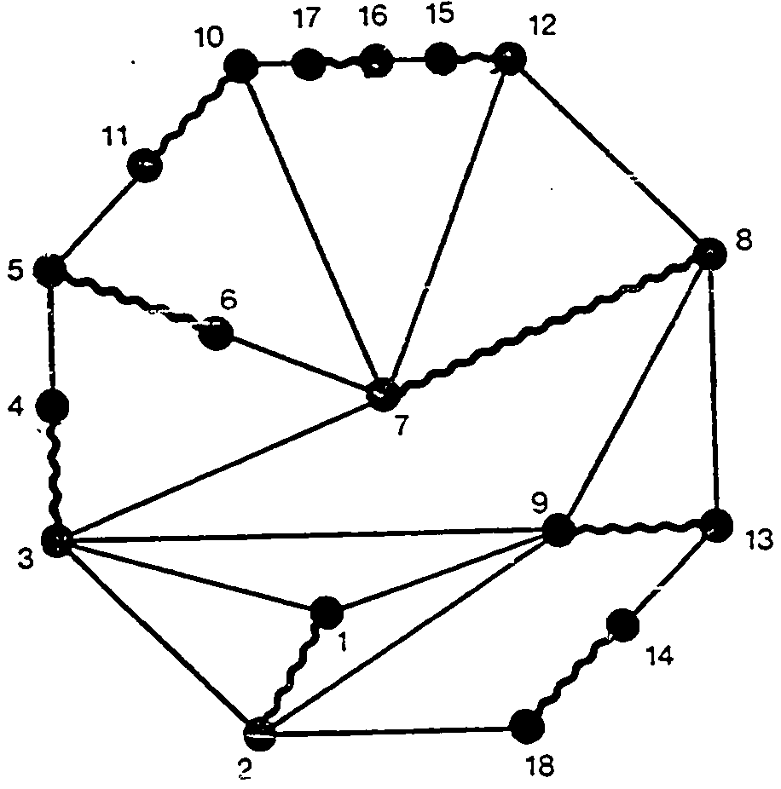
Testing WMATCH
Correct for graph on slide 7, but incorrect for:
Weighted graph
Weight = 246
Weight = 247

Slide 41
Locally Optimal Choices
When we add (u, v) to M we say the edge is locally optimal if all other eligible edges e of the form (x, u) or (v, x) such that x is free have cost w(e) ≤ w(u, v).
Theorem 2. A maximal matching M made of locally optimal choices has cost 0.5w(M_{opt}) ≤ w(M).
• With a budget of 2w(M) we will pay for Mopt.
• Each edge (u, v) in M pays for the edges e in M_{opt} incident to u and v, only if w(e) ≤ w(u, v).
• All edges in M_{opt} are paid for.

Slide 42
Idea
The greedy algorithm makes globally optimal choices, but local optimality is enough to get the 0.5 bound.
In fact global optimal choices doesn’t improve the approximation factor which is tight, consider a path of length 3.
Could we get a faster algorithm if we make local instead of global optimal choices?

Slide 43
try(u, v)
1 C_{u} <- C_{v} <- null
2 while (u AND v are free) AND (9(x, u) or (v, x) in E)
3 do if u is free AND (x, u) in E
4 then move (x, u) from E to C_{u}
5 if w(u, v) < w(x, u)
6 then try(x, u)
7 if v is free AND (v, y) 2 E
8 then move (v, y) from E to C_{v}
9 if w(u, v) < w(v, y)
10 then try(v, y)
11 if u and v are free
12 then M <- M + (u, v)
13 if u is free AND v is matched
14 then put back in E edges {(x, u) in C_{u} | x is free}
15 if u is matched AND v is free
16 then put back in E edges {(u, y) in C_{v} | y is free}
LOC-matching(G,w)
1 M <- null
2 for (u, v) 2 E
3 do if u and v are free
4 then try(u, v)
5 return M

Slide 44
Analysis
The algorithm is a 0.5-factor approximation:
After each call to TRY(u, v) at least one end point must be matched. This means M is maximal.
The algorithm makes locally optimal choices.

Slide 45
Analysis
The running time of the algorithm is O(E):
Each call to try(u, v) does O(| C_{u} | + | C_{v} |) work.
If at the end both u and v are matched we don’t add anything back.
Charge the permanently removed edges.
Suppose u is free and v is matched. Then | C_{u} | ≤ | C_{v} |. Charge only edges in C_{v} which are permanently removed.
Edges are permanently removed just once, so the total charge is O(E).

Slide 46
  In each step
    Add at most two new edges to M
    remove up to four edges of M

