Slide 1
Geometric Hashing: An Overview
Haim J. Wolfson and Isidore Rigoutos
IEEE Computational Science & Engineering, 1997
Presented by Timothy Lee
March 1, 2007

Slide 2
Motivation
Object recognition (ultimate goal of most computer vision research).
Inputs:
  A database of objects.
  A scene or image to recognize.
Problems:
  Objects in the scene undergo some transformations.
  Objects may partially occlude each other.
  Computationally expensive to retrieve each object from database and compare it against the observed scene.

Slide 3
Problem Statement
Recognition under Similarity Transformation:
“Is there a transformed (rotated, translated and scaled) subset of some model point-set which matches a subset of the scene point-set?”

Slide 4
Outline
  General Framework
  Two Stage Algorithm
  Complexity
  Recognition of Polyhedra Objects
  Recognition under Various Transformations
  Index distributions
  Noise modeling
  Bayesian formulation
  Comparisons
  Current research

Slide 5
General Framework (1/4)
Two stage algorithm:
Preprocessing (for each model):
For each feature points pair:
    Define a local coordinate basis on this pair
    Compute and quantize all other feature points in this coordinate basis
    Record (model, basis) in a hash table

Slide 6
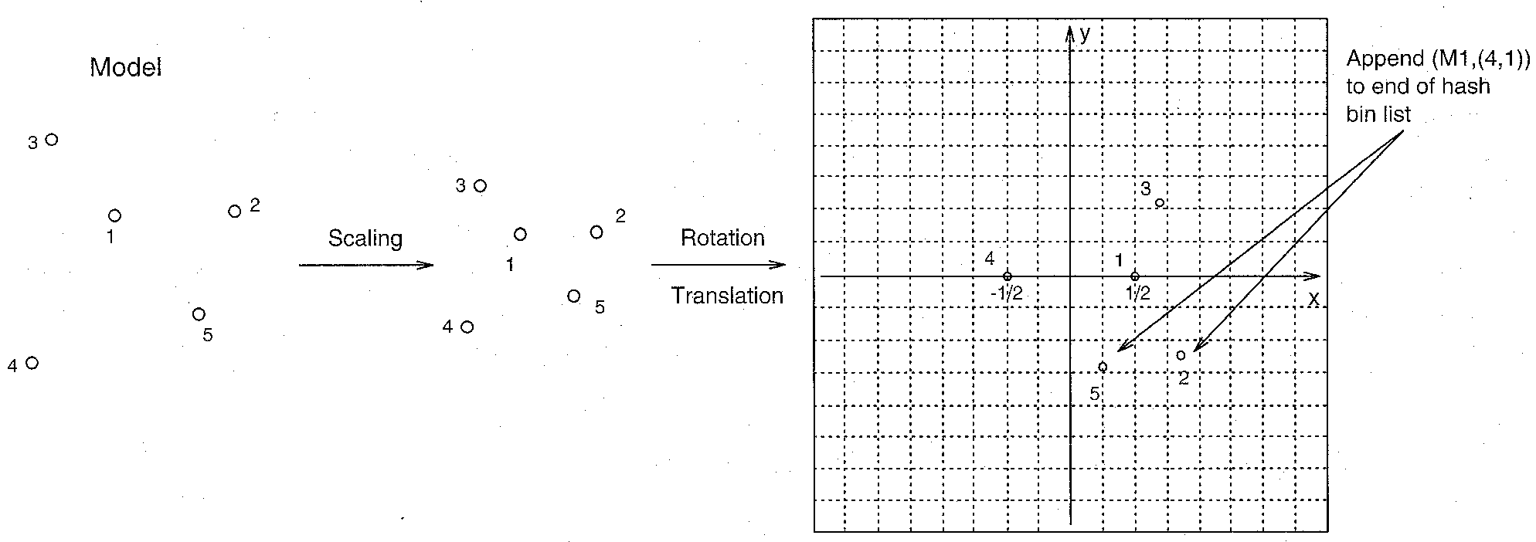
General Framework (2/4)

Slide 7
General Framework (3/4)
Online recognition (given a scene, extract feature points):
  Pick arbitrary ordered pair:
    Compute the other points using this pair as a basis
    For all the transformed points, vote all records (model, basis) appear in the corresponding entry in the hash table, and histogram them
  Matching candidates: (model, basis) pairs with large number of votes.
  Recover the transformation that results in the best least-squares match between all corresponding feature points
  Transform the features, and verify against the input image features (if fails, repeat to 1)

Slide 8
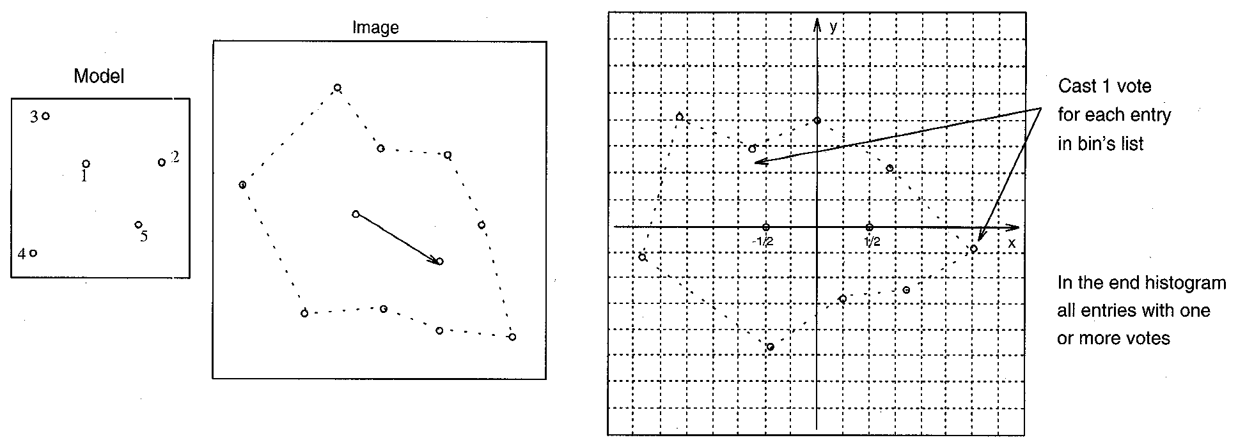
General Framework (4/4)

Slide 9
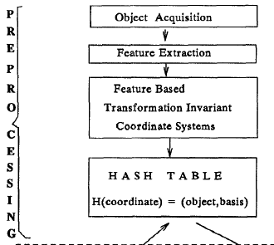
Two Stage Algorithm (1/2)

Slide 10
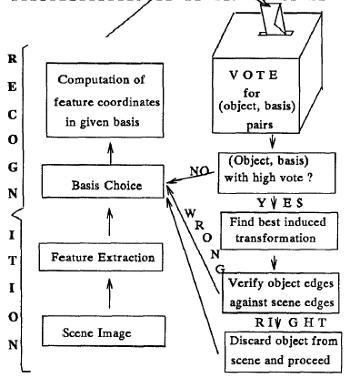
Two Stage Algorithm (2/2)

Slide 11
Complexity
  Assume m=n, and k is the number of points to define the basis.
  Preprocessing: O(n^{k+1}) for a single model.
    This is done off-line, so complexities add
  Recognition: O(n^{k+1}) against all objects in the database.

Slide 12
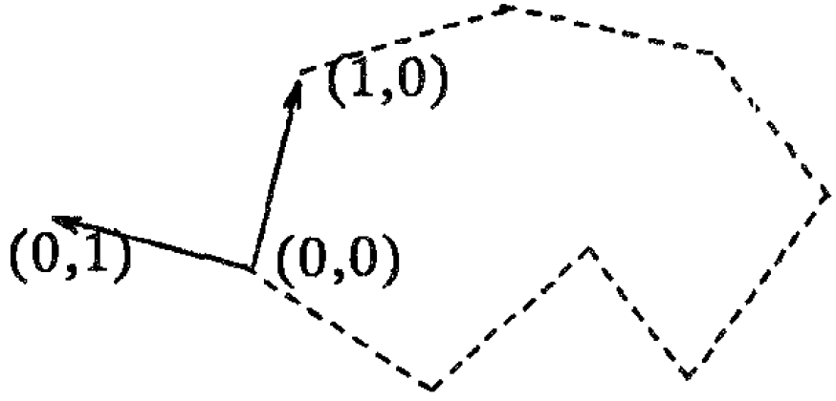
Recognition of Polyhedral Objects
Polygonal objects
    Choose an edge as the basis, record (model, basis edge) in the hash table.
    Preprocessing and recognition is O(n²).

Slide 13
Under Various Transformations (1/2)
Translation in 2D and 3D.
    1-point basis.
    O(n²).
Similarity transformation in 2D.
    2-point basis.
    O(n³).
Similarity transformation in 3D.
    3-point basis.
    O(n⁴).

Slide 14
Under Various Transformations (2/2)
Affine transformation
    3-point basis.
    O(n⁴)
Projective transformation
    4-point basis.
    O(n⁵)

Slide 15
Index Distributions

Slide 16
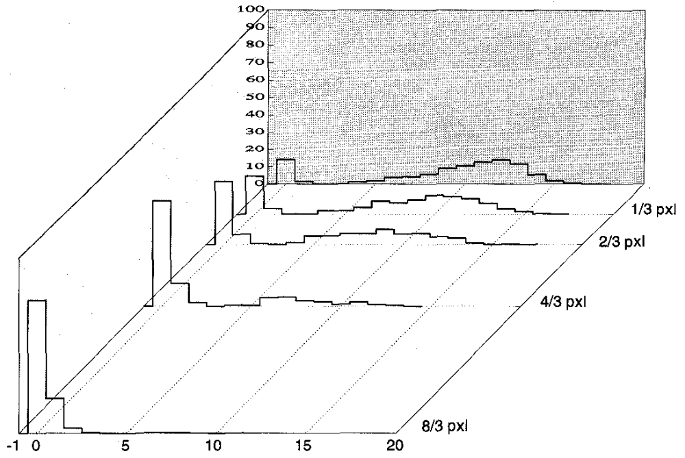
Noise Modeling (1/2)

Slide 17
Noise Modeling (2/2)
Qualitative conclusions:
  The larger the separation of basis points, the smaller the spread of invariants
  The closer a point is to the center of its coordinate frame, the smaller the spread of invariants
  “Lonely” points carry more information, but are more sensitive to noise

Slide 18
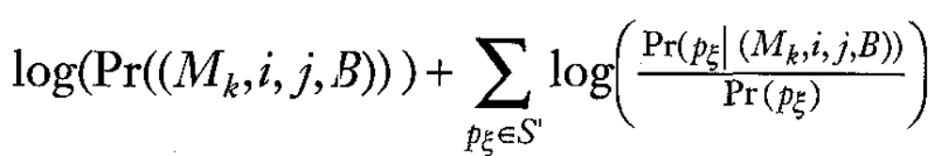
Bayesian Formulation
Maximize
Over all possible model/basis combinations and basis selections

Slide 19
Comparisons (1/3)
Brute Force Recognition
  Let m: points on the model,
n: points on the scene.
  Recognize a single model: O((m x n)² x t) where t is the complexity to verify the model against the scene.
  If m=n, and t=n, then we have O(n⁵) to recognize a single model.

Slide 20
Comparisons (2/3)
With alignment method
    Eumerates all possible pairs in objects and images
    Geometric hashing processes models simultaneously, alignment method processes sequentially
    Alignment method does not require additional memory, geometric hashing requires large memory to store hash table
    Geometric hashing more efficient if:
      The scene contains enough features (6-10) for efficient recognition by voting.
      There are many models.

Slide 21
Comparisons (3/3)
With Generalized Hough Transform (GHT).
    GHT quantizes all possible (continuous) transformations between the model and the scene into a set of bins
    Geometric Hashing quantizes just the (discrete) transformation represented by the basis

Slide 22
Summary
  Able to recognize objects that have undergo an arbitrary transformation.
  Can perform partial matching.
  Efficient and can be parallelized easily.
  Use transformation-invariant access key to the hash table.
  Two phases (preprocessing and recognition).
  Requires a large memory to store hash table.

Slide 23
Current Research
Matching objects with internal degrees of freedom
  Visual recognition of articulate objects
  Docking of flexible receptor-drug molecules
  Detection of partially similar molecules in drug databases

