Slide 1
Protein Sequencing and Identification by Mass Spectrometry

Slide 2
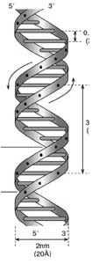
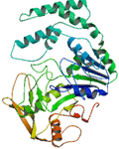
Motivation
Proteins are working units of the cells
  The number of found genes is much less than the number of expressed proteins
  Directly related with cell processes and diseases
DNA
mRNA
Protein
Alternative
splicing
Post-translational
Modification
SNP
~30,000 human genes
>100,000 RNA messages
>1,000,000 distinct protein forms

Slide 3
Breaking Protein into Peptides and Peptides into Fragment Ions
Proteases, e.g. trypsin, break protein into peptides.
A Tandem Mass Spectrometer further breaks the peptides down into fragment ions and measures the mass of each piece.
Mass Spectrometer accelerates the fragmented ions; heavier ions accelerate slower than lighter ones.
Mass Spectrometer measures mass/charge ratio of an ion.

Slide 4
Peptide Fragmentation
Collision Induced Dissociation
H⁺
H...-HN-CH-CO . . . NH-CH-CO-NH-CH-CO-…OH
R_{i-1}
R_{i}
R_{i+1}
Prefix Fragment
Suffix Fragment
Peptides tend to fragment along the backbone.
Fragments can also lose neutral chemical groups like NH₃ and H₂O.

Slide 5
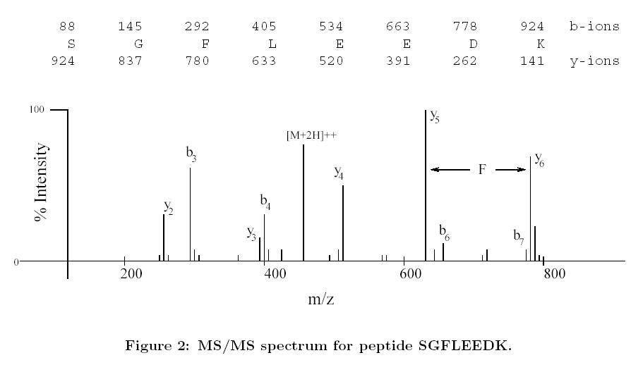
Ideal Mass Spectrum

Slide 6
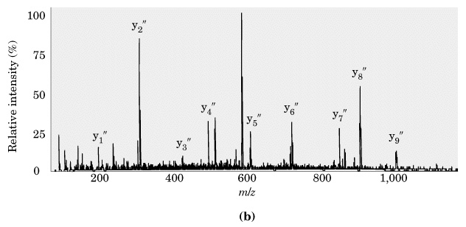
Real Mass Spectrum

Slide 7
Mass Spectra
G
V
D
D
H₂O
L
K
K
L
D
V
G
57 Da = ‘G’
99 Da = ‘V’
mass
0
The peaks in the mass spectrum:
  Prefix
  Fragments with neutral losses (-H₂O, -NH₃)
  Noise and missing peaks.
and Suffix Fragments.

Slide 8
Protein Identification with MS/MS
G
V
D
L
K
Peptide Identification:
MS/MS
Intensity
mass
mass
0
0

Slide 9
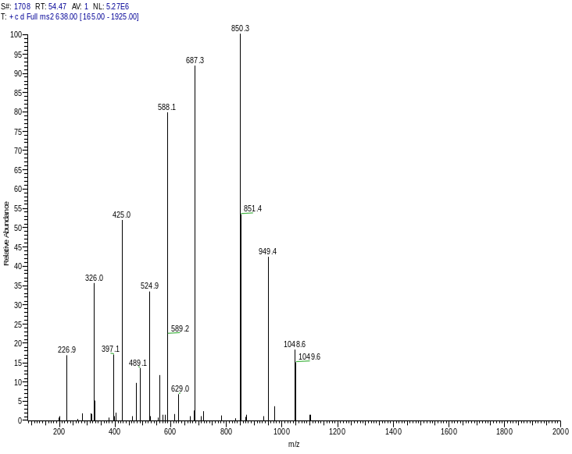
Protein Identification by Tandem Mass Spectrometry
S
e
q
u
e
n
c
e
MS/MS instrument
Database search
Sequest
de Novo interpretation
Sherenga

Slide 10
De novo Peptide Sequencing
Sequence

Slide 11
Building Spectrum Graph
How to create vertices (from masses)
How to create edges (from mass differences)
How to score paths
How to find best path

Slide 12
Edges of Spectrum Graph
Two vertices with mass difference corresponding to an amino acid A:
  Connect with an edge labeled by A
Gap edges for di- and tri-peptides

Slide 13
References
Neil C. Jones and Pavel A. Pevzner, An Introduction to Bioinformatics Algorithms, MIT Press, 2004.
Dancik V, Addona TA, Clauser KR, Vath JE, and Pevzner PA., “De novo peptide sequencing via tandem mass spectrometry”, J Comput Biol. 1999 Fall-Winter;6(3-4):327-42.

