Slide 1
Investigating the Hausdorff Distance – Project Update
CSC/Math 870
Yelena Gartsman

Slide 2
Agenda
Quick Recap of Last Presentation
Algorithm for Finding Hausdorff Distance between Polygons
Hausdorff Distance Calculator Tool - Demo
Intro to Partial Hausdorff Distance

Slide 3
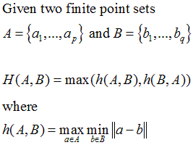
Recap
Hausdorff distance is the maximum distance of a set to the nearest point in the other set

Slide 4
Definitions
Simple polygon
  A polygon with no self-intersecting edges
Convex polygon
  A polygon is said convex if the line that joins any two points of the polygon is entirely inside the polygon
Supporting line
  Straight line L passing through a vertex of a polygon P, such that the interior of P lies entirely on one side of L
Monotone polygon
  A polygon P is monotone in some direction d if an orthogonal line to d intersects P in no more than two points;
  A convex polygon is monotone in any direction

Slide 5
Assumptions
Polygons A and B are simple convex polygons
Polygons A and B are disjoint from each other, i.e. - they don't intersect together
no polygon contains the other
a is the furthest point of polygon A relative to polygon B, while b is the closest point of polygon B relative to polygon A
Vertices of both polygons are enumerated counterclockwise

Slide 6
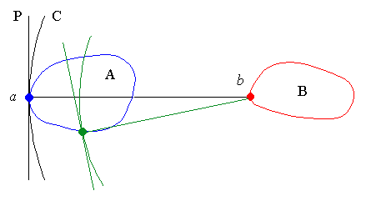
Lemmas (1/4)
The perpendicular to ab at a is a supporting line of A, and A and B on the same side relative to that line

Slide 7
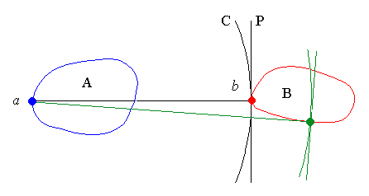
Lemmas (2/4)
The perpendicular to ab at b is a supporting line of B, and A and B are on different sides relative to that line

Slide 8
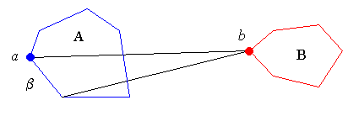
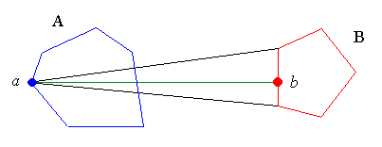
Lemmas (3/4)
There is a vertex x of A such that the distance from x to B is equal to h (A, B)

Slide 9
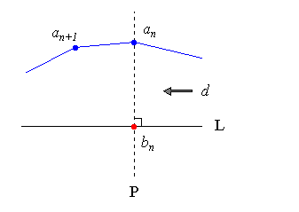
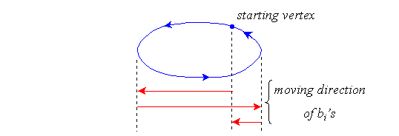
Lemmas (4/4)
Let b_{i} be the closest point of B from vertex a _{i} of A. If d is the moving direction (clockwise or counterclockwise) from b_{i} to b_{i+1} then, for a complete cycle through all vertices of A, d changes no more than twice

Slide 10
Algorithm (1/2)
Point CheckForClosePoint (Point a, Point b1 , Point b2) :
1 Find point z where line b1b2 crosses its perpendicular through a
2 If (z is between b1 and b2)
3 return z
4 Else
5 Find line P that is perpendicular to line ab2 at b2
6 if P is a supporting line of B
7 return b2
8 else
9 return NULL

Slide 11
Algorithm (2/2)
double HausdorffDistance (Polygon A, Polygon B) :
1 From a1, find the closest point b1 and compute d1 = d (a1, b1)
2 h(A, B) = d1
3 for each vertex ai of A
4 if ai+1 is to the left of aibi
5 find bi+1, scanning B counterclockwise with 6 CheckForClosePoint from bi
7 if ai+1 is to the right of aibi
8 find bi+1, scanning B clockwise with 9 CheckForClosePoint from bi
10 if ai+1 is anywhere on aibi
11 bi+1 = bi
12 di+1 = d(ai+1, bi+1)
13 h (A, B) = max(h(A,B), di+1)

Slide 12
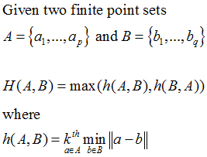
Partial Hausdorff Distance (PHD)
PHD between two sets is the k-th ranked distance between a point and its nearest neighbor in the other set where distances are ranked in increasing order

Slide 13
Why PHD?
The Hausdorff distance is very sensitive to noise: a single outlier can determine the distance value
  The PHD has the advantage of being robust to outliers* produced by noise and occlusions
  * The feature points that are absent from the other image are called outliers

Slide 14
Related Documents
Point Pattern Matching http://www3.sympatico.ca/vpaquin/tutorial1/tutorial.htm
Hausdorff Distance between Convex Polygons http://cgm.cs.mcgill.ca/~godfried/teaching/cg- projects/98/normand/main.html
Wikipedia
http://en.wikipedia.org/wiki/Hausdorff_distance
A New Similarity Measure Using Hausdorff Distance Map (Baudrier, Millon, Nicolier, Ruan)
A Multi-Resolution Technique for Comparing Images Using the Hausdorff Distance (Huttenlocher, Rucklidge)
Comparing Images Using Hausdorff the Hausdorff Distance
http://www.cs.cornell.edu/~dph/papers%5CHKR-TPAMI-93.pdf
The Hausdorff Metric
http://www.diss.fu-berlin.de/1999/1/kap2.pdf

