Slide 1
Investigating the Hausdorff Distance
CSC/Math 870
Yelena Gartsman

Slide 2
Agenda
Recap
Intro to Other Distances
Implementations
Future Work
Demo

Slide 3
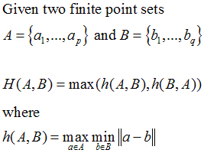
Hausdorff Distance Definition
Hausdorff distance is the maximum distance of a set to the nearest point in the other set

Slide 4
Hausdorff Distance between
Point Sets -- Algorithm
double HausdorffDistance (Set A, Set B) :
hDistance = 0
2 for every Point ai of A
3 shortestDistance = infinity
4 for every Point bj of B
5 dij = d(ai, bj)
6 if(dij < shortestDistance) then
7 shortestDistance = dij
8 if shortestDistance > hDistance then
9 hDistance = shortestDistance
10 return hDistance

Slide 5
Hausdorff Distance between
Convex Polygons -- Algorithm (1/2)
Point CheckForClosePoint (Point a, Point b1 , Point b2) :
1 Find point z where line b1b2 crosses its perpendicular through a
2 If (z is between b1 and b2)
3 return z
4 Else
5 Find line P that is perpendicular to line ab2 at b2
6 if P is a supporting line of B
7 return b2
8 else
9 return NULL

Slide 6
Hausdorff Distance between
Convex Polygons -- Algorithm (2/2)
double HausdorffDistance (Polygon A, Polygon B) :
1 From a1, find the closest point b1 and compute d1 = d (a1, b1)
2 h(A, B) = d1
3 for each vertex ai of A
4 if ai+1 is to the left of aibi
5 find bi+1, scanning B counterclockwise with 6 CheckForClosePoint from bi
7 if ai+1 is to the right of aibi
8 find bi+1, scanning B clockwise with 9 CheckForClosePoint from bi
10 if ai+1 is anywhere on aibi
11 bi+1 = bi
12 di+1 = d(ai+1, bi+1)
13 h (A, B) = max(h(A,B), di+1)
14 return h(A,B)

Slide 7
Complexity
Hausdorff Distance between Point Sets
O(nm) -- brute force
O((n+m)log(n+m)) – using Voronoi diagrams
where n and m are the number of points in each set
Hausdorff Distance between Convex Polygons
  O(n+m)
  where n and m are the number of vertices in each polygon

Slide 8
Issues with Hausdorff Distance
Sensitive to noise
Only takes into account the sets of points on both curves and does not reflect the course of the curve

Slide 9
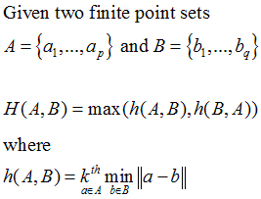
Partial Hausdorff Distance – (1/2)
PHD between two sets is the k-th ranked distance between a point and its nearest neighbor in the other set where distances are ranked in increasing order

Slide 10
Partial Hausdorff Distance – (2/2)
Pros:
  Not sensitive to noise
  Easy to compute
Cons:
Not a metric
Figuring out the k-th value

Slide 11
Metric
To be a metric our distance must satisfy the following properties:
  Non-negativity
    d(x, y) ≥ 0
  Identity
    d(x, y) = 0 iff x = y
  Symmetry
    d(x, y) = d(y, x)
  Triangle Inequality
    d(x, z) ≤ d(x, y) + d(y, z)

Slide 12

Area of Symmetric Difference
Distance – (1/2)
The area of the symmetric difference distance is the area of the regions lying within one of the two polygons but not both of them or
Also, known as Template Metric

Slide 13
Area of Symmetric Difference
Distance – (2/2)
Pros:
  Not sensitive to noise
  Easy to compute
  Metric
Cons:
Captures only a crude notion of shape
Difficult to find the right overlay of two objects
Usage:
Perfect for applications such as:
OCR since characters are aligned with the page
Bit-Map image comparison -- just sum the differences of the corresponding pixels

Slide 14
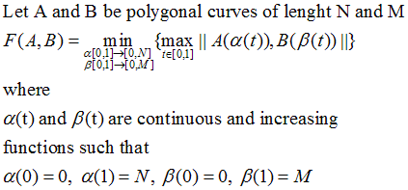
Fréchet Distance – (1/2)
Fréchet distance is the minimum leash distance that can keep the person and the dog walking on their own tracks from the beginning to the end (without retracting)
Note: A polygonal curve A:[0,N] is a continuous and piecewise linear curve made of N connected segments

Slide 15
Fréchet Distance – (2/2)
Pros:
Sensitive to order along two curves
Metric
For convex contours, equals to Hausdorff distance
Cons:
Semi-computable for 2-D surfaces – no approximation algorithms exist
For convex contours, equals to Hausdorff distance
Usage:
Perfect for pattern recognition

Slide 16
Implementations -- (1/4)
In addition to Hausdorff Distance algorithms for Point Sets and Convex Polygons, implemented:
Convex Hull
    Sort points by increasing (x,y)
    Let L be the leftmost point and R be the rightmost point
    Partition the point set into two lists. The upper list begins with L and ends with R; the lower list begins with R and ends with L
    Traverse the point lists, eliminating all but the extreme points
    Eliminate L from lower and R from upper, if necessary
    Join the point lists

Slide 17
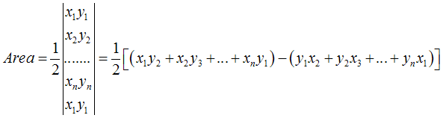
Implementations -- (2/4)
Area of convex polygon

Slide 18
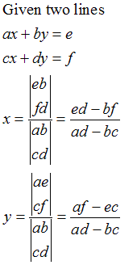
Implementations -- (3/4)
Intersection of two lines
    Cramer’s Rule

Slide 19
Implementations -- (4/4)
Intersection of two polygon
    Find intersection points of set A and set B
    Find vertices of set A that are inside set B
    Find vertices of set B that are inside set A
    Combine all unique points

Slide 20
Possibilities in Shape Matching
Align objects by overlapping centroids
Assign score to pairs of objects using
  Area of Symmetric Difference
    The larger the overlap of two objects →
    the higher the score
  Hasdorff Distance
    The lower the distance between two objects →
    the higher the score

Slide 21
Future Work
Test Calculator with real-world data, especially data with outliers
Modify Hausdorff Distance between Convex Polygons algorithm to work for non-convex and overlapping polygons
Modify Calculator to enable user enter data by drawing points sets/polygons
Implement Hausdorff Distance between Point Sets algorithm using Voronoi diagrams
Improve graphs

Slide 22
Related Documents
Point Pattern Matching
  http://www3.sympatico.ca/vpaquin/tutorial1/tutorial.htm
Hausdorff Distance between Convex Polygons
  http://cgm.cs.mcgill.ca/~godfried/teaching/cg-projects/98/normand/main.html
A New Similarity Measure Using Hausdorff Distance Map (Baudrier, Millon, Nicolier, Ruan)
A Multi-Resolution Technique for Comparing Images Using the Hausdorff Distance (Huttenlocher, Rucklidge)
Comparing Images Using Hausdorff the Hausdorff Distance
http://www.cs.cornell.edu/~dph/papers%5CHKR-TPAMI-93.pdf
The Hausdorff Metric
http://www.diss.fu-berlin.de/1999/1/kap2.pdf
Computing the Fréchet distance between two polygonal curves
http://www.cim.mcgill.ca/~stephane/cs507/Project.html
Matching Convex Shapes with Respect to the Symmetric Difference
http://citeseer.ist.psu.edu/cache/papers/cs/12224/http:zSzzSzwww.inf.fu- berlin.dezSz~rotezSzPaperszSzpostscript- gzippedzSzMatchingzPzconvexzPzshapeszPzwithzPzrespectzPztozPzthezPzsymmetriczPzdifference.p df/alt97matching.pdf
Shape Similarity Measures, Properties, and Constructions
http://citeseer.ist.psu.edu/cache/papers/cs/17282/ftp:zSzzSzftp.cs.uu.nlzSzpubzSzRUUzSzCSzSztechrepszSzCS- 2000zSz2000-37.pdf/shape-similarity-measures-properties.pdf

