Slide 1
Investigating the Hausdorff Distance
CSC/Math 870
Yelena Gartsman

Slide 2
Project Goals
Compute the Hausdorff distance between point sets and polygons
Analyze the effect of outliers and noise on the Hausdorff distance
Compare Hausdorff distance with other distances
Investigate application of Hausdorff distance

Slide 3
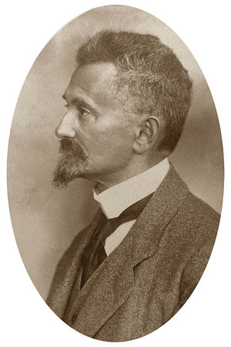
Felix Hausdorff
Felix Hausdorff
(11/08/1868 – 01/26/1942)
German mathematician who is considered to be one of the founders of modern topology and who contributed significantly to set theory, descriptive set theory, measure theory, function theory, and functional analysis
Published philosophical and literary works under the pseudonym "Paul Mongré”
Committed suicide together with his wife and sister-in-law to avoid being sent to a concentration camp

Slide 4

Hausdorff Distance Between Point Sets
Hausdorff distance is the maximum distance of a set to the nearest point in the other set
In other words, Hausdorff distance from set A to set B is a maximin function, defined as
where a and b are points of sets A and B respectively, and d(a,b) is the Euclidian distance between a and b
Note, this is also known as directed Hausdorff Distance (i.e. distance from A to B)

Slide 5
Algorithm and Complexity
hDistance = 0
for every point a_i of A
shortestDistance = infinity
for every point b_j of B
d_ij = d(a_i, b_j)
if(d_ij < shortestDistance) then
shortestDistance = d_ij
if shortestDistance > hDistance then
hDistance = shortestDistance
Complexity is O(nm) where n and m are the number of points in each set

Slide 6
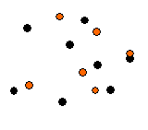

Example
For all black points find the closest red point
Let h(B,R) be the maximum of such distances
For all red points find the closest black point
Let h(R,B) be the maximum of such distances
Finally,
Let
Note, this is a more general definition of Hausdorff Distance (i.e. distance between B and R)

Slide 7
Why Hausdorff Distance
The shortest distance does not consider the whole shape
The shortest distance does not account for the position of the objects
  Hausdorff distance gives the maximal distance between any point of one polygon to the other polygon and it is sensitive to the position

Slide 8
Hausdorff Distance Between Polygons
Two polygons are within Hausdorff distance r from each other iff any point of one polygon is within distance r from some point of the other polygon
Or more formally, the Hausdorff distance h(A,B) is the minimal number r such that the closed r-neighborhood of A contains B and the closed r-neighborhood of B contains A

Slide 9
Application Examples
Image matching
  Face recognition, military surveillance
Shape similarity
  Optical Character Recognition
Merge of partially overlapping images into a single image
  Robot mapping
… and many more …

Slide 10
Related Documents
On the complexity of measuring the similarity between geometric objects in higher dimensions http://www.diss.fuberlin.de/1999/1/kap2.pdf
Hausdorff Distance between Convex Polygons http://cgm.cs.mcgill.ca/~godfried/teaching/cg- projects/98/normand/main.html
Comparing Images Using the Hausdorff Distance
http://www.cs.cornell.edu/~dph/papers%5CHKR-TPAMI-93.pdf
Wikipedia
http://en.wikipedia.org/wiki/Hausdorff_distance

