Slide 1
CAS Datenanalyse 2016/2017

Slide 2
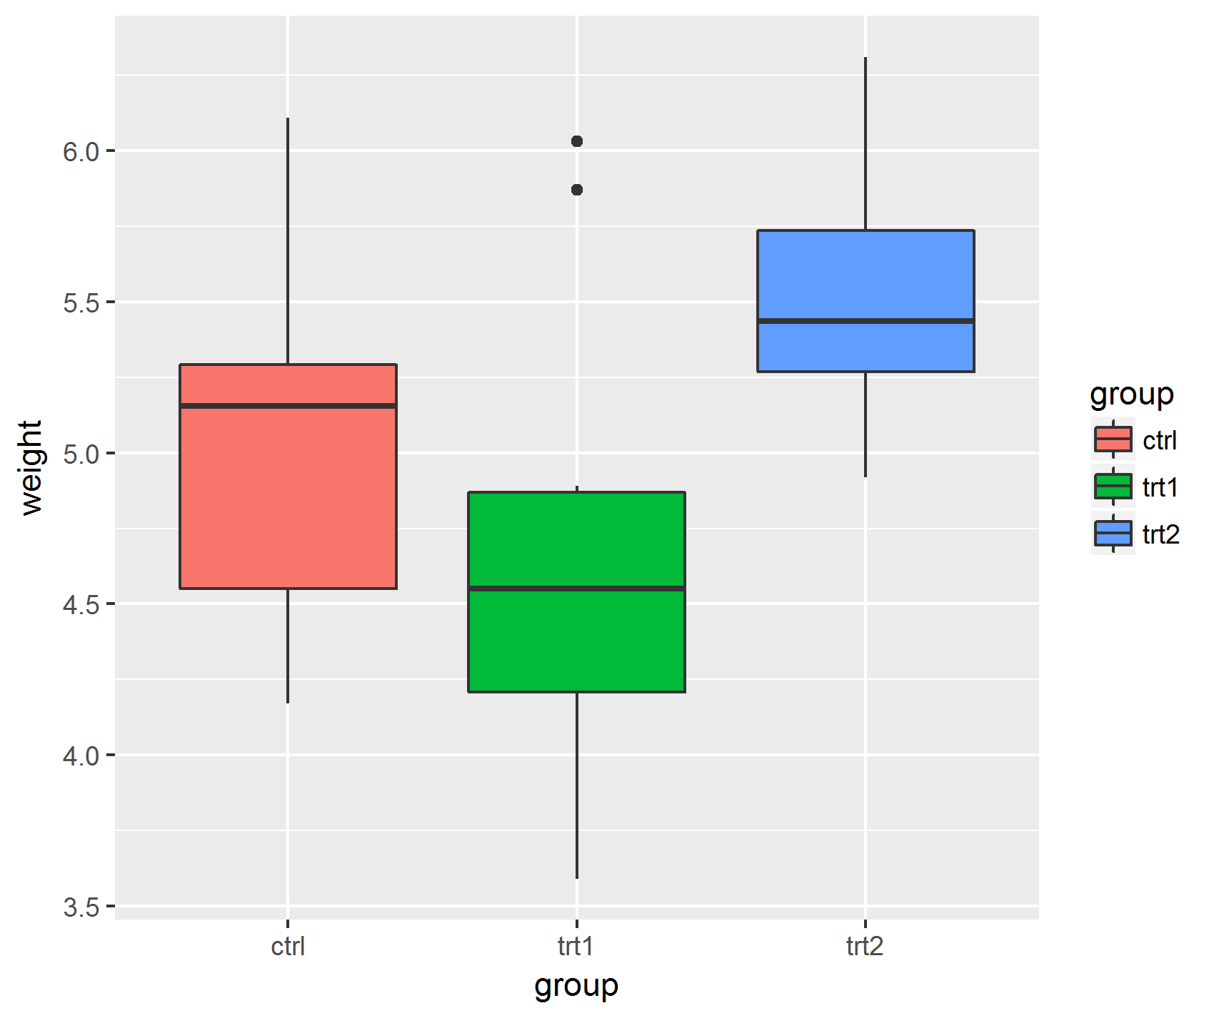
Editierbare Vektor Graphik versus (uneditierbares) Raster Format
6.0
5.5
group
weight
5.0
ctrl
trt1
trt2
4.5
4.0
3.5
ctrl
trt1
trt2
group

