Slide 1

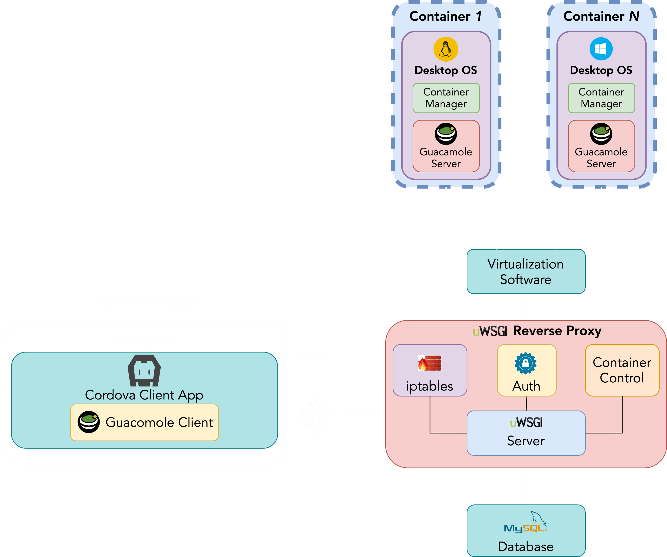
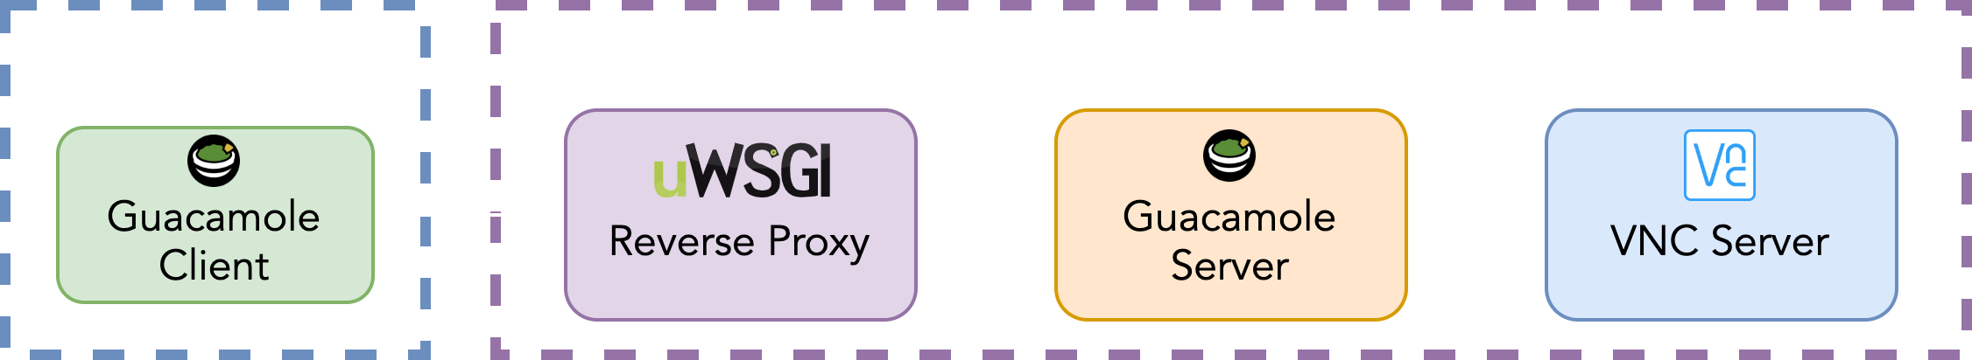
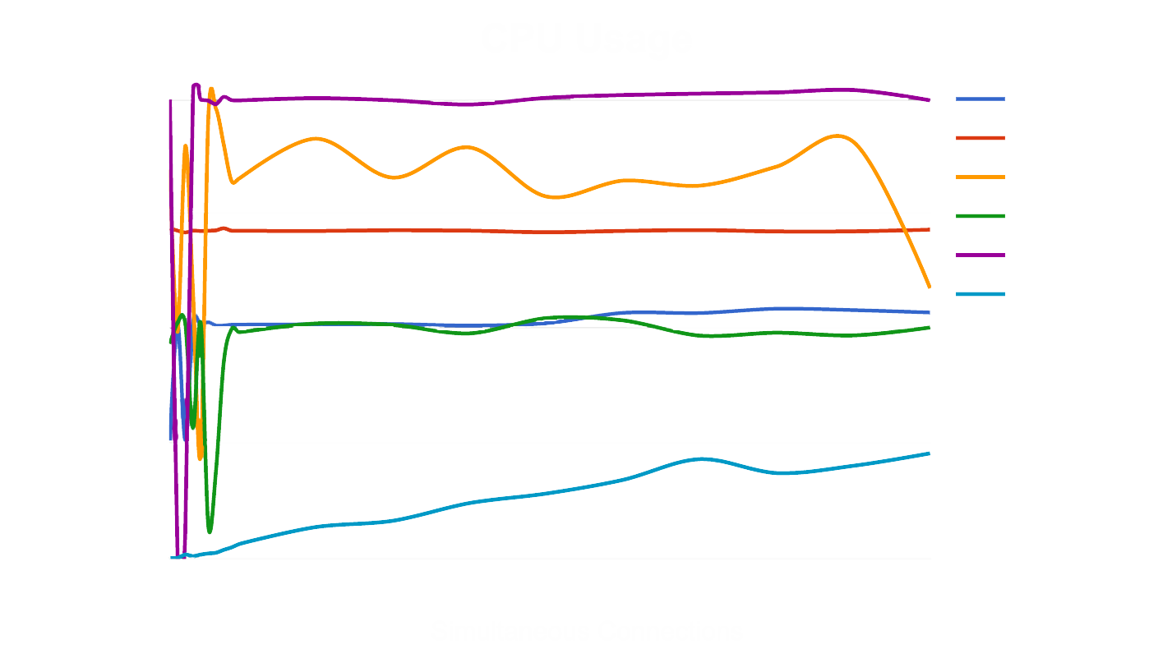
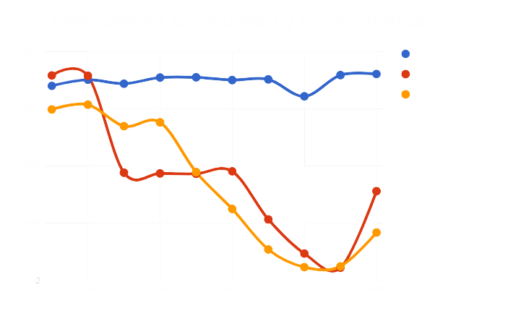
StreamingOS: Low Cost Education System
Group: 2020.15 Consultant: Wojciech Golab Members: Anurag Joshi, Matthew Milne, Surag Sudesh, Vidit Soni, Vinayak Sharma
MOTIVATION
OVERVIEW
FEATURES
Mobile devices for educational purposes is becoming increasingly more common in primary and secondary schools
The cost of educational technologies range from $142 to $490 USD per student [1]
Educational technologies become quickly outdated and need to be replaced, forcing schools to spend continuous amounts of money on maintenance
CORE COMPONENTS
Cordova client application
uWSGI Reverse Proxy Server
Desktop OS Container
Permission Server
MySQL Database
iptables Port Forwarding
Student Birds’ Eye View: Teachers can view the screens of all students in one convenient location
Broadcast: Teachers can seamlessly share their screen with all students
Application Permissions: Teachers can permit and revoke access to specific applications for each student
Messaging: Teachers can broadcast personalized messages to send to their students’ devices
Heterogeneity: The application can be run on multiple platforms such as Windows, Linux, Android and iOS
Portability: The education devices can fit in a standard backpack and weighs approximately 300g (3 apples)
OBJECTIVE
Provide students and teachers with inexpensive mobile devices
Utilize the power of cloud computing to keep up with the increase in computer resource usage of modern applications over time
COMPETITIVE ADVANTAGE
DESIGN ALTERNATIVES
Cost: The cost of the full system, including the mobile device and backend system, does not exceed $75 USD per year per student (full calculations in table below) [4]
Teacher Features: Wide array of teacher functionalities including bird’s eye view, broadcast, app permissions, messaging, etc. which enhances the education experience
Future Proof: As the computational needs for students increase, the cloud system can scale
Student Device: Initially a Raspberry Pi Zero was used. However, this limited the device portability. To make the devices accessible in an everyday classroom, a 7-inch tablet was decided upon
Remote Desktop Software: Only noVNC was initially used for connecting the student devices to the remote OS containers. Due to high latency when performing intensive tasks (especially in Windows), Guacamole was used which is a combination of noVNC and RDP
ANALYSIS
Parameters | Windows | Linux
Type of Azure VM | B2S | B1S
Number of Cores | 2 | 1
RAM | 4 GB | 1 GB
Temporary Storage | 8 GB | 4 GB
VM Cost (USD) Per Month | $19.48 | $3.42
Disk Type | Standard SSD | Standard SSD
Disk Storage | 32 GB | 32 GB
Storage Cost (USD) Per Month | $2.40 + $0.20 (for transactions) | $2.40
Subtotal (USD) Per Month | $22.08 | $6.02
Student Birds’ Eye View: The refresh time for the student screenshots is 4.98s on average
OS Container Cleanup: The average time for cleaning up a student’s session on Linux is 44.00s, and Windows is 35.69s
Server Performance: uWSGI is a lightweight web server that excels in relation to low CPU usage and simultaneous connections compared to existing alternatives [2] as shown in the graph (CPU Usage) below
Web Server Concurrency: uWSGI served the highest number of concurrent requests with the lowest amount of threads, allowing for lighter server [3] as shown in the graph (Web Server Concurrency Performance) below
HOW IT WORKS
Container Request: The Reverse Proxy finds a free OS container hosted on Azure, and sets up a network route with the client device using iptables
User Connects: The client sets up a guacamole connection using the network port provided by the Reverse Proxy
Student Birds’ Eye View: OS containers periodically send screenshots of student sessions to the teacher’s client via the Reverse Proxy
Broadcast: When a teacher starts broadcasting, the Reverse Proxy obtains the teacher’s current guacamole session and sends a view-only event ID to all clients
Messaging: All clients have an event-stream backed by individual message queues in which the server places events for delivery
REFERENCES
[1] B. B. a. R. L. Ross, "The Cost of School-Based Educational Technology Programs", 3 March 2013. [Online]. Available: https://www.rand.org/pubs/monograph_reports/MR634/index2.html.
[Accessed 1 June 2019]
[2] O. Habib, "AppDynamics", 11 May 2016. [Online]. Available:
https://www.appdynamics.com/blog/engineering/a-performance-analysis-of-python-wsgi-
servers-part-2/. [Accessed 24 June 2019]
[3] M. Gavrilov, "ITNext", 18 January 2018. [Online]. Available:
https://itnext.io/performancecomparison-between-nginx-unit-and-uwsgi-python3-
4511fc172a4c?gi=bb89601c22b3. [Accessed 24 June 2019]
[4] "Azure Pricing Calculator", Microsoft Corporation, [Online]. Available:
https://azure.microsoft.com/en-ca/pricing/calculator/. [Accessed 15 Jan 2020]

