Slide 1
Group 5
Financial Assistance
Jon Youhanaie Raghib Bangloria
Toma Milano Dwaine Foster
Matt Helbig
Agency
Information

Slide 2
Agency Information
Agency
Information

Slide 3

Interview with:
Kimberly Holly, Director of Development

Slide 4
Service Area Overview
Provides immediate financial assistance to low income Chicago area individuals and families
Their goal is to help people through a crisis or life changing transition

Slide 5
Whom do they serve?
Individuals and families with low-income
Individuals and families experiencing crisis or on the brink of crisis

Slide 6
Causes of the Problem
Loss of employment
Medical disability or emergency
Loss or delay of a public benefit
Natural disaster
Substantial change in household composition
Victimization by criminal activity
Illegal action by a landlord
Displacement by government or private action
Other conditions constituting a hardship comparable to the others on this list.

Slide 7

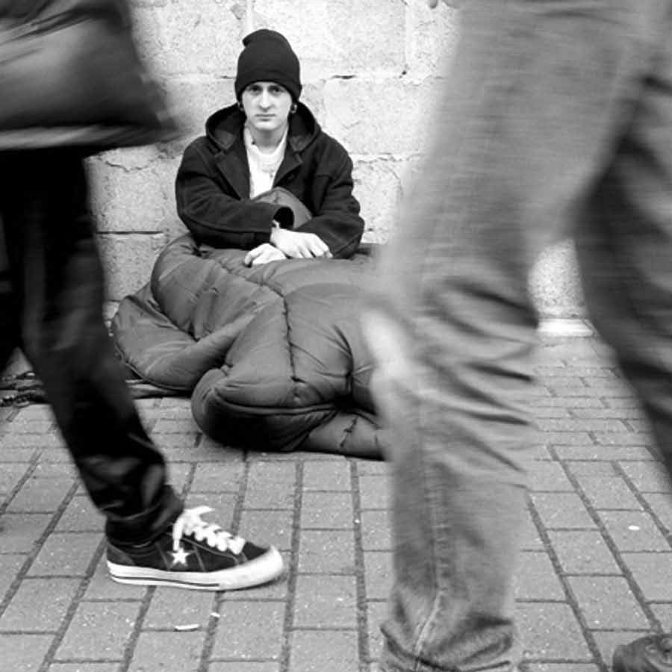
Options for Assistance
Flexible Financial Fund
Crisis Solution Grant
Funds can be used for food vouchers, prescription medicine, eye glasses, clothing
Payments are made to landlord or service provider
Self-Sufficiency Grant
Helps families to obtain more sustainable income
State Homelessness Prevention Fund
These funds can be used for security deposits, rent, mortgages, and utilities who are experiencing crisis

Slide 8
Organization History
The company was created in 1973.
Founder identified a resources gap.
Quickly distributed resources for those in need
Merged with other charitable organizations
Operates Mayor Daley’s Chicago Homelessness Prevention Fund.

Slide 9
History of the Problem
The problem is as old as humans using resources
The problem became more prevalent in urban areas but occurs everywhere
The current problem is not enough is done to help those in need

Slide 10
Measuring Success
Number of individuals and families helped
Money Raised through fundraising and donations
Time it takes to give assistance
Organization efficiencies

Slide 11
Success Stories
Carmel
Fixed Income on Section 8
She failed a home inspection because her stove was broken
Within a week she got a replacement stove and passed inspection
Eric
Unemployed and homeless
Participated in Sustainable Income Program
Got funds to attend Security Officer Training and money for food
Now has his own apartment and sustainable income

Slide 12
Key Individuals
Norman Stone
He observed a gap in services low-income families needed and the resources the City of Chicago provided them was inadequate
Used his own money and started distributing funds to people
Founded the Emergency Fund in 1973

Slide 13
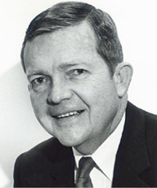
Key Individuals
Tom Owens
Co-Chairman for the Emergency Fund
Established My Brother’s Keeper which later merged with The Emergency Fund

Slide 14

Key Individuals
Nonie Brennan
Current CEO of The Emergency Fund
DePaul University Alumni and Professor
She has led the organization through significant growth
Organization becoming the largest provider of homelessness funding in the mid-west

Slide 15
Company Statistics
Headquarters is located in Chicago
24 Employees
Over 75 active volunteers

Slide 16



Alternatives
Catholic Charities of the Archdiocese of Chicago
Salvation Army
Society of St. Vincent DePaul

Slide 17
Organization Funding
Donations
Fundraising
Illinois Department of Human Services Grants
Federal Government Grants

Slide 18
SWOT Analysis
Strength
One of a few organizations who give this type of funding
Weakness
Opportunity
Utilize social media and the Internet to obtain donations and educate those needing help
Threat
If they can’t raise enough money clients will suffer or they will go elsewhere for assistance
Provides immediate access to assistance without red-tape
During negative economic conditions all of these decrease the amount of funding received
Limited to donations, fundraising efforts and grants from the government.

Slide 19
Website Analysis
Website Analysis

Slide 20
Type of Website
Hierarchical Structure
Static Code
Info needs to be
manually changed
Homepage
Our Programs
Flexible Financing Fund
State Homelessness Fund

Slide 21
Website Goals
Educate the public and those needing help
Direct those in need to assistance
Accept Donations
Tell their story

Slide 22
Customer Service
Expedite assistance requests
Case Manager works quickly to give assistance
No direct contact with the company
Those needing assistance should call 3-1-1

Slide 23
Privacy Policies
Outsources administrative services:
Credit Card Transactions
Mail
Managing databases
The exchange of personal information with these 3rd parties requires strict handling of confidential information

Slide 24

Security
Secure Server Technology used throughout online donation Process
Emergencyfund.org uses Volusion’s high grade encryption software and HTTPS Security Protocol to communicate with browser software
We hold the right to terminate your ability to interact with emergencyfund.org website and organization in the event we feel you have broken the terms and conditions of usage

Slide 25
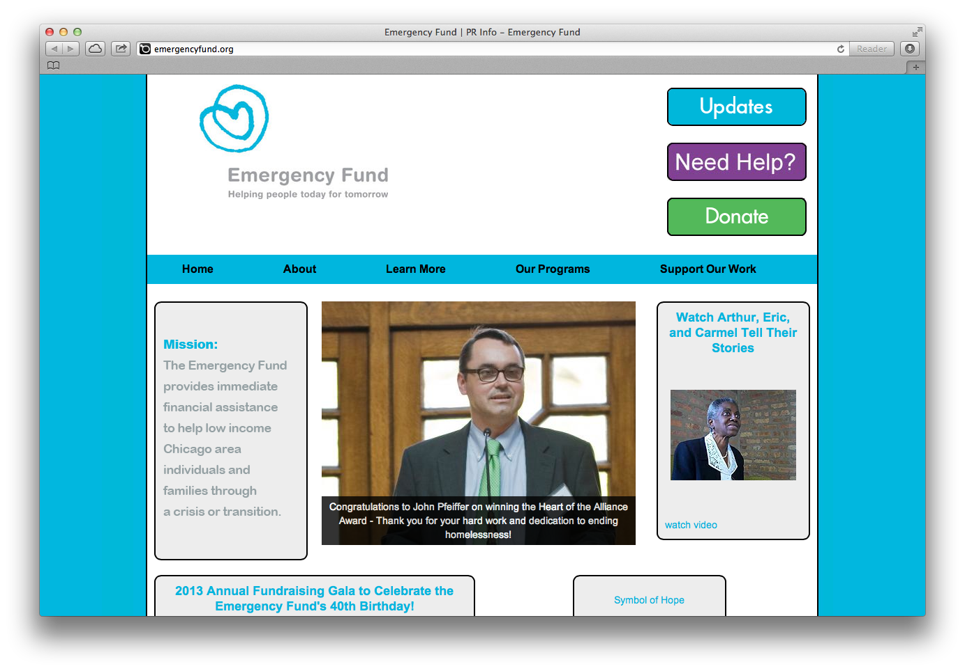

Slide 26
Website Marketing
Website
Marketing

Slide 27

Clients
Low income families or individuals
Homeless
Unemployed individuals
Families who are financially unstable due to some catastrophic event.

Slide 28

Clients
Donors are also clients of the site
They provide money for the funds
Can be an “emergency fund” for the emergency fund.
Donations are more important than distribution in the sense that there is a lack of distribution if there is no donation to begin with.

Slide 29

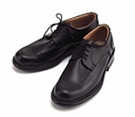
Clients
Individuals who want to shop for people who need temporary financial help.
Gift catalogs allow this.
E.g. Purchase a uniform for someone starting a new job.
Purchase a 30 day CTA pass to help a person seek employment or to maintain a new job until their first check

Slide 30

Why use this site
From a donors perspective “It will provide the financial relief to the ones in need
From the receiver’s perspective “It will aid you when in need.
Such as the temporary CTA pass.
Gives the ability to temporarily aid others in a different or a unique approach.
Other websites do not offer the ability to purchase certain gifts or in many cases they do not even have the gift catalog ability

Slide 31

Meeting the Needs
Basic needs for the head of household
Ability to donate for shelter. E.g. rent
Kitchen supplies to aid the cooking process for the family.
School supplies, Eye exams and glasses, clothing
Heat is important especially for a Chicago land residents

Slide 32
Marketing itself
Very easy to use
Click on Donate and it will give you many different options on what to donate.
Donating can be done online, thus no visits required
Colors of the website give it a warm feeling

Slide 33
Group Findings and Recommendations

Slide 34

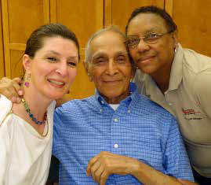
Catholic Charities
“By providing food, clothing, shelter and counseling, we bring hope to the hopeless in the city of Chicago and its suburbs. “
162+ Programs Including:
Adoption
Health Care
Emergency Financial Assistance
Assists more than 1 million people in Cook/Lake county annually.

Slide 35
Major Differences
Smaller in scope.
Lacks some media formats
No events listing
Amateur layout
Covers a wider range of services
Includes maps to service sites (based on region)

Slide 36
Why Catholic Charities Has the Better Site
All links are in working order
Regularly updated
Well-organized
En Español

Slide 37
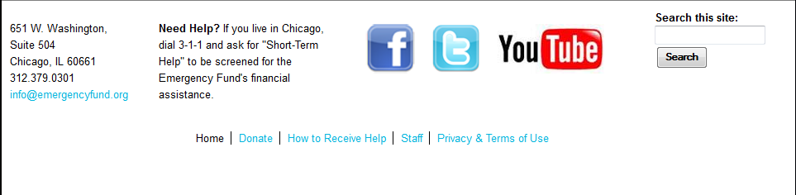
What Emergency Fund Does Well
Easy to navigate
Makes use of social media
Navigational and other important links at the bottom of each page
Multiple donation options

Slide 38
Needs Work
Home page layout is scattered
Some links are dead/incomplete
All section headings return Home

Slide 39
No Website?
Could still reach wide audience
Partnered with a number of agencies
Most assistance-related information is obtained through direct contact

Slide 40
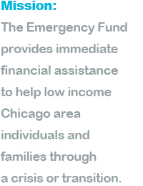
Advice
Organize home page
Make featured articles and blog posts available from Home
Consistency for font/text

Slide 41
Website Tour

Slide 42
