Slide 1
URBAN AIR-QUALITY
CONSISTENCY PROFILING
with Relaxed Functional Dependencies
A reproducible analytical workflow for approximate environmental rules
Matteo Ercolino
KDIID · Final project presentation
01
Notes:
Introduce the project as an analysis of approximate consistency in urban air-quality observations.
The central method is Relaxed Functional Dependencies, or RFDs.
Clarify the scope immediately: the work does not predict pollution and does not make causal claims.

Slide 2
KDIID · RFD CONSISTENCY PROFILING
Why deterministic rules are the wrong target
Urban environmental data are:
The analytical question
noisy and affected by measurement uncertainty
When observations are similar in context and pollutant levels, how often do other measurements remain similar?
variable across time, sites, and weather conditions
influenced by factors that are not fully observed
Measure approximate regularity—without forcing exact laws.
The goal is to quantify approximate consistency, not to predict outcomes or prove causality.
02
Notes:
Explain why classical deterministic constraints are too rigid for this domain.
The objective is descriptive and diagnostic: quantify how often a proposed consistency relation holds.
This framing makes moderate confidence meaningful when it is clearly above chance.

Slide 3
KDIID · RFD CONSISTENCY PROFILING
A conceptual Urban Digital Twin
The Digital Twin is a framing device for an analytical loop:
01
02
03
04
HISTORICAL DATA
APPROXIMATE RULES
VIOLATIONS
MONITORING
Two stations, pollutants, meteorology
RFDs describe expected similarity
Cases that break the expected pattern
Monthly metrics reveal regime changes
Not built here
3D platform · real-time infrastructure · operational control system
The contribution is a reproducible analytical workflow—not a 3D or real-time platform.
03
Notes:
Define Urban Digital Twin narrowly and explicitly.
The twin is conceptual: it organizes historical data, approximate rules, violations, and monitoring.
The implemented contribution is the reproducible workflow shown on the slide.

Slide 4
KDIID · RFD CONSISTENCY PROFILING
Dataset design
Beijing Multi-Site Air Quality Data Set
Aotizhongxin + Changping · March 2013–February 2017
66,619
11
1,676
1,403,650
clean observations
final variables
weekly profiles
pairwise comparisons
Missing-value policy
summarize missingness → drop incomplete rows on selected columns → no imputation
All 66,619 rows feed weekly station × time-slot medians; DiMε uses eight projected attributes.
04
Notes:
State the selected dataset, stations, and common four-year period.
The full cleaned dataset is retained for descriptive profiling.
Pairwise RFD validation is quadratic, so a deterministic balanced sample of 750 rows per station is used.
The missing-value policy is transparent and does not impute values.

Slide 5
KDIID · RFD CONSISTENCY PROFILING
From exact equality to expected similarity
CLASSICAL FD
RELAXED FD
X₁ = X₂
X₁ ≈ X₂
implies
implies expected similarity
Y₁ = Y₂
Y₁ ≈ Y₂
exact constraints
threshold-based regularities
RFDs match noisy environmental observations better than deterministic functional dependencies.
05
Notes:
Contrast exact functional dependencies with threshold-based similarity.
For categorical attributes, similarity can still mean exact equality.
For numeric attributes, similarity is defined by absolute thresholds; hour uses circular distance.

Slide 6
KDIID · RFD CONSISTENCY PROFILING
How similarity is defined
CATEGORICAL ATTRIBUTES
MEDIUM SETUP · MAIN CONFIGURATION
station, time_slot → exact match
TEMP
≤ 2.0
NO2
≤ 10.0
EXTENT
WSPM
≤ 1.0
O3
≤ 10.0
g3 ≤ 0.10 · greedy mode
PM2.5
≤ 10.0
g3
≤ 0.10
NUMERICAL ATTRIBUTES
PM10
≤ 15.0
absolute distance thresholds
Medium similarity thresholds are DiMε inputs.
Thresholds are supplied to DiMε; inferring thresholds would instead be DOMINO's role.
06
Notes:
These thresholds are heuristic and interpretable; they are not claimed to be statistically optimal.
The medium setup is the main configuration used for the candidate-rule results.
Strict and relaxed settings provide sensitivity analysis, checking that the interpretation does not depend on one threshold choice.

Slide 7
KDIID · RFD CONSISTENCY PROFILING
RFD discovery with DiMε
DiMε discovers minimal RFDs through difference matrices, lattice exploration, candidate pruning and g3 validation.
01
02
03
04
DIFFERENCE MATRICES
SIMILAR SUBSETS
COMPLETE LATTICE
g3 VALIDATION
Absolute distance + categorical equality
Pattern subsets; singleton stripping
C+ candidates, joins, pruning
Greedy vertex cover at ε = 0.10
Inputs
8 attributes · similarity thresholds · extent threshold ε
Outputs: minimal RFDs + g3.
07
Notes:
Define Urban Digital Twin narrowly and explicitly.
The twin is conceptual: it organizes historical data, approximate rules, violations, and monitoring.
The implemented contribution is the reproducible workflow shown on the slide.

Slide 8
KDIID · RFD CONSISTENCY PROFILING
Post-discovery metrics
SUPPORT
CONFIDENCE
BASELINE
antecedent pairs / all pairs
valid pairs / antecedent pairs
mean confidence over 30 seeded RHS permutations
How often are tuples comparable?
How often does the rule hold?
What happens by chance?
LIFT
confidence
=
> 1 means more informative than chance
baseline confidence
DiMε discovers with g3; support, confidence, baseline, and lift rank its outputs afterward.
08
Notes:
Define support and confidence using pair counts.
Explain that the RHS is permuted 30 times while antecedent structure remains fixed.
Lift compares observed confidence with this permutation baseline.
Support must still be considered: a high confidence rule with very few antecedent pairs can be unstable.

Slide 9
KDIID · RFD CONSISTENCY PROFILING
DiMε pipeline step
01
02
03
04
05
06
07
08
Preprocess
Profile
Weekly
projection
DiMε
discovery
Permutation
baseline
Bootstrap
Temporal +
monthly
Violations
PREPARE
DISCOVER
VALIDATE
INVESTIGATE
Discovery is DiMε; every baseline and robustness check is strictly post-discovery.
09
Notes:
Walk through the pipeline from data cleaning to violation analysis.
Candidate validation is followed by a chance baseline, resampling, chronological validation, and monthly monitoring.
This sequence is the methodological contribution of the project.

Slide 10
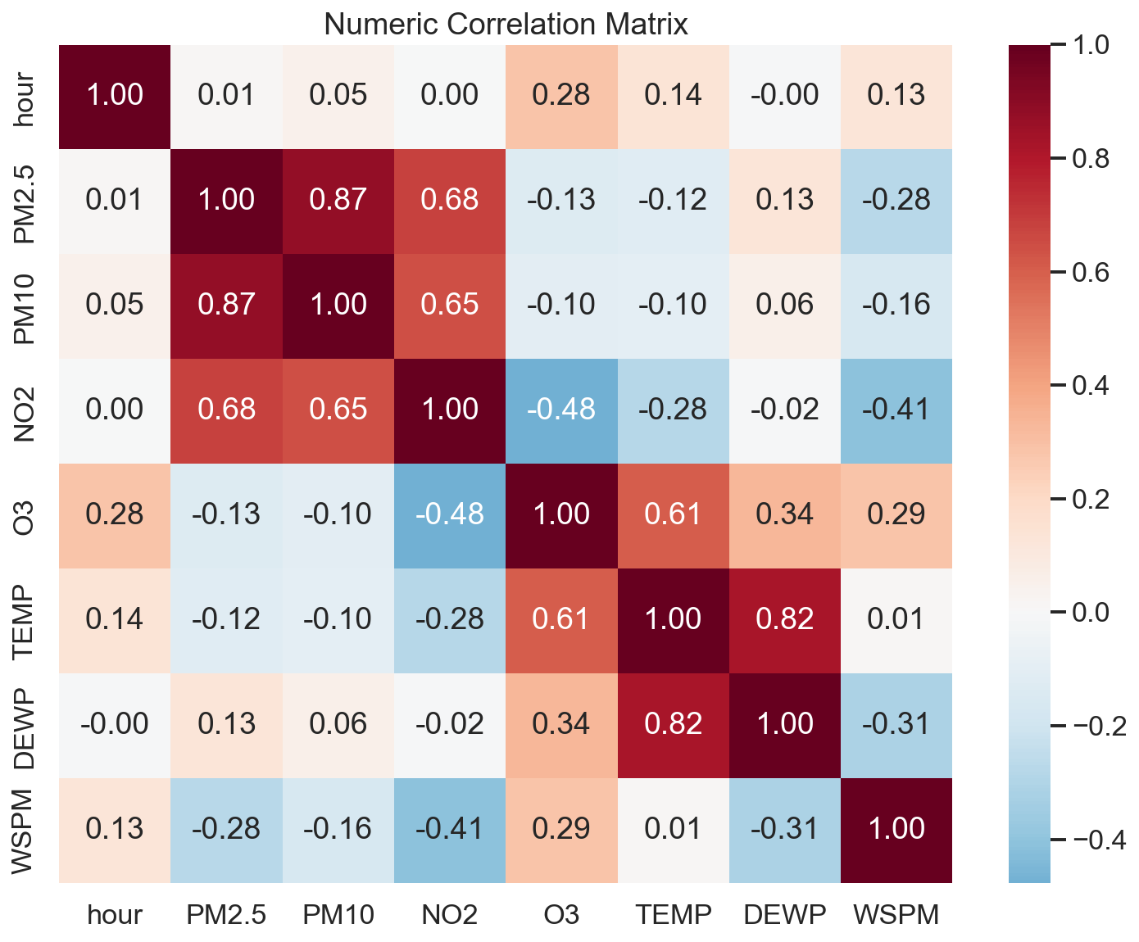
KDIID · RFD CONSISTENCY PROFILING
Descriptive profiling reveals one dominant pattern
0.874
PM2.5–PM10
Pearson correlation
Correlation is descriptive context—not an RFD metric and not causal evidence.
Fine and coarse particulate matter form the clearest descriptive relationship in the dataset.
10
Notes:
Use the correlation matrix only as descriptive context.
Highlight the PM2.5–PM10 correlation of 0.874, the strongest pollutant relationship.
Stress that correlation, RFD consistency, and causality are three different concepts.

Slide 11
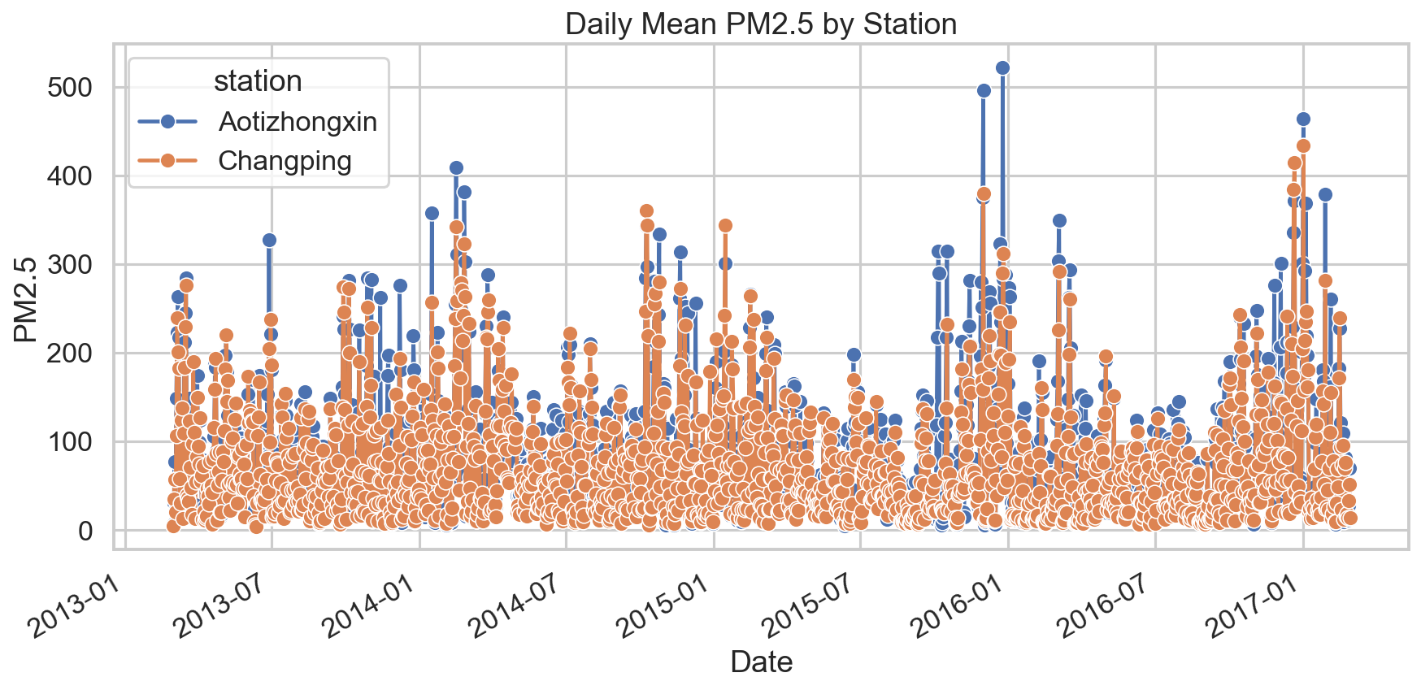
KDIID · RFD CONSISTENCY PROFILING
PM2.5 behavior changes across time and stations
Temporal and site-level variability motivates continuous profiling rather than one static summary.
11
Notes:
The plot shows daily mean PM2.5 by station for readability.
Point out that peaks and quieter periods do not align perfectly across the two sites.
This motivates monthly monitoring of RFD metrics rather than relying only on a global estimate.

Slide 12
KDIID · RFD CONSISTENCY PROFILING
Top RFDs discovered by DiMε
Rule
Support
Conf.
g3
Lift
station, PM10, NO2, O3, TEMP → WSPM
0.0016
0.899
0.092
1.163
PM2.5, PM10, NO2, O3, TEMP → WSPM
0.0013
0.889
0.074
1.155
time_slot → WSPM
0.2496
0.858
0.047
1.113
5 minimal RFDs · 960 candidates · 8 lattice levels
Four of five RFDs have low support; time_slot → WSPM is most general (support 0.24955).
12
Notes:
Present the three strongest raw candidate rules under the medium threshold configuration.
The top rule has confidence 0.483, which is moderate and must not be described as a strong dependency.
Its lift of 3.24 is the key result: the observed consistency is much higher than the permuted RHS baseline.
Support is low as a fraction, but it still corresponds to many pairwise comparisons and is interpreted together with confidence, baseline, and lift.

Slide 13
KDIID · RFD CONSISTENCY PROFILING
Sensitivity to similarity thresholds
Configuration
RFD
Distinct RHS
WSPM share
Note
strict_075x
19
6
0.632
—
medium
5
1
1.000
—
loose_150x
1
1
1.000
∅ → WSPM
1. Medium gives a compact and interpretable rule set. 2. Strict thresholds reveal alternative RHS: WSPM dominance is not absolute. 3. Loose thresholds collapse to uninformative rules.
Medium remains the main run; sensitivity qualifies interpretation without changing the primary results.
13
Notes:
Since DiMε depends on similarity thresholds, I tested whether the main result was stable under alternative threshold settings. The medium configuration gives a compact set of five RFDs, all with WSPM as RHS. With stricter thresholds, more RHS emerge, so WSPM dominance is not an absolute property of the dataset. With looser thresholds, the discovery collapses to almost trivial rules such as empty set -> WSPM. For this reason, the medium configuration is used as the main setting and the sensitivity analysis is used as a robustness and interpretation check.

Slide 14
KDIID · RFD CONSISTENCY PROFILING
g3 and confidence answer different questions
Minimum tuple-removal fraction needed to make an RFD hold.
g3 ERROR
Valid similar pairs divided by antecedent pairs.
CONF.
DiMε discovers rules with g3 ≤ 0.10.
Pairwise confidence ranks discovered rules afterward.
DISCOVERY ≠ RANKING
Low g3 can coexist with pair violations because tuple removal and pair counting differ.
14
Notes:
PM2.5 is the fine fraction included in the PM10 size class, so coherence is environmentally plausible.
Adding NO2 may represent shared emission conditions, but this is an interpretation—not causal proof.
Unobserved weather, source mixtures, and particulate composition can explain violations.

Slide 15
KDIID · RFD CONSISTENCY PROFILING
Post-discovery validation design
Discovered RFDs → robustness checks
30
75 / 25
49
200
bootstrap
train / test
monthly windows
pairs / rule
Bootstrap resampling quantifies variability in support, confidence and lift.
Chronological validation separates the 2013–2016 training period from the 2016–2017 test year.
Monthly profiling and violation-pair exports support monitoring and targeted follow-up.
15
Notes:
Explain that pollutants and meteorological variables are grouped into low, medium, and high quantile bins.
The top binned rule reaches confidence 0.689 and lift 2.07.
This is not directly comparable to the raw rule because discretization makes similarity less demanding.

Slide 16
KDIID · RFD CONSISTENCY PROFILING
The top DiMε rule remains relatively stable
BOOTSTRAP · 30 BALANCED RESAMPLES
CHRONOLOGICAL VALIDATION · 75 / 25
0.930
1.207
TRAIN
TEST
mean confidence
mean lift
Mar 2013–Feb 2016
Mar 2016–Feb 2017
lift 1.161
lift 1.178
95% empirical lift interval
[1.171, 1.244]
Confidence rises from 0.888 to 0.937.
Bootstrap and the held-out year keep lift above 1 for the top DiMε rule.
16
Notes:
Bootstrap results summarize 30 balanced resamples.
The mean lift is 3.35, with empirical 95% interval from 3.15 to 3.57.
The chronological split trains on the first three years and tests on the final year.
The top rule's lift is 3.15 in train and 3.35 in test, supporting relative stability.

Slide 17
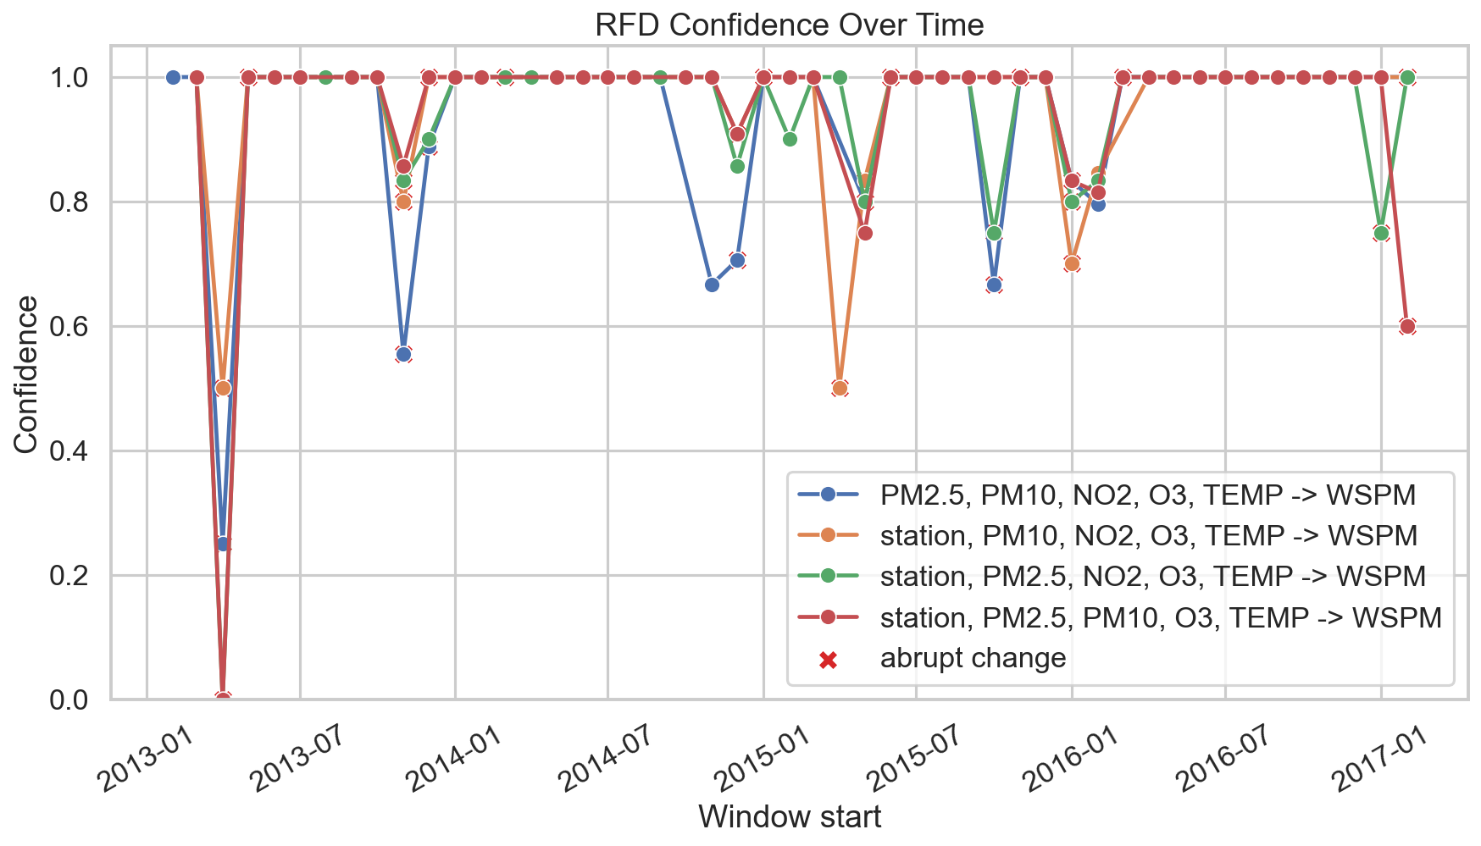
KDIID · RFD CONSISTENCY PROFILING
Continuous profiling exposes changing regimes
49
monthly windows
confidence varies over time
support changes with comparability
pair counts affect reliability
Monthly metrics are recalculated only for RFDs discovered by DiMε.
17
Notes:
The continuous profile covers 48 monthly windows.
Monthly confidence varies substantially, which is expected in a seasonal environmental system.
Do not interpret confidence alone: support and antecedent-pair counts show how much evidence is available in each month.
Abrupt changes are monitoring signals, not automatic anomalies.

Slide 18
KDIID · RFD CONSISTENCY PROFILING
Violations as investigation targets
Top 2 DiMε RFDs · 200 strongest pairs each
A violation may reflect:
local site heterogeneity
unobserved local conditions
meteorology outside the rule
weekly aggregation effects
measurement or data-quality issues
Top group: Changping · Jan 2016 · afternoon · 9 pairs.
The value of violations lies in targeted follow-up, not automatic labeling.
18
Notes:
The chart aggregates the same exported violation-pair counts by station into eight six-month periods so the time labels remain readable.
It still represents the two strongest raw RFDs and preserves the original interpretation.
Violations can indicate heterogeneous local conditions, missing explanatory variables, unusual events, or data-quality problems.
They should be investigated with contextual data rather than labeled as errors by default.

Slide 19
KDIID · RFD CONSISTENCY PROFILING
What the workflow contributes
RFD discovery with DiMε: difference matrices, lattice, C+, g3 and pruning.
5 minimal RFDs from 960 candidates across all 8 lattice levels.
Baseline, lift, bootstrap and temporal checks are post-discovery.
The weekly projection uses every one of the 66,619 cleaned rows.
Four of five RFDs have low support and describe specific regularities.
“The contribution is a reproducible RFD discovery and profiling workflow: DiMε discovers the rules, while post-discovery metrics explain their scope and stability.”
Thank you
19
Notes:
Close by returning to the methodological contribution: a reproducible consistency-profiling workflow.
The strongest results are approximate and clearly above chance, not deterministic.
Continuous profiling shows how RFDs can support monitoring over time.
The empty discovery result is intentional evidence of conservative thresholds rather than a failed experiment.
End with the quoted sentence as the main answer to what the project contributes.

Slide 20
KDIID · BACKUP
Backup · Sources
01
Beijing Multi-Site Air Quality Data Set, UCI Machine Learning Repository
02
KDIID Lecture 3, Relaxed Functional Dependencies · DiMε slides 29–41
03
Caruccio, Deufemia, Polese, “Mining relaxed functional dependencies from data”, Data Mining and Knowledge Discovery, 2020
20
Notes:
Backup slide; do not include it in the timed oral presentation unless the committee asks about data or methodological references.

