Slide 1

Recommendation Systems Project
Mate Balogh

Slide 2
Item recommendations for visitors in an online store based on implicit feedback to provide better user experience and to boost sales.

Slide 3
Methodology
Dataset
Business needs
Requirement details
Model planning
Model construction
Explanation
Evaluation

Slide 4
Dataset
E-commerce dataset¹
Elements:
Tree of categories
Click stream data of users
Item properties
Event types in stream:
View
Add to cart
Transaction
¹ Retailrocket recommender system dataset from Kaggle

Slide 5
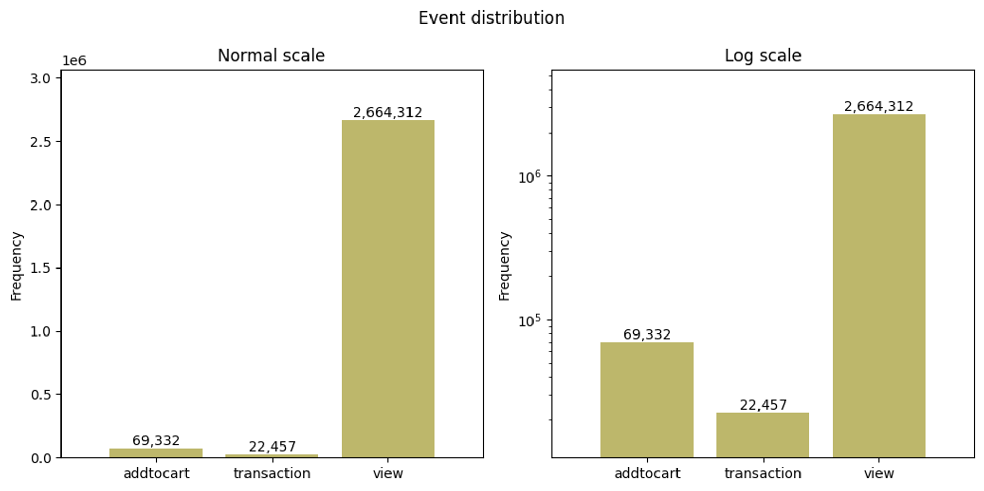

Slide 6
Business Needs
Home page recommendations Popular items, Items purchased by similar users
Newsletter recommendations Discovered patterns

Slide 7
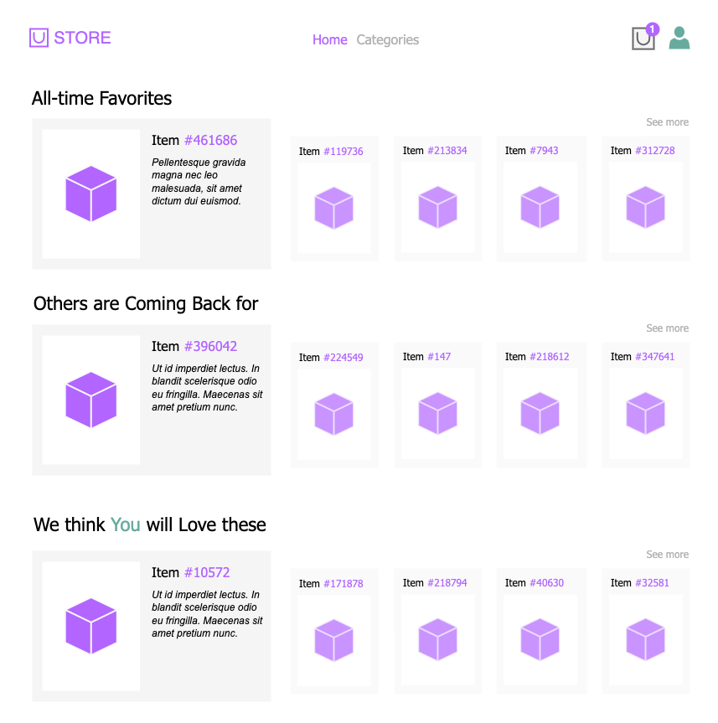

Slide 10
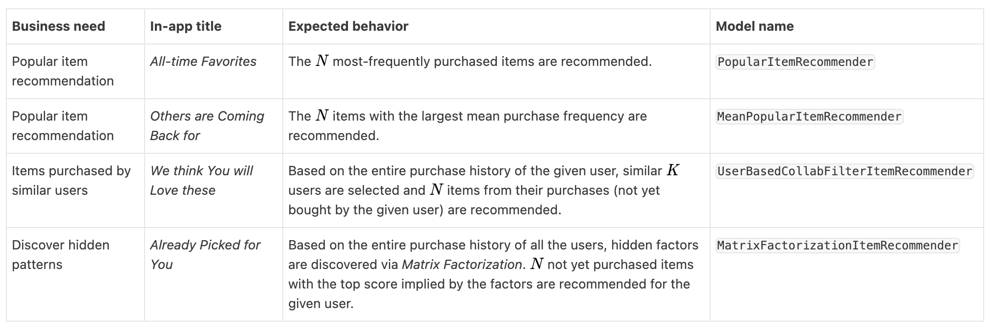
Requirement Details

Slide 11
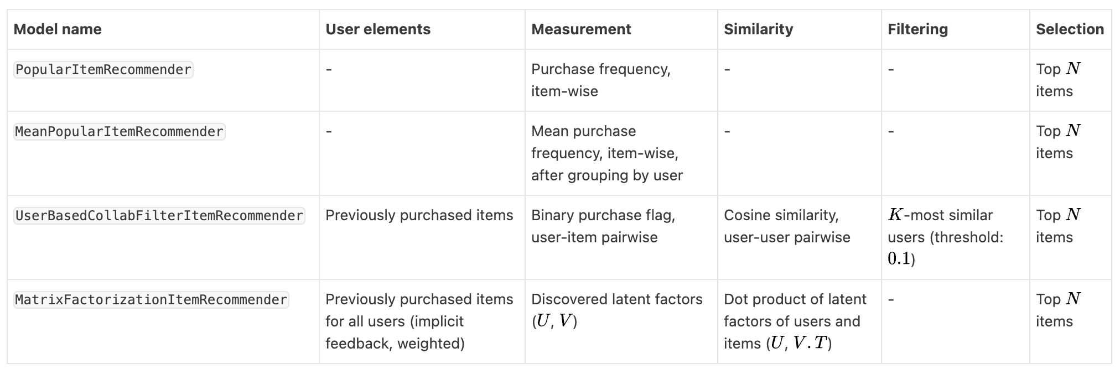
Model Planning

Slide 12
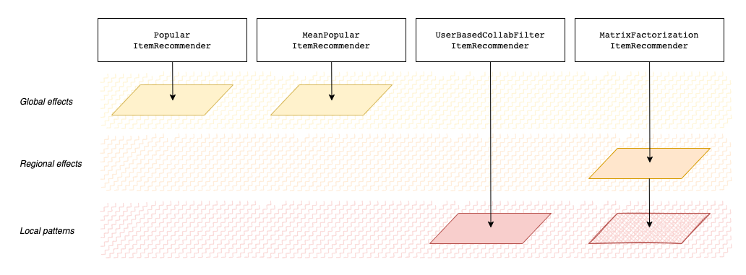

Slide 13
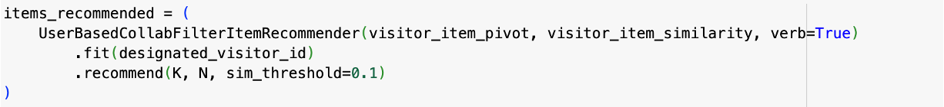
Model Construction*
* Model call syntaxes. For the model implementations, visit the Python notebook on GitHub

Slide 14
Explanation

Slide 15
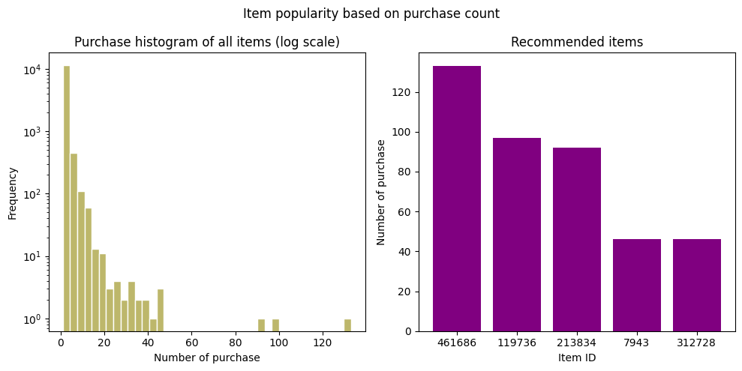

Slide 16
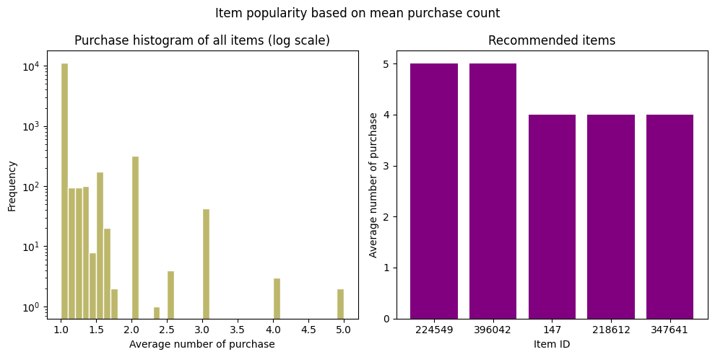

Slide 17
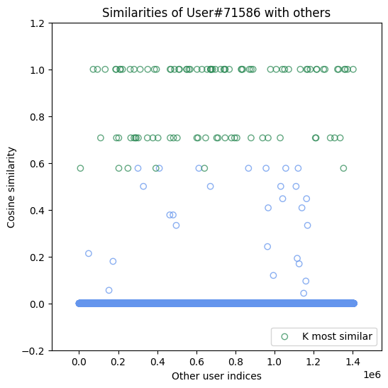
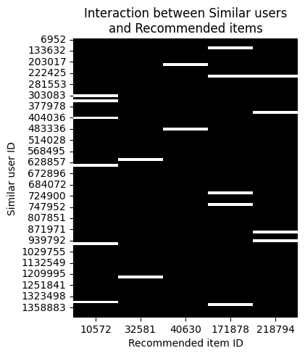

Slide 18
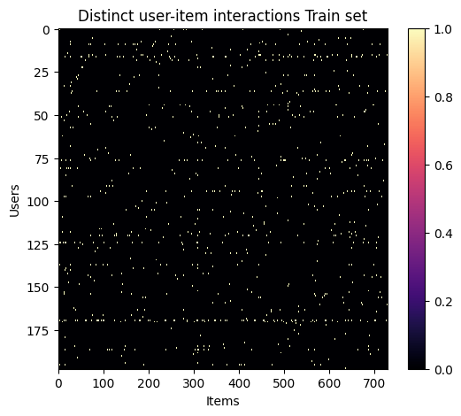

Matrix Factorization (Weighted)

Slide 19
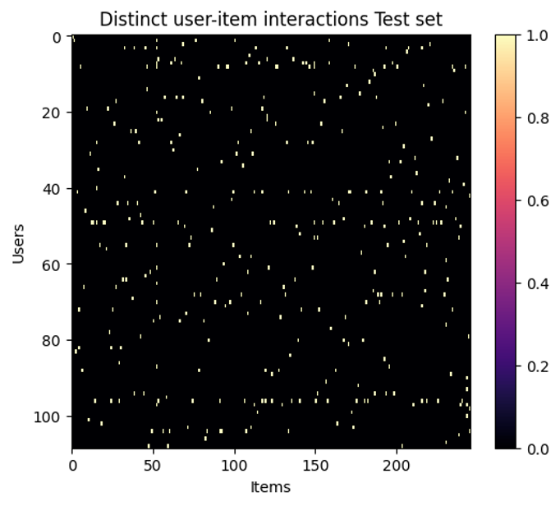
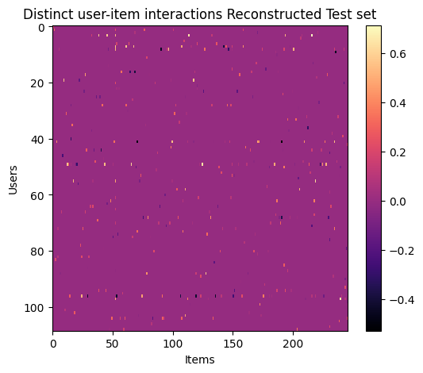
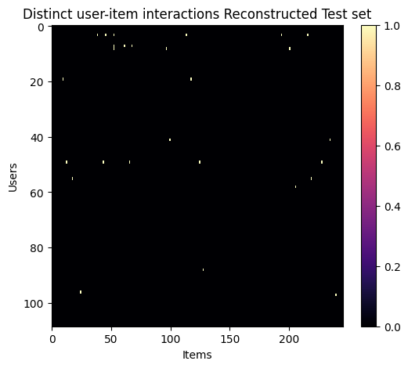
Reconstruction with U and V

Slide 20
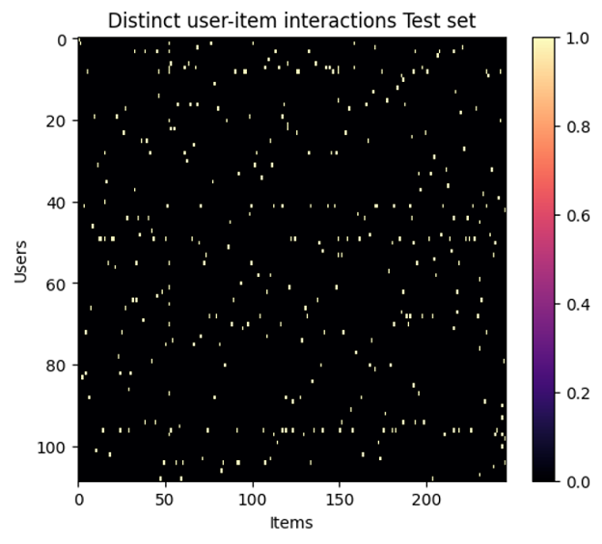
Reconstruction with U and V

Slide 21
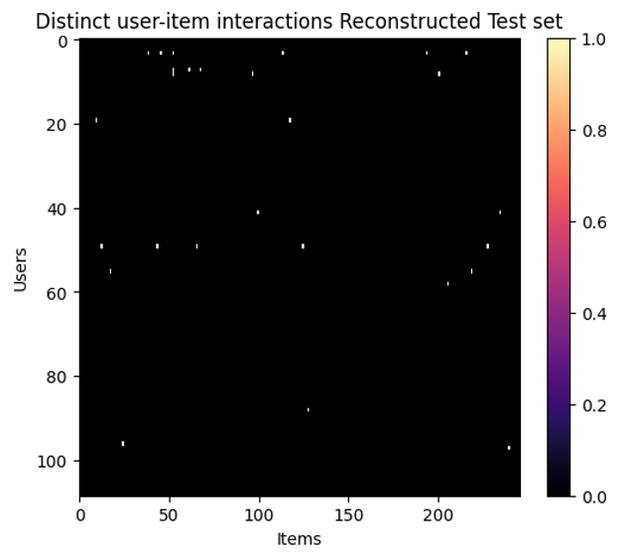
Reconstruction with U and V

Slide 22
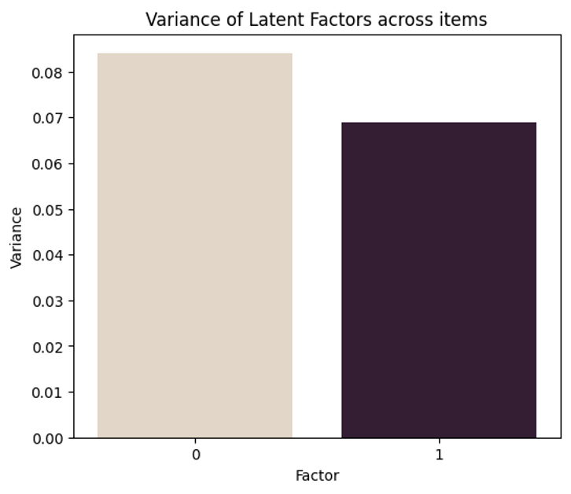
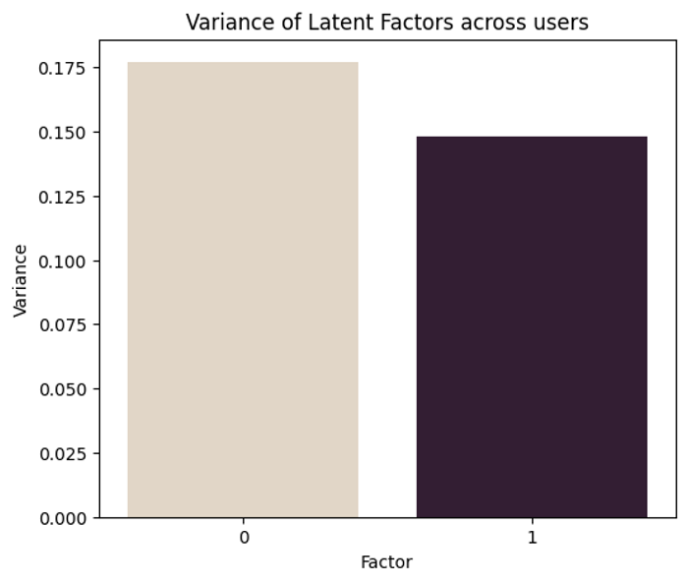
Variance of Latent Factors

Slide 23
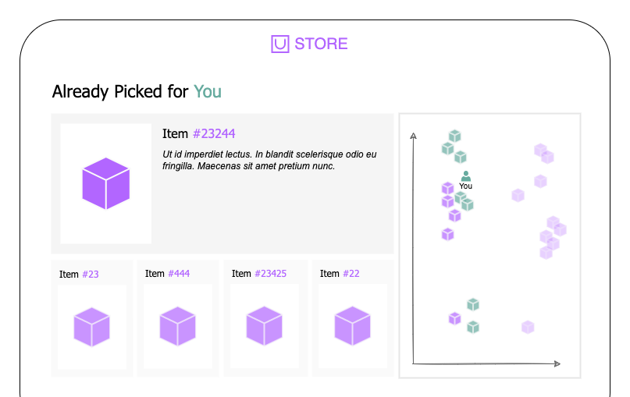

Slide 24
Future Directions
Investigate effect of bias(es)
Complete MF model
Interpret behavior of MF in details
Evaluate model performances
Incorporate other implicit feedbacks (view, addtocart, addtocart -> transaction)

Slide 25
Project-based Topics and Questions
Collaborative Filtering Fundamentals and Similarity-Based Methods
Matrix Factorization and Latent Factor Models
Handling Implicit Feedback and Data Preprocessing

Slide 26
1. Collaborative Filtering Fundamentals and Similarity-Based Methods
Source: Recommender Systems Handbook – Chapter 4: Neighborhood-based Recommendation Methods
Key aspects:
Core concepts of user-based and item-based collaborative filtering
Different similarity metrics (e.g., Cosine, Pearson)
Rating normalization and neighborhood selection strategies

Slide 27
2. Matrix Factorization and Latent Factor Models
Source: ch09-recsys2.pdf Concepts of SVD, latent factors, and gradient descent optimization
Key aspects:
Representing users/items as vectors in a shared latent space
Learning via RMSE minimization using gradient descent
Comparing factorization with neighborhood methods

Slide 28
3. Handling Implicit Feedback and Data Preprocessing
Source: Recommender Systems Handbook – Chapter 2: Data Mining Methods for Recommender Systems
Key aspects:
How to interpret implicit feedback (views, cart additions) as signals of user preference
Denoising, dimensionality reduction, and sampling strategies
Importance of preprocessing for high-quality recommendations

