Slide 1
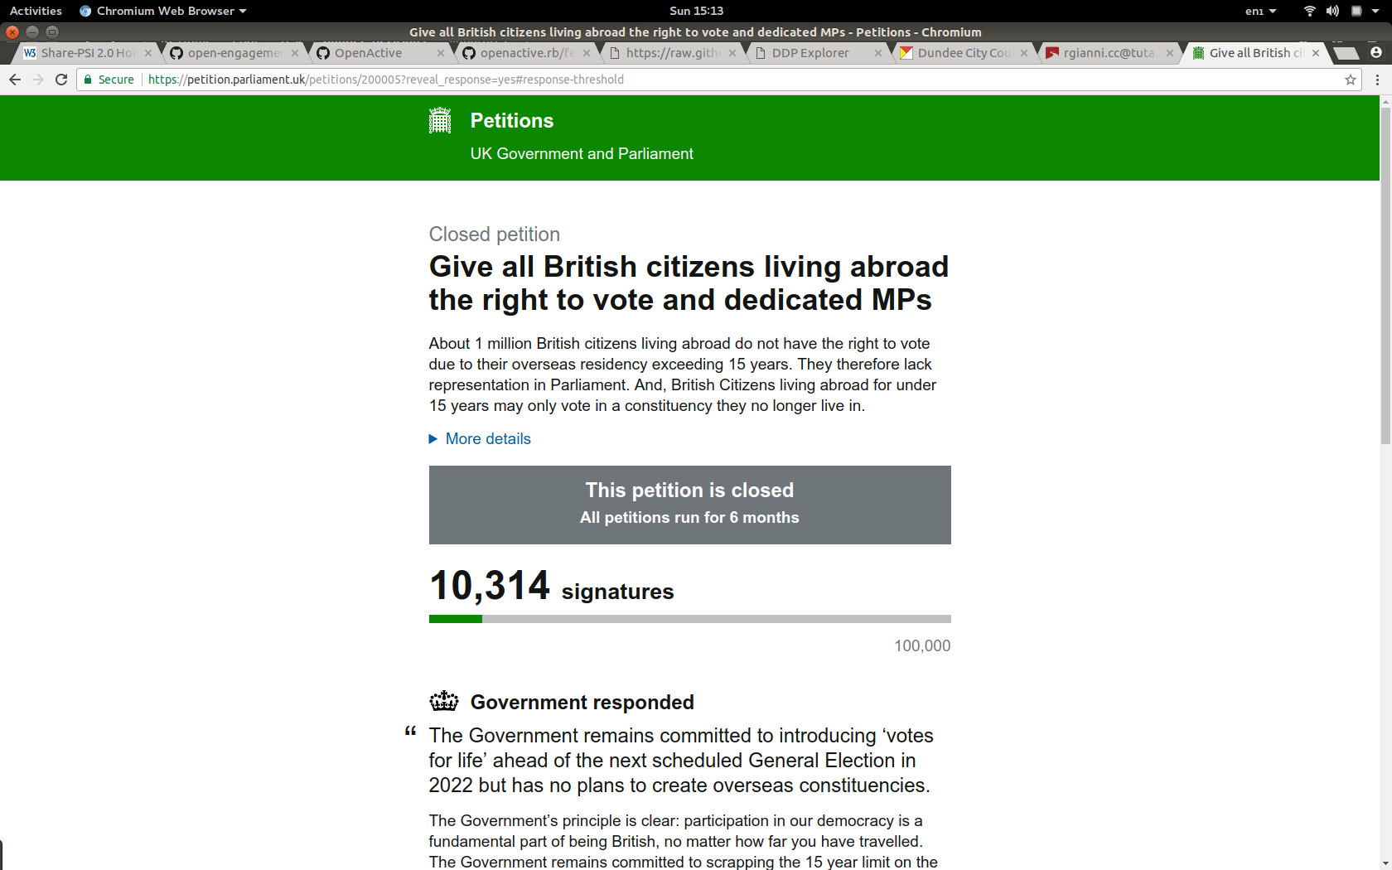

Slide 2
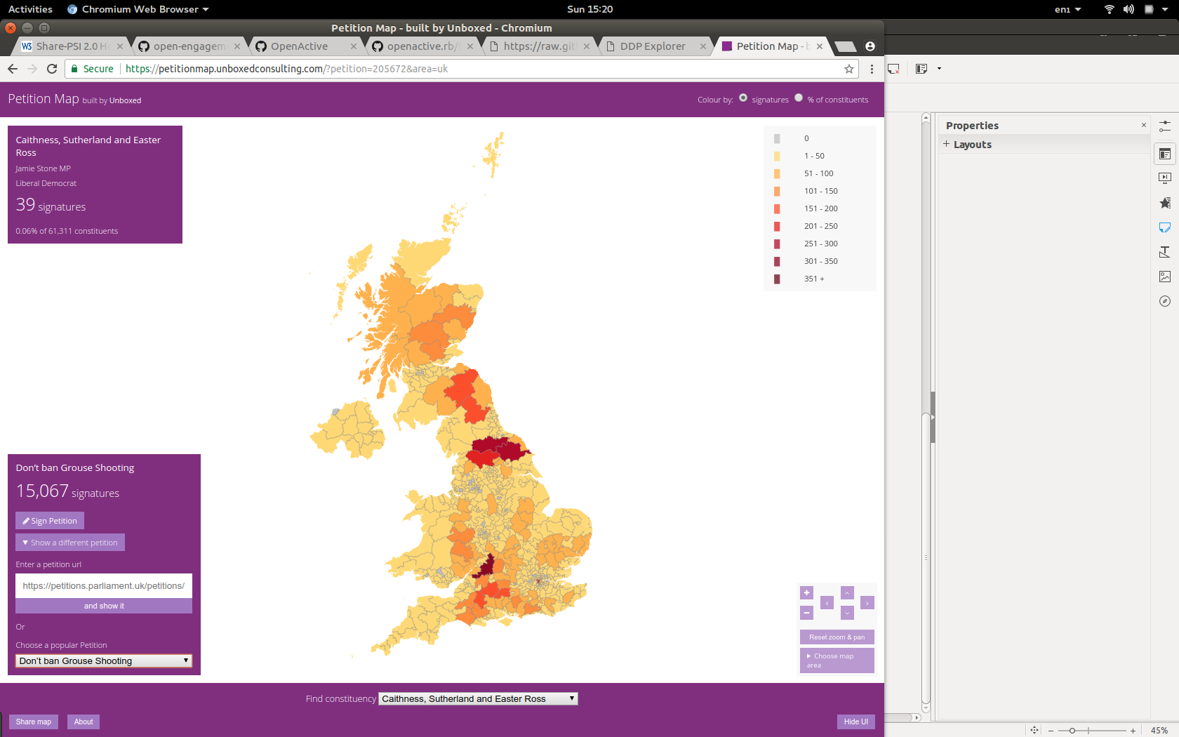

Slide 3
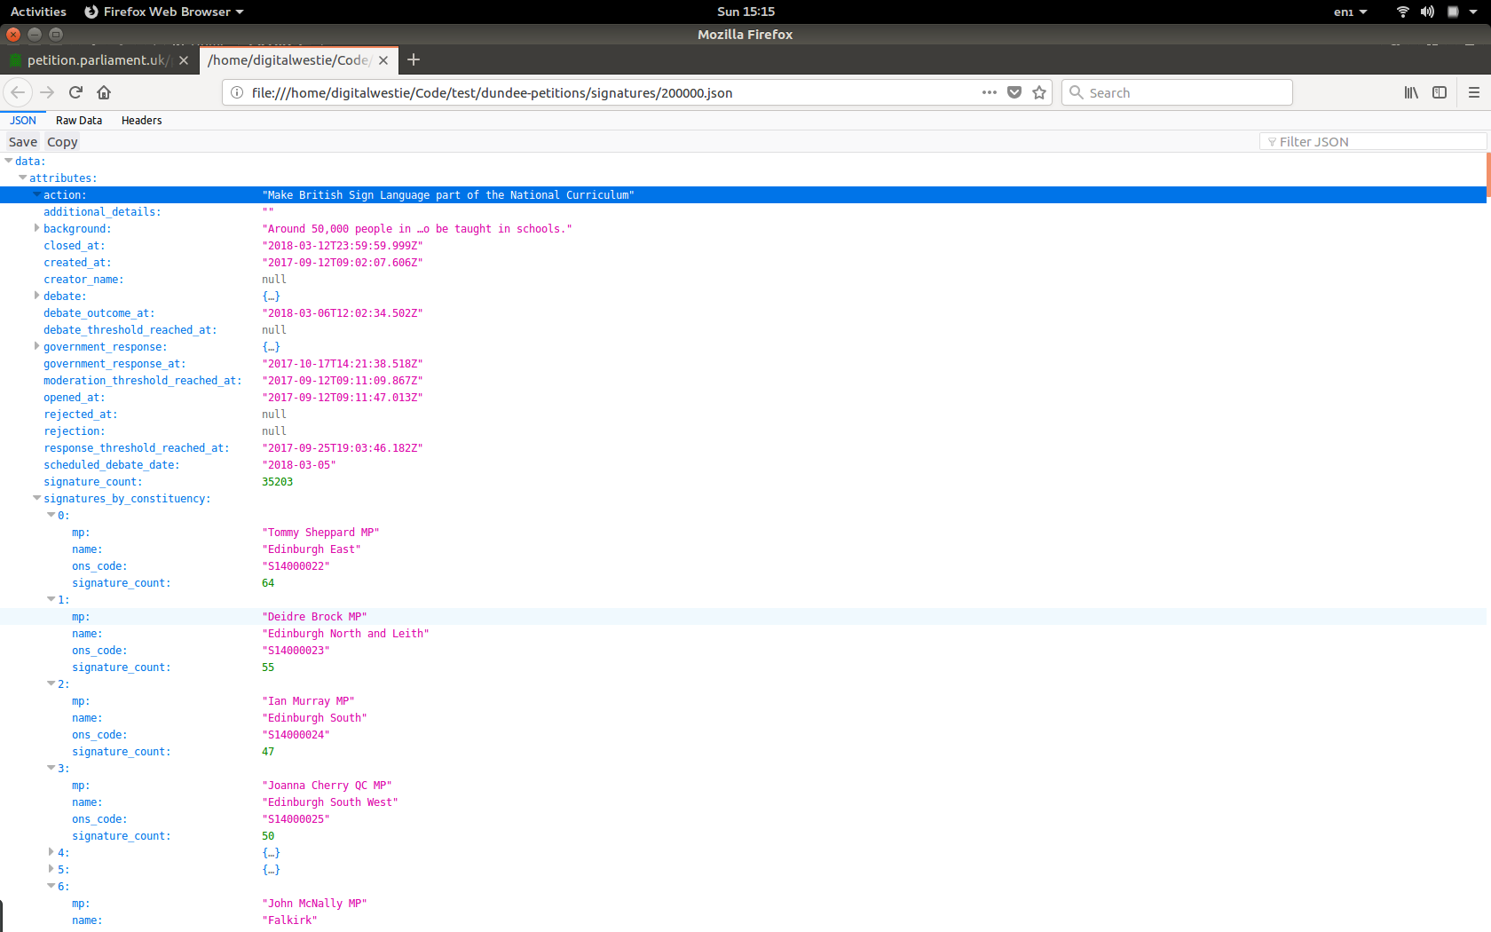

Slide 4
2017 ~ Government
5,509 Petitions so far...

Slide 5
2017 ~ Government
5,509 Petitions so far…
268 Petitions

Slide 6
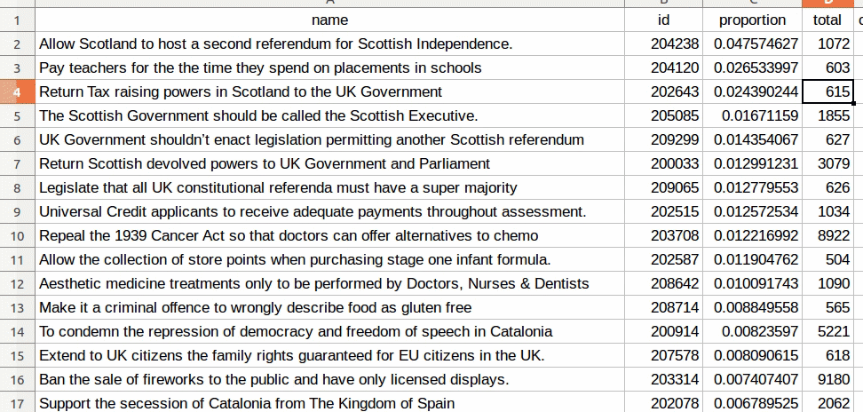

Slide 7
#1
Allow Scotland to host a second referendum for Scottish Independence.
Total Signatures: 1072
Signatures in Dundee: 51

Slide 8
#2: Return Tax raising powers in Scotland to the UK Government
#3: Return Scottish devolved powers to UK Government and Parliament

Slide 9
#4
Universal Credit applicants to receive adequate payments throughout assessment.
Total Signatures: 1034
Signatures in Dundee: 13

Slide 10
#9
Ban the sale of fireworks to the public and have only licensed displays.

Slide 11
#10
Legalise cannabis for medical and recreational use.

Slide 12
#17
Make fair transitional state pension arrangements for 1950’s women

Slide 13
#19
Make parking of ICE vehicles at EV charging points a more serious offence

Slide 14
#218
Allow Martial Arts to be on the GCSE/A Level syllabus.

Slide 15
#266
Make homework voluntary for children

Slide 16
Petitions >500 signatures #18
Regulate the eyelash extension industry making training compulsory

