Slide 1
Predicting Major League Soccer Salaries
Matthew Kulynych

Slide 2
Introduction

Slide 3
How can we predict guaranteed compensation of Major League Soccer players using performance-related statistics from the previous season?

Slide 4
Importance and Goals
Predict guaranteed salary
How clubs can find a reasonable salary
Sports Analytics career aspirations
Over/underpaid players?

Slide 5
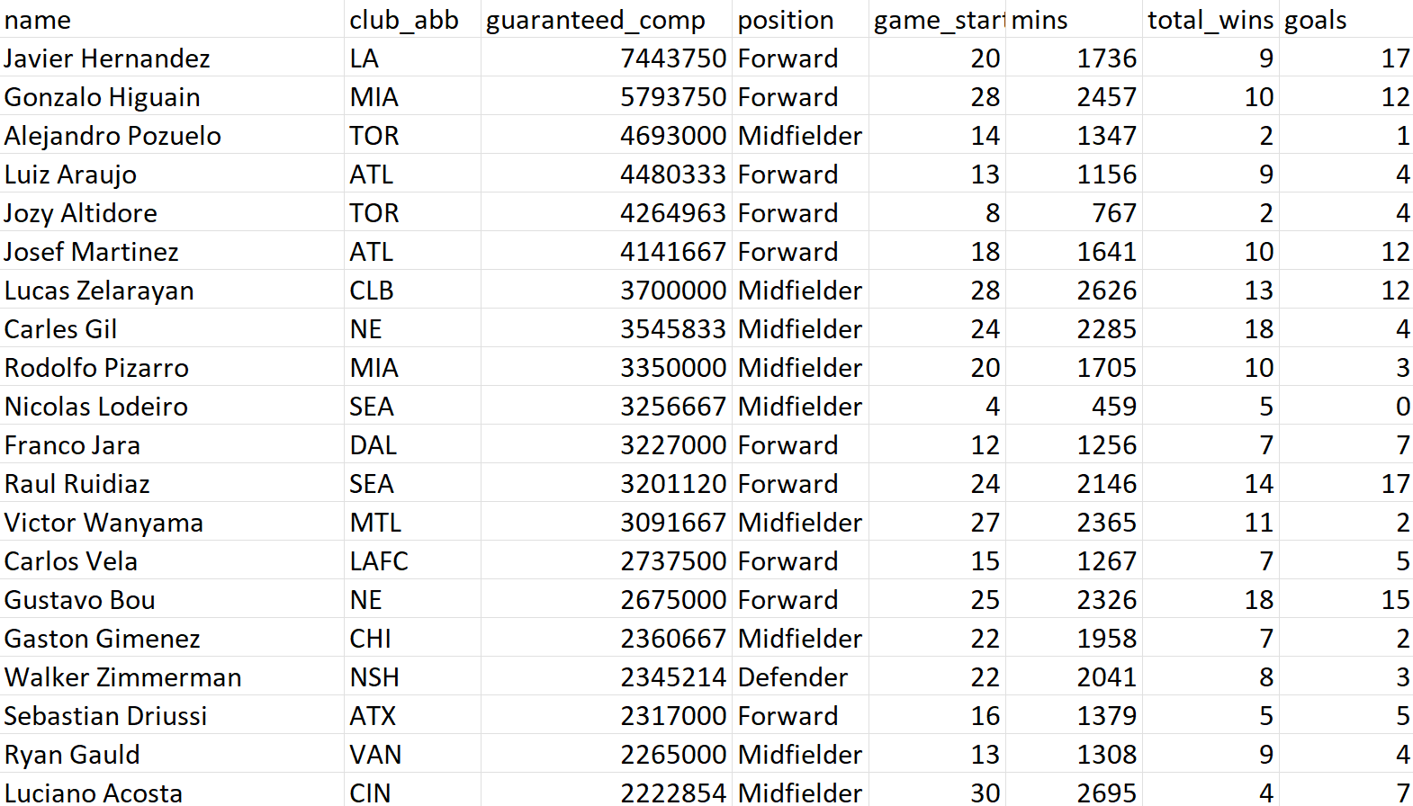
Data Set
Dimensions Before Cleaning:
623 Rows
109 Columns
Description
Performance statistics from 2021
Salary information from 2021, 2022
Collected from MLS, MLSPA

Slide 6
Variable Descriptions
Response Variable
Guaranteed Compensation
Guaranteed Salary (in dollars) 2022
Explanatory Variables
Minutes
Total minutes played 2021
Goals
Total goals scored 2021
Assists
Total assists 2021
Explanatory Variables
Accurate Forward Zone Passes
Accurate pass to attacking half 2021
Successful Dribbles
Beat defender while dribbling 2021
Tackle Success Percentage
Percent tackles where ball is taken 2021
Others
Dataset, Stats_Description.txt

Slide 7
Data Cleaning, EDA

Slide 8
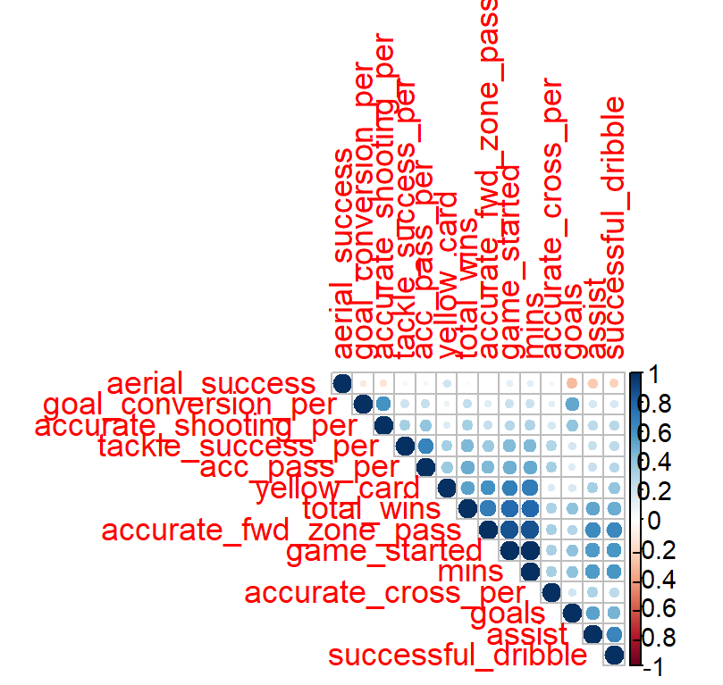
Data Cleaning
Response Variable
Large range, high values
Log transformation
Shrink the range, keep the ordering
Variable Selection, Creation
Kept 20 columns initially
Aerial Duel Success
Duels won - Duels lost
Accurate Pass Percentage
(Accurate Passes) / (Total Passes)
Replaced N/A with 0
Dropped “games started”, high correlation with minutes played
Subsetting
Removed Goalkeepers

Slide 9
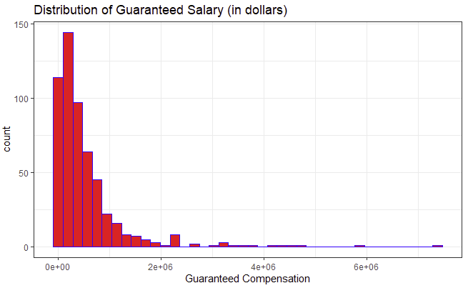
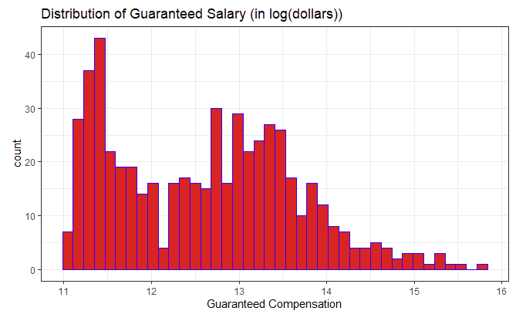
Salary Distribution (Pre/Post Transformation)

Slide 10
Post Transformation Distribution

Slide 11
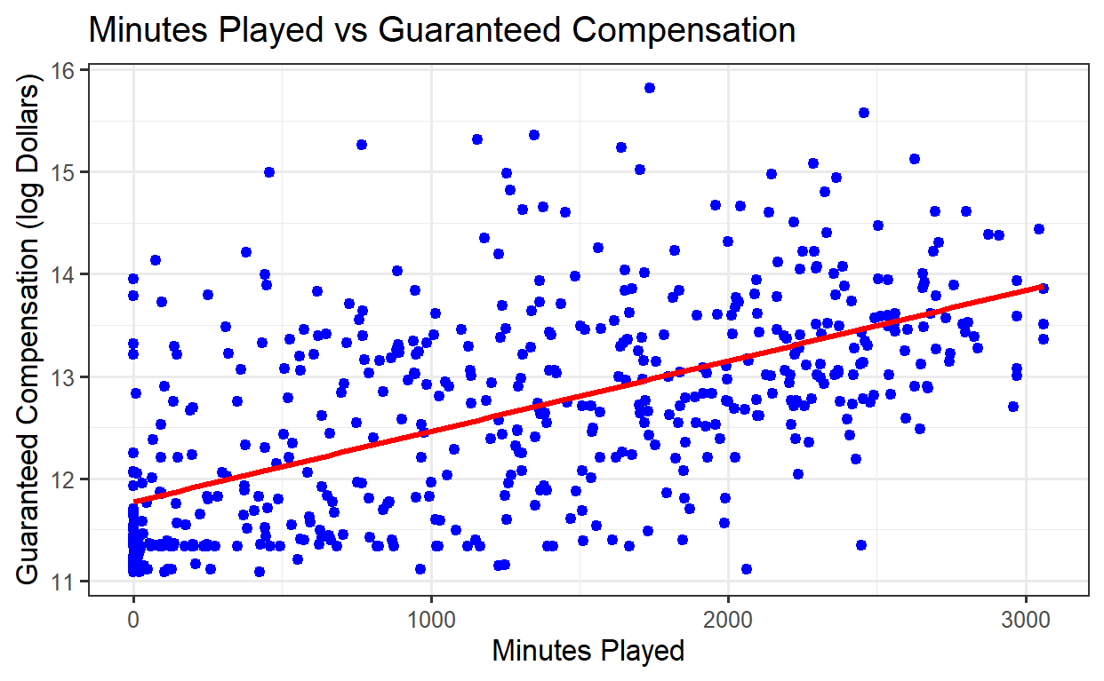
Minutes

Slide 12
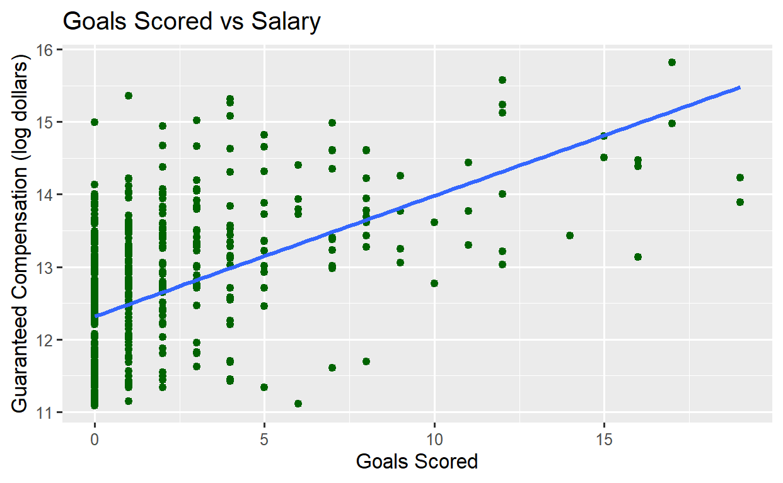
Goals

Slide 13
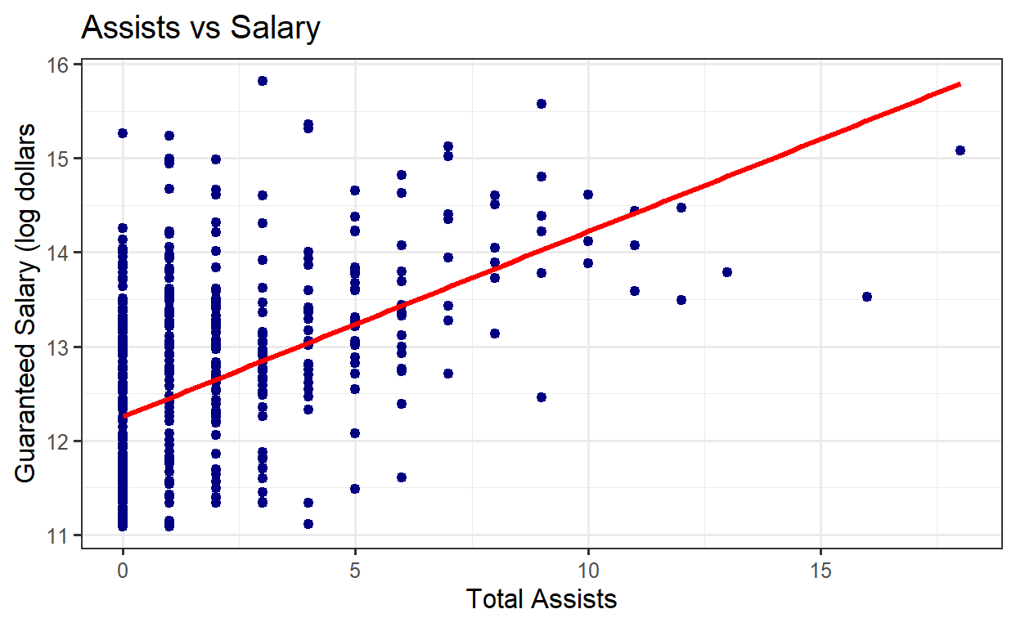
Assists

Slide 14
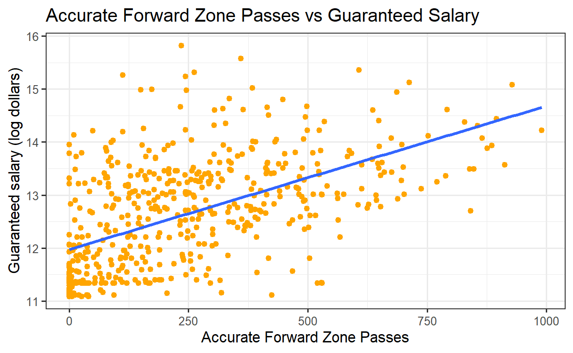
Accurate Forward Zone Passes

Slide 15
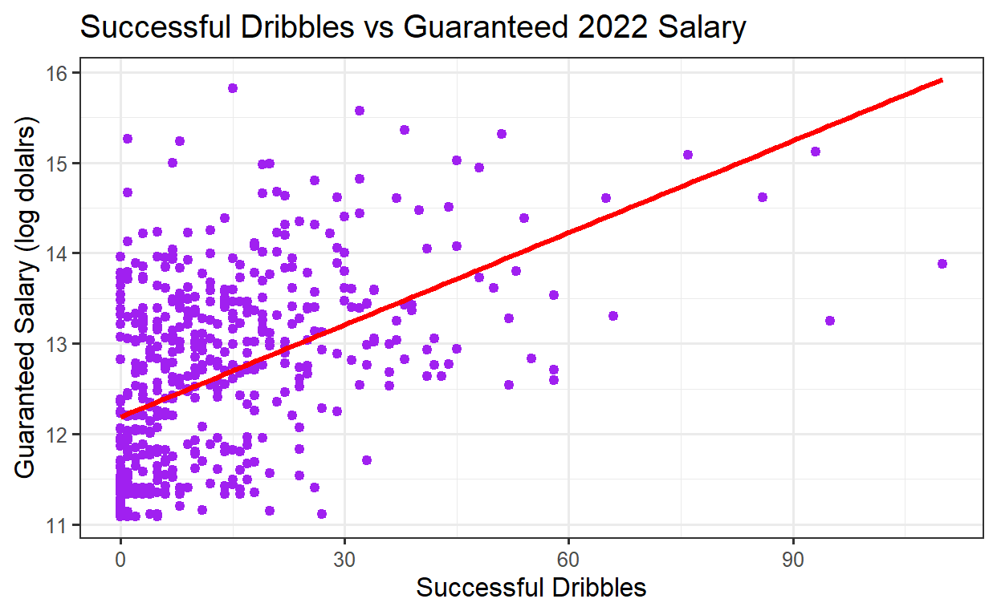
Successful
Dribbles

Slide 16
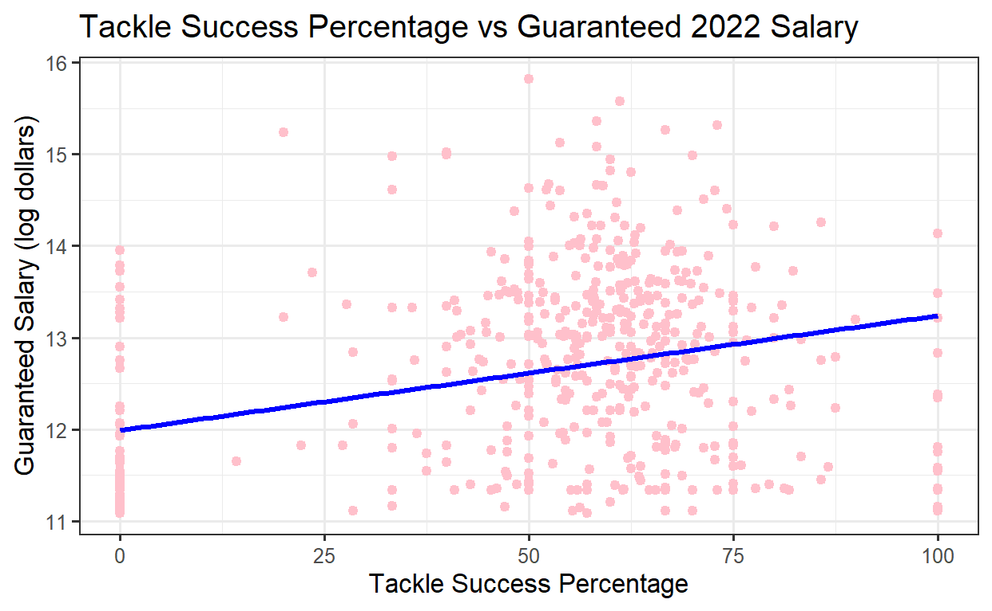
Tackle Success
Percentage

Slide 17
Method 1: K-Nearest Neighbors

Slide 18
KNN: Description
Algorithm
Predict based on k-closest points
Run through data, calculate distance metric (Gower’s Distance) to each other point
Predicted Y = average Y of k neighbors
Use 10-Fold CV for predictive accuracy with RMSE
Pros and Cons
Pros
Handle different shaped distributions (like our data)
More flexible
With correct “k”, handles outliers better
Cons
Prone to overfitting
Cannot use for association tasks
Slow run time (O(n^2))

Slide 19
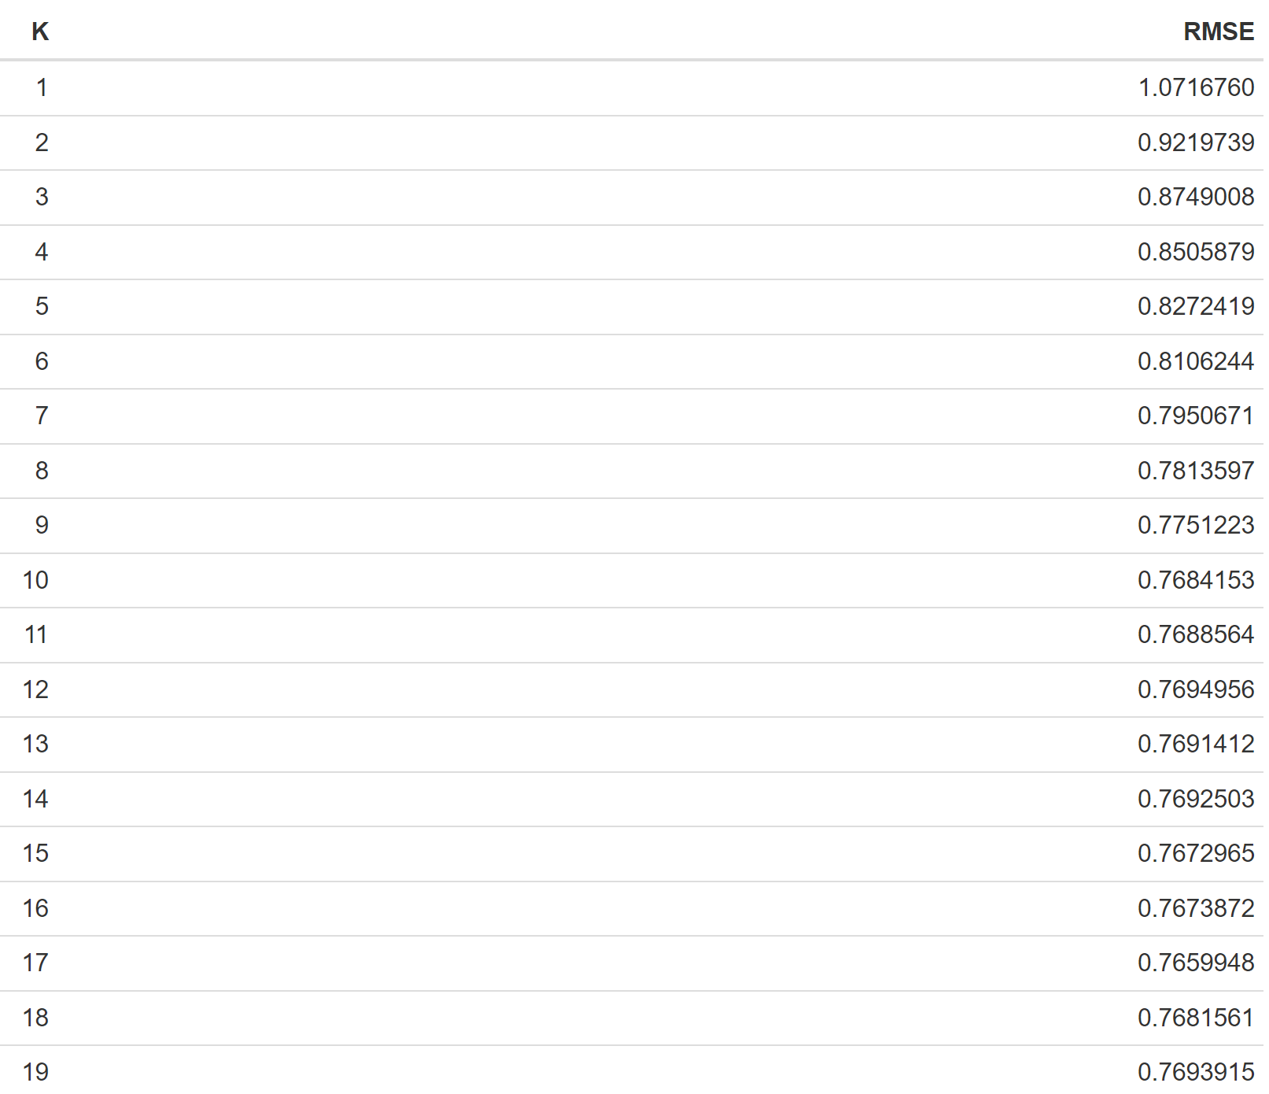
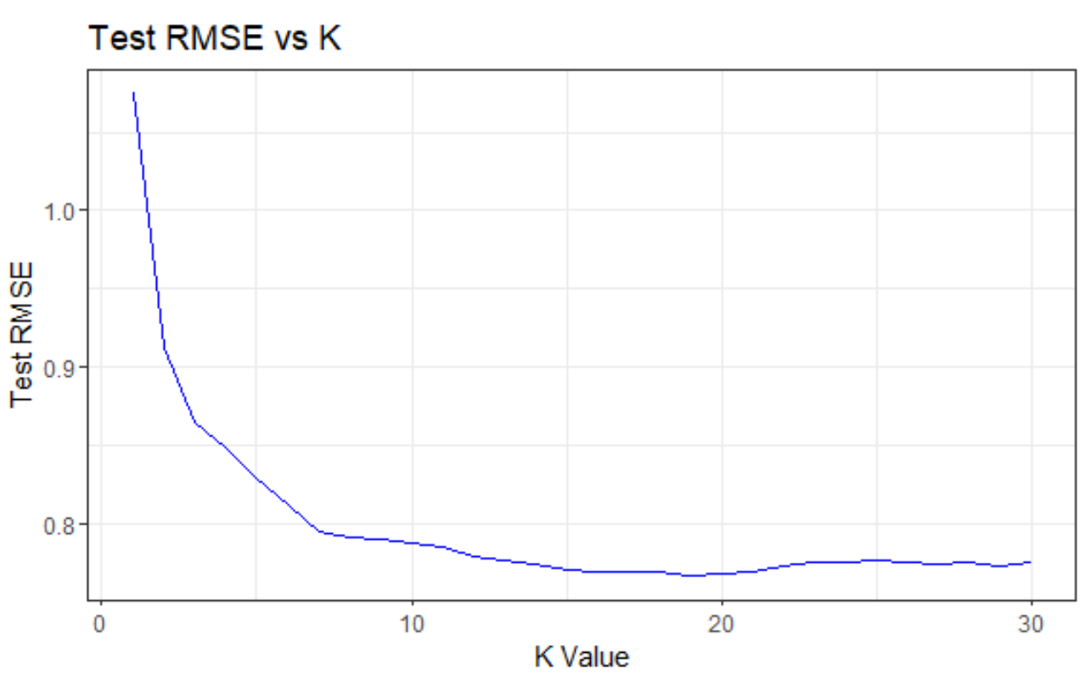
KNN: Results
(insert table here)

Slide 20
KNN: Results
Lowest RMSE at k = 19
Drop slows off at k = 7
Chose K = 7 to avoid overfitting
Test RMSE: 0.795
On average, our predictions are off by 0.795 log dollars

Slide 21
Method 2: Elastic Net

Slide 22
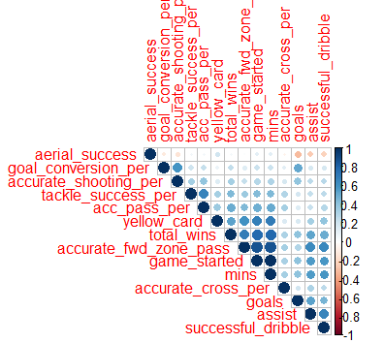
Elastic Net
Reasons
High correlation between explanatory variables
Increases variance of coefficients
My data had high correlation
Minutes, forward zone passes in particular
Penalty term added to shrink coefficients towards 0
Fits linear regression model with penalized terms

Slide 23
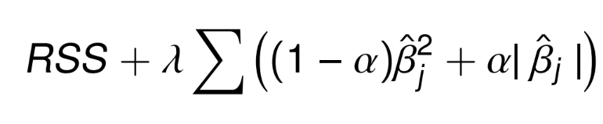
Elastic Net: Description
Fit regression model that minimizes:
Where 𝜆 >= 0 and 0 <= ⍺ <= 1 are scalars
Penalty term on residual sum of squares
Fit elastic net models from alpha in [0,1] for different lambda values
Choose one with lowest test RMSE w/ 10-fold CV
Pros and Cons
Pros
Handle correlated features
Can perform selection (some coefficients = 0)
Cons
Biased coefficients
Can be computationally expensive

Slide 24
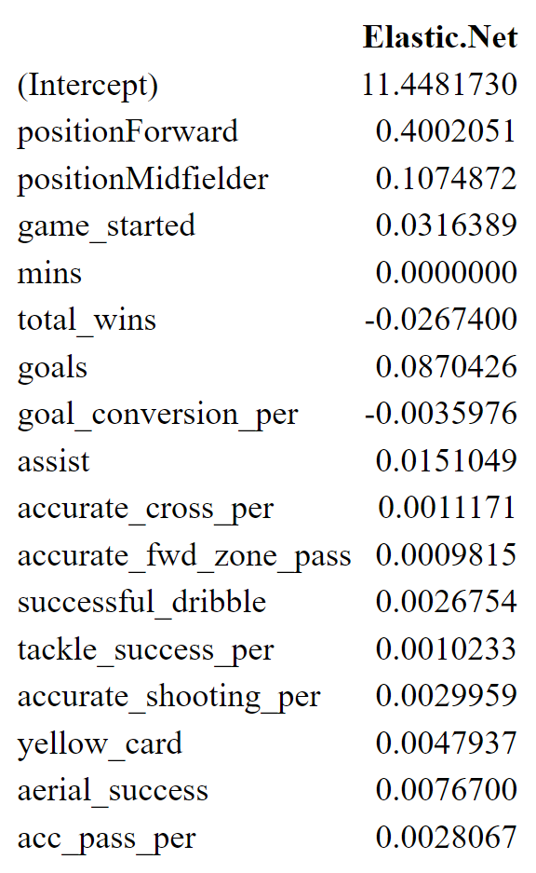
Elastic Net: Results
Final Model:
𝜆 = .64
⍺ = .01
RMSE: 0.756

Slide 25
Method 3: Random Forests

Slide 26
Random Forest: Reasons
Similar to K-NN
Does not require a shape assumption
Uses regression trees
Assumes clusters in data based on features
Can be very powerful

Slide 27
Random Forest
Algorithm
Fits multiple regression trees (split data at nodes based on features)
Uses bootstrapped sample to fit many trees
Takes average predicted value
Use points not in current tree to test predictive accuracy
Pros and Cons
Pros
Handles different shapes/clusters
Handles outliers well
Can see some association with individual trees
Cons
Individual trees prone to overfitting
Computationally expensive (fit 10000 trees)

Slide 28
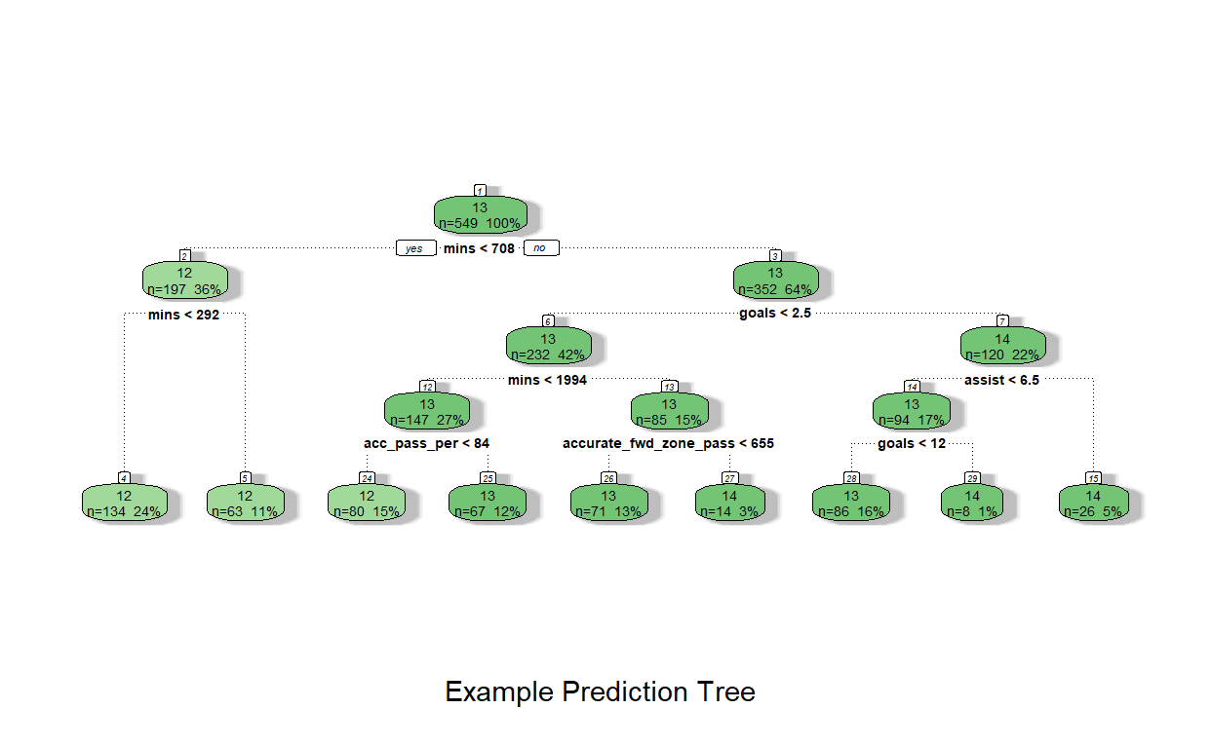

Slide 29
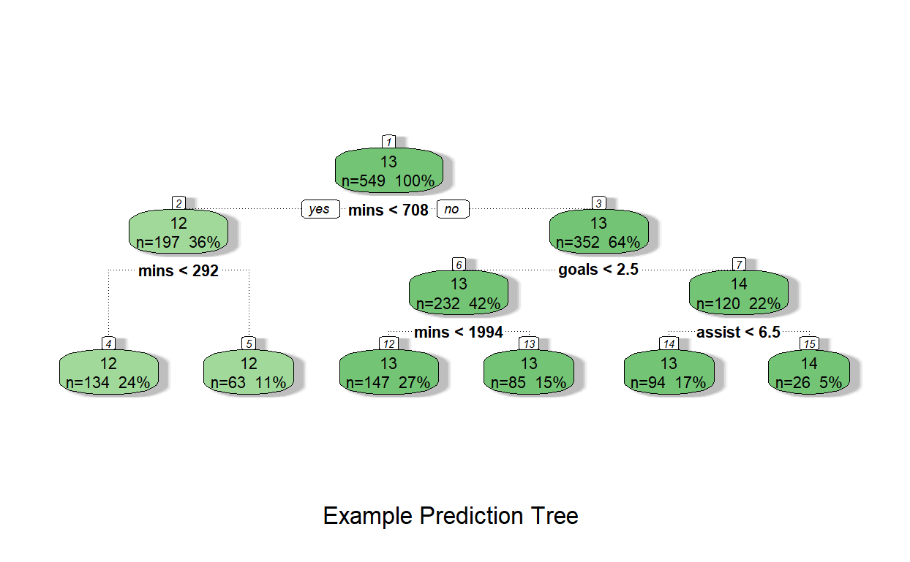
Random Forest: Results
Using 10,000 trees, got RMSE of 0.787
On average, predictions of log dollars off by 0.787
Slightly better than KNN, worse than Elastic Net

Slide 30
Conclusions

Slide 31
Comparing RMSEs
Method: | K-NN | Elastic Net | Random Forests
Test RMSE | 0.794 | 0.753 | 0.787

Slide 32
Comparing RMSEs
Range of log dollars is 15.82-11.09 = 4.73
Best RMSE (0.753) is off by 15.9% of the range
Not great, not bad
K-NN is 16.8%
Forest is 16.6%
Thus, out of these, I would choose the Elastic Net Model
Performance likely improves with:
More variables
More data

Slide 33
References
Data Set: https://www.kaggle.com/datasets/viv6369/mls-season-2021-players-stats-and-their-salaries?select=Stats_description.txt

