Slide 1
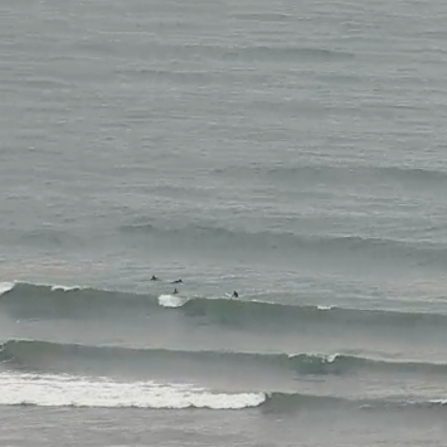

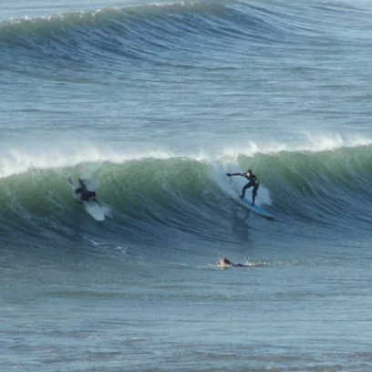
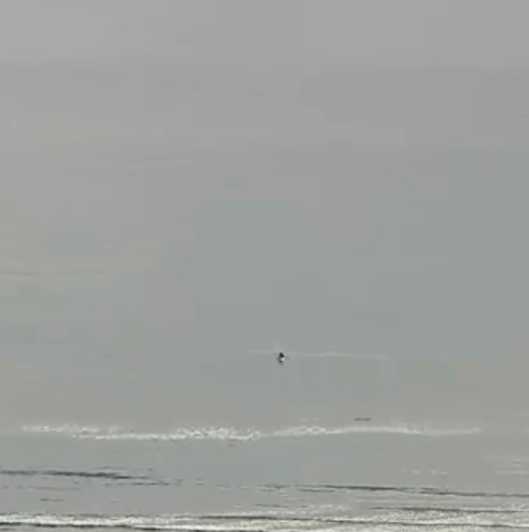
CLASSIFICATION OF SURFING IMAGES
Name: Matthew King
Supervisor: Dr John Wilson
Second marker: Dr Clemens Kupke
Marking scheme: Experimentation-based

Slide 2

Aims and Objectives
Aims
Create, as well as evaluate, models that can interpret images of surfing locations and determine whether the conditions at the time are suitable for surfing.
Develop models using different machine learning algorithms and determine which algorithm works best for this task.
Objectives
Develop a model that can classify images from a single surfing location.
Enhance this model to classify images from multiple surfing locations.
Bonus: Make the model provide a rating rather than a binary classification.

Slide 3
Background
Background research was carried out on the machine learning process, algorithms, types, and technologies.
Commonly used algorithms for image classification include:
Convolutional Neural Networks (CNN)
Support Vector Machine (SVM)
Random Forest (RF)
K-nearest Neighbors (KNN)

Slide 4
Requirements
The system must load images from folders and preprocess them.
The system must allow models to be trained and tested using one of the provided datasets.
The system must provide information describing how well a model performs on a dataset.
The system must allow different models to be compared using appropriate performance metrics.
The system must allow models to be saved and loaded.

Slide 5
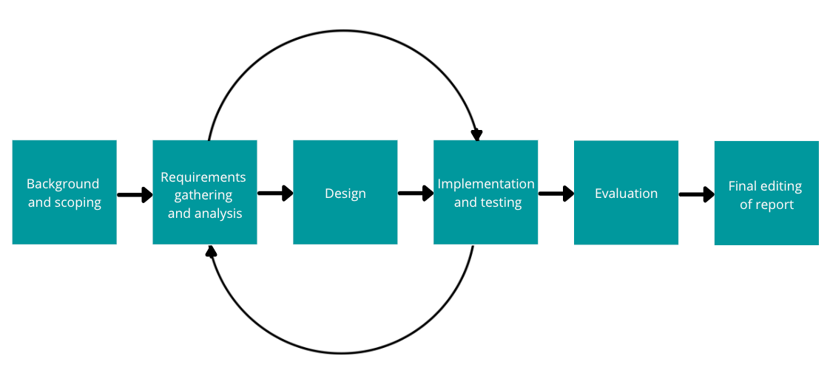




Methodology and Technologies
Agile Methodology
Technologies

Slide 6
Implementation
Collected 300 images of the Bantham beach in Devon.
Added functionality to load images from folders and preprocess them.
Created 4 models that can classify images from this surfing location.
Tested the models using different splits of the dataset.
CNN: 100%
SVM: 98%
RF: 95%
KNN: 73%

Slide 7
Evaluation Plans
Phase 1
Use a set of images from the same website.
Evaluate and compare the models based on accuracy, precision, and recall.
Compare models that use the same algorithm with different parameters, as well as models that use different algorithms.
Phase 2
Repeat the process using a different set of images.

Slide 8
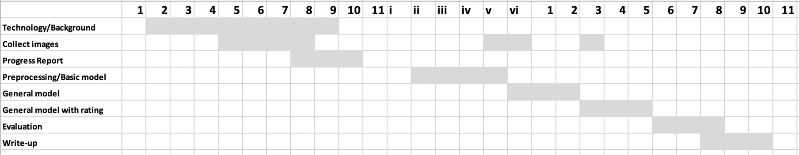
Project Plan and Progress

