Slide 1

On Picard Groups and Jacobians of Directed Graphs
JAIUNG JUN
YOUNGSU KIM
MATTHEW PISANO

Slide 2
Introduction
One player game played on a graph where chips are fired between vertices along their adjacent edges.
Introduced by several papers in 1980s.
Has become important tool in structural combinatorics and other areas of mathematics.
The main area of study is undirected variant.
Game can also be played on directed graphs, this is our focus.

Slide 3
Applications
More applications understandable when more complex graphs understood.
Notable economic applications
Can model flow of assets between entities.
Game theory applications in games with similar play-styles of tiles and pieces.

Slide 4
Preliminaries

Slide 5
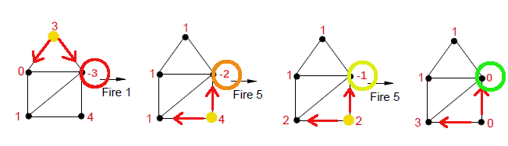
The Chip Firing Game

Slide 6
The Chip Firing Game
At start, each vertex on a graph assigned integer # of chips.
Chips can be lent or borrowed at each vertex.
Chips are either sent or received along each edge equally.
In directed graphs, vertices only interact with another along outgoing or bidirectional edge.
All edges bidirectional when undirected.
Game is won once all vertices have ≥0 chips.

Slide 7
Directed Graphs
Directed graphs have some combination of directed edges.
For our purposes, a bidirectional edge can be thought of as two, opposite, directed edges.
We define an orientation of a graph as the set of labels of the direction of each edge.

Slide 8
Terminal Strong Components
Sub-graphs of a larger, directed graph.
Terminal: only edges pointing into the sub-graph.
Strongly connected: all vertices have directed path to all others.
Help to understand how game is played on directed graphs.
Can trap chips to effect how game evolves.
Not applicable to undirected graphs as all sub-graphs are strongly connected.

Slide 9
Divisors
Divisor is integer vector v ∈ ℤ^{n} representing a state of the game.
i^{th} element of v is chips on i^{th} vertex of the graph.
Linear algebra useful for describing game behavior.
State vectors facilitate later calculations.

Slide 10
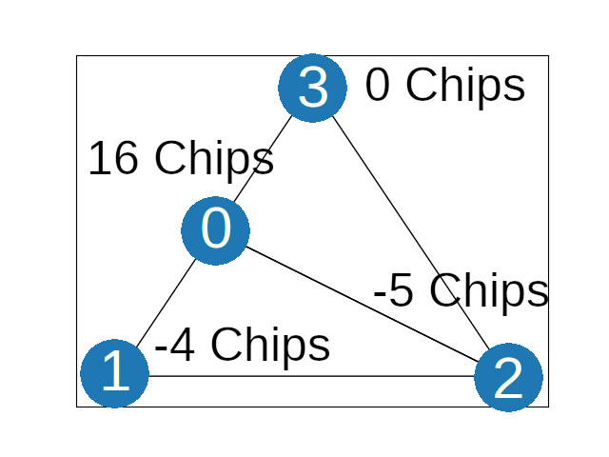
Divisors
Where divisor
D = [16, -4, -5,0]
G =

Slide 11
Equivalence Relations and Classes
Equivalence Relations (~) used to group similar divisors easily.
Similar divisors gotten from each other by moves.
An Equivalence Class, [D] a set of divisors that are all equivalent.
Divisor Set, Div(G), is free abelian group of all possible divisors.
All members related to one of the graph’s equivalence classes.
Elements generated through moves, based on one of the classes.

Slide 12
The Picard Group
The Picard Group,^{Div(G)}/~, is the group of all equivalence classes.
The larger the Picard Group, the more states a game can occupy.
Picard Group is finitely generated abelian group. All member vectors can be added or subtracted and still be within group.
Picard group made of Jacobian and ℤ^{n}.
From structure theorem of finitely generated abelian groups.
Easier to calculate when broken up like this.

Slide 13
The Jacobian
Degree of divisor, deg(d), is the sum of its chips.
# chips static during game play so deg([D]) = deg(d).
The Jacobian is the torsion sub-group of Picard.
Divisors in Jacobian have degree zero.
Comprised of invariant factors like (ℤx) where x = # of distinct eq classes with degree 0.
Invariant factors multiplied are tuple.
Divisors generated by combination of eq classes, similar to construction by basis.

Slide 14
Rank
Free part of Picard group in form of ℤ^{n} (n-tuple).
n is the Rank.
Represents # of ways chips can be distributed among Jacobian classes (scaling up or down).

Slide 15
The Laplacian and The Smith Normal Form
Laplacian: a bridge between the conceptual game and mathematics used to understand it.
For graph with n vertices, n x n matrix encoding all valid moves.
Multiplying transpose of the i^{th} row by a divisor results in the divisor (state) after making lending move at the i^{th} vertex.
Smith Normal Form (SNF): integer matrix obtained from the Laplacian.
SNF encodes information about the Picard Group in diagonal elements.
Calculating the SNF illustrates ways a game can be played.
To create: Laplacian is reduced to a diagonal matrix.

Slide 16
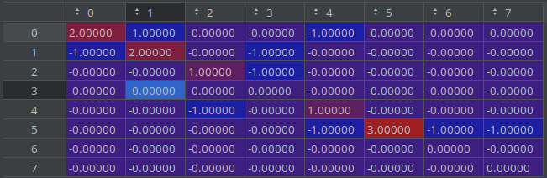
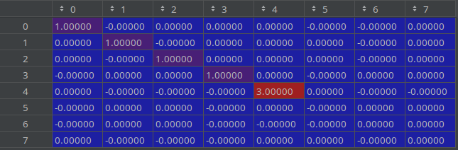
The Laplacian and The Smith Normal Form
Laplacian
Smith Normal Form
The non-zero elements of diagonal represent Jacobian
# diagonal zeros represent rank.
Here, Pic(G) = ℤ3 x ℤ³ , the Jacobian comes from the 3 at S4,4 and the rank from 3 zero rows.

Slide 17
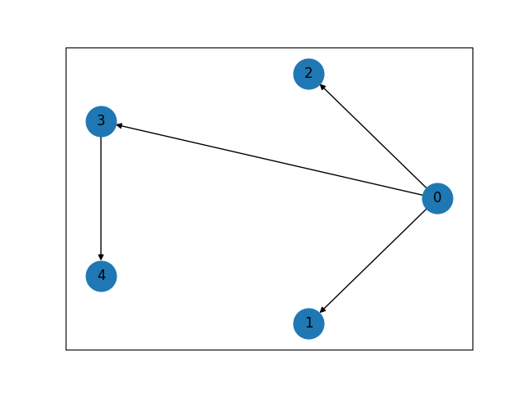
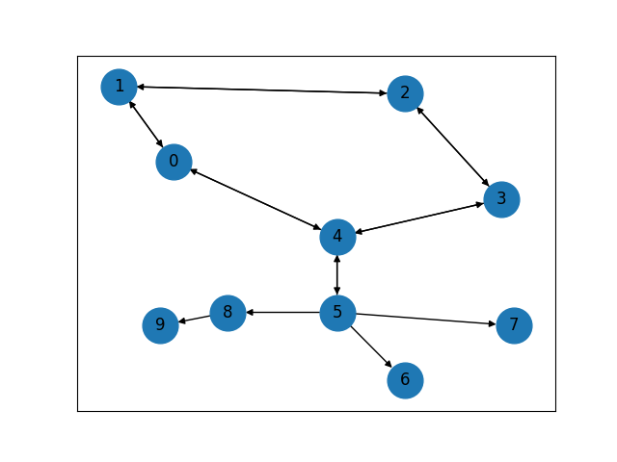
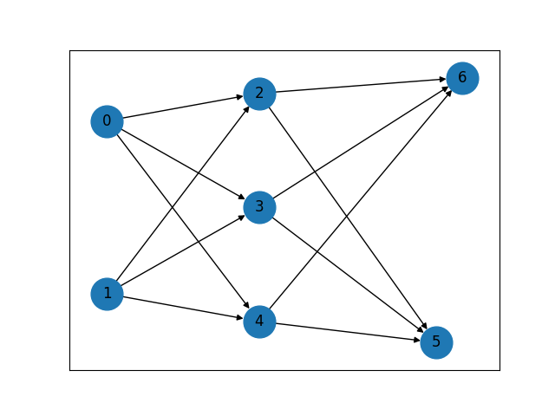
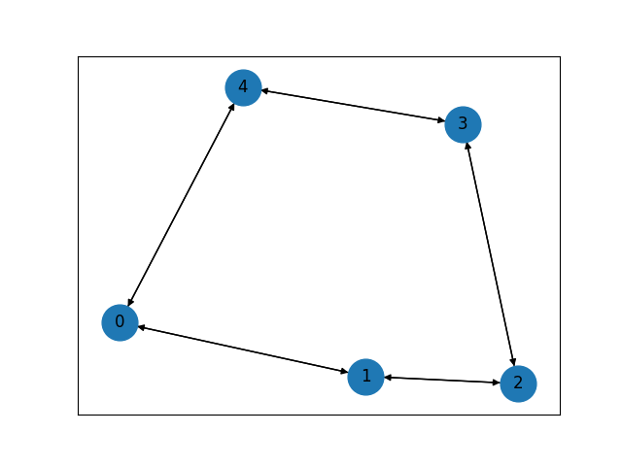
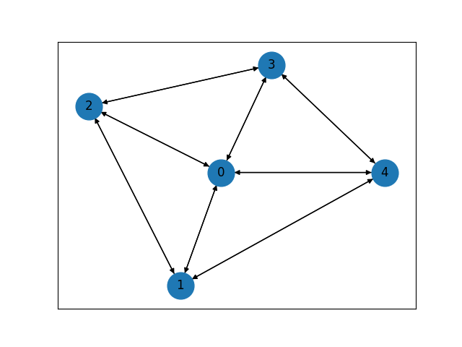
Focused Graphs
Tree Graph
Pseudo-Tree Graph
Multipartite Graph
Cycle Graph
Wheel Graph

Slide 18
Code

Slide 19
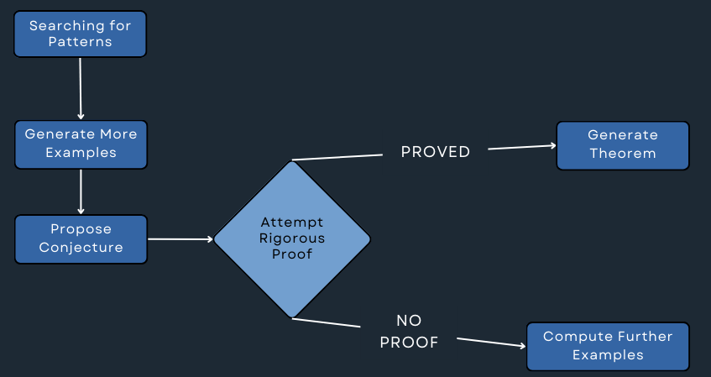
Research Methods

Slide 20
Code Structure
No open source library available.
Implemented all algorithms and graphs manually within my source code.
Helped me to understand the algorithms better.

Slide 21
Divisor Class
The first class implemented was the Divisor class.
Encapsulates the behavior of a Divisor of a graph.
Essentially just a wrapper for a vector with helper functions added.

Slide 22
Graph Class
A complex class representing an entire graph.
Given some number of vertices, it allows for edge creation and orientation.
Helper functions to create cycles, wheels, etc.
Game play progression functions (lend, borrow).
Gluing functions.

Slide 23
Algorithms
Contains high-level functions to facilitate our testing.
Get Picard of all graph orientations, gather distribution of invariant factors for graph sizes, etc.

Slide 24
Utilities
Contains functions for calculating the Smith Normal Form, the Picard group, logging, and performance measuring functions.
Formatting functions to ensure Picard group and Jacobian are in a human-readable form.
ℤ_a x ℤ_b x … x ℤ^r

Slide 25
Optimizations
Matrix operations can be very expensive.
The SNF calculation has a time complexity of about O(n³) for a size n graph.
Added a preparation algorithm designed to partially reduce the Laplacian in less steps.

Slide 26
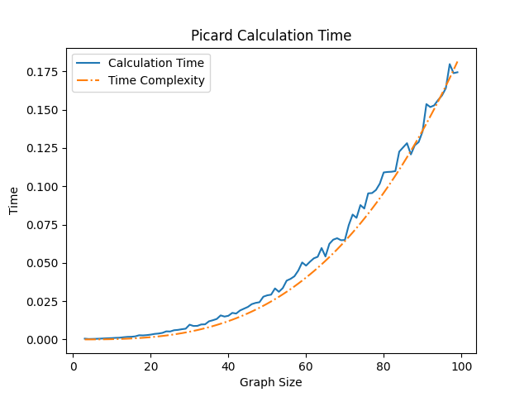
Optimizations

Slide 27
Optimizations
Cached Picard and Jacobian in memory until graph orientation is changed.
Analysis algorithms designed for multiprocessing.
Can be used on more powerful computers efficiently.

Slide 28
Research

Slide 29
Objectives
Undirected chip firing games well studied and explored, the directed case is not.
Our goal is to explore ways to calculate these directed graphs, study their relationships with their undirected counterparts.

Slide 30
Research Methods

Slide 31
Tree Graphs
Theorem:
Jacobian always trivial group.
Proven through induction. No changes with more vertices added.
Theorem:
Rank calculated inductively. By constructing by edge, rank determined by two rules.
No change if new edge inwards or bidirectional.
If edge outwards, the rank increases by one if # of terminal strong components also grows.
Rank # of terminal strong components.

Slide 32
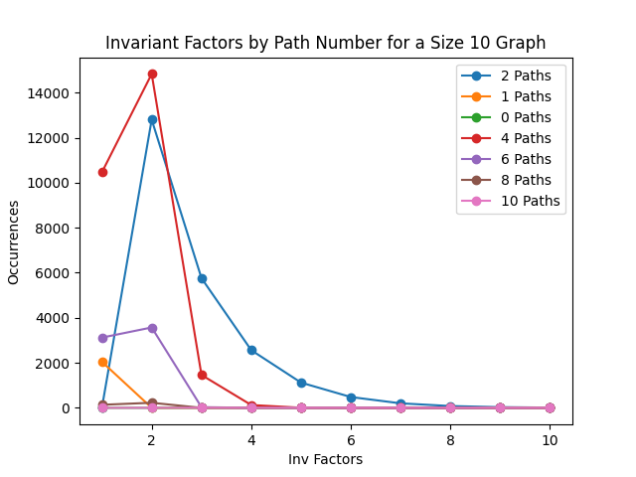
Invariant Factors of Cycle Graphs
A demonstration of the distribution of invariant factors

Slide 33
Invariant Factors of Cycle Graphs
Theorem:
Proved there is always some orientation of a cycle such that Jacobian is trivial or ℤk where k≤n when n≥3.
Most common are the trivial factor and ℤ2.

Slide 34
Patterns in Cycle Graphs
Able to calculate Jacobian for arbitrary cycle graphs (Cn) with two paths.
Definition: a path is a connected sub-graph of Cn all arrows oriented in a single direction or are bidirectional. One terminal strong component.
Either only one edge or bounded by one directed edge on each side.
Theorem:
Jacobian is ℤ(x+2), x is the number of bidirectional edges clockwise of the counter-clockwise path and counter-clockwise of the clockwise path.
Theorem:
Rank # of terminal strong components

Slide 35
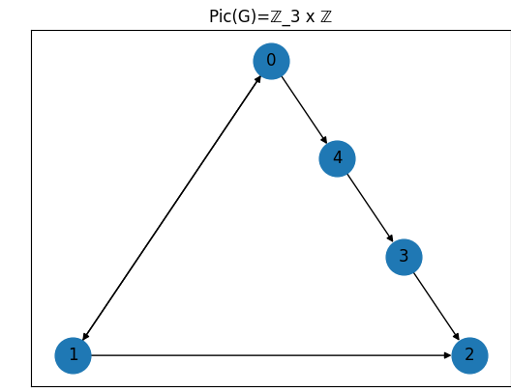


Patterns in Cycle Graphs

Slide 36
Creating a Pseudo-Tree
Created by gluing a tree to a cycle graph in one of two ways.
By Vertex – vertices will be glued together will be merged into one vertex.
By Edge – the two graphs are joined by an additional edge. Helps to preserve the attributes.
Jacobian often being Jac(cycle) x Jac(tree).
Our data for these graphs is less developed, although it is still noting the differences in the methods of gluing.

Slide 37
Wheel Graphs
Broke edges into two groups: rim and spokes.
By orienting all edges of either group the same way, trying combinations, we noticed four distinct cases in patterns.
Most interesting for graphs with bidirectional rims and inward spokes.
Similar to undirected wheel graph.
Conjecture:
Number of equivalence classes in invariant factors proportional to φ^{n}.
This can also be modeled as a series similar to the Lucas numbers.

Slide 38
Connections Between Wheel and Cycle Graphs
Wheel graphs with outward spokes, similar to cycles.
Due to the fact that chips only fired along outgoing edges. Spokes point outward → vertices on rim cannot interact with axle.
Theorem:
When Pic(Cn-1) = ℤa x ℤ^{n}, Pic(Wn) = ℤ(n-1)*a x ℤ^{n} when all spokes point outward when a and n co-prime.

Slide 39
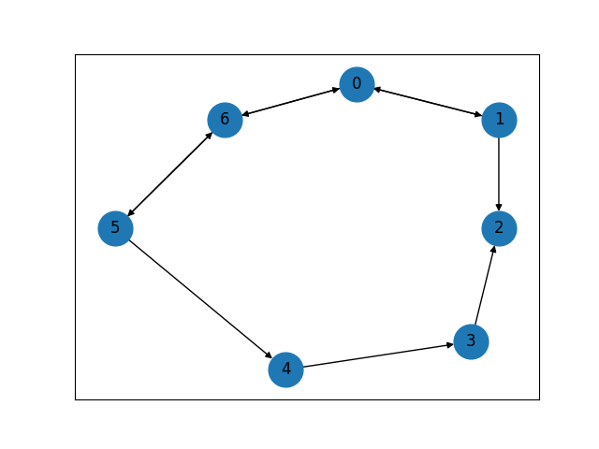
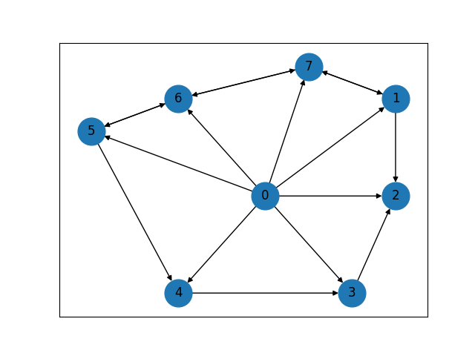
Connections Between Wheel and Cycle Graphs
Pic(C7) = ℤ5 x ℤ Pic(W8) = ℤ35 x ℤ

Slide 40
Multipartite Graphs
Structure intentionally designed to resemble artificial neural networks.
Direct all edges forward.
Notable patterns in both a Perceptron style model with two layers and Hidden Layer model with three layers.
Theorem:
For two layers in the form of f→s where f and s are # of vertices in the first and second layers. Pic(G) = ℤf−1^{s} x ℤ^{s}.
Conjecture:
Three layer model more complex, being split into cases.
Invariant factors are based off of the size of all three layers and the rank is just the size of the last layer.

Slide 41
References
Norman L Biggs. Chip-firing and the critical group of a graph. Journal of Algebraic Combinatorics, 9(1):25–45, 1999.
Matthew Baker and Serguei Norine. Riemann–Roch and Abel–Jacobi theory on a finite graph. Advances in Mathematics, 215(2):766–788, 2007.
Brian Jacobson, Andrew Niedermaier, and Victor Reiner. Critical groups for complete multipartite graphs and Cartesian products of complete graphs. Journal of Graph Theory, 44(3):231–250, 2003.
Caroline J Klivans. The mathematics of chip-firing. Chapman and Hall/CRC, 2018.
Richard P Stanley. Smith normal form in combinatorics. Journal of Combinatorial Theory, Series A, 144:476–495, 2016.
David G Wagner. The critical group of a directed graph. arXiv preprint math/0010241, 2000.
Image of chip firing game. Wikipedia. https://www.wikiwand.com/en/Chip-firing_game

Slide 42
Thank You

