Slide 1
On Picard Groups and Jacobians of Directed Graphs
JAIUNG JUN
YOUNGSU KIM
MATTHEW PISANO

Slide 2
Introduction
A chip firing game is a one player graph game.
Since its origin in 1983, it has since become an important tool in structural combinatorics and other areas of mathematics.
This game has directed and undirected variants. The directed case has been studied much less.
We hope to change this through the patterns and techniques we have developed in our investigation.

Slide 3
Preliminaries

Slide 4
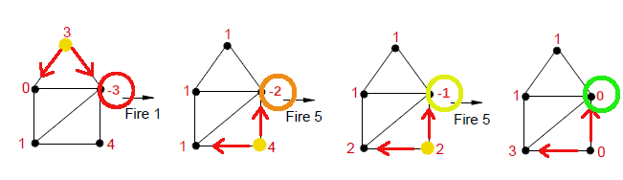
The Chip Firing Game

Slide 5
The Chip Firing Game
When a game is started, each vertex on a graph is assigned a certain number of chips.
During play, chips can be lent or borrowed equally at each node.
Vertices can only interact with another along an outgoing or bidirectional edge.
The game is won once every vertex has a zero or greater number of chips, meaning that no vertex is in debt.

Slide 6
Applications
Through analysis Chip-Firing games become more easily usable in different applications.
Notable usages in the fields of economics and game design.

Slide 7
Terminal Strong Components
Terminal strong components are sub-graphs of a larger oriented graph.
Regions of a graph that are strongly connected.
They are also terminal, with edges only going in.
Understanding these regions is important for understanding how the game is played.
An example of their importance is how chips can only be lent into these regions, trapping them until a borrowing move has been made.

Slide 8
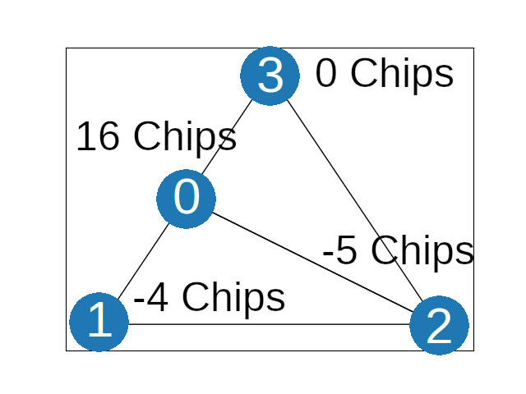
Divisors
Where divisor
D = [16, -4, -5,0]
G =

Slide 9
Divisors and Equivalence Relations
A Divisor of a graph G, is an integer vector v ∈ ℤ^{n}.
Two divisors have an Equivalence Relation (∼) if one divisor can be obtained from the other by lending or borrowing moves.
An Equivalence Class, [D], is the set of all divisors that are equivalent to each other.
The collection of all divisors on a graph defines a free abelian group Div(G), the divisor group of G.

Slide 10
The Picard Group and The Jacobian
The Picard Group of a graph, Pic(G), is the set of all equivalence classes that the divisors of that graph G can be in.
The Picard Group is a finitely generated abelian group.
The degree of a divisor or an equivalence class is the sum of each of the divisor’s elements.
The Jacobian of a graph, Jac(G), is the torsion sub-group of Pic(G) such that every divisor in each equivalence class has a degree of 0.
If a divisor is in one of the Jacobian’s classes, it can be made winning after a finite series of moves.

Slide 11
The Picard Group and The Jacobian
The Picard Group is comprised of two parts, the Jacobian and ℤ^{n}:
The Jacobian itself is comprised of one or more invariant factors which are each in the form of ℤx.
Two invariant factors multiplied together represent a tuple. These represent a graph state that is a combination of multiple classes combined together.
In the form of ℤ^{n} (an n-tuple of integers where n is the rank), representing the number of ways any number of chips can be distributed along classes represented by the Jacobian.
Using the Picard Group, we can completely describe any initial or intermediate state of a game, given the graph that it is played on.

Slide 12
The Laplacian and The Smith Normal Form
The Laplacian of a graph helps to serve as a bridge between the conceptual game and the mathematics behind those concepts.
For a graph of size n, it is an n x n matrix representing all valid lending or borrowing moves that graph can make.
The Smith Normal Form (SNF) of a Laplacian is a matrix obtained from the Laplacian. The SNF encodes information about the Picard Group in its diagonal elements.

Slide 13
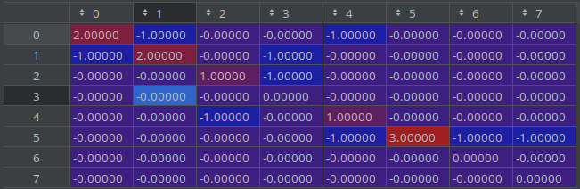
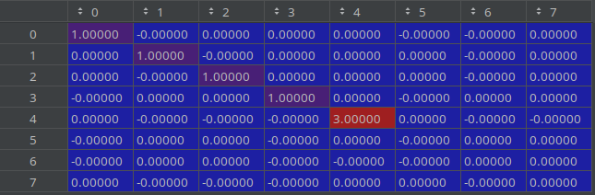
The Laplacian and The Smith Normal Form
The non-zero elements of the diagonal represent the Jacobian of a graph while the diagonal zeros represent the rank of the Picard Group.
Here,
Pic(G) = ℤ3 x ℤ³ , the Jacobian comes from the 3 at M4,4 and the rank from 3 empty rows.
Laplacian
Smith Normal Form

Slide 14
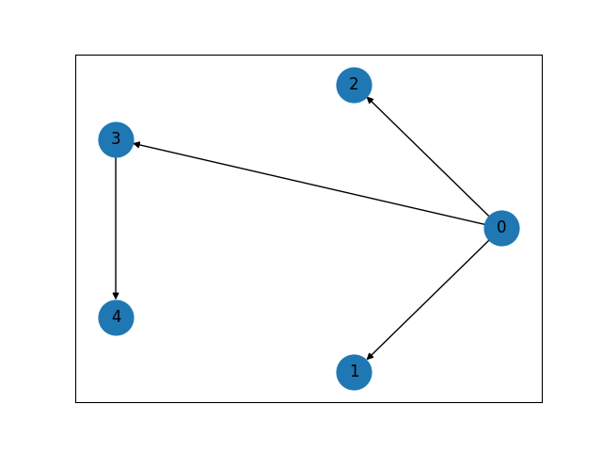
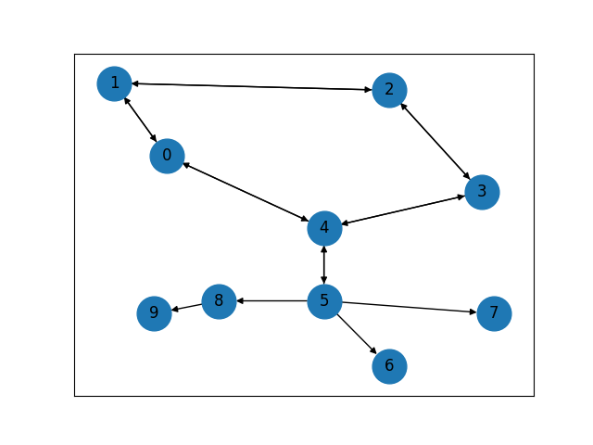
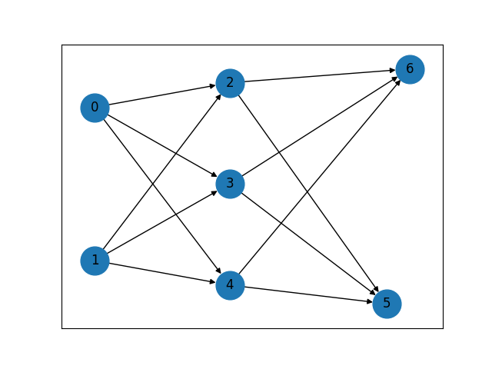
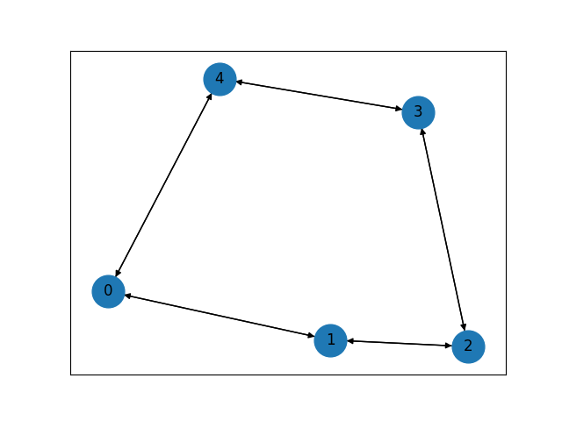
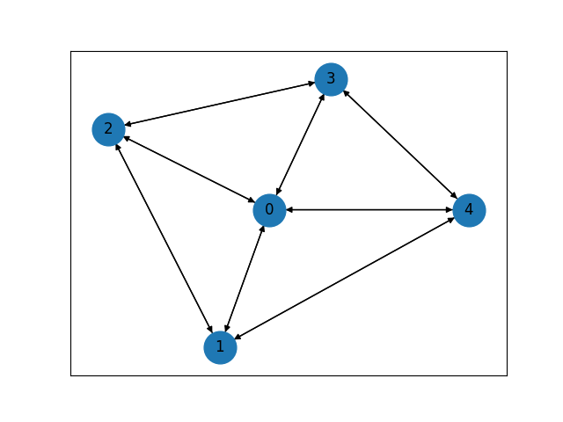
Focused Graphs
Tree Graph
Pseudo-Tree Graph
Multipartite Graph
Cycle Graph
Wheel Graph

Slide 15
Research

Slide 16
Objectives
While chip firing games with undirected graphs are well studied and explored, the directed case has not received as much attention.
Our goal is to explore ways to calculate these directed graphs and to study their relationships with their undirected counterparts.

Slide 17
Methods
By using our focused graphs as a guide, we conducted our research by looking for patterns within different configurations and graph sizes.
We then computed many examples of said configuration to see if our original guesses held up.
If that was the case, we then moved on to rigorously proving the conjectures that we could and adding even more computational results to those that we could not.

Slide 18
Finding a Tree’s Picard Group
The Picard group is commonly written in the form Pic(G) = Jac(G) x ℤ^{n}, where n is the rank of the Picard group.
We have noticed that this rank for a tree graph can be easily calculated inductively. Its rank can be determined by following two rules (thrm).
We can see that the rank of a tree corresponds to the number of terminal strong components of that tree.
The Jacobian of a tree is relatively simple, it is always the trivial group (thrm).
We have also proven this through induction

Slide 19
Creating a Pseudo-Tree
A Pseudo-tree can be created by gluing a tree to a cycle graph in one of two ways.
By Vertex – Here, whichever vertices will be glued together will be merged into one vertex.
By Edge – With this method, the two graphs are joined by an additional edge. This helps to preserve the attributes of the original graphs into the resulting glues pseudo-tree, such as the Jacobian often being Jac(cycle) x Jac(tree) (conj).

Slide 20
Finding The Picard Group of a Cycle Graph
We find the rank of the Picard group of a cycle graph is similarly to that of a tree.
We have proved that there is always some orientation of a cycle such that the Jacobian is trivial or ℤk where k≤n when n≥3 (thrm).
We have been able to calculate the Jacobian for any arbitrary cycle graph (Cn) with two paths. (thrm).
For these graphs, the Jacobian is ℤ(x+2) where x is the number of bidirectional edges on one side of the paths.

Slide 21
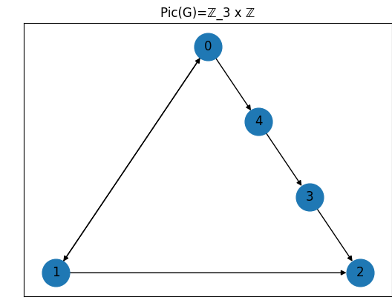


Finding The Picard Group of a Cycle Graph

Slide 22
Finding The Picard Group of a Wheel Graph
For wheel graphs, we looked for patterns that arose within the invariant factors of the Jacobian. For this strategy, we broke the edges into those belonging to the rim of the wheel and those of the spokes. By orienting all the edges of either group the same way and trying all nine combinations, we noticed four well-defined patterns.
The most interesting of these cases was for graphs whose rims were bidirectional and whose spokes pointed inward. Here, the size of each invariant factor was proportional to φ^{n}, where φ represents the golden ratio (conj).

Slide 23
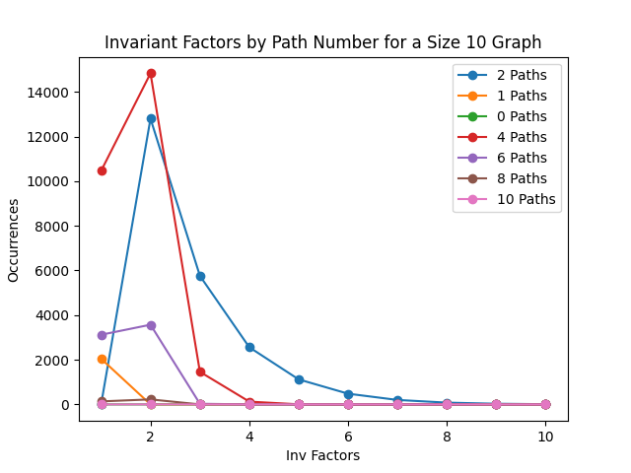
Finding The Picard Group of a Cycle Graph
A demonstration of the distribution of invariant factors

Slide 24
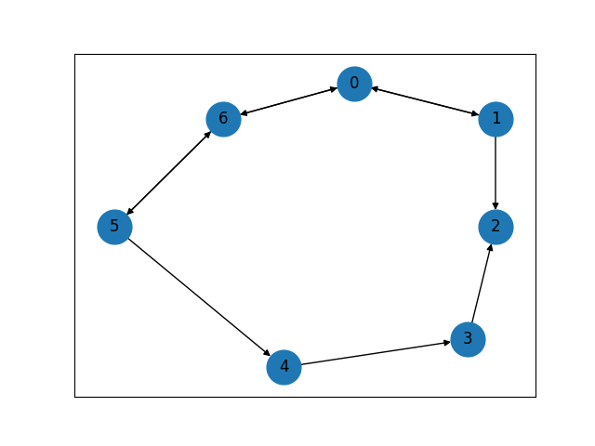
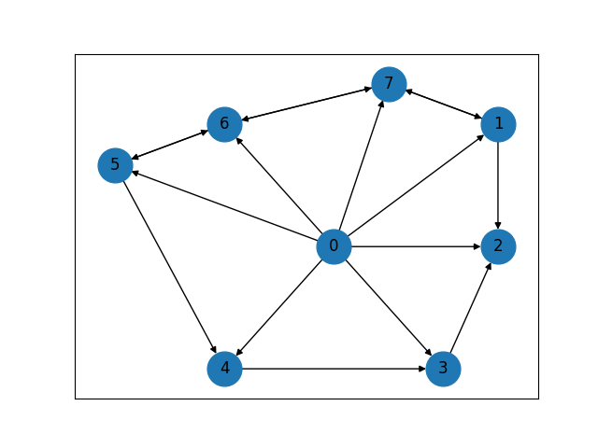
Connections Between Wheel and Cycle Graphs
Pic(C7) = ℤ5 x ℤ Pic(W8) = ℤ35 x ℤ

Slide 25
Connections Between Wheel and Cycle Graphs
During our experiments with wheel graphs whose spokes pointed outward, their Picard groups behave similarly to the cycle graph one size smaller, as if the central vertex was not there at all (thrm).
This is due to the fact that chips are only fired along outgoing edges.
These relations are also split into several cases, for example:
For prime cycle graphs, arbitrary Picard groups of wheeln appear to be ℤ(n-1)*a x ℤ where a is in the Picard group of C(n-1) ℤa x ℤ when all spokes point outward.

Slide 26
Finding The Picard Group of a Multipartite Graph
The structure of these graphs that we investigate are intentionally designed to resemble artificial neural networks.
We were able to find notable patterns in both a Perceptron style model with two layers and a Hidden Layer model with three layers (conj).
For two layers in the form of f→s where f and s are the number of nodes in the first and second layers, respectively. For these graphs, Pic(G) = ℤf−1^{s} x ℤ^{s}.
For the three layer model, things once again become more complex, being split into cases.

