Slide 1

Understanding Stress
Insights, Solutions, and Opportunities for Growth
By: Matthew Saxby
Contemplation by: Claire McCall

Slide 2
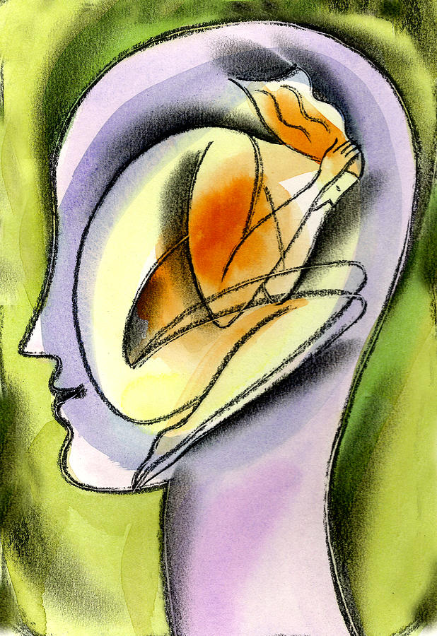
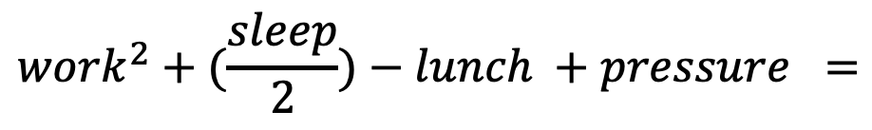
The Typical stress equation
$${work}^{2}+(\frac{sleep}{2})−lunch +pressure =$$
Increased Stress
Stress and Psychological Health by: Leon Zernitsky
Notes:
-We live in a culture where we are constantly being bombarded with work, deadlines, and expectations.
-I go to class for 3-4 hours each day, develop for 2-4 hours in the marketing office, then do 3-7 hours of homework every evening.
-This leaves very few hours for meals, devotionals, exercise, time with my friends, and even sleep.
-Often times, I don’t know about you, I find myself chewing more than I can swallow on a daily basis.
-This has resulted in increased stress levels in my life this last year of college.
-Each and every one of us in this meeting has had to learn how to balance our work, relationships, and our health to a certain extent, and I want to talk about the importance of balance.
-Let me share with you what I call the stress equation. This is nothing mathematical or data driven, purely just my own observations from daily life.
- Let me at least speak for myself and say that I want to decrease the average stress
I had noticed these themes for some time in my regular life, and I wanted to figure out some real trends.

Slide 3
My Fall Semester Research
Variable Name | Type | Description
date | long date format | The day the data comes from. (8/26/2024 – 12/12/2024)
hours_slept | float | Total hours slept; (to_sleep – wake_up)
to_sleep | hour | The previous night’s bedtime
wake_up | hour | That day’s wake up time
times_waking_up | int | Number of times woken up throughout the night
sleep_score | float | Between 0-100; (hours_slept/8 * 70) - (times_waking_up * 5)
cups_coffee | int | Cups of coffee drank throughout the day
exercise | bool | If I worked out or not that day
homework_hours | int | Number of hours I spent on homework or studying that day
class_hours | int | Number of hours I spent in class that day
test_project_day | bool | If I had a test on that day
stress_level | int | Between 0-10; The estimated maximum stress level I experienced that day.

Slide 4
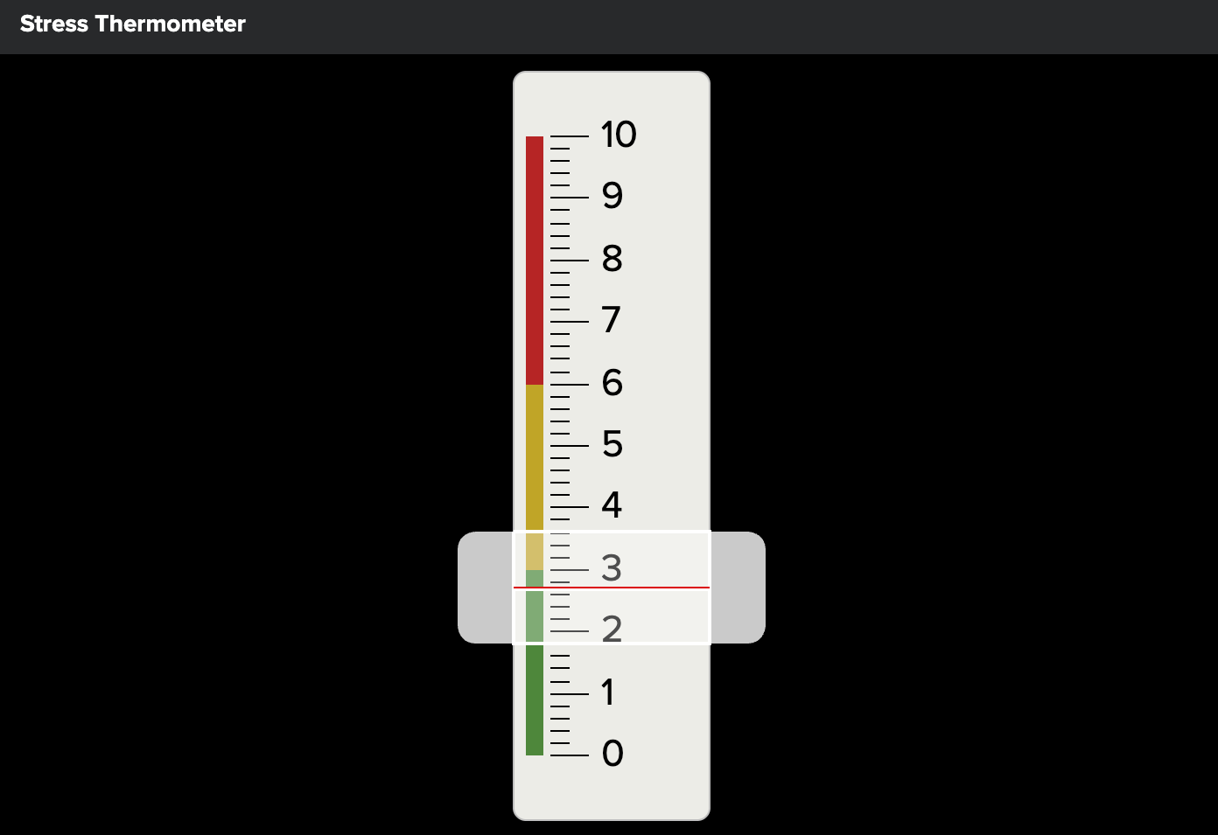
Average Stress Fall 2024

Slide 5
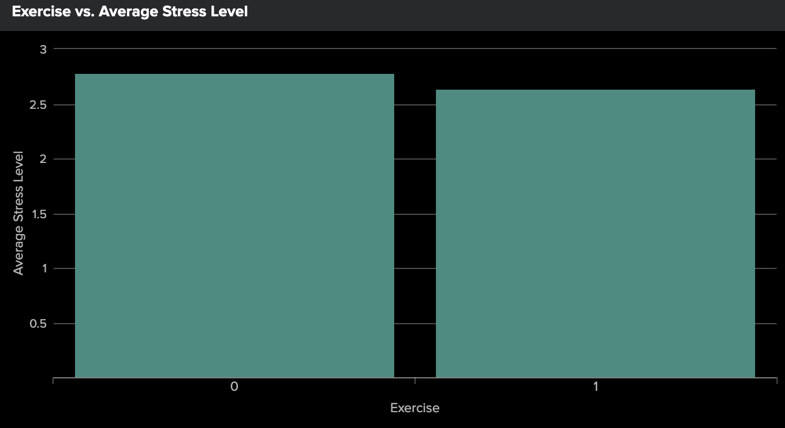
Exercise vs Average Stress

Slide 6
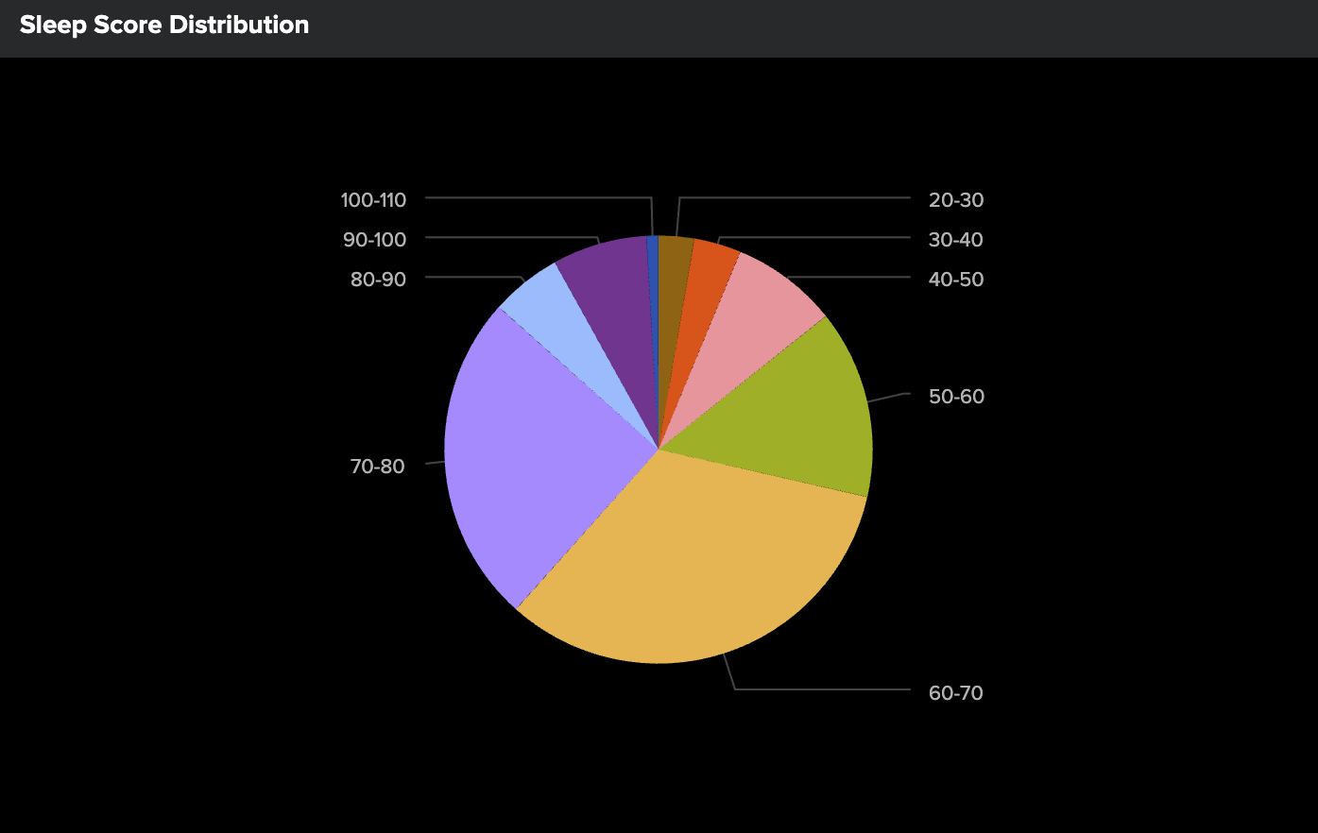
Sleep Score Distribution

Slide 7
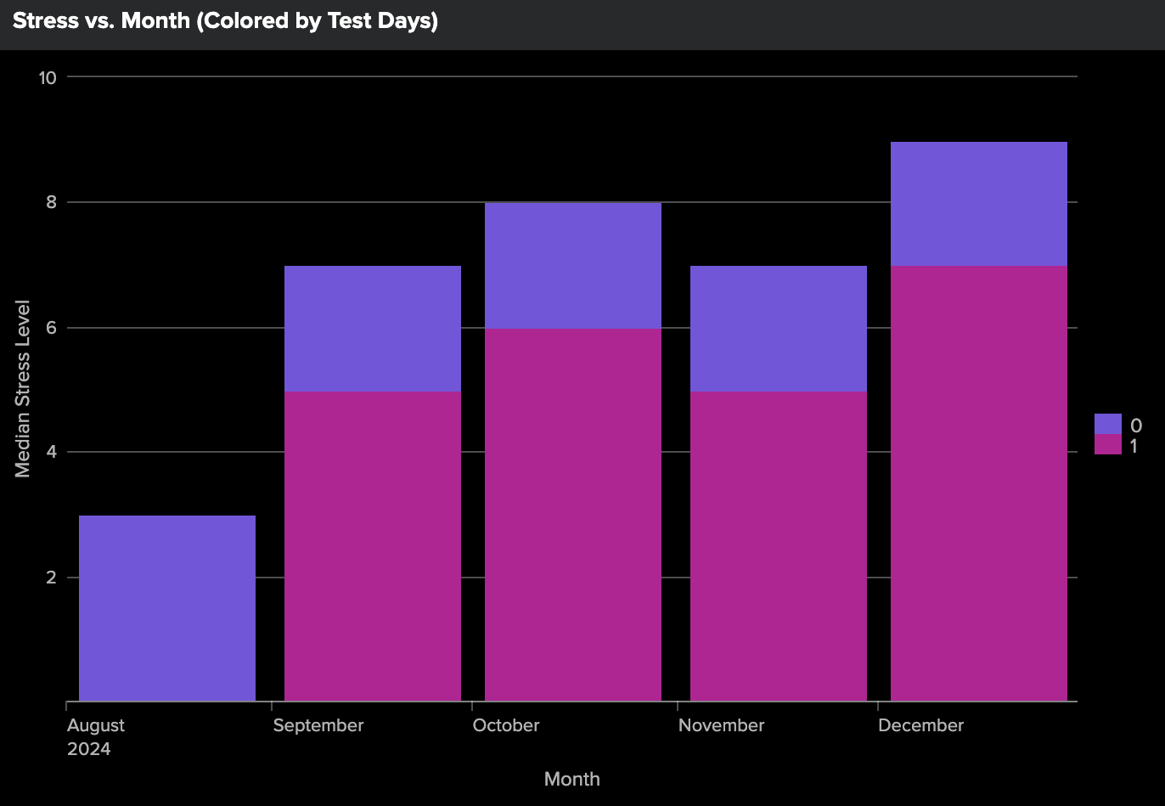
Month vs. Stress Level

Slide 8
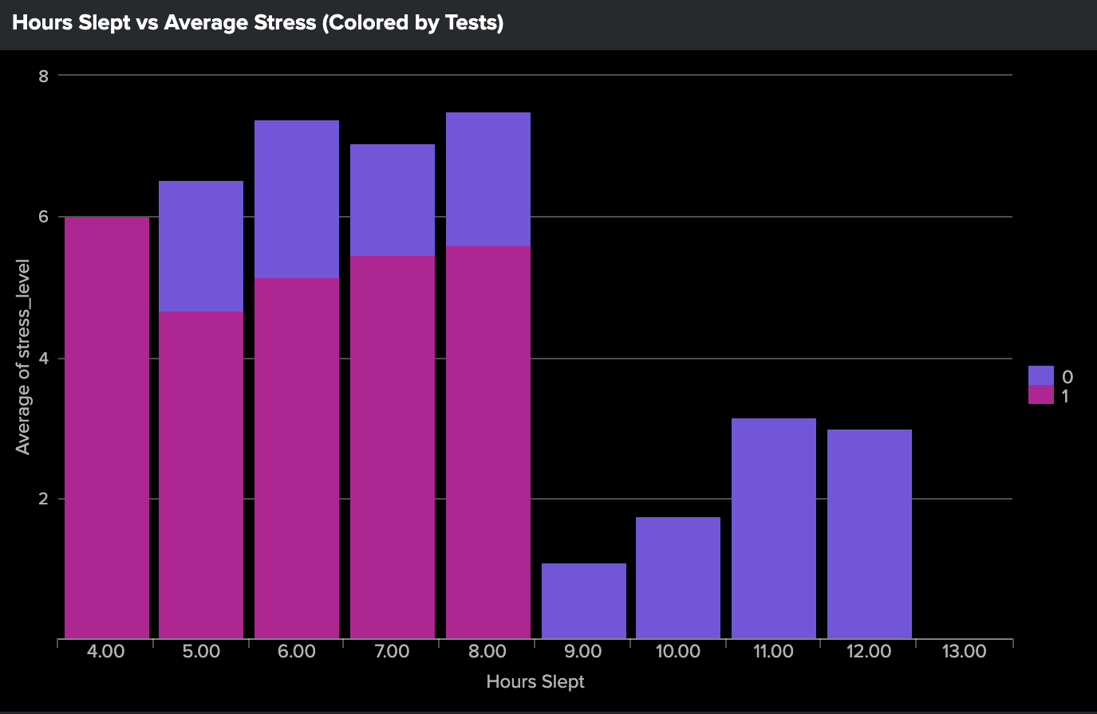
Hours Slept vs Average Stress

Slide 9
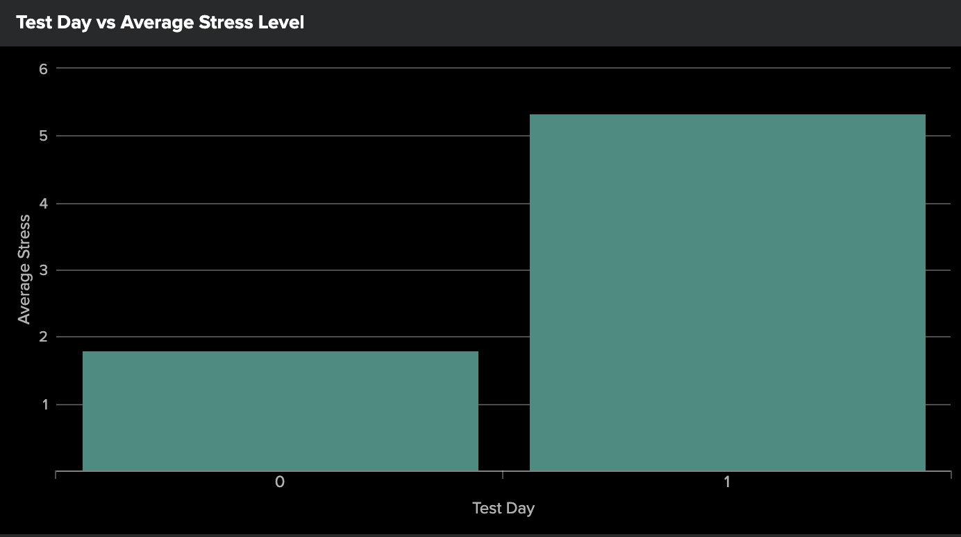
Test Day vs Average Stress

Slide 10
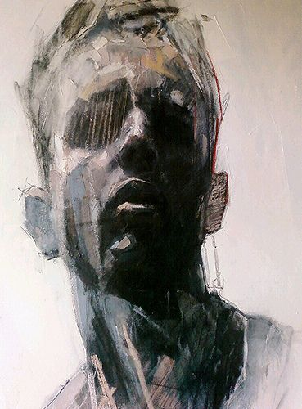
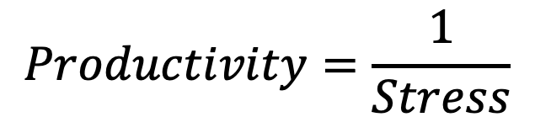
Productivity and Stress
- The University of Oklahoma at Tulsa conducted a cross-sectional study between perceived stress-level (PSS) and productivity.
- The study concluded with a strong negative relationship between PSS and Productivity
$$Productivity=\frac{1}{Stress}$$
Unnamed by: Ryan Hewett
Bui, Tina, et al. “Workplace Stress and Productivity: A Cross-Sectional Study.” Kansas Journal of Medicine, U.S. National Library of Medicine, 12 Feb. 2021, pmc.ncbi.nlm.nih.gov/articles/PMC7889069/.

Slide 11
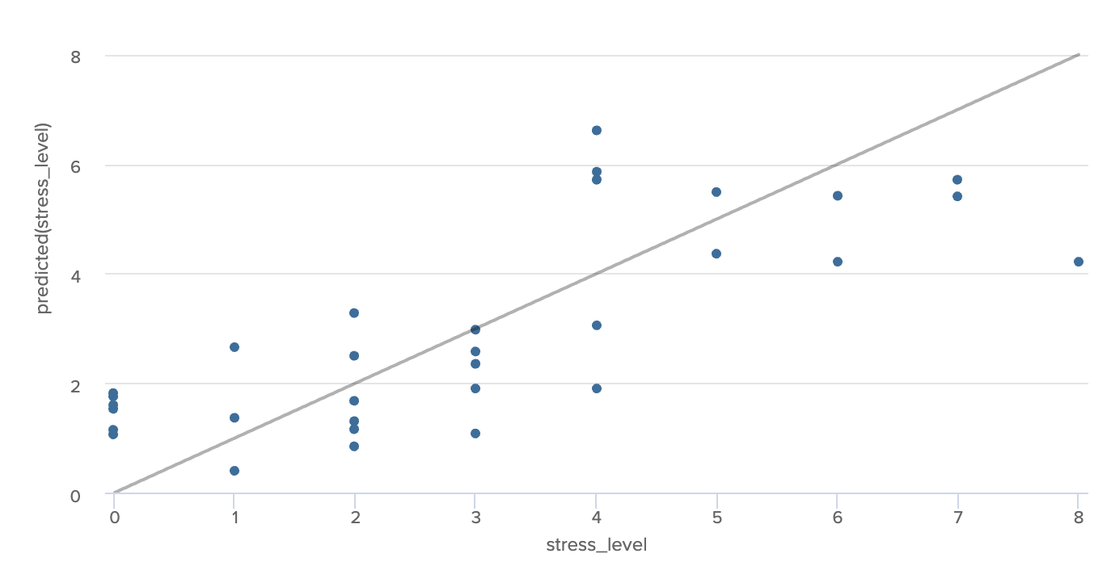
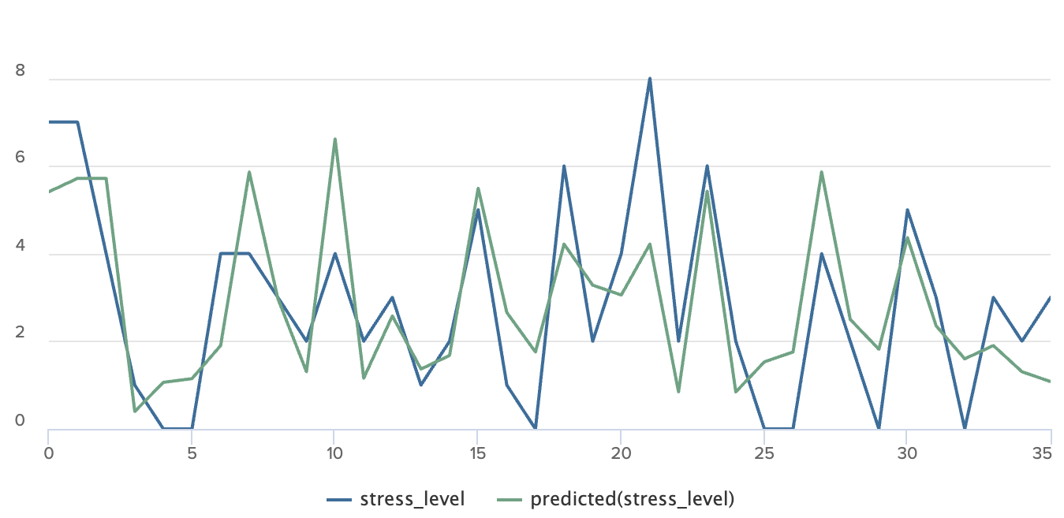
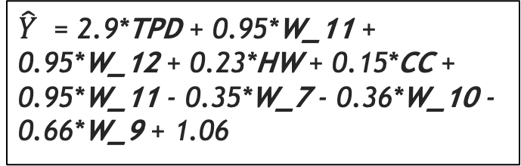
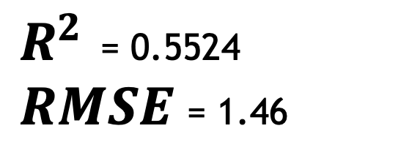
Stress Prediction Model
Linear Regression Model
$\hat{Y}$ = 2.9*TPD + 0.95*W_11 + 0.95*W_12 + 0.23*HW + 0.15*CC + 0.95*W_11 - 0.35*W_7 - 0.36*W_10 - 0.66*W_9 + 1.06
$R^{2}$ = 0.5524
$RMSE$= 1.46

Slide 12

Personal application
-Health & Well-being
-Academic & Work Performance
-Emotional & Mental Health
-Relationships & Social Life
-Financial & Lifestyle Decisions
unknown by unknown artist

Slide 13
Questions?

Slide 14
Resources / Works cited
Splunk Enterprise
Search & Reporting
Machine Learning Took Kit
Excel
ChatGPT
Power Point

