Slide 1
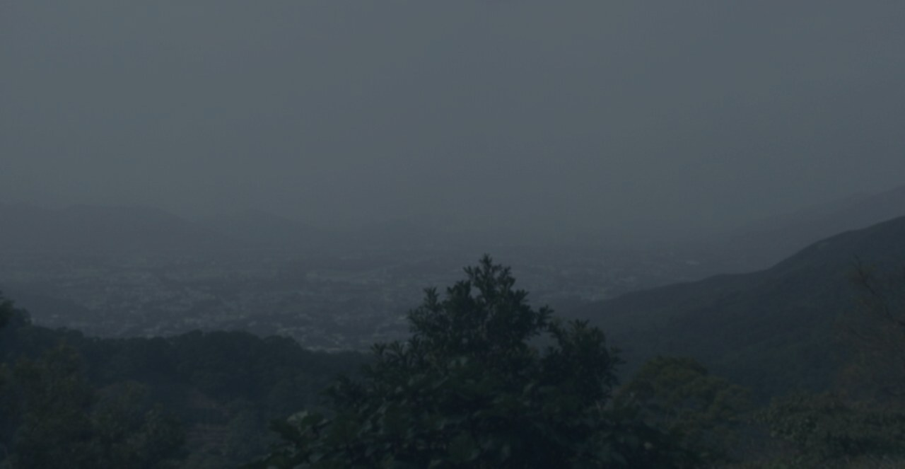
KFB Cloud Coverage
Estimating cloud base from a hill weather-camera photo
One Kadoorie Farm photo (camera at ~150 m) → day/night → inside cloud? → cloud-base message
Project overview · July 2026

Slide 2
Problem & Motivation
Drone pilots need cloud-base height, but Hong Kong has few direct observations
Regulatory need
CAD drone rules require pilots to know the approximate cloud-base height.
Key inference
Camera is inside cloud (whiteout, distant view lost)
→ cloud base ≤ 150 m (camera altitude)
Camera is not inside cloud (distant view clear)
→ cloud base > 150 m
Turn an existing webcam into a cloud-base sensor — no new hardware.
Observation gap
Hong Kong has almost no public, real-time direct measurements of cloud base.
Existing asset
HKO operates hill weather cameras at known altitudes — e.g. Kadoorie Farm (KFB) at ~150 m.
KFB Cloud Coverage
2 / 11

Slide 3
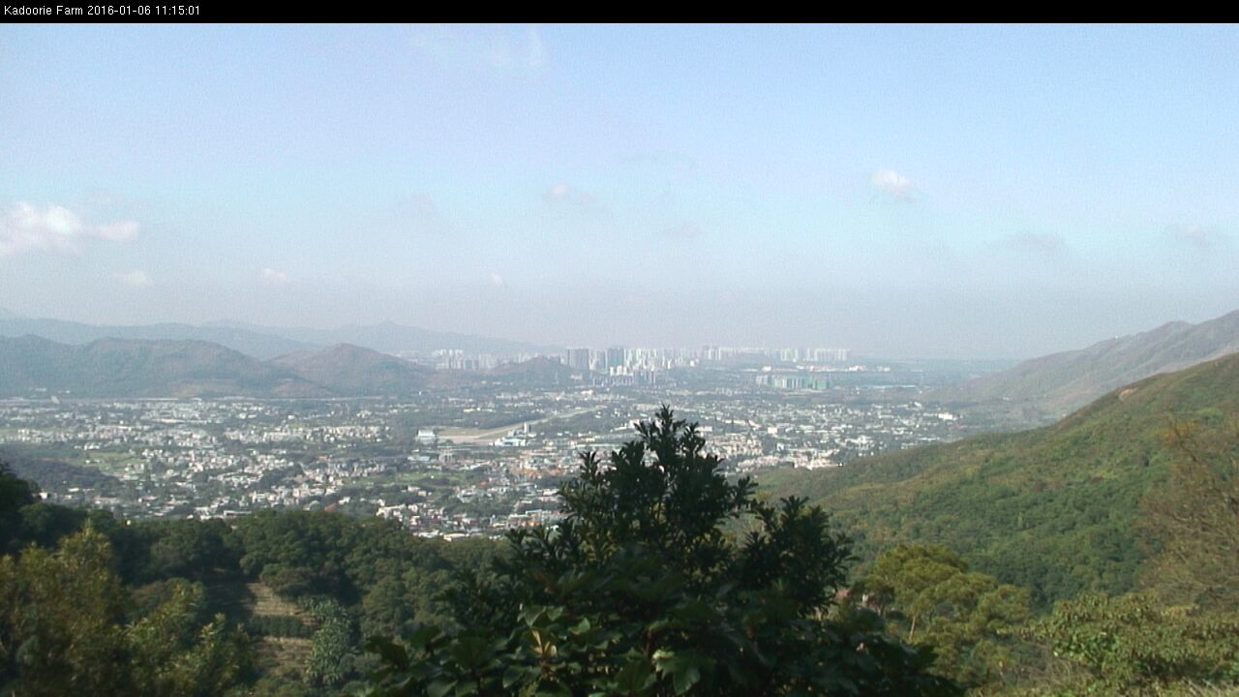
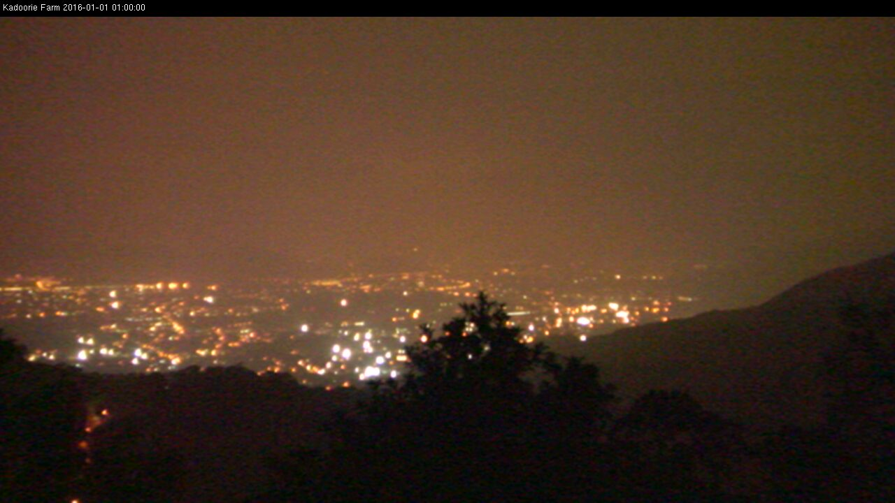
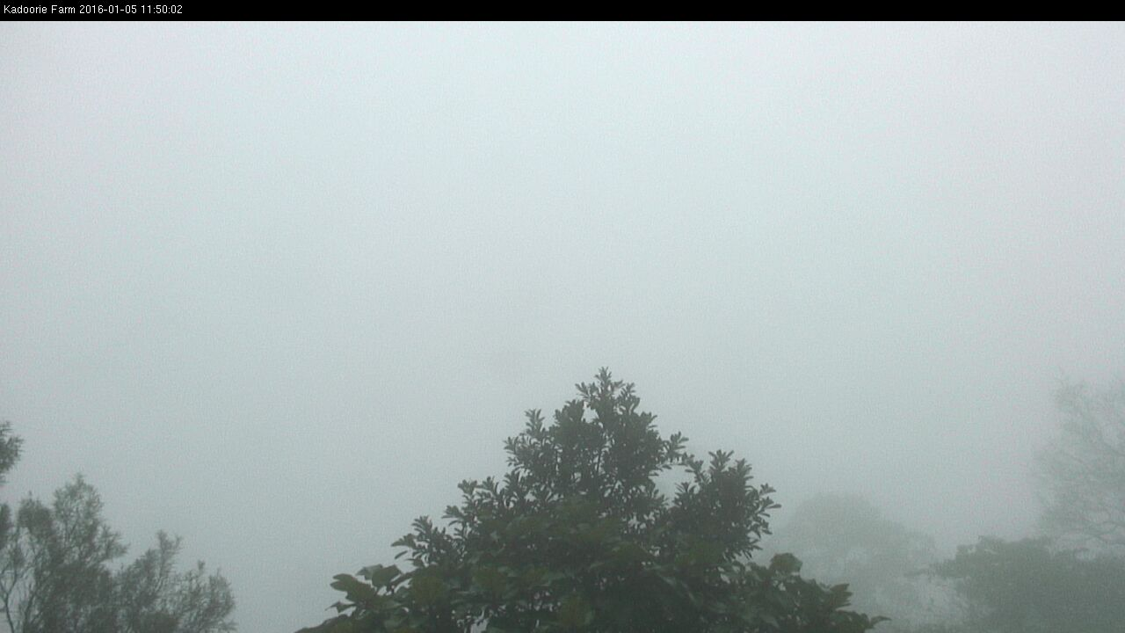
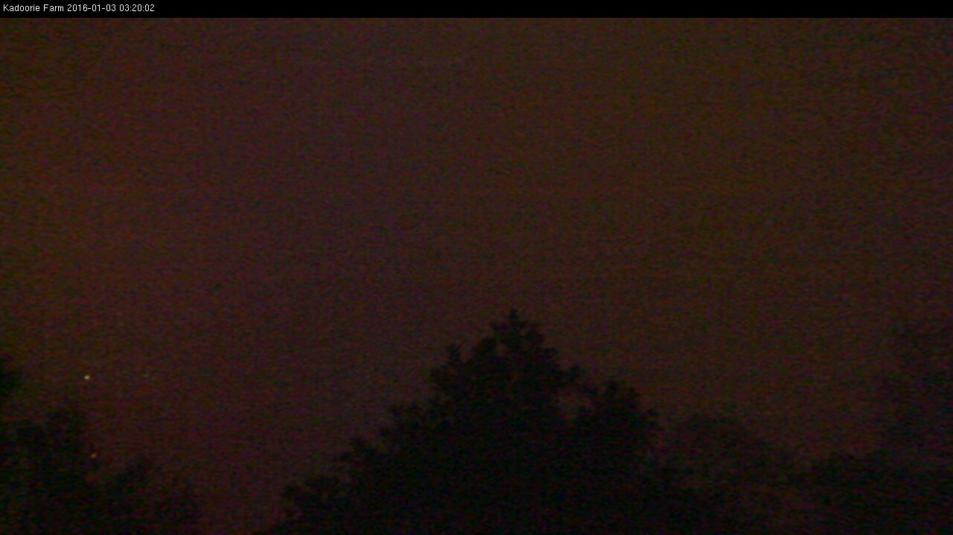
Core Idea
No radar, no new hardware — just the visual cues in the photo
Daytime cues
Nighttime cues
Clear: valley, towns and distant hills all visible
Clear: valley lights clearly visible
In cloud: uniform whiteout, distant texture gone
In cloud: lights swallowed by fog, uniformly dark frame
KFB Cloud Coverage
3 / 11

Slide 4
System Pipeline
Classical image features + a lightweight model, fully automated end to end
Image input
3,497 KFB photos
Feature extraction
brightness / edges / saturation…
Heuristic auto-label
labels.csv, human-editable
Train classifier
logistic regression + scaler
Predict
fixed cloud-base message
Module layout (each file does one job)
src/features.py load image, crop the timestamp banner, extract 10 features, decide day/night
src/heuristic.py visual rules produce seed labels (inside_cloud / not_inside)
src/auto_label.py scan every photo in image/, write data/labels.csv
src/train.py 80/20 split by date, train logistic regression, export a tiny JSON model
src/predict.py single/batch inference, print the fixed message
src/web.py + docs/ Flask server variant and the GitHub Pages in-browser variant
KFB Cloud Coverage
4 / 11
Notes:
how to do the labeling at src/heuristic.py ? do you need some ‘weather observer’ expertise on analysing the weather photos?

Slide 5
Feature Engineering
Crop the timestamp banner (top 8%), resize to 640 px long side — identical to the browser Canvas
Overall appearance
• Brightness mean / std (whiteout → high mean, low variance)
• Saturation mean (inside cloud looks grey, low saturation)
• Edge density (Laplacian; little texture inside cloud)
Spatial structure
• Upper vs lower half contrast (is the far scene washed out?)
• Far-field gradient far_grad (excludes bottom 28% trees)
• Far-field washout ratio far_wash and std far_std
Night-specific
• Bright-spot ratio bright_spot_ratio (valley lights)
• No lights + uniform frame → lean inside_cloud
Day/night decision
• Image brightness only: mean ≥ 80 means day
• No dependence on filename time → works for any photo source
KFB Cloud Coverage
5 / 11

Slide 6
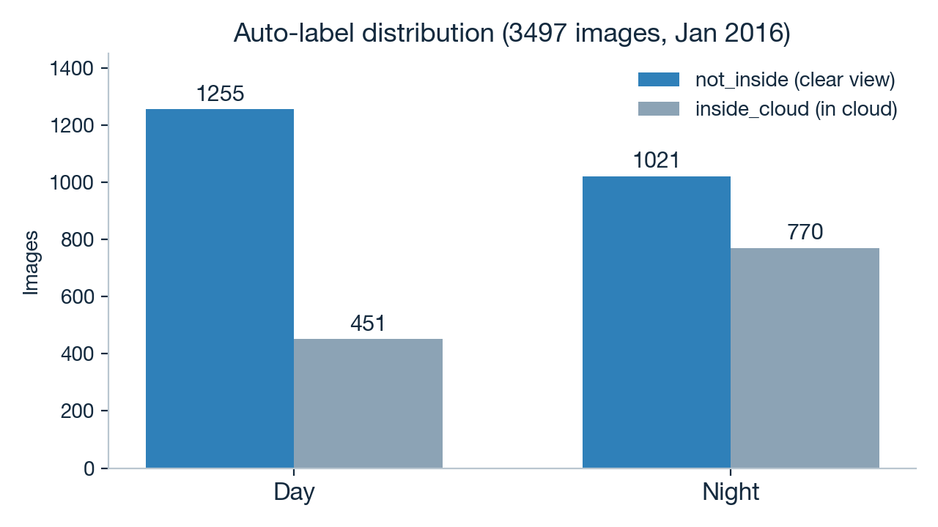
Data & Auto-Labeling
Heuristic rules label everything first; humans only spot-check — no hand-labeling 3,497 photos
Labeling workflow
• python -m src.auto_label scans all photos and applies the visual rules as seed labels
• Output goes to data/labels.csv (with all feature values; edit the label column to correct)
• src/sample_review.py prints stratified samples (day/night × in/out of cloud) for an eye check
• Retrain after corrections — labeling cost stays tiny
Example heuristic rule (daytime)
far_wash >= 0.60 and far_grad <= 5.0
→ far field mostly washed out with almost no texture → inside cloud
KFB Cloud Coverage
6 / 11
Notes:
how you do the spot-check for the 3497 images? how many photos were checked?

Slide 7
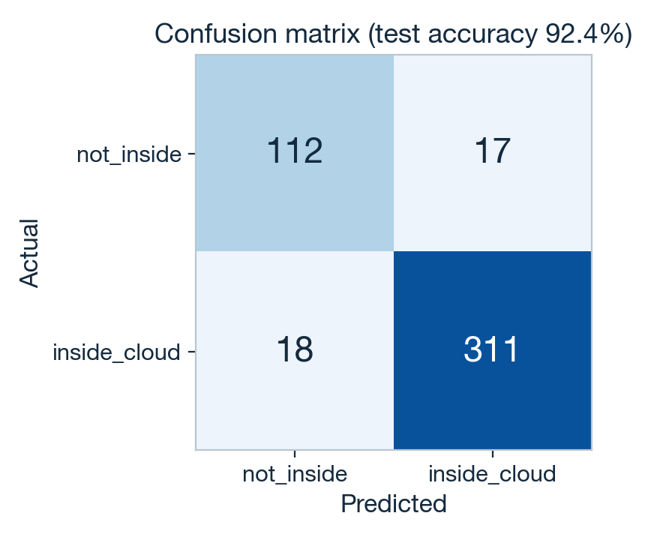
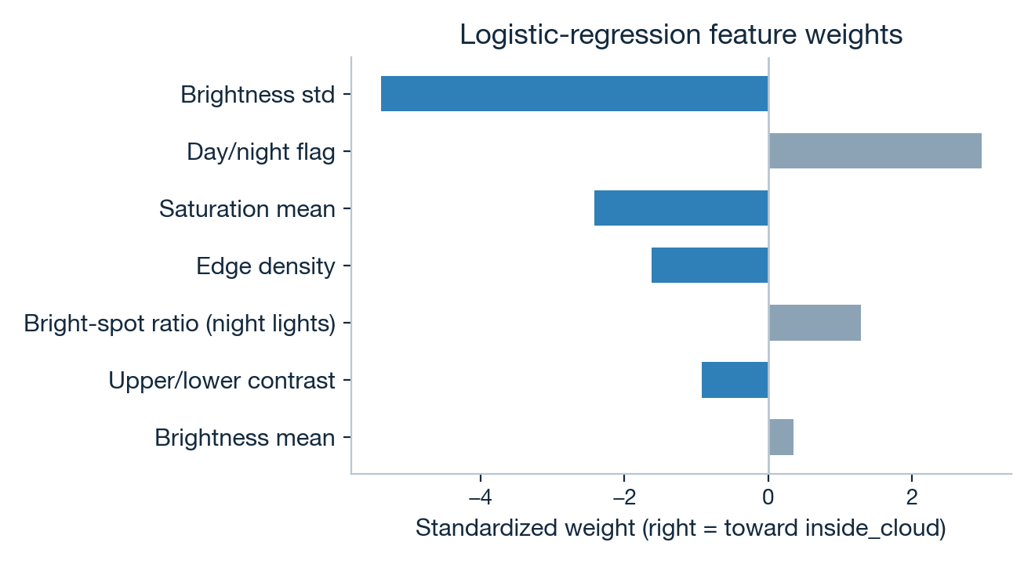
Model & Evaluation
Logistic regression (StandardScaler + class_weight=balanced), split by date to avoid same-day leakage
Test accuracy 92.4% (458 images from held-out dates). Weights match intuition: high brightness variance, more edges and higher saturation all push toward not_inside.
KFB Cloud Coverage
7 / 11
Notes:
can you show the 17 + 18 case out of the 3K photos that seem the tool may mis-interpret the photo?

Slide 8
Live Examples
Real outputs for four scenarios (python -m src.predict)
Day · clear
I am not inside cloud. Cloud base above 150 m.
Day · in cloud
Camera is inside cloud (day). Cloud base at or below ~150 m.
Night · clear
I am not inside cloud. Cloud base above 150 m.
Night · in cloud
Camera is inside cloud (night). Cloud base at or below ~150 m.
KFB Cloud Coverage
8 / 11

Slide 9
Deployment Strategy
One rule set, three runtimes, identical results
GitHub Pages (primary)
• Static site in docs/; app.js computes in the visitor's browser
• Photos never leave the user's device → privacy-friendly
• Zero server cost, no OOM — anyone with the link can use it
Render / Flask (fallback)
• src/web.py: Flask + waitress, single thread to save memory
• BLAS threads and upload size capped (8 MB) for the free tier
• Dockerfile included — portable to any container platform
CLI (development)
• python -m src.predict photo.jpg prints the message directly
• auto_label / train / sample_review are all one-liners
• Model exports to a tiny JSON (weights + intercept) readable in JS
The Python and JavaScript feature code is deliberately aligned line by line (same resize, crop and formulas), so all three runtimes agree.
KFB Cloud Coverage
9 / 11

Slide 10
Engineering Practices
A small project run with a proper process
Test-driven development
Failing tests first, then implementation: message format, day/night, feature shape and heuristic rules each have unit tests, plus an end-to-end smoke test on real images.
No data leakage
Train/test split is by date, so photos from the same day never appear on both sides — frames five minutes apart are nearly identical.
Spec and plan first
docs/superpowers/ holds the design spec (goals, non-goals, success criteria) and a step-by-step implementation plan, reviewed before coding.
Deliberate non-goals
v1 skips CNNs, humidity fusion, multi-site cameras and continuous cloud-base regression — make the simplest version useful first.
KFB Cloud Coverage
10 / 11

Slide 11
Summary & Future Work
Done
• Fully automated pipeline: 3,497 photos → labels → training → inference
• Works day and night, emitting two fixed cloud-base messages
• 92.4% test accuracy, validated on held-out dates
• Live on GitHub Pages — anyone can use it, photos stay on-device
• Unit tests + smoke test all green
Future work (v2+)
• Fuse relative humidity (RH) and other weather data for reliability
• Combine altitudes to upgrade from a binary call to a cloud-base height range
• Consider a lightweight CNN only if classical features plateau on corrected labels
• Collect data across seasons to handle rain and haze confounders
One photo, one answer: is the cloud base above or below 150 metres?
KFB Cloud Coverage
11 / 11
Notes:
can u do the same training for other hill top weather camera ?
https://www.hko.gov.hk/en/wxinfo/ts/index_webcam.htm
victoria peak (2 view angles) (700m amsl)
Tai Mo Shan (2 view angles) (900m amsl)
Kowloon City （1 view angle) (100m amsl)
Kau Sai Chau (1 view angle) (100m amsl)
you may also cross-check with the RH recorded in the surrounding areas of the wx photo site e.g. RH over 90-95% as a screening criteria.

Slide 12
Can you try implement your tool to auto estimate the
cloud base height of KFBG from all photos as viewed from :
https://www.hko.gov.hk/en/wxinfo/ts/webcam/KFB_photo.htm

Slide 13
after learning to check cloud base height with photos, see if you can explore to ‘estimate’ the minimum horizontal visibility as viewed from some weather photo site. i will provide too GROUND truth for your validation

Slide 14
please be reminded that we do not need to determine VERY detail/precisely the visibility (in km/m). we need only to tell :
What can be the minimum visibility as seen from the photo view ? we care on 300m, 500m,1km,3km,5km.
e.g. AI estimate the visibility here is at least ‘ 500m/1km..’ .

Slide 15
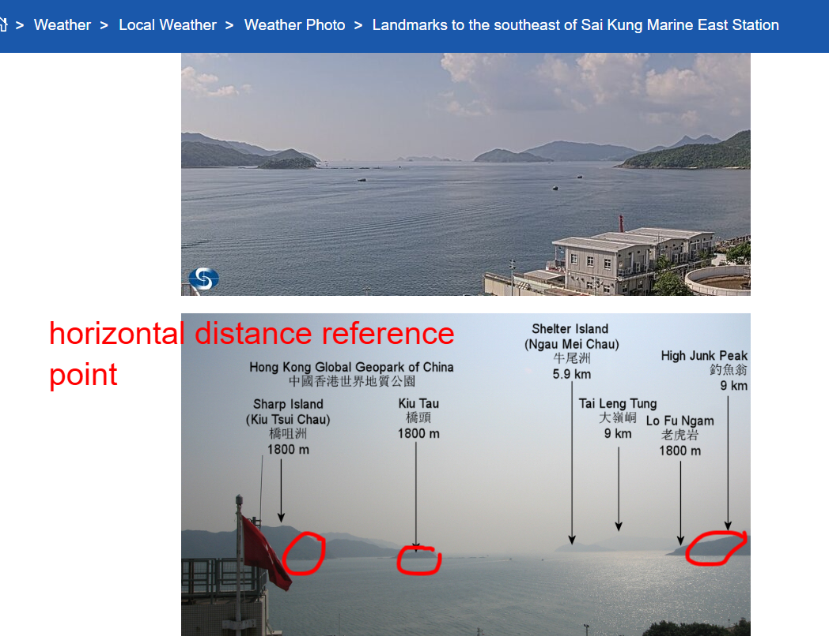

Slide 16
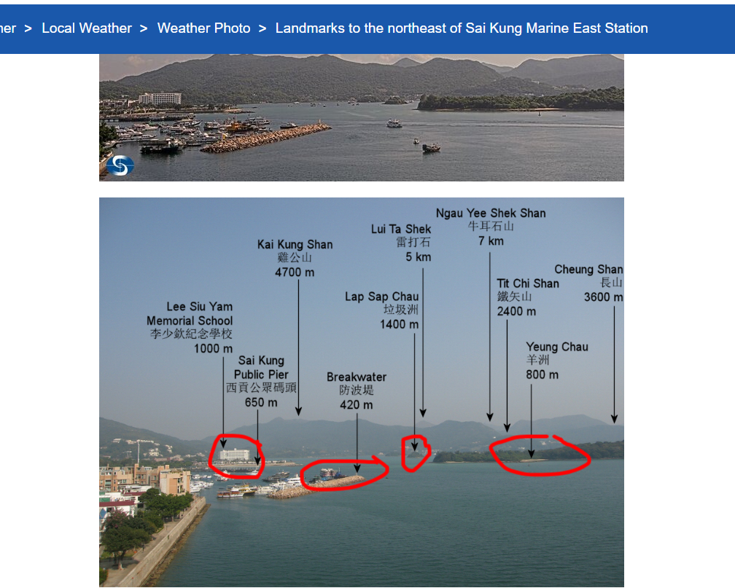

Slide 17
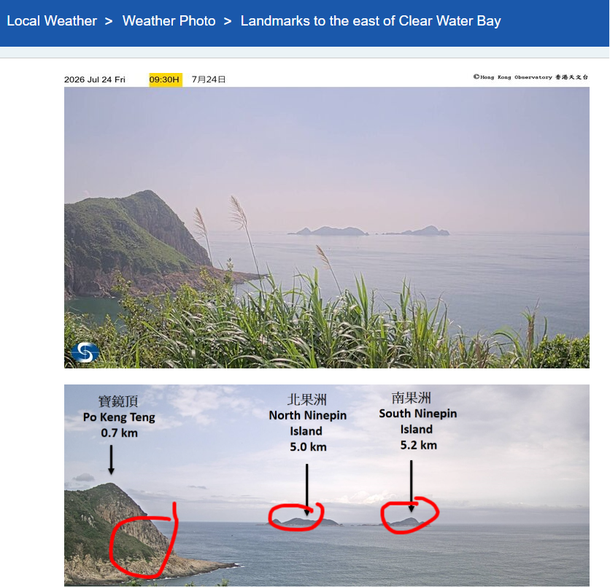

Slide 18
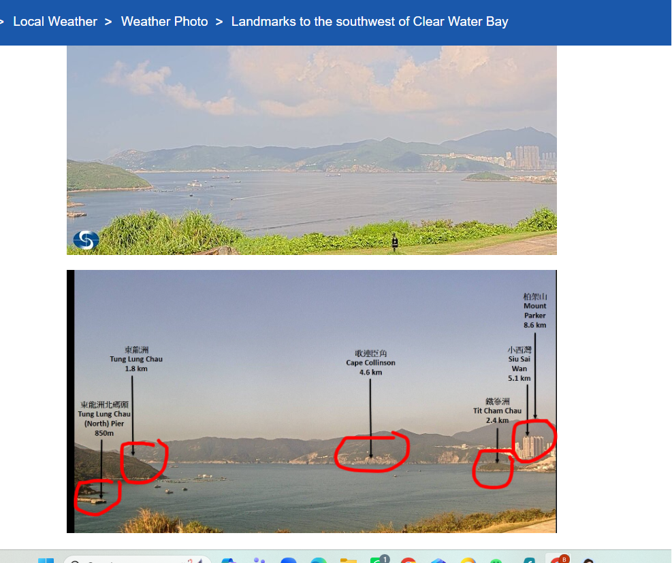

Slide 19
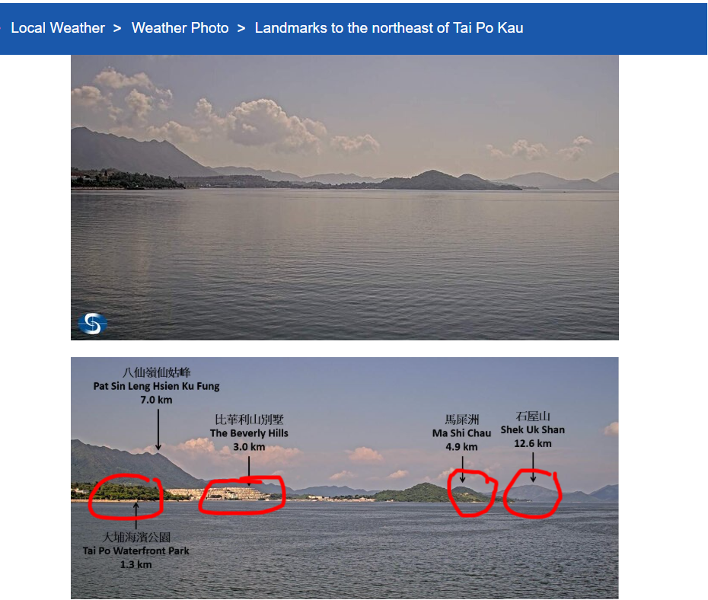

Slide 20
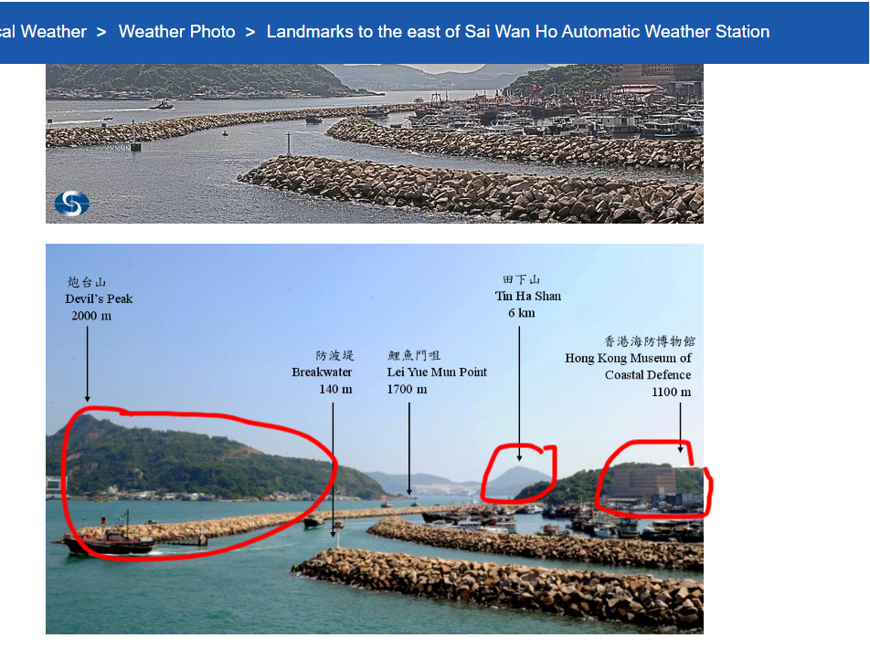

Slide 21
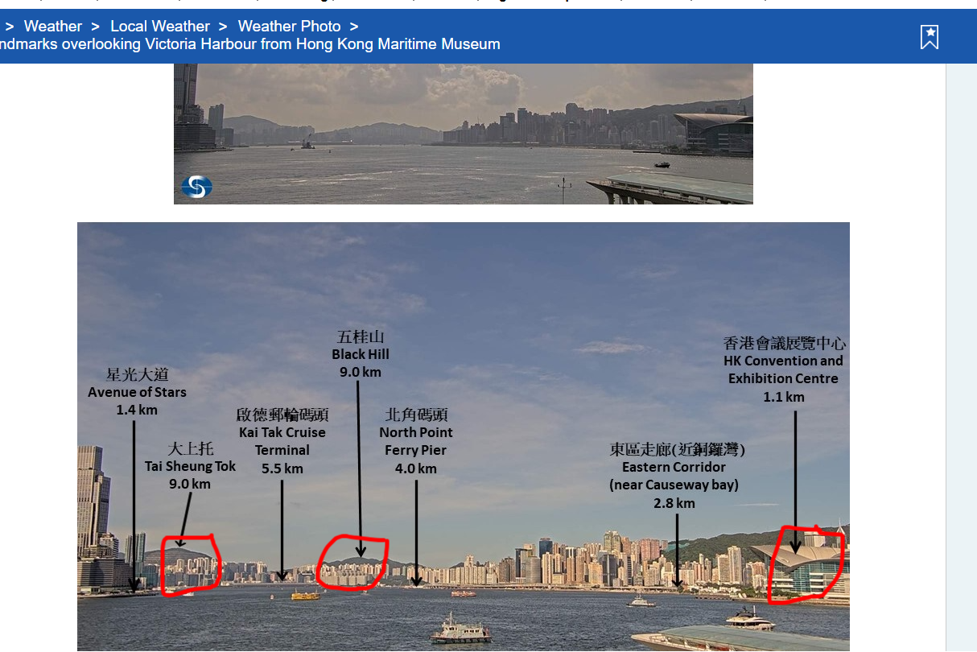

Slide 22
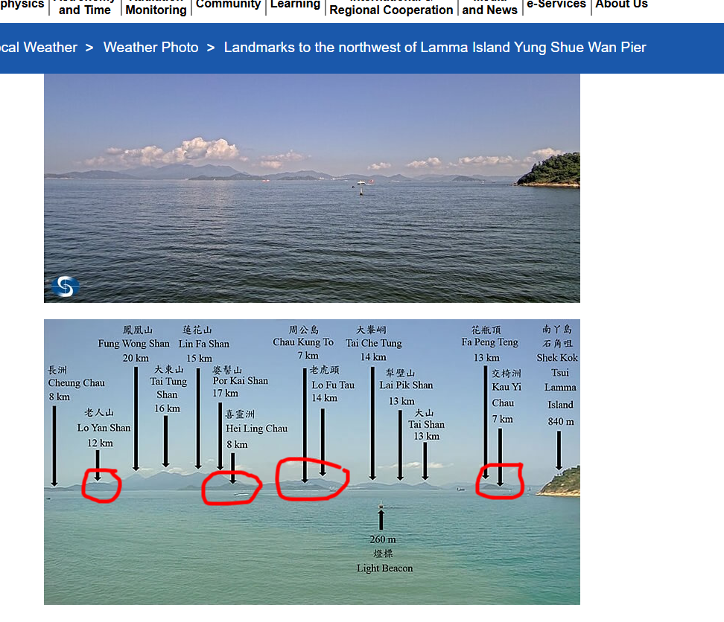

Slide 24
For cloud base height estimation ..
For cloud based height estimation across HK border, is it possible to do the same training as you did for ‘KFBG’ for other hill-weather station ?
https://www.hko.gov.hk/en/wxinfo/ts/index_webcam.htm

Slide 25
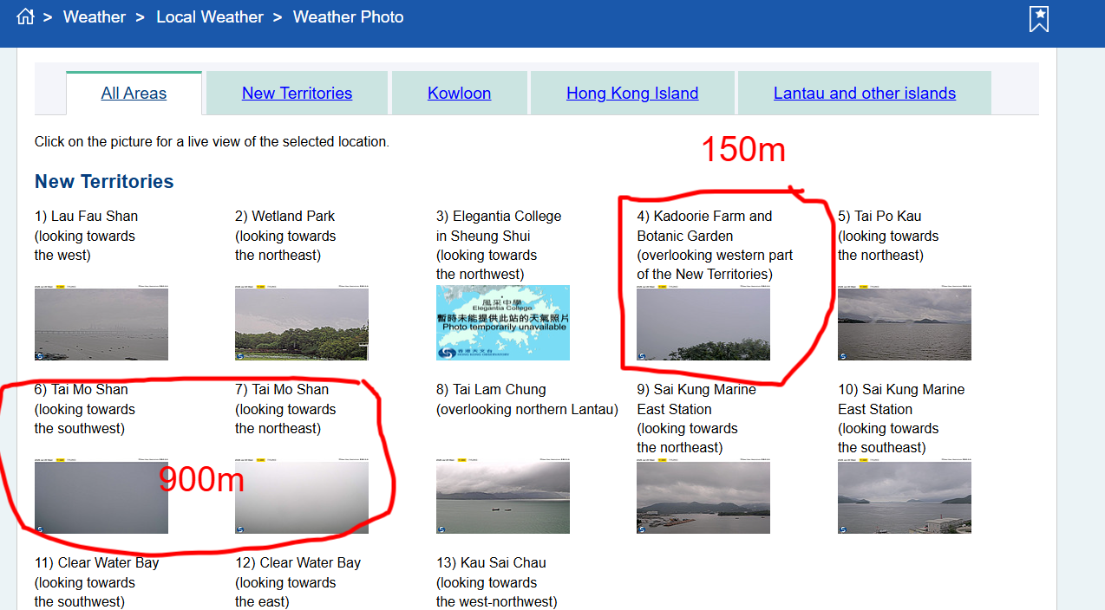

Slide 26
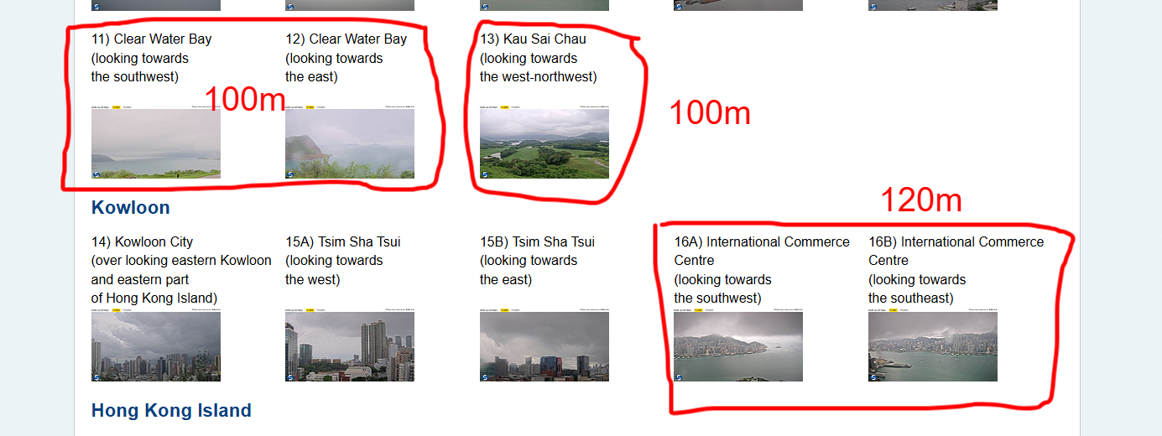

Slide 27
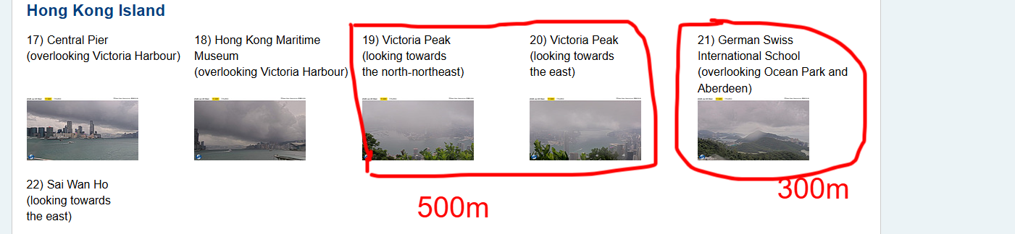
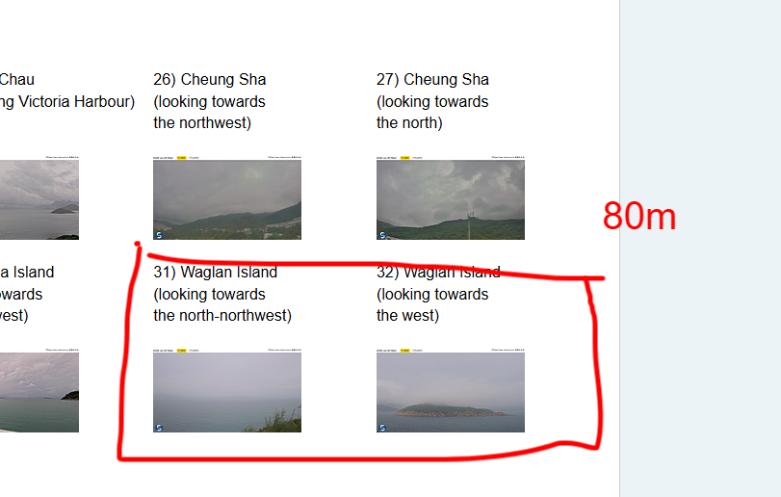

Slide 28
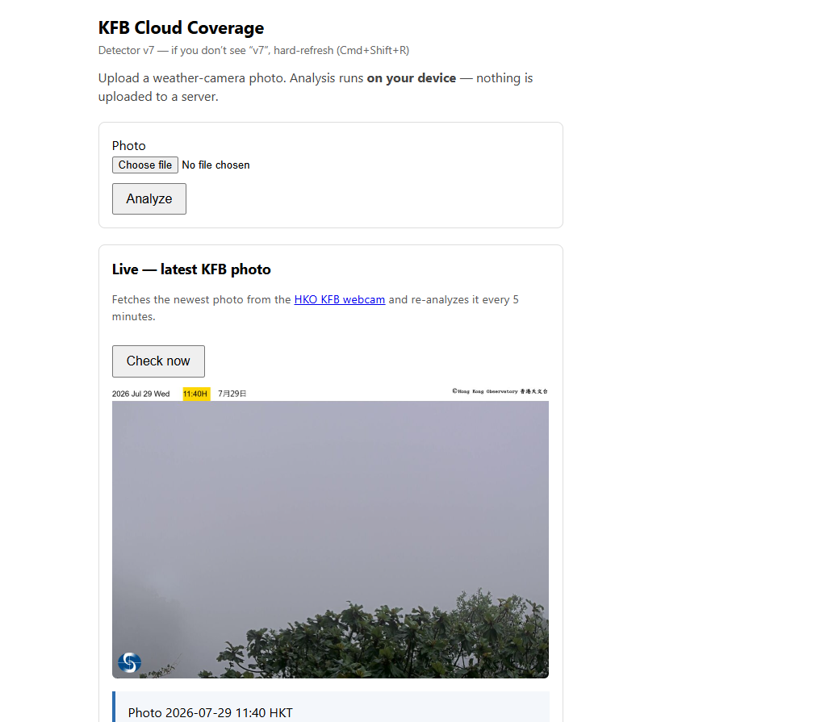
without providing you the original weather photos from these weather stations, can you also do the auto - cloud cover/not identification ?
add the auto-determination at the same pages for other wx station.

Slide 30
New Feature: Visibility Estimation
Requested on slide 14: estimate minimum visibility from the photo.
Output is one of five levels (not a precise measurement):
• Visibility: at or below 300 m (camera in cloud/fog)
• Visibility: at least 300 m
• Visibility: at least 500 m
• Visibility: at least 1 km
• Visibility: at least 3 km
• Visibility: at least 5 km (far field clear)
Method (day): far-field wash ratio & gradient — washed/low-texture → closer bracket.
Method (night): valley bright-spot density → proxy for light visibility.
Both results (cloud-base height + visibility estimate) now shown together on the web app.

Slide 31
New Feature: Multi-Station Support
Requested on slides 24 & 28: apply the same cloud/not-cloud analysis
to other HKO hill weather stations (not just KFBG).
The web app now has a Station selector:
• KFBG — Kadoorie Farm & Botanic Garden (~150 m)
• Tai Mo Shan (~957 m)
• Victoria Peak (~396 m)
• Lantau Peak (~934 m)
• Ma On Shan (~702 m)
• Lion Rock (~495 m)
• Pat Sin Leng (~639 m)
Each station uses its own altitude for the cloud-base message.
No retraining needed — same heuristic feature logic works across stations.
Reference: https://www.hko.gov.hk/en/wxinfo/ts/index_webcam.htm

Slide 32
v6 Web App — Summary of Changes
1. Station selector (7 HK hill weather stations, each with correct altitude)
2. Visibility estimate (300 m / 500 m / 1 km / 3 km / 5 km)
3. Output now shows two lines:
• Cloud-base height result (existing)
• Visibility estimate (new)
4. Debug line shows station name + key feature values.
5. No server changes needed — all logic runs in the browser.
Files updated:
• docs/index.html (v6 — station selector, visibility output block)
• docs/app.js (formatMessage, estimateVisibility, analyzeFile, STATIONS map)

