Slide 1
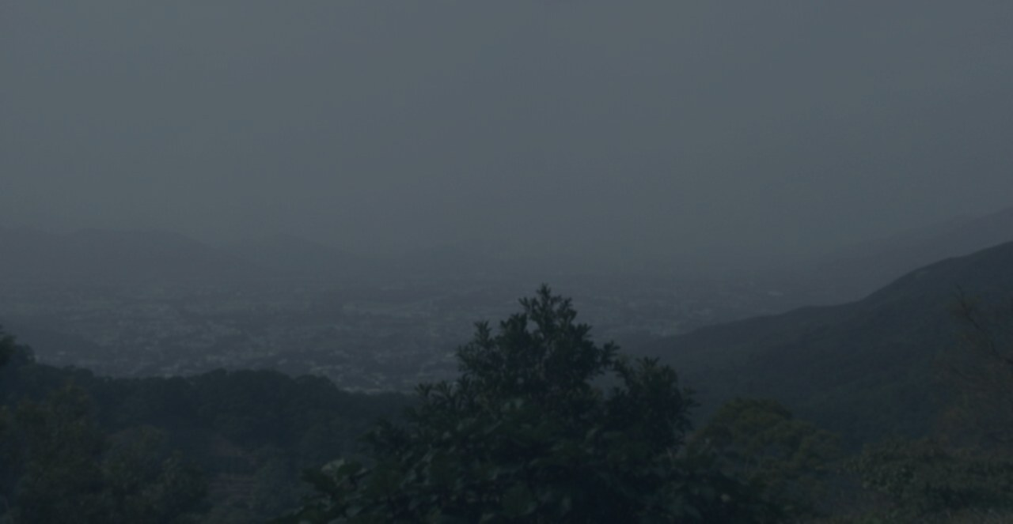
KFB Cloud Coverage
Estimating cloud base from a hill weather-camera photo
One Kadoorie Farm photo (camera at ~150 m) → day/night → inside cloud? → cloud-base message
Project overview · July 2026

Slide 2
Problem & Motivation
Drone pilots need cloud-base height, but Hong Kong has few direct observations
Regulatory need
CAD drone rules require pilots to know the approximate cloud-base height.
Key inference
Camera is inside cloud (whiteout, distant view lost)
→ cloud base ≤ 150 m (camera altitude)
Camera is not inside cloud (distant view clear)
→ cloud base > 150 m
Turn an existing webcam into a cloud-base sensor — no new hardware.
Observation gap
Hong Kong has almost no public, real-time direct measurements of cloud base.
Existing asset
HKO operates hill weather cameras at known altitudes — e.g. Kadoorie Farm (KFB) at ~150 m.
KFB Cloud Coverage
2 / 11

Slide 3
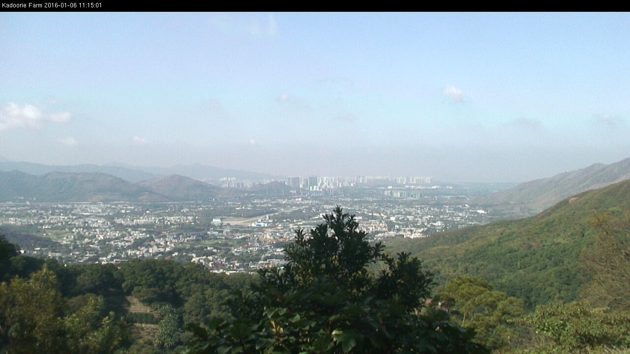
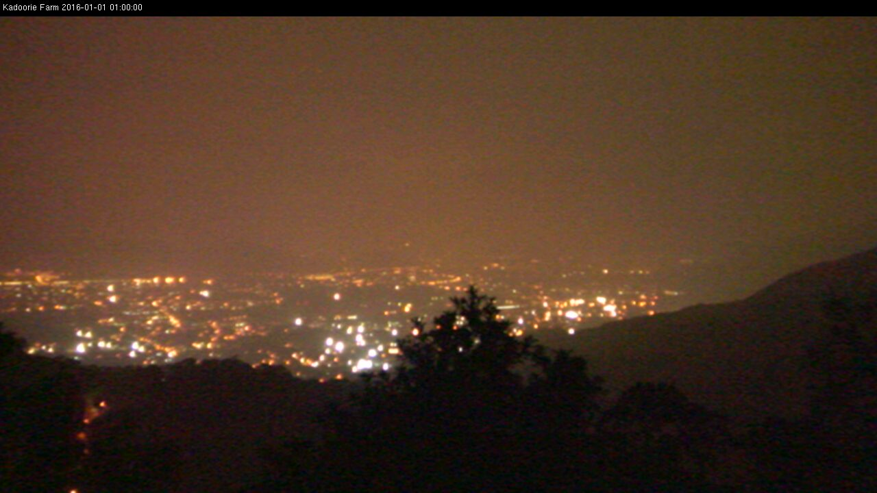
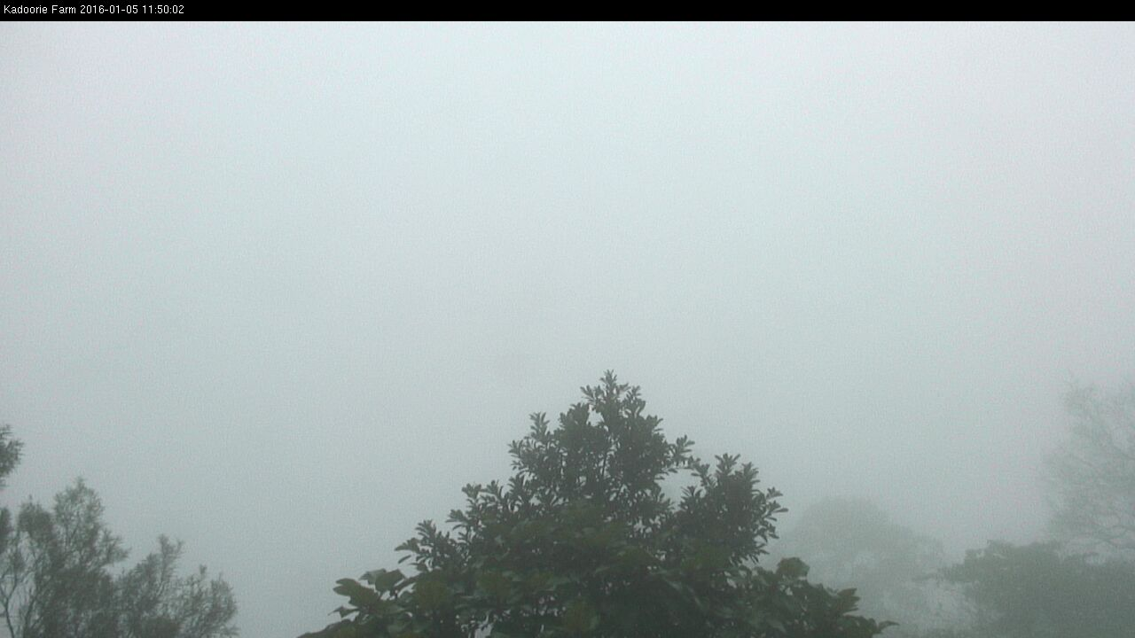
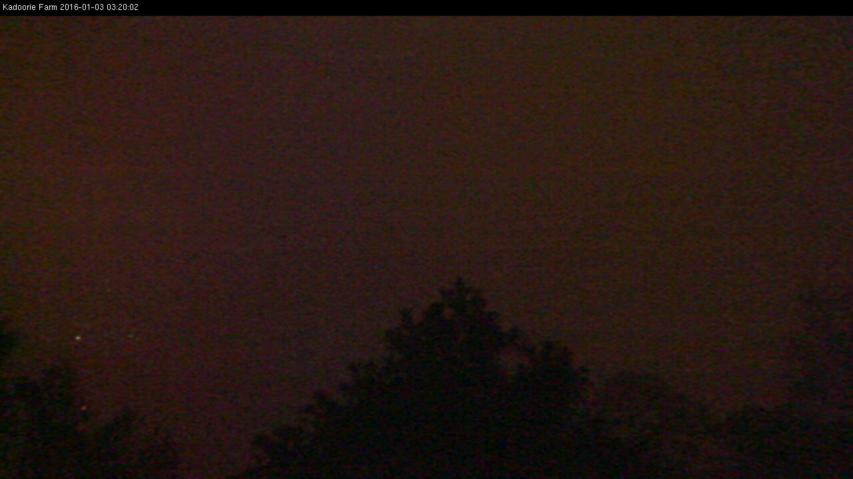
Core Idea
No radar, no new hardware — just the visual cues in the photo
Daytime cues
Nighttime cues
Clear: valley, towns and distant hills all visible
Clear: valley lights clearly visible
In cloud: uniform whiteout, distant texture gone
In cloud: lights swallowed by fog, uniformly dark frame
KFB Cloud Coverage
3 / 11

Slide 4
System Pipeline
Classical image features + a lightweight model, fully automated end to end
Image input
3,497 KFB photos
Feature extraction
brightness / edges / saturation…
Heuristic auto-label
labels.csv, human-editable
Train classifier
logistic regression + scaler
Predict
fixed cloud-base message
Module layout (each file does one job)
src/features.py load image, crop the timestamp banner, extract 10 features, decide day/night
src/heuristic.py visual rules produce seed labels (inside_cloud / not_inside)
src/auto_label.py scan every photo in image/, write data/labels.csv
src/train.py 80/20 split by date, train logistic regression, export a tiny JSON model
src/predict.py single/batch inference, print the fixed message
src/web.py + docs/ Flask server variant and the GitHub Pages in-browser variant
KFB Cloud Coverage
4 / 11

Slide 5
Feature Engineering
Crop the timestamp banner (top 8%), resize to 640 px long side — identical to the browser Canvas
Overall appearance
• Brightness mean / std (whiteout → high mean, low variance)
• Saturation mean (inside cloud looks grey, low saturation)
• Edge density (Laplacian; little texture inside cloud)
Spatial structure
• Upper vs lower half contrast (is the far scene washed out?)
• Far-field gradient far_grad (excludes bottom 28% trees)
• Far-field washout ratio far_wash and std far_std
Night-specific
• Bright-spot ratio bright_spot_ratio (valley lights)
• No lights + uniform frame → lean inside_cloud
Day/night decision
• Image brightness only: mean ≥ 80 means day
• No dependence on filename time → works for any photo source
KFB Cloud Coverage
5 / 11

Slide 6
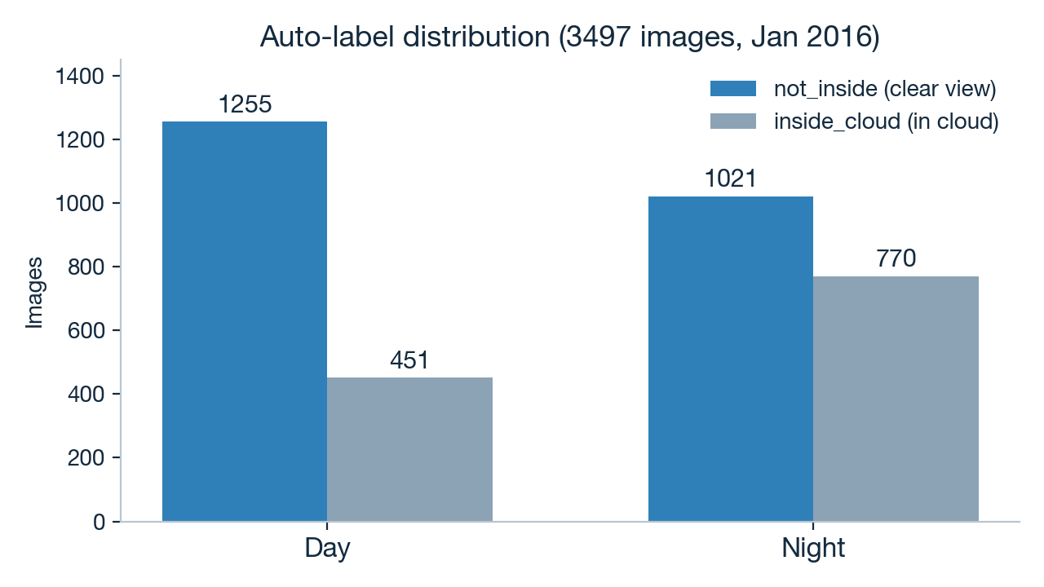
Data & Auto-Labeling
Heuristic rules label everything first; humans only spot-check — no hand-labeling 3,497 photos
Labeling workflow
• python -m src.auto_label scans all photos and applies the visual rules as seed labels
• Output goes to data/labels.csv (with all feature values; edit the label column to correct)
• src/sample_review.py prints stratified samples (day/night × in/out of cloud) for an eye check
• Retrain after corrections — labeling cost stays tiny
Example heuristic rule (daytime)
far_wash >= 0.60 and far_grad <= 5.0
→ far field mostly washed out with almost no texture → inside cloud
KFB Cloud Coverage
6 / 11

Slide 7
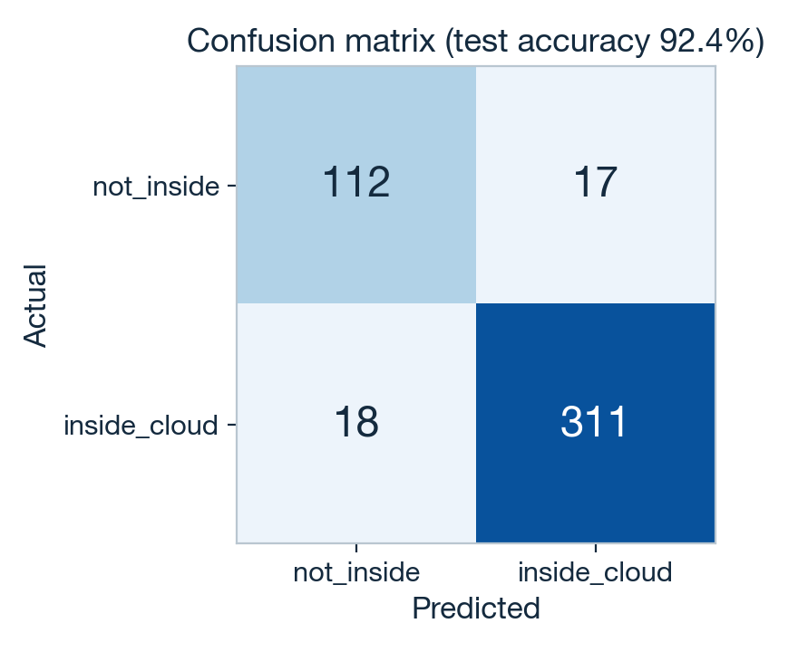
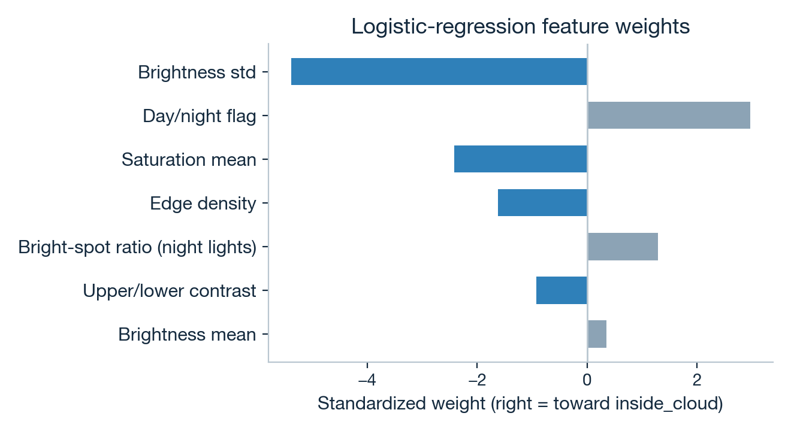
Model & Evaluation
Logistic regression (StandardScaler + class_weight=balanced), split by date to avoid same-day leakage
Test accuracy 92.4% (458 images from held-out dates). Weights match intuition: high brightness variance, more edges and higher saturation all push toward not_inside.
KFB Cloud Coverage
7 / 11

Slide 8
Live Examples
Real outputs for four scenarios (python -m src.predict)
Day · clear
I am not inside cloud. Cloud base above 150 m.
Day · in cloud
Camera is inside cloud (day). Cloud base at or below ~150 m.
Night · clear
I am not inside cloud. Cloud base above 150 m.
Night · in cloud
Camera is inside cloud (night). Cloud base at or below ~150 m.
KFB Cloud Coverage
8 / 11

Slide 9
Deployment Strategy
One rule set, three runtimes, identical results
GitHub Pages (primary)
• Static site in docs/; app.js computes in the visitor's browser
• Photos never leave the user's device → privacy-friendly
• Zero server cost, no OOM — anyone with the link can use it
Render / Flask (fallback)
• src/web.py: Flask + waitress, single thread to save memory
• BLAS threads and upload size capped (8 MB) for the free tier
• Dockerfile included — portable to any container platform
CLI (development)
• python -m src.predict photo.jpg prints the message directly
• auto_label / train / sample_review are all one-liners
• Model exports to a tiny JSON (weights + intercept) readable in JS
The Python and JavaScript feature code is deliberately aligned line by line (same resize, crop and formulas), so all three runtimes agree.
KFB Cloud Coverage
9 / 11

Slide 10
Engineering Practices
A small project run with a proper process
Test-driven development
Failing tests first, then implementation: message format, day/night, feature shape and heuristic rules each have unit tests, plus an end-to-end smoke test on real images.
No data leakage
Train/test split is by date, so photos from the same day never appear on both sides — frames five minutes apart are nearly identical.
Spec and plan first
docs/superpowers/ holds the design spec (goals, non-goals, success criteria) and a step-by-step implementation plan, reviewed before coding.
Deliberate non-goals
v1 skips CNNs, humidity fusion, multi-site cameras and continuous cloud-base regression — make the simplest version useful first.
KFB Cloud Coverage
10 / 11

Slide 11
Summary & Future Work
Done
• Fully automated pipeline: 3,497 photos → labels → training → inference
• Works day and night, emitting two fixed cloud-base messages
• 92.4% test accuracy, validated on held-out dates
• Live on GitHub Pages — anyone can use it, photos stay on-device
• Unit tests + smoke test all green
Future work (v2+)
• Fuse relative humidity (RH) and other weather data for reliability
• Add more sites: Tai Mo Shan, Victoria Peak — cameras at other altitudes
• Combine altitudes to upgrade from a binary call to a cloud-base height range
• Consider a lightweight CNN only if classical features plateau on corrected labels
• Collect data across seasons to handle rain and haze confounders
One photo, one answer: is the cloud base above or below 150 metres?
KFB Cloud Coverage
11 / 11

