Slide 1
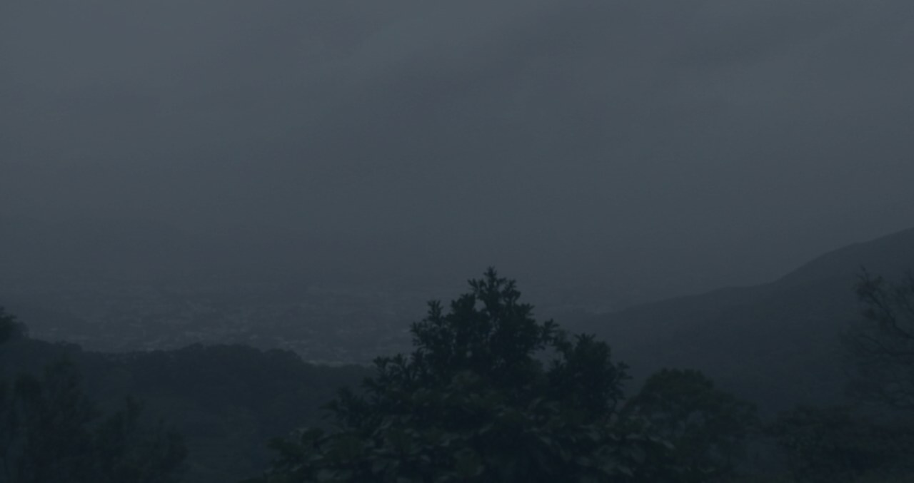
KFB Cloud Coverage
Process update — combine every unique label, hold out dates, ship
172,343 unique frames · 357 dates · date-balanced 80/20
Holdout 97.8% · golden 96.5% · 111 86.5% · day 96.4% · night 76.8%
September 2026 · Kadoorie Farm webcam at ~150 m

Slide 2
Why this update
v1 used 2016. d413d74 added 2023 hourly. This ships every unique frame.
Before (d413d74)
• 8,354 rows: 142 golden + 8,212 hourly
• No Jan–Apr minutes in the fit
• Date-grouped 80/20, train-split fit
• 111 visual check 83.8% / day 94.6%
• Night 73.2% still the weak slice
What changed
• Add 163,989 extra per-minute rows
• 111 visual labels override hourly seed
• Weight 1/date, humans ×20
• Date-grouped 80/20, train-split fit
• Same 9 features, same JSON export
Why date-balance
• Jan–Apr is ~1,440 frames/day
• May–Dec is only 24 hourly frames/day
• Equal-weight minutes drown later months
• Mass: golden 40%, hourly 35%, minutes 18%, 111 7%
• Keeps a full-year prior in the model
KFB Cloud Coverage
2 / 10

Slide 3
Updated process
Photos → features → seed labels → human override → date-split train → live
1. Ingest
Hourly year + Jan–Apr minutes
2. Features
9 numbers, no CNN
3. Seed labels
heuristic, not the model
4. Human GT
142 golden + 111 visual
5. Train
date-balanced 80/20
6. Ship
tiny JSON, Pages + Flask
Photo in HKO KFB webcam / USB dump. Crop top 8% timestamp, resize 640 px — same as the browser.
Dedup Filename unique. Hourly overwrites the matching minute. Golden and 111 override both.
Weights (1 / n_frames on that YYMMDD) × 20 if human. Mean-normalized so April minutes cannot own the loss.
Split hygiene GroupShuffleSplit by date, rs=42. Shipped JSON is the train-split fit — no full-data refit.
Live loop GitHub Actions every ~5 min → live.json. Pages runs the same JSON if the feed is stale.
KFB Cloud Coverage
3 / 10

Slide 4
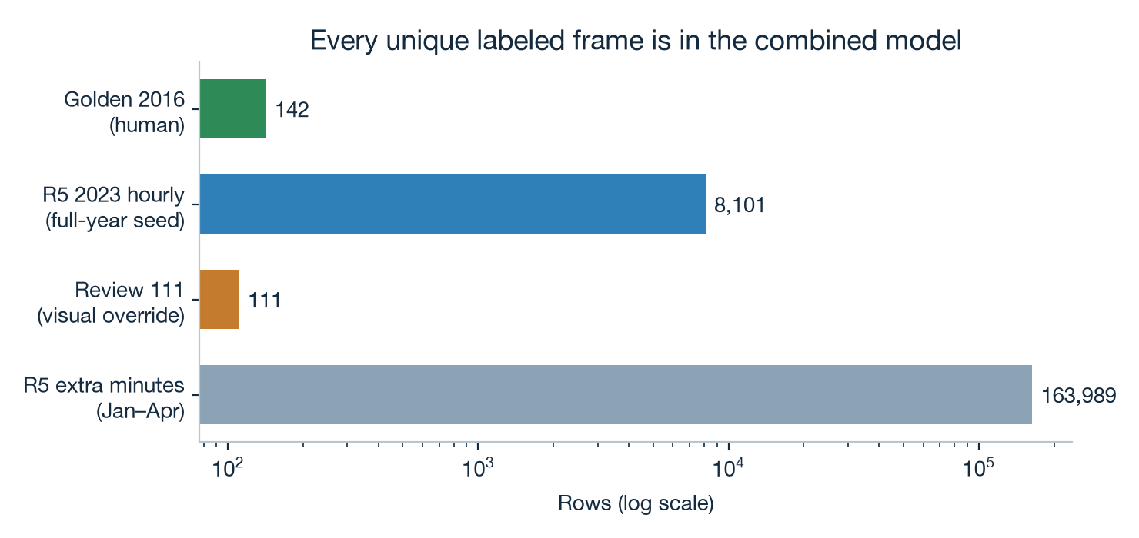
All train data combined
172,343 unique frames · 21,583 inside_cloud · 357 dates
How each set is used
• Golden 142 (2016, human) — honest labels. Override any auto-label.
• R5 hourly 8,101 (2023) — year-round seed. How May–Dec enter the model.
• R5 extra minutes 163,989 (Jan–Apr) — denser time, down-weighted per date.
• Review 111 — visual GT overrides. 20 on test dates.
USB minutes stop 22 Apr. Date-balance is how we still keep a year.
KFB Cloud Coverage
4 / 10

Slide 5
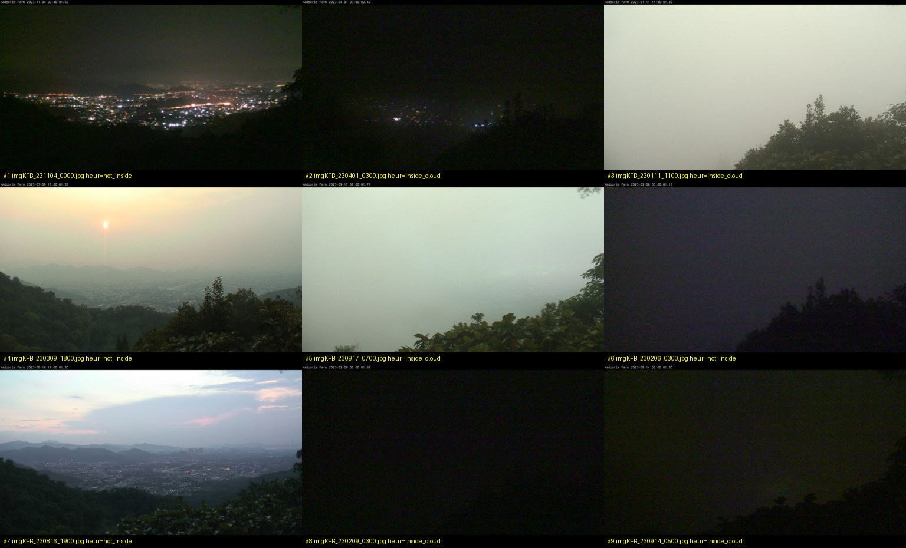
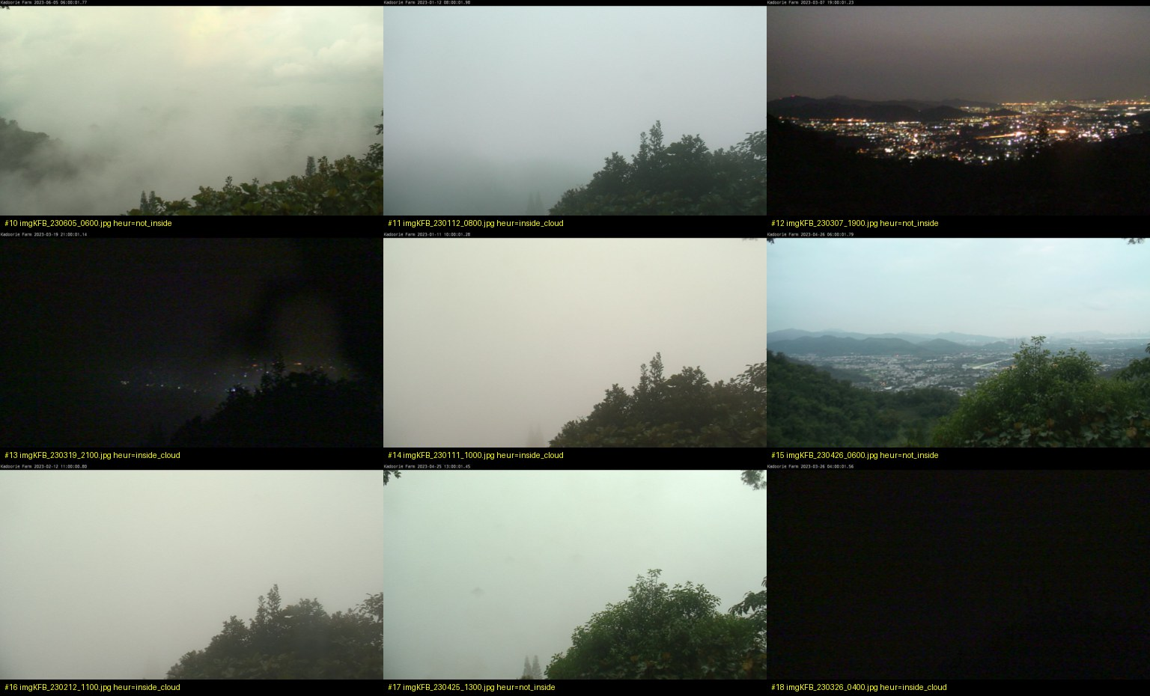
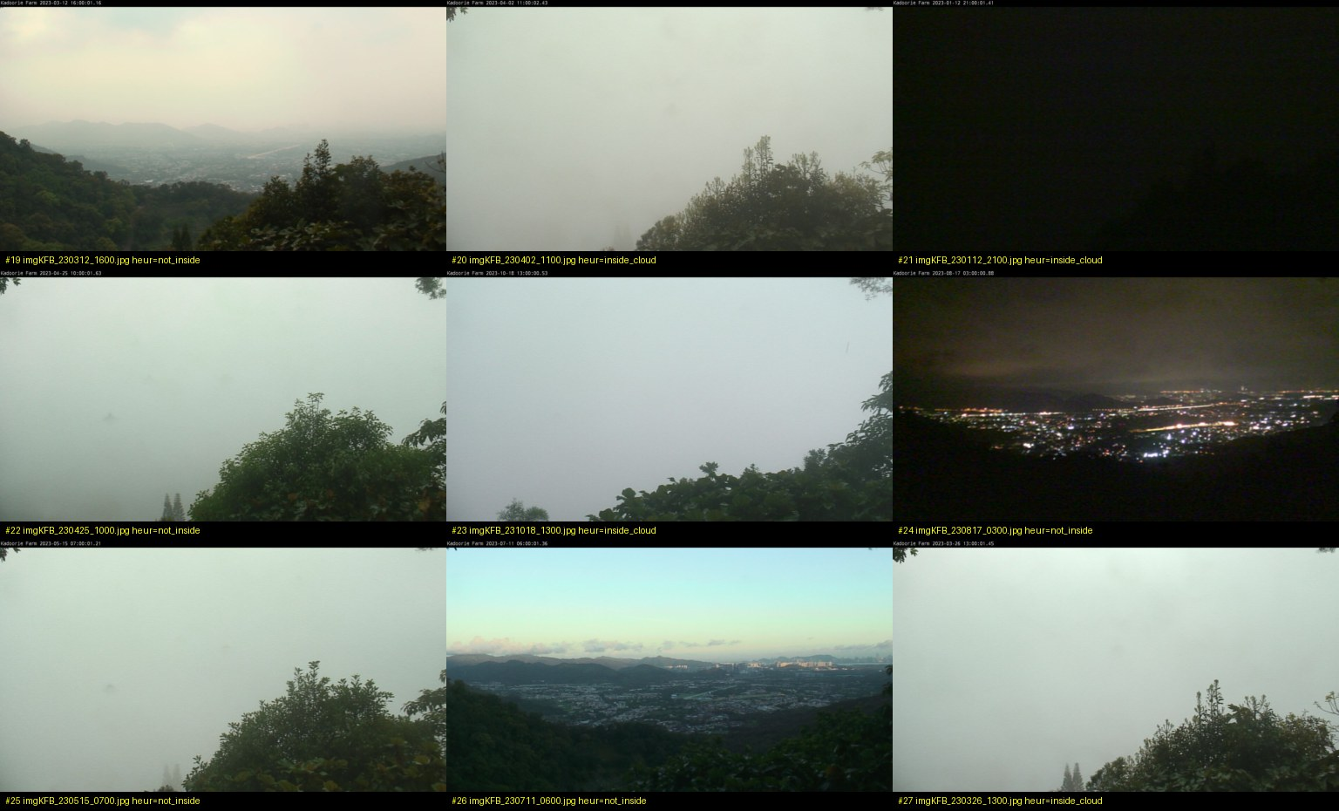
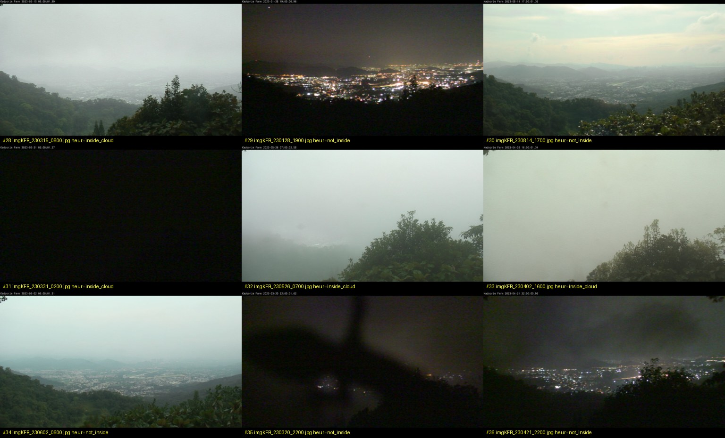
How the 111 photos were labeled
review_r5/grid_01–13.jpg — judged against the project rule, then used as human overrides
grid_01
grid_02
grid_03
grid_04
Label rule (same for day and night)
Day: washed-out textureless far field = inside; visible valley = not inside. Night: lightless flat frame = inside; any valley lights = not inside. Result: 57 inside / 54 not inside.
KFB Cloud Coverage
5 / 10

Slide 6
Date holdout — unseen 42,714 frames
GroupShuffleSplit 80/20 by YYMMDD · train-split fit, no full-data refit
Slice | n | Acc | P | R | F1 | Confusion [[TN,FP],[FN,TP]]
All test | 42714 | 97.8% | 0.843 | 0.996 | 0.913 | [[36926, 907], [19, 4862]]
Golden 2016 | 46 | 93.5% | 0.700 | 1.000 | 0.824 | [[36, 3], [0, 7]]
R5 hourly seed | 1636 | 96.9% | 0.728 | 0.977 | 0.834 | [[1460, 47], [3, 126]]
111 on test dates | 20 | 75.0% | 0.688 | 1.000 | 0.815 | [[4, 5], [0, 11]]
Train (ref.) | 129629 | 96.9% | 0.819 | 0.977 | 0.891 | [[109314, 3613], [393, 16309]]
d413d74, same test | 42714 | 98.0% | 0.856 | 0.996 | 0.921 | [[37018, 815], [19, 4862]]
Read this carefully
Recall 0.996 on 42,714 unseen-date rows. Accuracy is tied with d413d74. Heuristic slices restates the rules that labeled most of the train set — trust golden and 111.
KFB Cloud Coverage
6 / 10

Slide 7
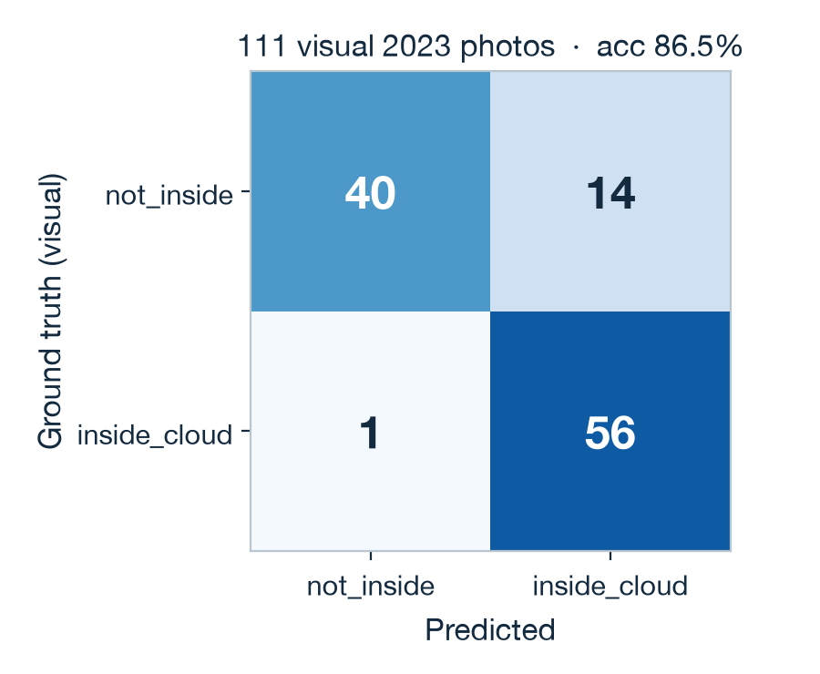
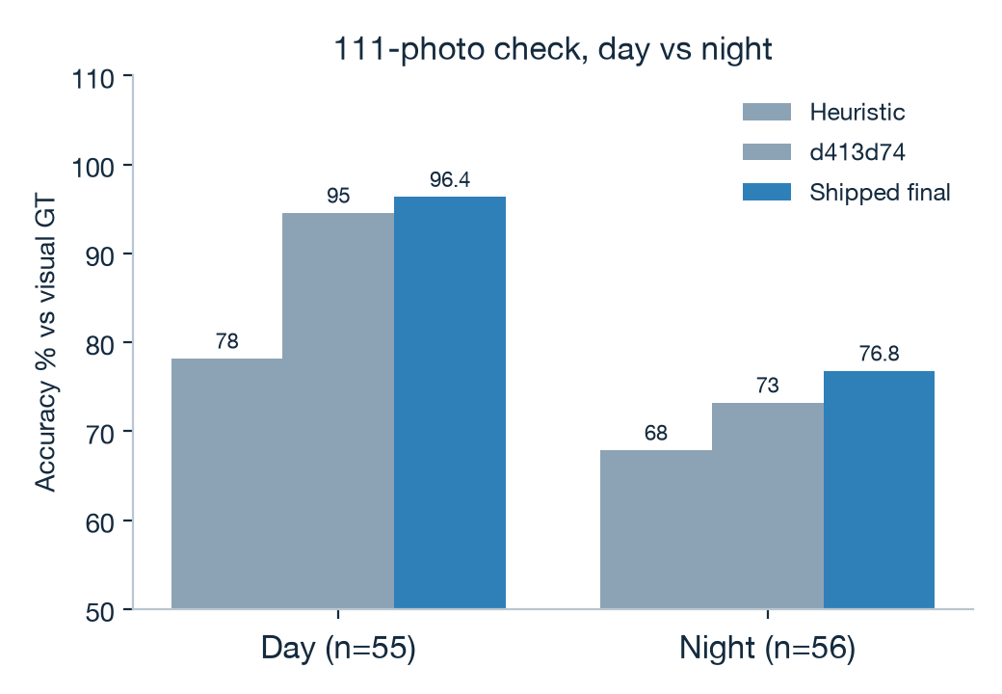
111 visual 2023 photos
Human overrides in the date split. Best 2023 eye-check we have.
Predictor | n | Acc | Prec | Recall | F1
Heuristic rules | 111 | 0.730 | 0.746 | 0.719 | 0.732
Previous d413d74 | 111 | 0.838 | 0.783 | 0.947 | 0.857
Combined final | 111 | 0.865 | 0.800 | 0.983 | 0.882
Final · day | 55 | 0.964 | 0.943 | 1.000 | 0.971
Final · night | 56 | 0.768 | 0.657 | 0.958 | 0.780
Final · 20 test dates | 20 | 0.750 | 0.688 | 1.000 | 0.815
KFB Cloud Coverage
7 / 10

Slide 8
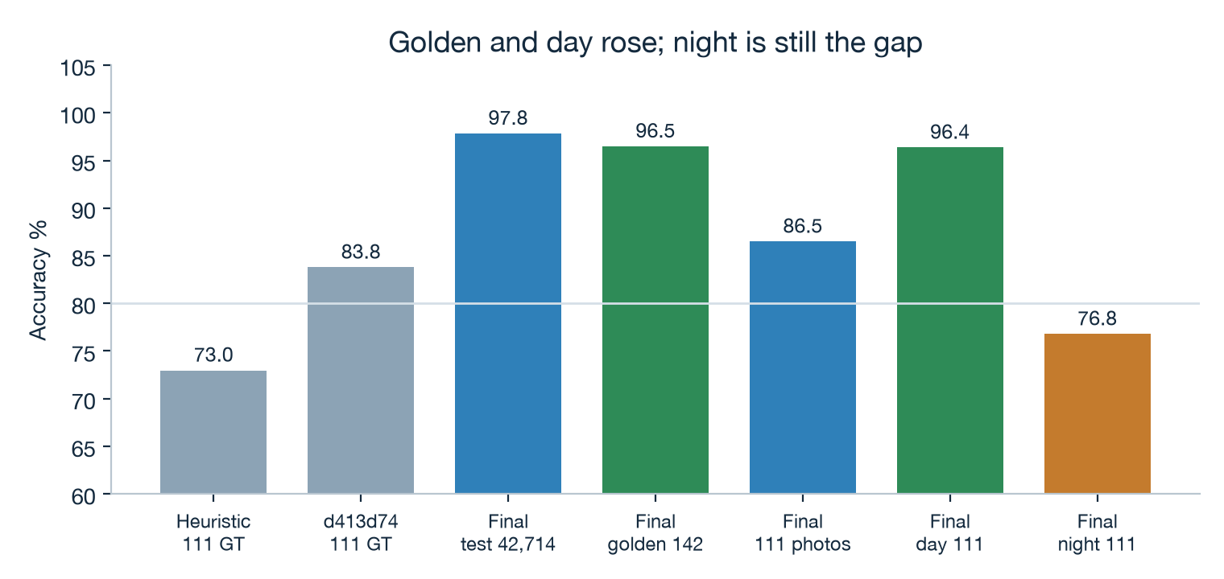
Day is the operational win — night is still the gap
111-photo split: 55 day / 56 night.
What changed
• Day 94.5% → 96.4%.
• Night 73.2% → 76.8% (precision 0.66).
• 111 overall 83.8% → 86.5% vs rules 73.0%.
• 20 held-out dates: 75.0% vs d413d74 70.0%.
Night faint-light false alarms remain the process debt.
KFB Cloud Coverage
8 / 10

Slide 9
Where it still fails — and what to change
Minutes plus visual overrides lifted day. Night precision is still the debt.
What improved
• 111-photo 83.8% → 86.5% vs rules 73.0%
• Recall 0.98 — one missed inside-frame vs 3 / 16
• Day 96.4% · night 76.8%
• Golden-all 2016 95.1% → 96.5%
What did not
• Night precision still 0.66
• 20 held-out 111 dates: 75% — small n
• USB minutes die 22 Apr — no May–Dec 1-minute coverage
• Heuristic seed still dominates most train labels
Next process steps (in order)
1. Hold the 111 fully out of the next fit. 2. Re-label night + borderline fog at full resolution. 3. If another USB year appears, extract it — keep date-balance.
KFB Cloud Coverage
9 / 10

Slide 10
Takeaways for this update
Shipped
combined final
Same JSON in models/ and docs/. Live Pages + Flask + CLI.
Train rows
172,343
Unique frames. Human overrides heuristic. Date-balanced.
Holdout
97.8%
42,714 unseen-date rows. Tied with d413d74.
111 visual
86.5%
Day 96.4% · night 76.8%.
One-sentence process update
Every unique labeled KFB frame is now in the model, weighted so a January minute does not count more than a November hour, and so 253 human rows still speak. Unseen dates score 97.8% against seed labels and 86.5% against visual photos. Night labeling is still the next process.
One photo, one answer: is the cloud base above or below 150 metres?
KFB Cloud Coverage
10 / 10

