Slide 1
Road Crash Project
- Singyoung Sun
- Rania Sandhu
- Tahmid Eshayat
- Matthew Lee

Slide 2
Introduction
Project overview
Background
Feature of interest
Method
overview
Modelling methodology
Results
Summary and development
Notes:
30 seconds- has to be comprehensive and succinct

Slide 3
Project overview - background
Road crash datasets from 2017 to 2018 retrieved from South Australian government
Aims to identify most significant features to explain the outcome of being fatal in road accidents

Slide 4
Project overview -features of interest
After data cleansing we have 130 feature columns
Features used in the data set:
Numerical variable include age, area, speed, occupant, number of occupants
Categorical variables include time, casualty type, seat belt, weather condition, traffic controls …
Label - “Fatal” or “not fatal”

Slide 5
Method -overview
Data preprocessing
Data cleansing
Data visualization
Feature selection
Model training

Slide 6
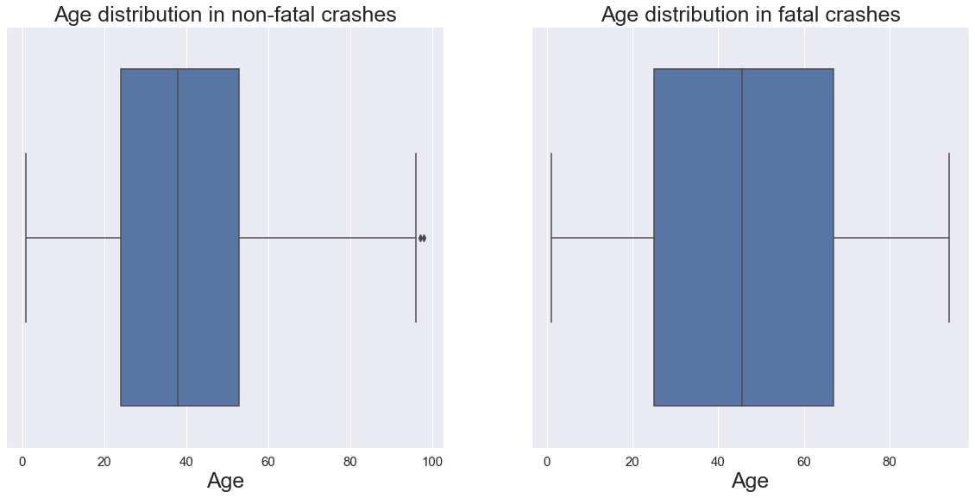
Age Distribution - Data visualization

Slide 7
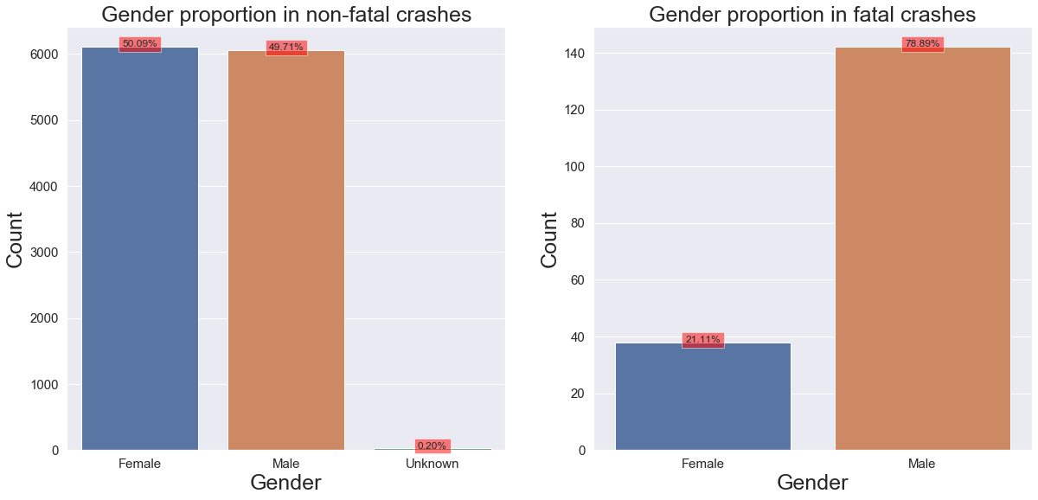
Gender Proportion - Data visualization

Slide 8
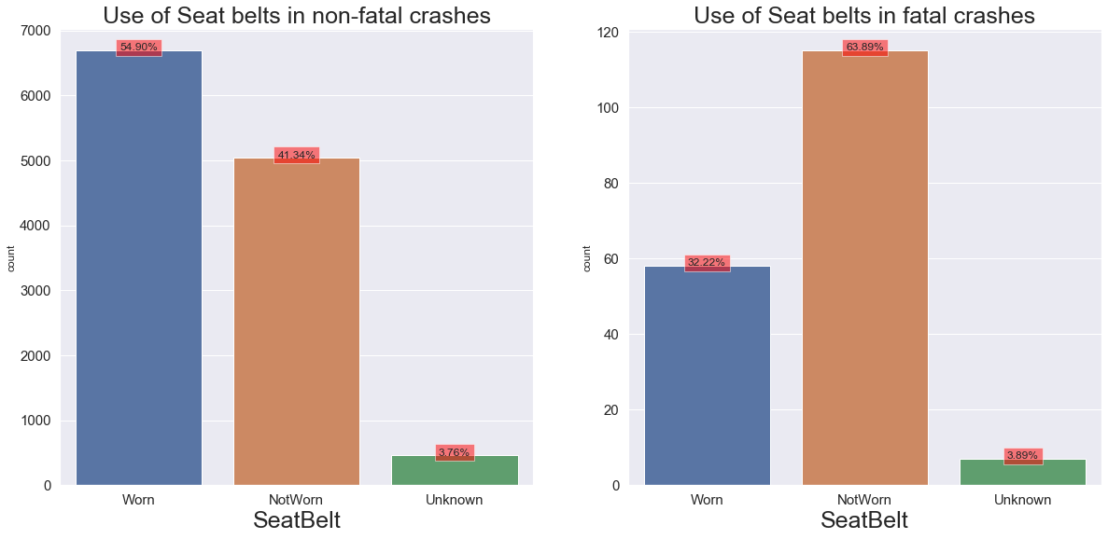
Seat belts - Data visualization

Slide 9
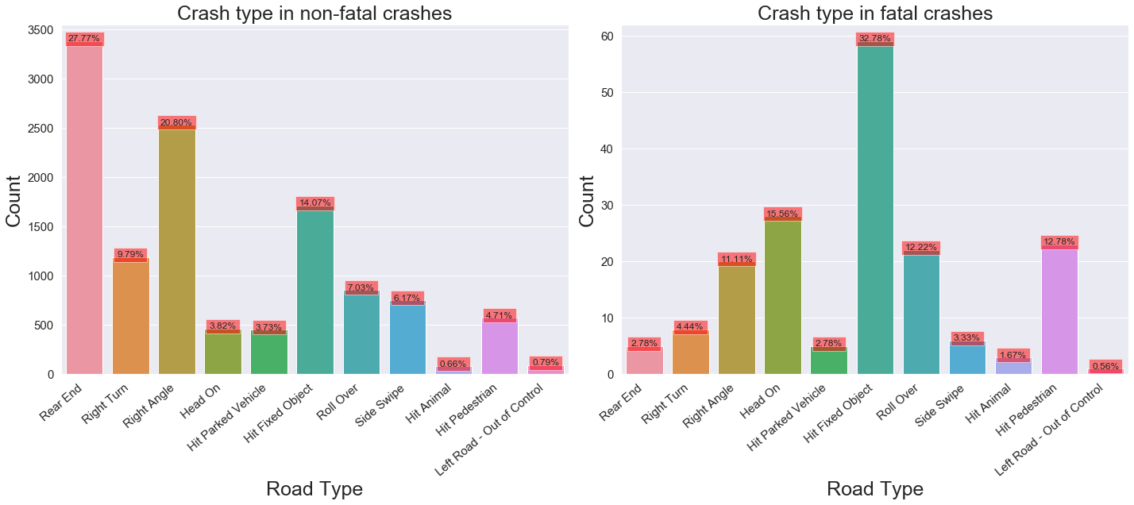
Crash Type - Data visualization

Slide 10
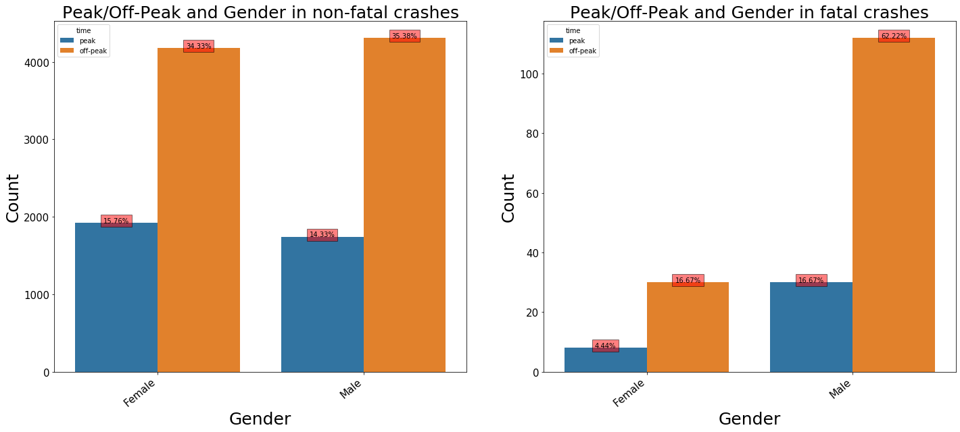
Peak/Off-Peake - Data visualization

Slide 11
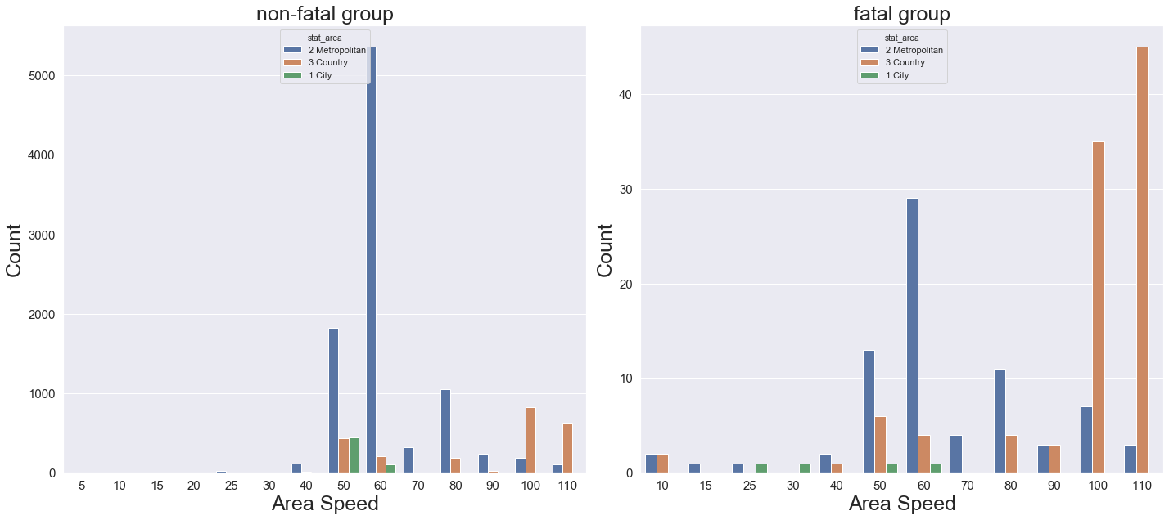
Fatal/Non-Fatal - Data visualization

Slide 12
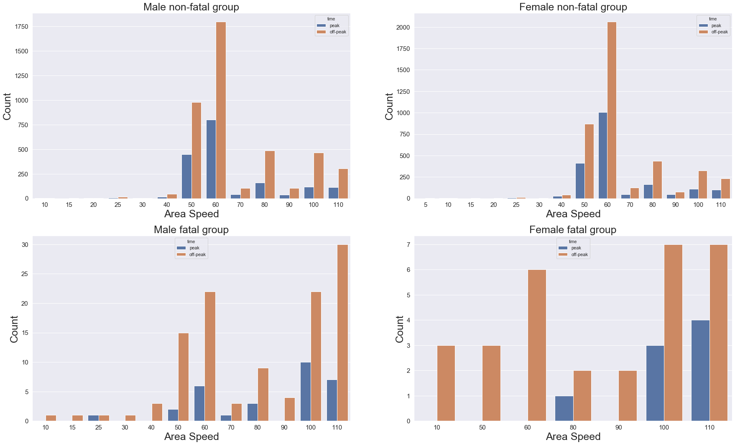
Data visualisation

Slide 13
Methodology
Dataset
Training phase
GridSearchCV
Stratified Kfold
RFE
Logistic
75% Train set
Upsampling
Split Train test
Downsampling
MLP
Test Performance
RUS boosting
25% Test set

Slide 14
RFE result
Rank | Logistic | Decision Tree | Random Forest | RUSBoost
1st | seat_belt_NotWorn | cas_age | cas_age | cas_age
2nd | cas_pos_in_veh_Driver | cas_total | area_speed | area_speed
3rd | crash_type_Rear End | area_speed | cas_total | thrown_out_Not Thrown Out
4th | area_speed | total_units | total_units | crash_type_Head On
5th | cas_gender_Male | unit_type_Medium | n_occupants | crash_type_Hit Fixed Object

Slide 15
Test set performance
Model | Resampling | Correct non-fatal class prediction | Correct fatal class prediction | ROC_AUC Score | Kappa
Logistic | Down | 48.03% | 95.56% | 71.79% | 2.38%
Logistic | Up | 84.18% | 60.00% | 72.09% | 7.27%
MLP | Down | 52.76% | 86.67% | 69.71% | 2.36
MLP | Up | 98.23% | 15.56% | 56.89% | 11.73%
Rusboosting | Down | 82.11% | 77.78% | 79.94% | 8.73%

Slide 16
Interpretation
Significant feature | Feature importance | Predicted class | Sample size
Age | 26.00% | Fatal | 12321
Area speed | 8.67% | Fatal | 12321
Head On collision | 7.67% | Fatal | 493
Hit Parked Vehicle | 4.67% | Non-fatal | 459
Crossing without Control | 4.00% | Fatal | 276
Hit Fixed Object | 3.00% | Fatal | 1773

Slide 17
Conclusion
Crashes with older aged occupants, taken place at high speed areas, associated with head on collisions, and hitting fixed objects would have a greater chance to be fatal in road accidents
Recommendations
Additional features:
1. health condition
2. total number of driving hours
3. GPS
4. Regrouping levels

