Slide 1
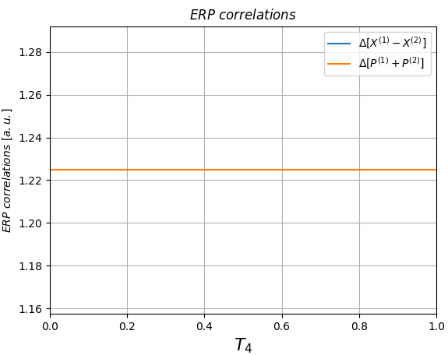

|1> + |1>, phase = 0 pi, detection=NONE.
|1> + |1>, phase = 0.25 pi, detection=FIRST.
The result doesn't depend on phase.

