Slide 1
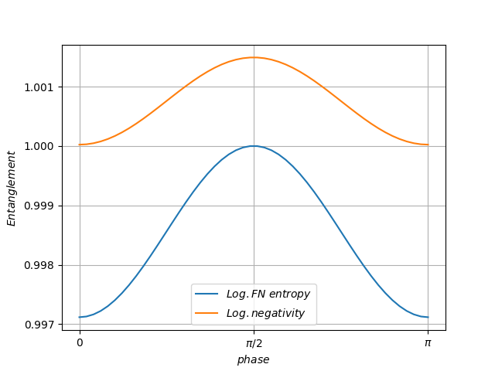
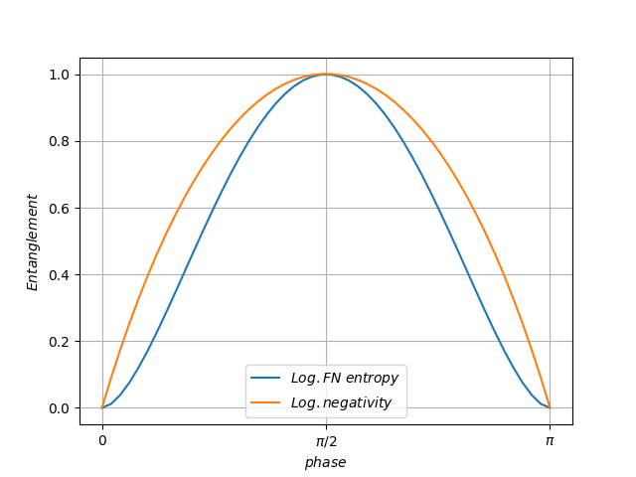
T2 = 0.01
T2 = 0.5
T2 = 0.99
Coherent + single photon.
2BS, varying phase.

Slide 2
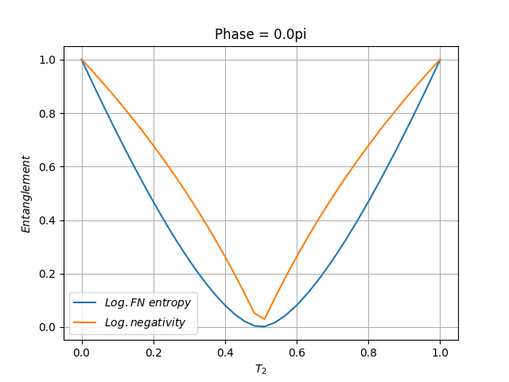
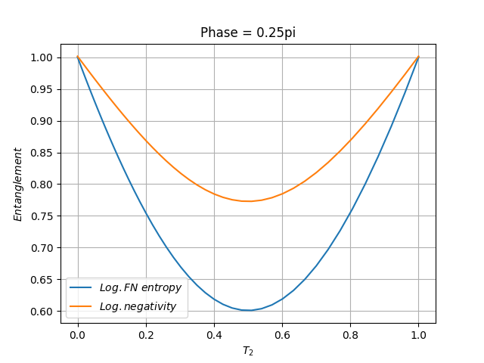
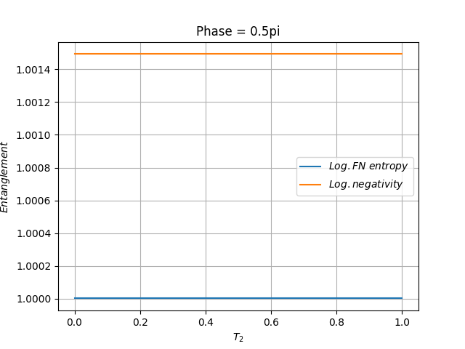
Coherent + single photon.
2BS, varying T2.

Slide 3
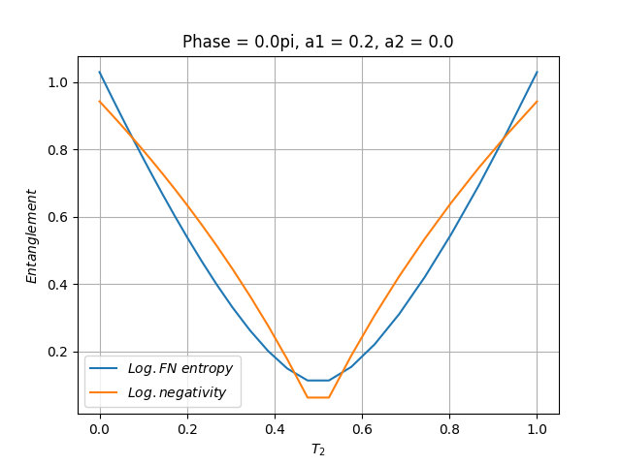
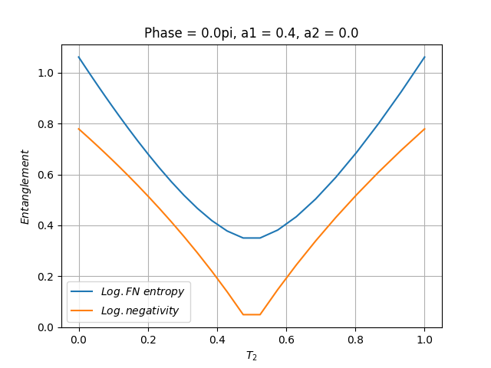
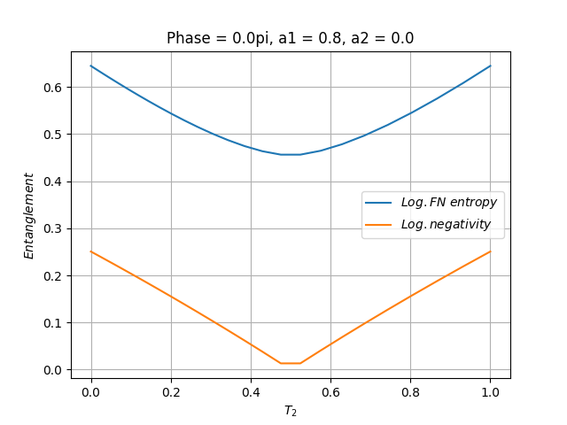
Coherent + single photon.
2 symmetrical BS with absorption, varying a1, a2 = 0.

Slide 4
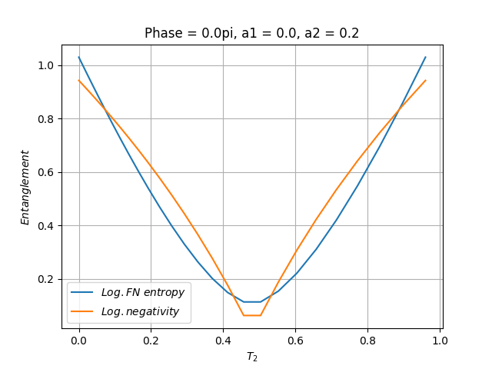
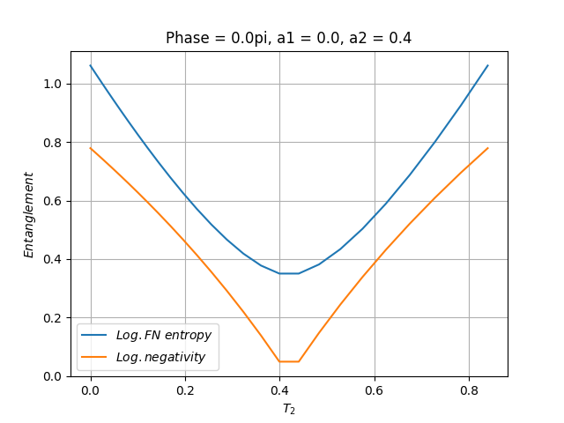
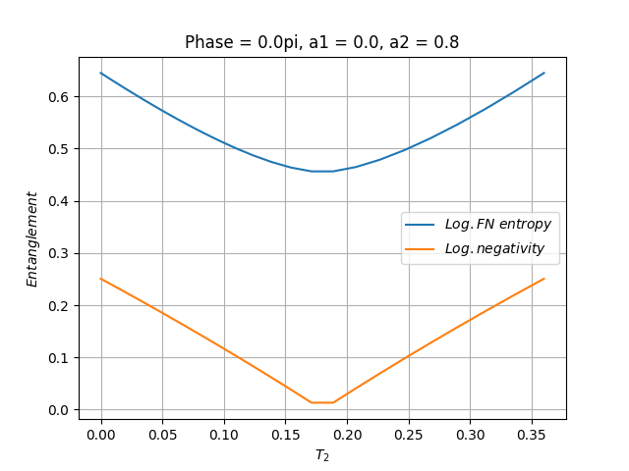
Coherent + single photon.
2 symmetrical BS with absorption, varying a2, a1 = 0.

