Slide 1
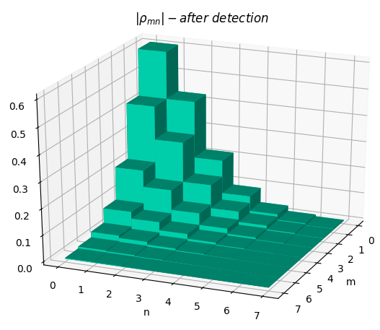
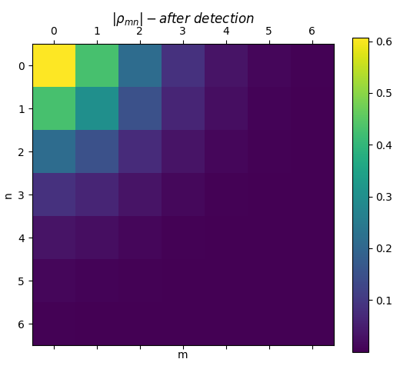
1) Two coherent states as an input.
Everywhere only one detector is clicked.
One channel traced dens. matrix after detection.

Slide 2
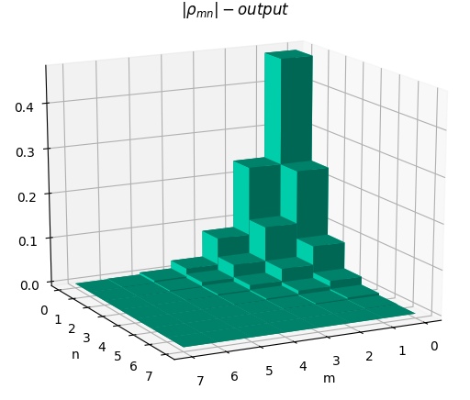
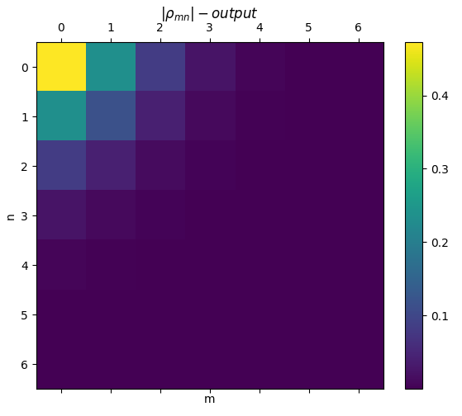
One channel traced dens. matrix after last beam splitter.

Slide 3
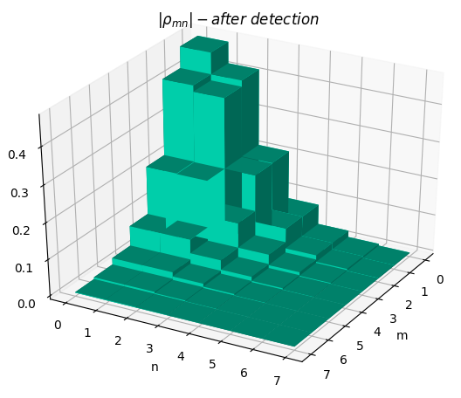
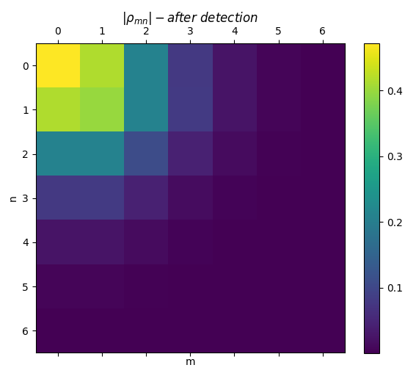
2) Coherent state and a single photon as an input.
One channel traced dens. matrix after detection.

Slide 4
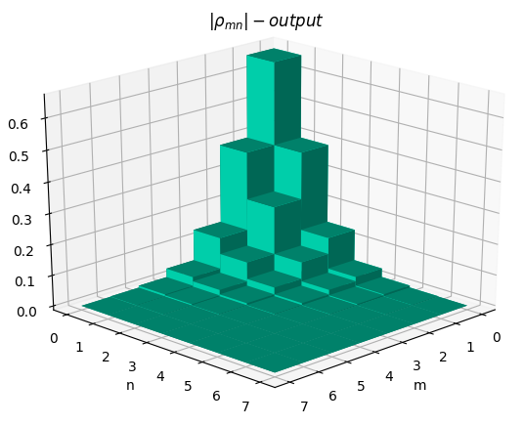
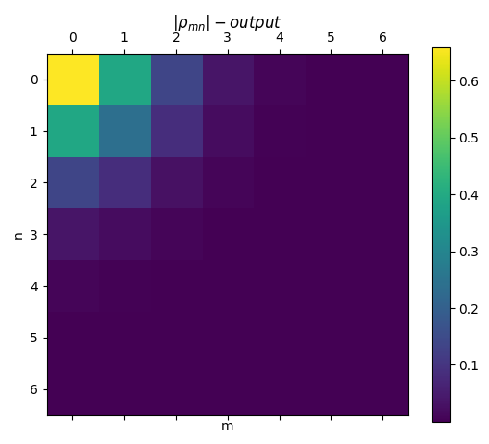
One channel traced dens. matrix after last beam splitter.

