Slide 1
Nonlinear transformations of quantum light.
Ph.D. Student Riabinin Matvei
Supervisers:
J.-Prof. Dr. Polina Sharapova
Prof. Dr. Torsten Meier
University of Paderborn.

Slide 2
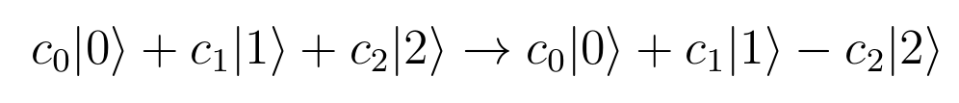
Motivation.
Stydying non linear transformations of quantum light, applying non-unitary operators.
Such transformations could be achived by applying detection.

Slide 3
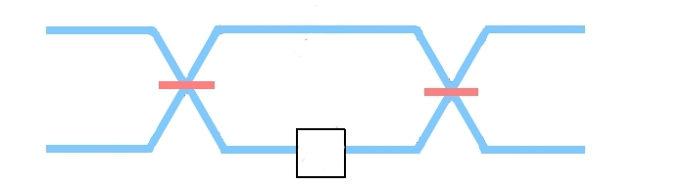
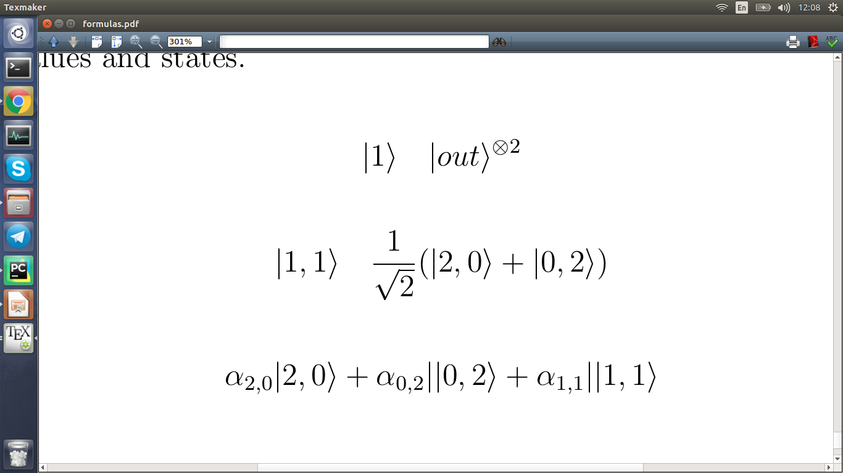
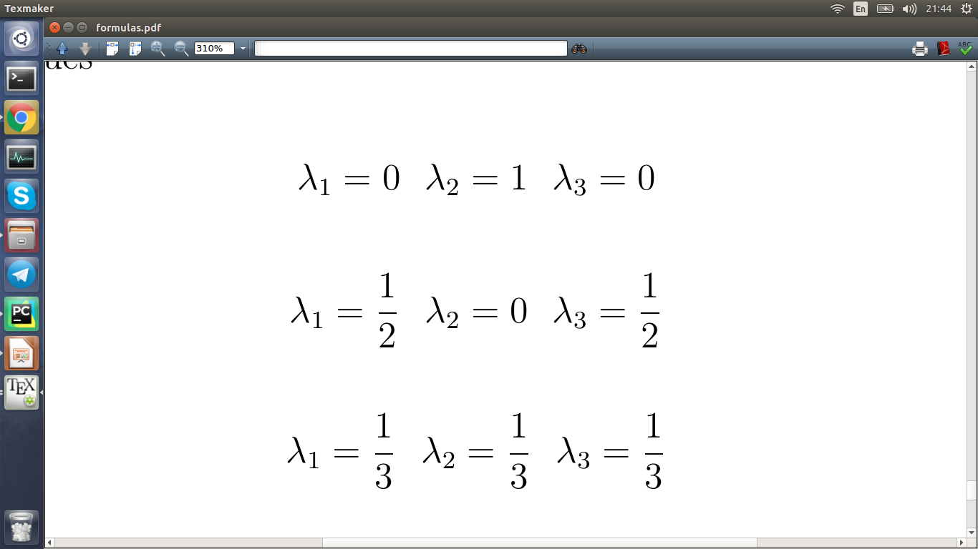
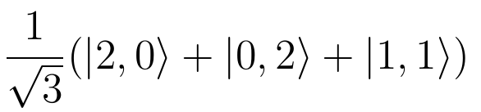
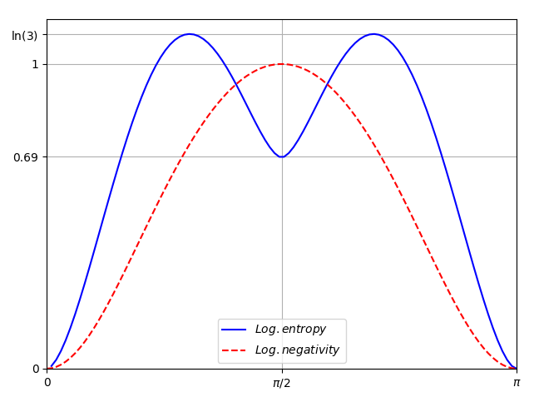
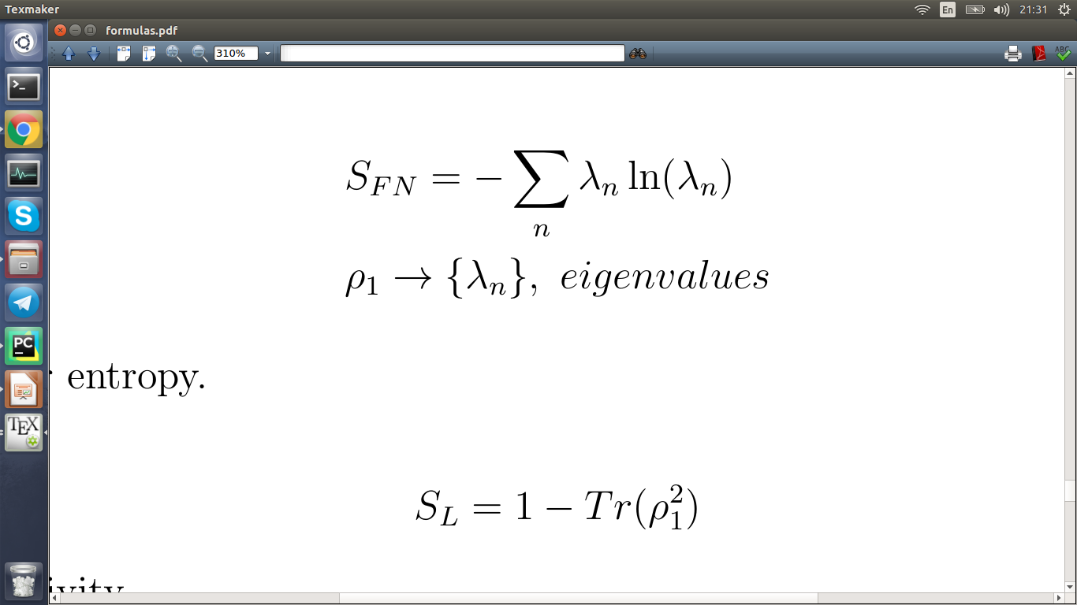
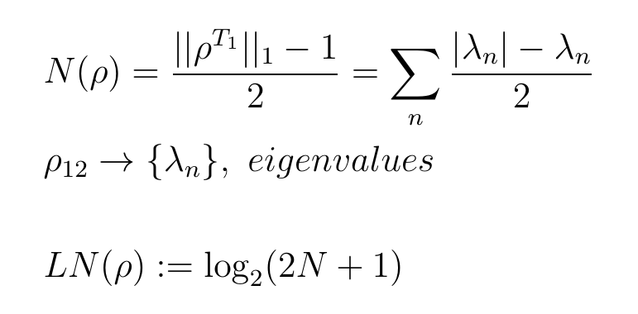
Simple setup.
phase modulation
Δφ

Slide 4
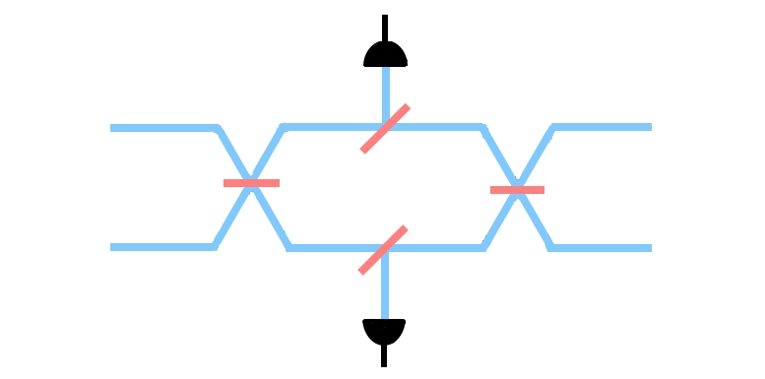
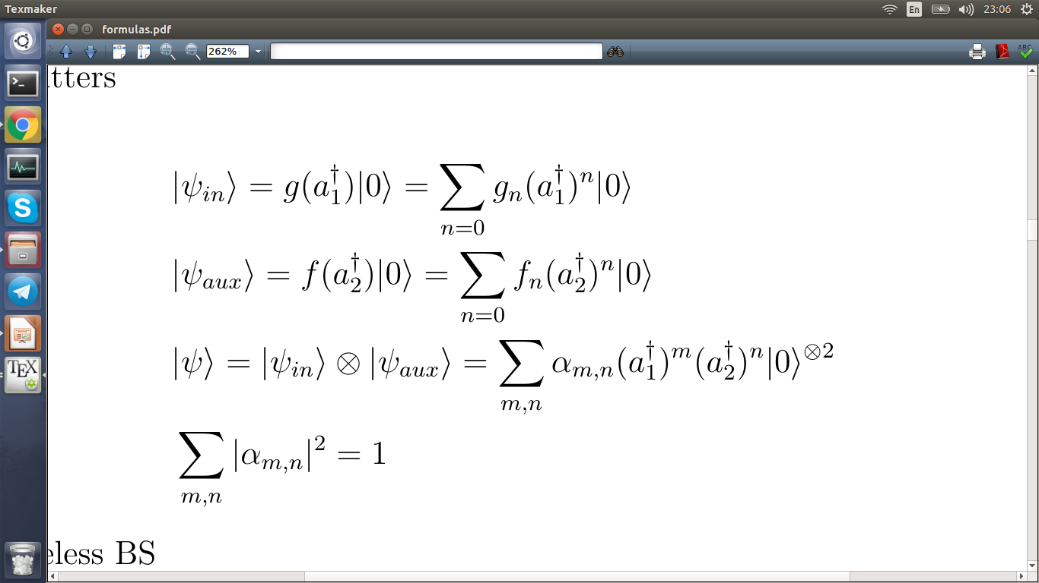
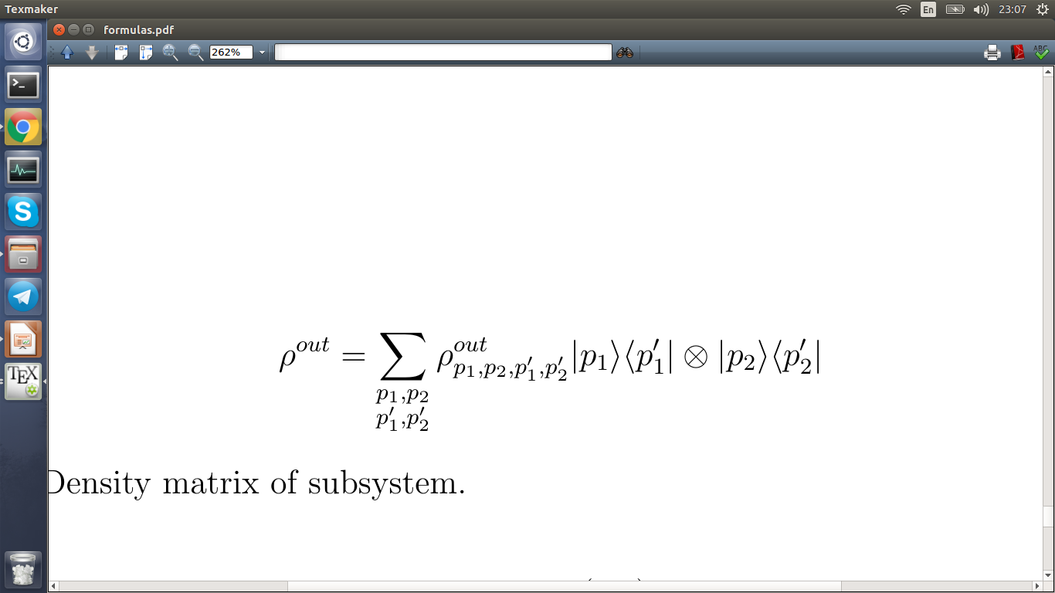
Scheme with detection.
D3
t3:r3
Δφ
t1:r1
t4:r4
t2:r2
D1

Slide 5
Theoretical approach.
- As an input for system there could be sent different quantum light states in two channels.

Slide 6
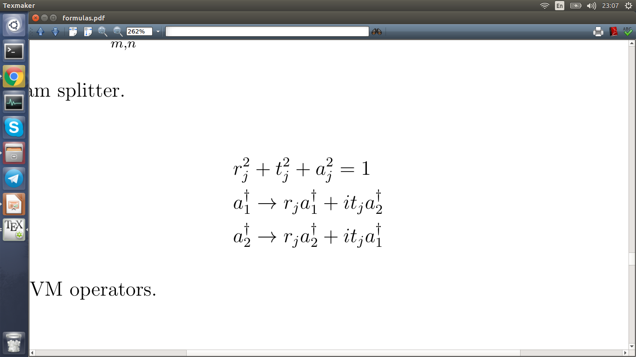
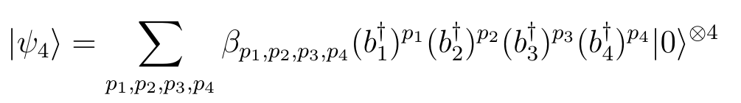
- Mutual state is transformed at beam splitter:
- After transformation at first, second and third BS, the state in 4 channels will look like this:

Slide 7
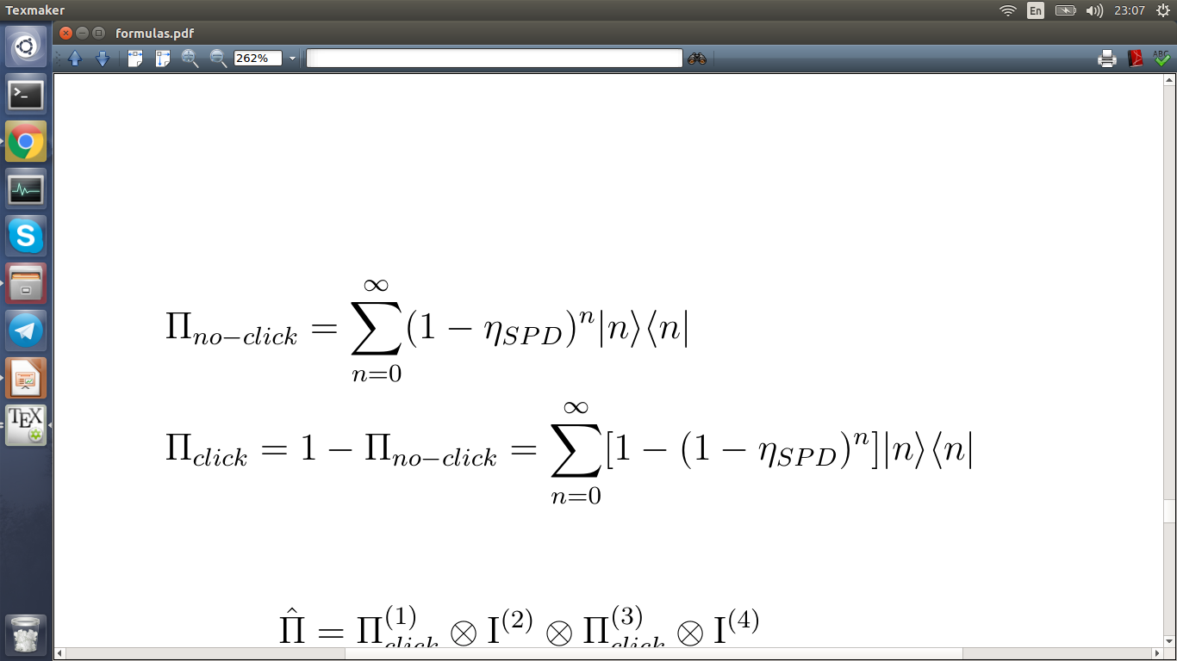
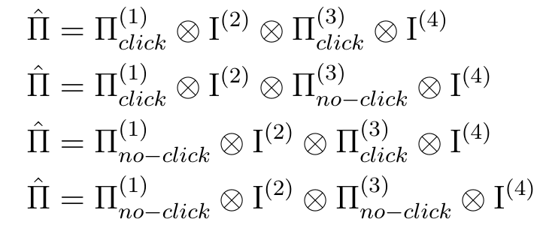
Detection.
- Detection is described in terms of POVM operators.
- Four possibilities of detectors behaviour in total.
- both are clicked.
- first is clicked, third is silent.
- first is silent, third is clicked.
- both are silent.

Slide 8
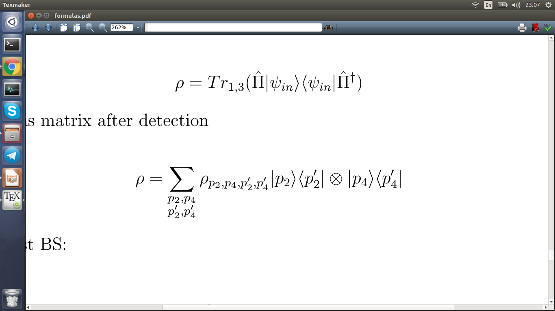
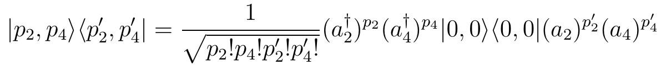
- After detection state is collapsed into density matrix:
- Density matrix is transformed at last beam splitter:
- And transform operators:

Slide 9
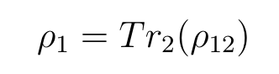
Entanglement.
- Output is found in terms of density matrix for two channels:
- Information about subsystem represented by reduced density matrix:

Slide 10
Von Neumann entropy.
Linear entropy.

Slide 11
Negativity.

Slide 12
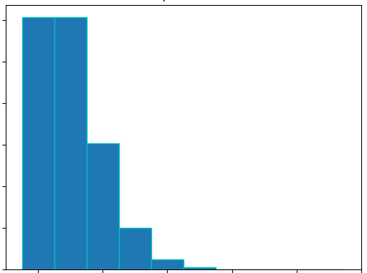
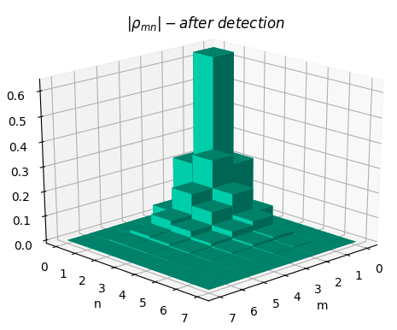
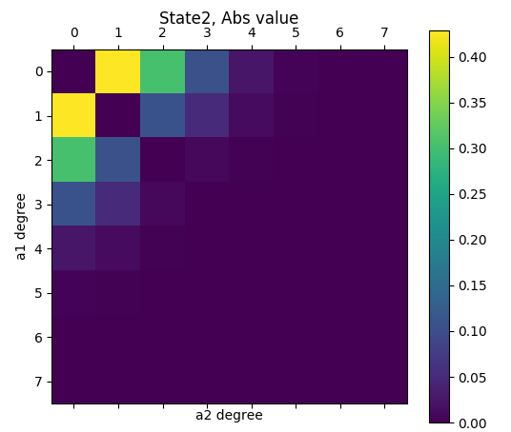
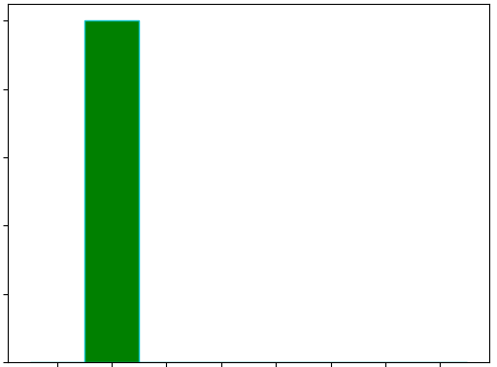
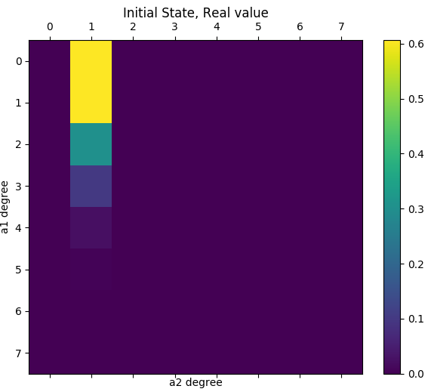
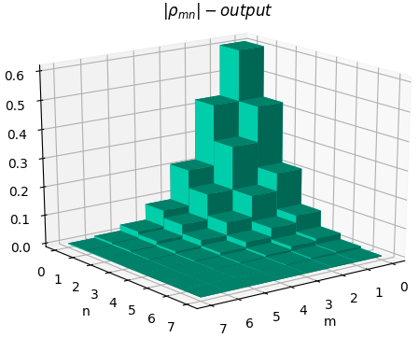
Scheme of calculation.
Coher .
state.
BS1.
Detection.
Single photon.
Last BS.
calculate
entanglement

Slide 13
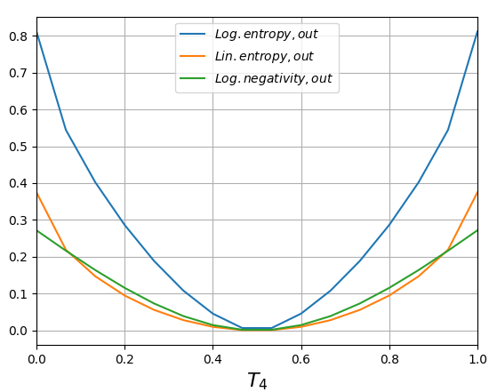
Entanglement.
As input there are coherent state with phot. number equals 1 and single photon. Considered that both detectors is clicked.
Δφ = 0

Slide 14
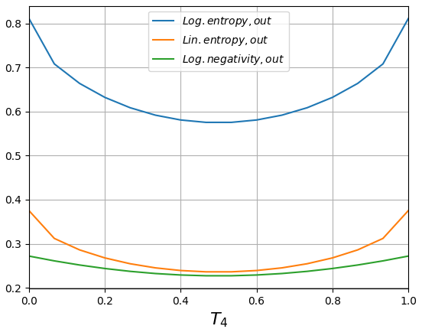
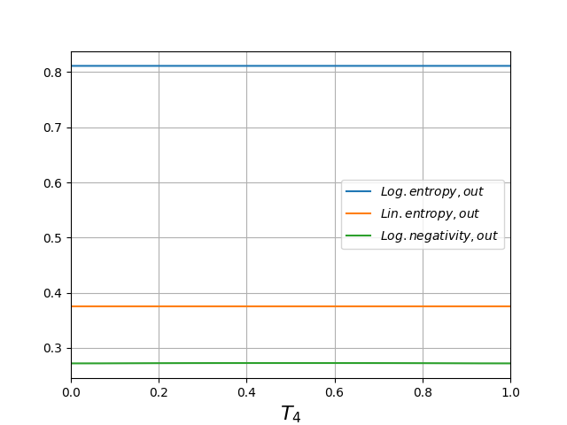
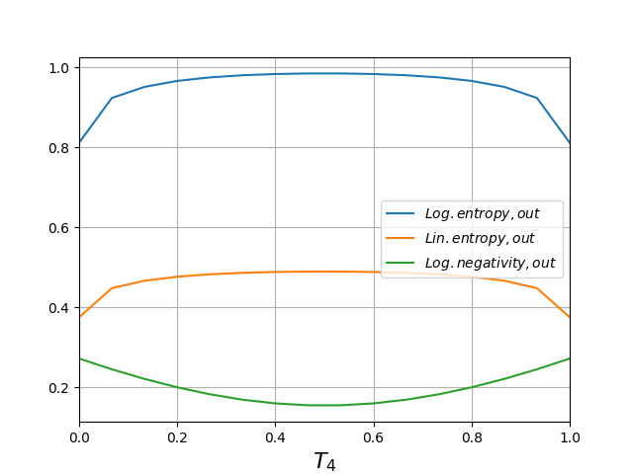
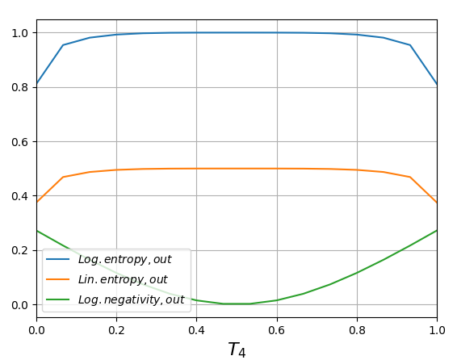
Δφ = 0.35π
Δφ = 0.5π
Δφ = 0.75π
Δφ = π
Δφ = 0.75pi

Slide 15
Δφ = 1.25π
Δφ = 1.5π
Δφ = 1.75π

