Slide 1
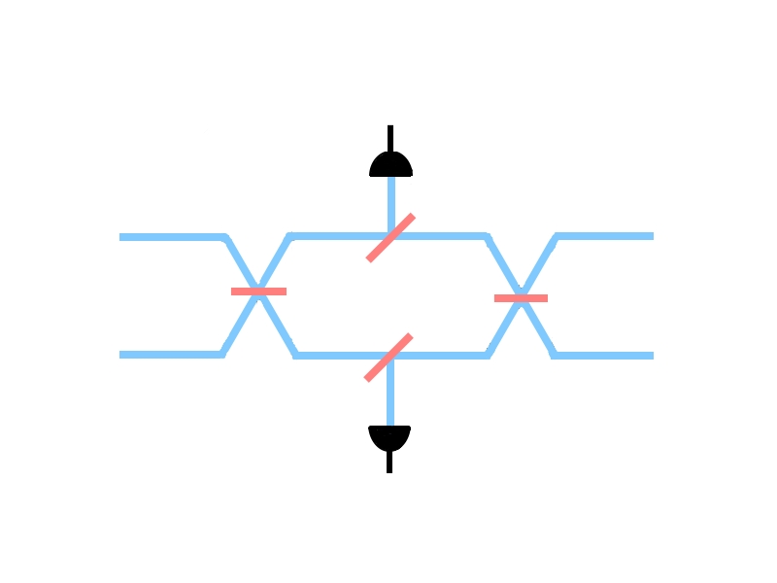
Setup.
det=THIRD
2
T3
Δφ
T4
1
T1
T2
det=FIRST

Slide 2
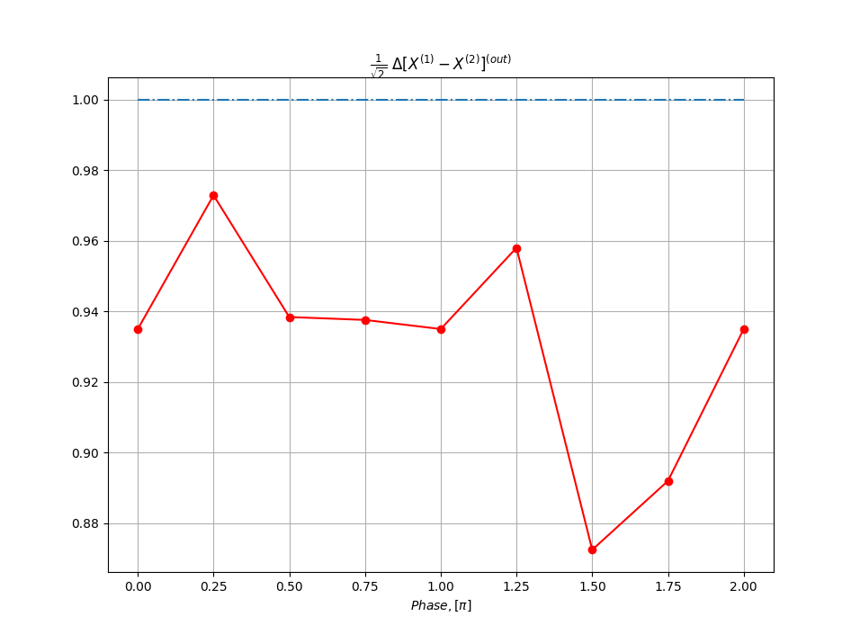
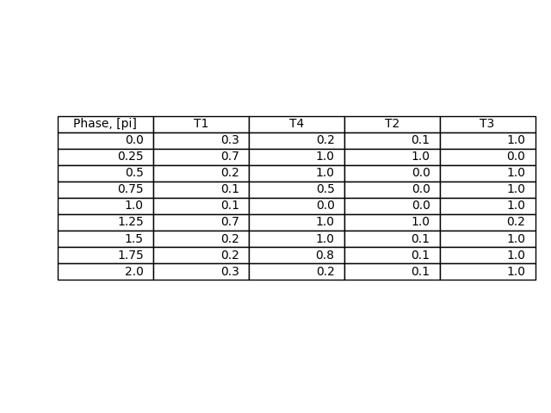
1. Single photon goes to the second(top) channel. Coherent state (alpha=1) goes to the first(bottom) channel. Third and only third detector clicks.
EPR[X] min values among all BS parameters.
Minimizing set of BS parameters.

Slide 3
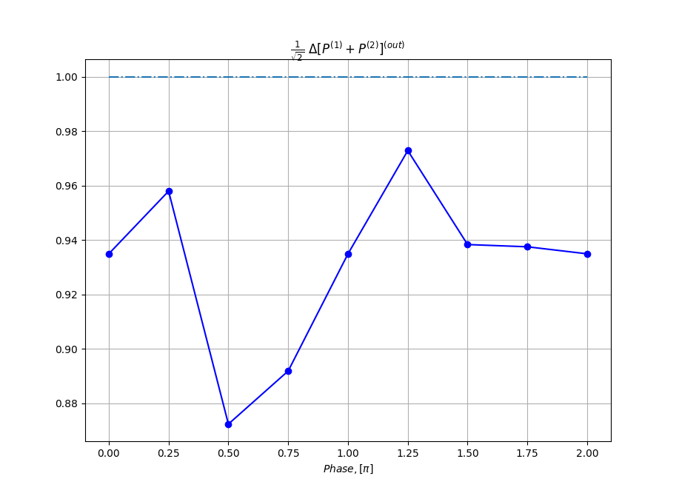

EPR[X] min values among all BS parameters.
Minimizing set of BS parameters.

Slide 4
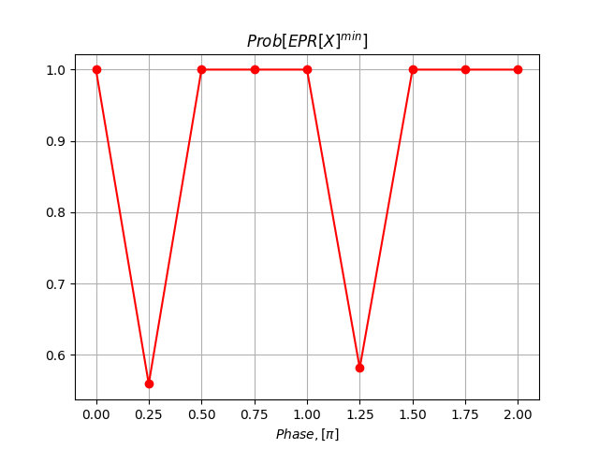
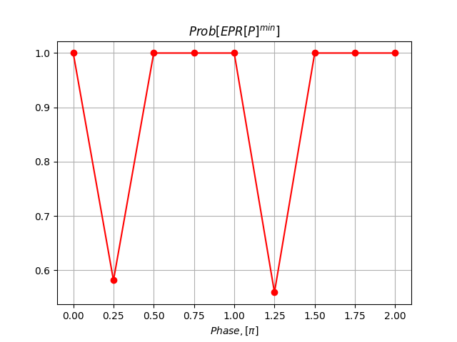
Probabilities for only third detector to click in case of EPR minimizing configuration form the previous slide.

Slide 5
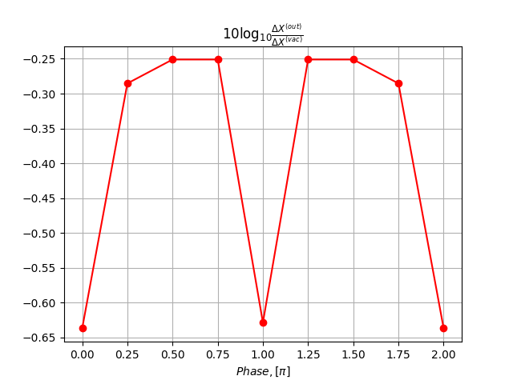

Max squeezing[X] over all parameters.
Minimizing set of BS parameters.

Slide 6
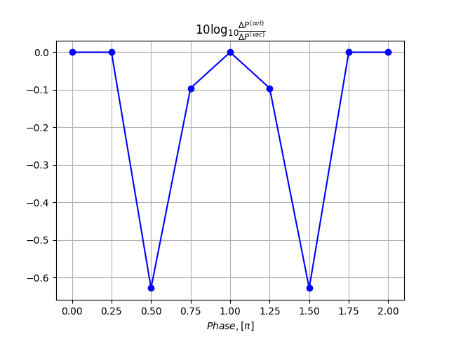

Max squeezing[P] over all parameters.
Minimizing set of BS parameters.

Slide 7
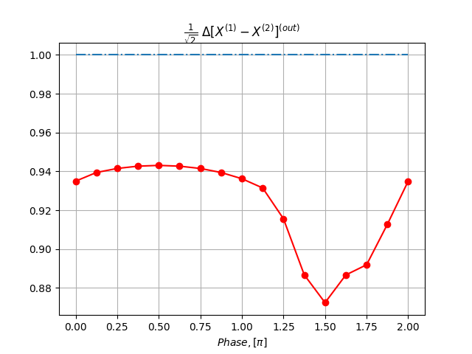
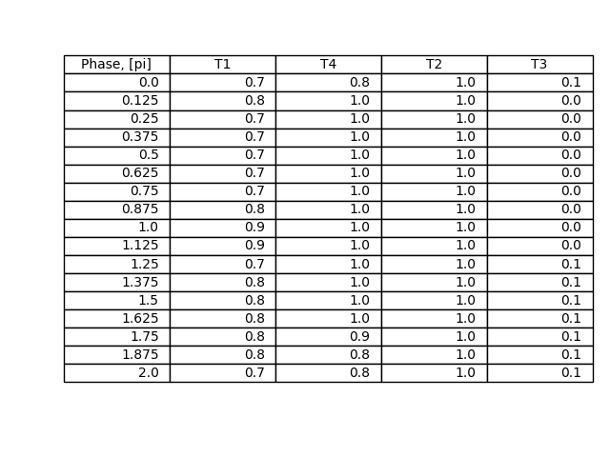
2. Single photon goes to the second(top) channel. Coherent state (alpha=1) goes to the first(bottom) channel. First and only first detector clicks.
EPR[X] correlations and minimizing parameters.

Slide 8
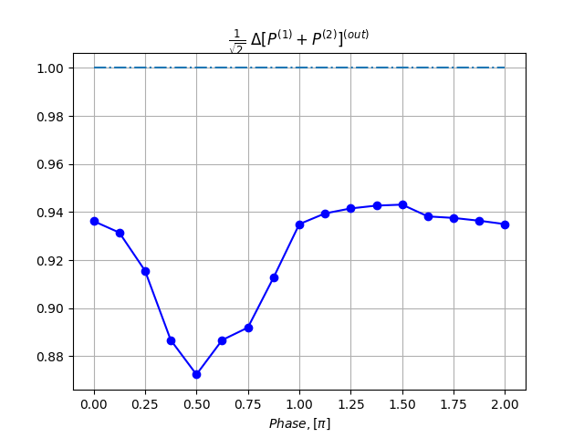
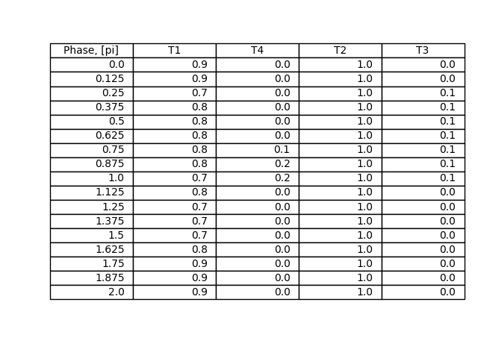
EPR[P] correlations and minimizing parameters.

Slide 9
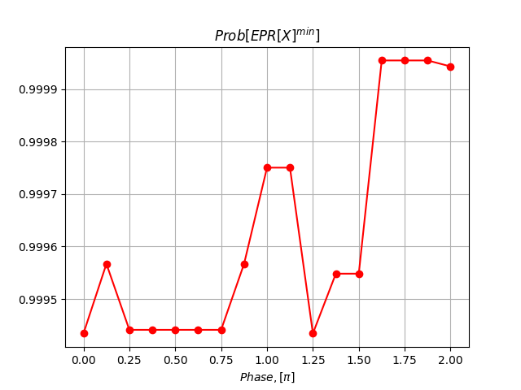
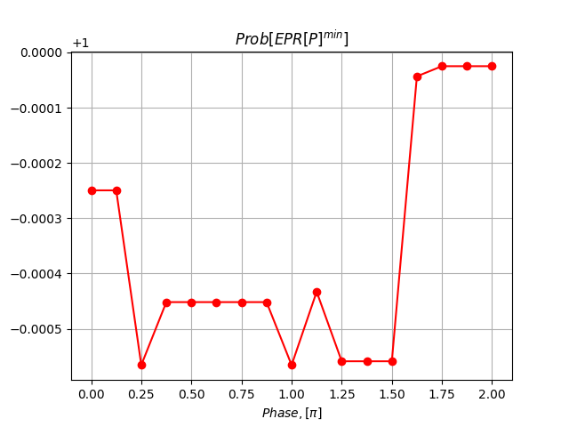
Probabilities for only first detector to click in case of EPR minimizing configuration form the previous slide.

