Slide 1
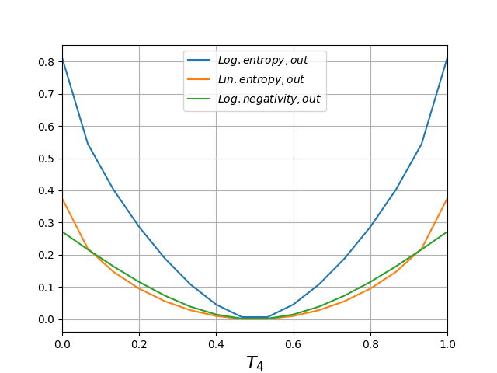
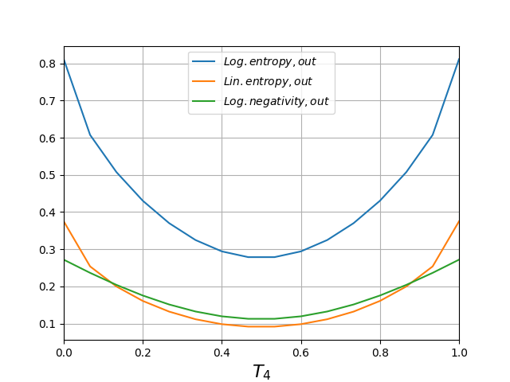
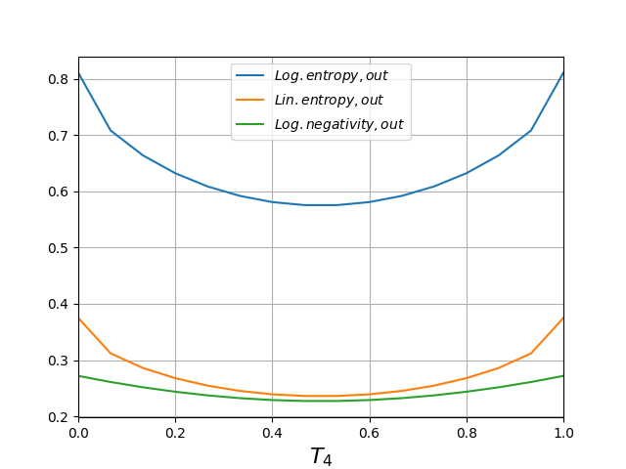
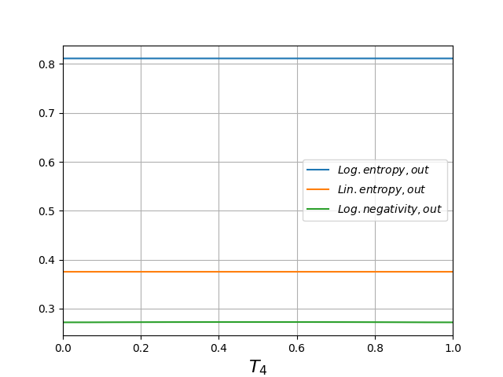
- Both detectors clicked, coher. atate and single photon.
Δφ = 0 π.
Δφ = 0.2 π.
Δφ = 0.35 π.
Δφ = 0.5 π.

Slide 2
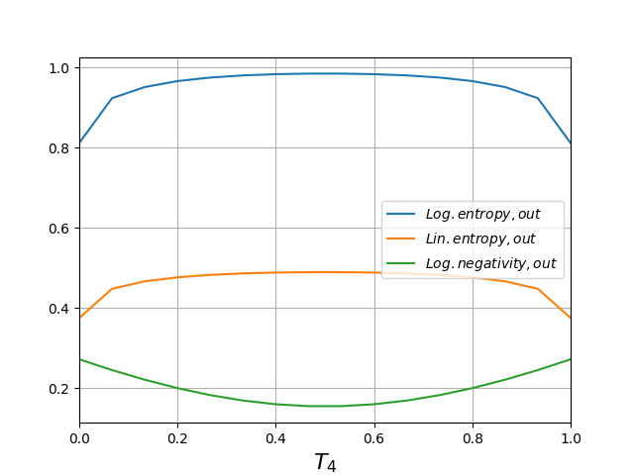
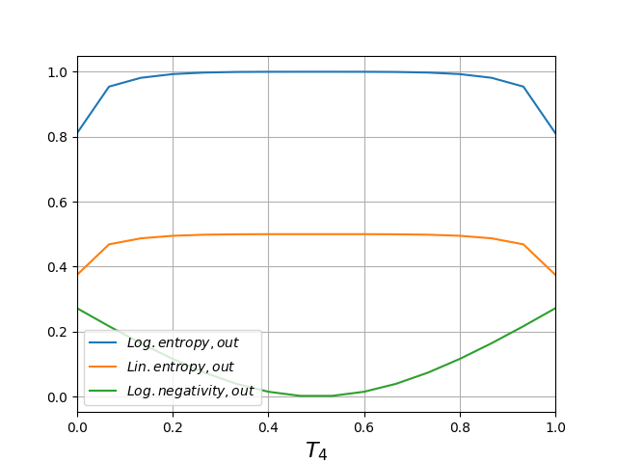
Δφ = 0.75 π.
Δφ = 1 π.
Δφ = 1.25 π.
Δφ = 1.5 π.

Slide 3
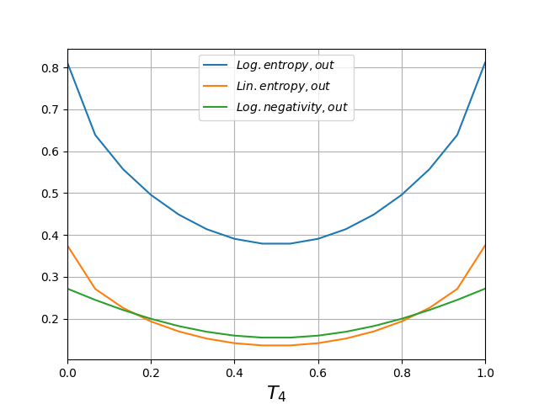
Δφ = 1.75 π.

