Slide 1
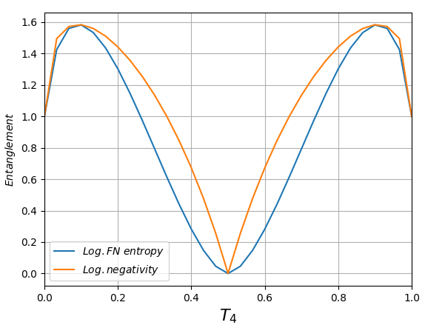
Single ph. + single ph., phase=0, detectors=NONE

Slide 2
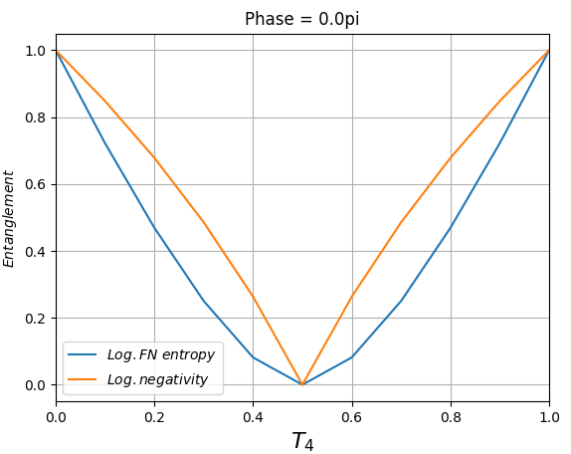
Single ph. + coher st.., phase=0, detectors=NONE

Slide 3
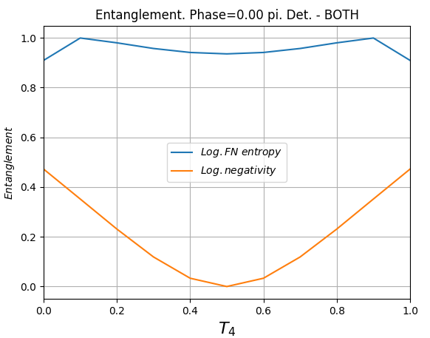
Single ph. + coher st.., phase=0, detectors=BOTH

Slide 4
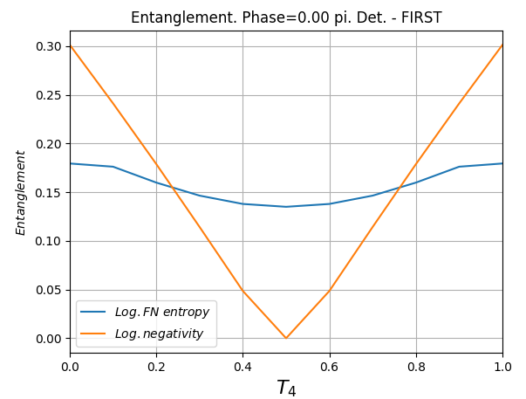
Single ph. + coher st.., phase=0, detectors=FIRST

Slide 5
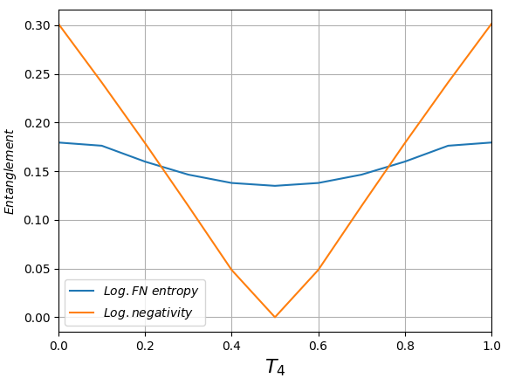
Single ph. + coher st.., phase=0, detectors=THIRD

