Slide 1
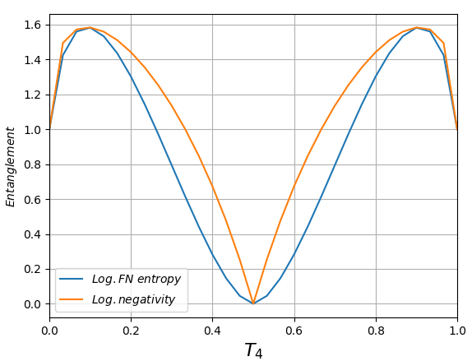
Single ph. + single ph., phase=0, detectors=NONE

Slide 2
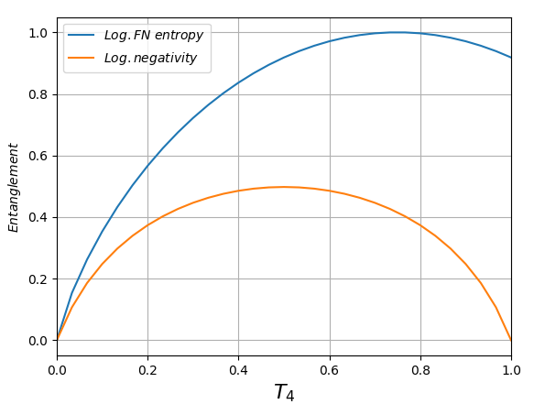
Single ph. + single ph., phase=0, detectors=FIRST

Slide 3
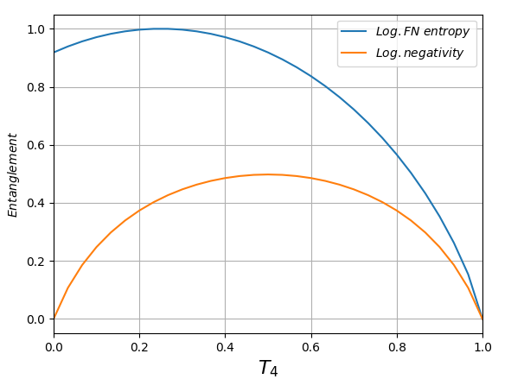
Single ph. + single ph., phase=0, detectors=THIRD

