Slide 1
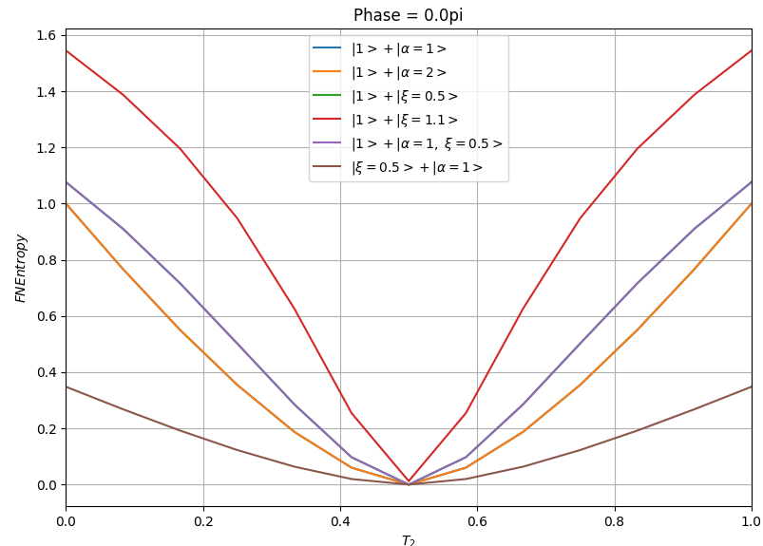
FN Entropy. Phase = 0.0 pi.

Slide 2
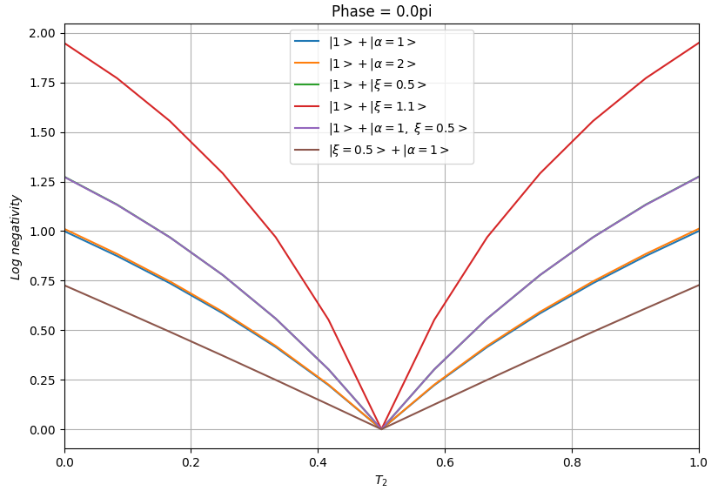
Log negatvity. Phase = 0.0 pi.

Slide 3
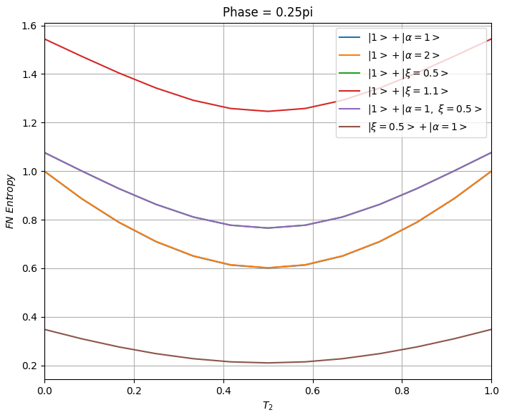
FN Entropy. Phase = 0.25 pi.

Slide 4
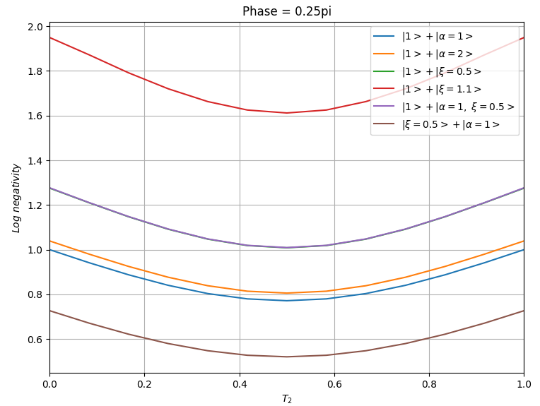
Log negatvity. Phase = 0.25 pi.

Slide 5
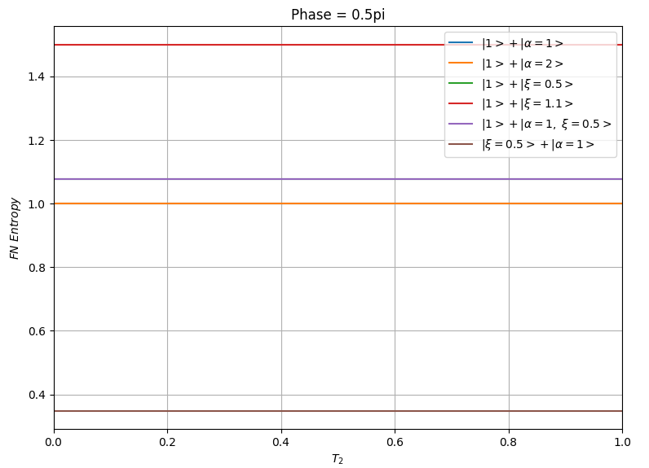
FN Entropy. Phase = 0.5 pi.

Slide 6
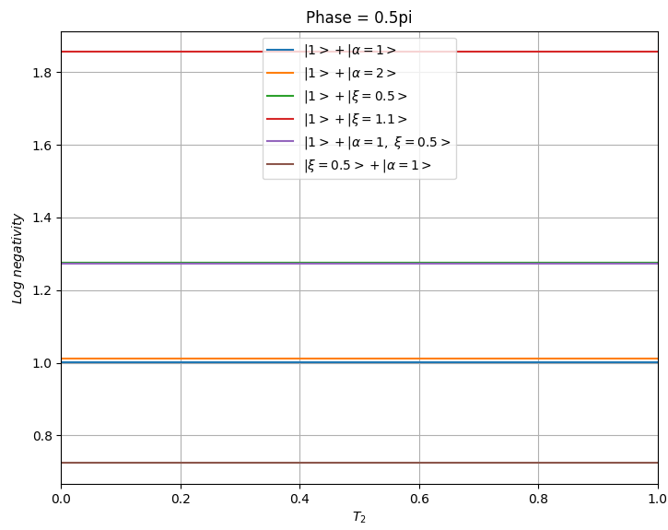
Log negatvity. Phase = 0.5 pi.

