Slide 1
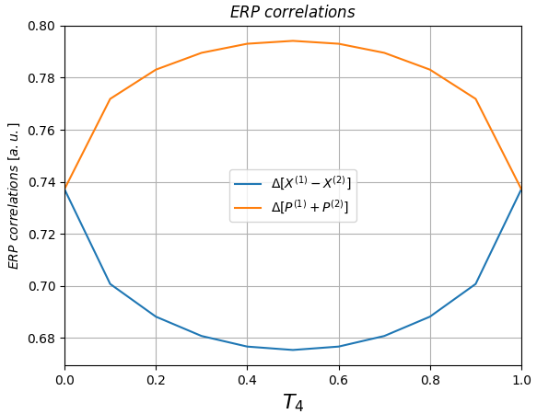
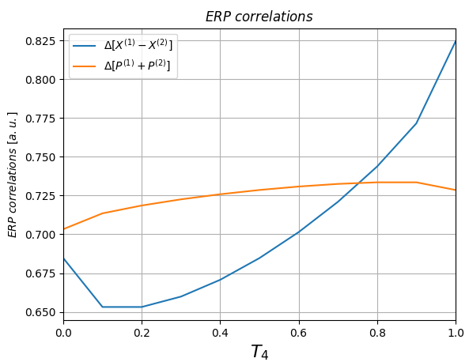
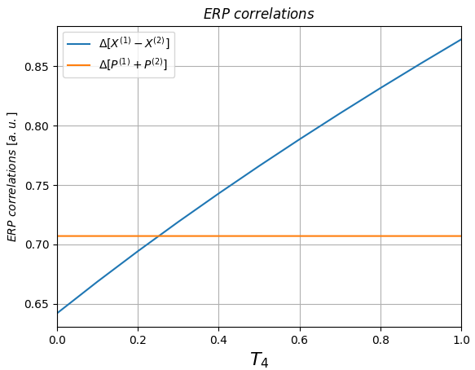
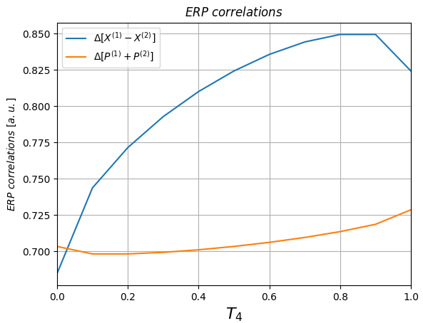
|1> + |alpha=1>, phase = 0 pi, detection=FIRST.
|1> + |alpha=1>, phase = 0.25 pi, detection=FIRST.
|1> + |alpha=1>, phase = 0.5 pi, detection=FIRST.
|1> + |alpha=1>, phase = 0.75 pi, detection=FIRST.

Slide 2
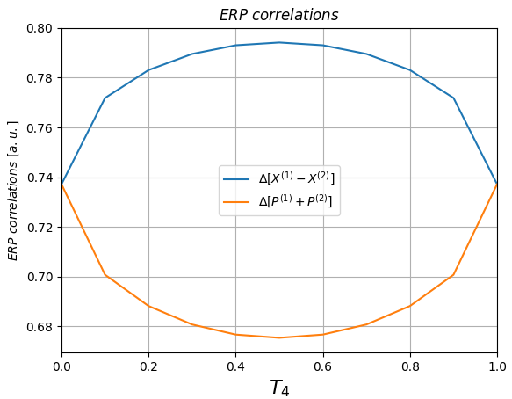
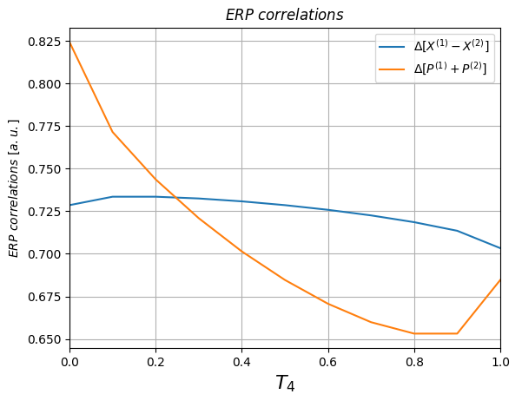
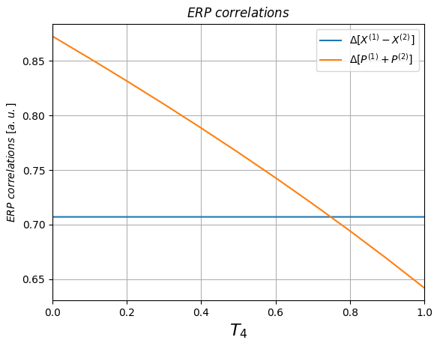
|1> + |alpha=1>, phase = 1.0 pi, detection=FIRST.
|1> + |alpha=1>, phase = 1.25 pi, detection=FIRST.
|1> + |alpha=1>, phase = 1.5 pi, detection=FIRST.

