Slide 1
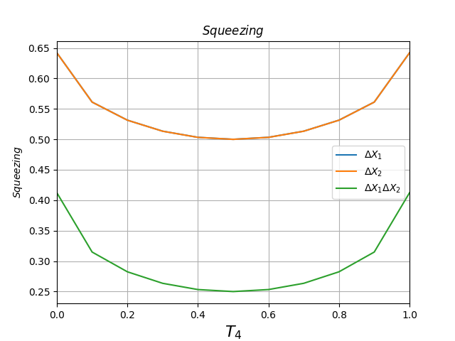
|1> + |alpha=1>, phase = 0 pi, detection=BOTH.

Slide 2
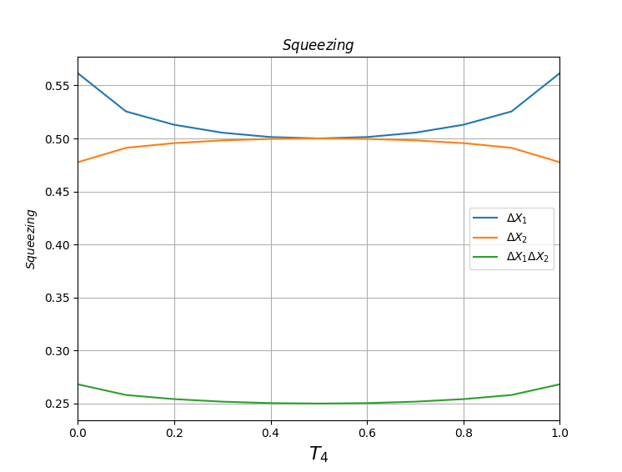
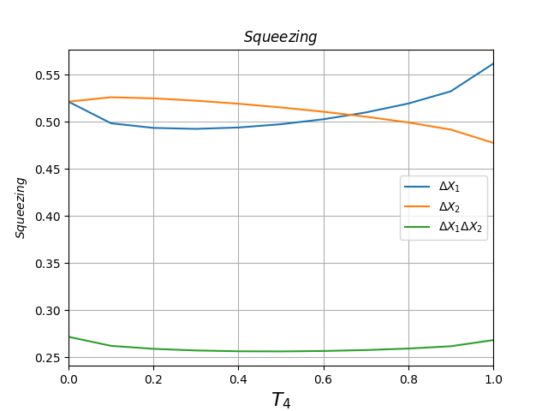
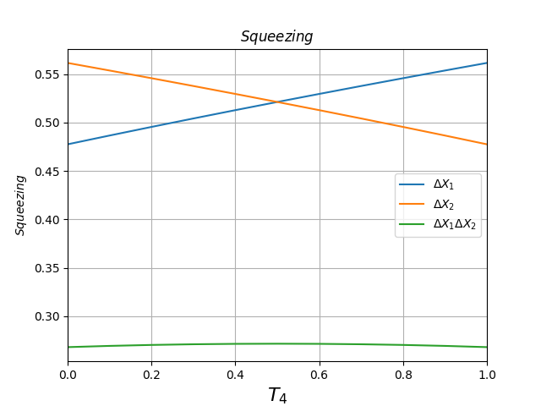
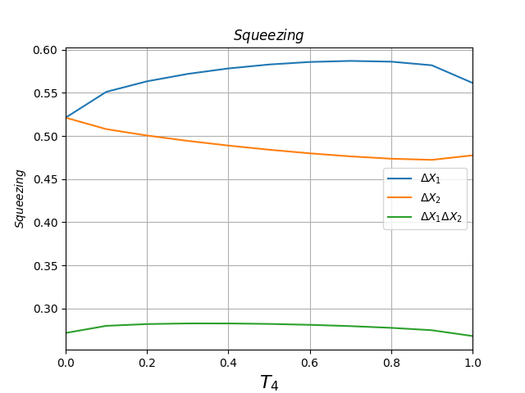
|1> + |alpha=1>, phase = 0 pi, detection=FIRST.
|1> + |alpha=1>, phase = 0.25 pi, detection=FIRST.
|1> + |alpha=1>, phase = 0.5 pi, detection=FIRST.
|1> + |alpha=1>, phase = 0.75 pi, detection=FIRST.

Slide 3
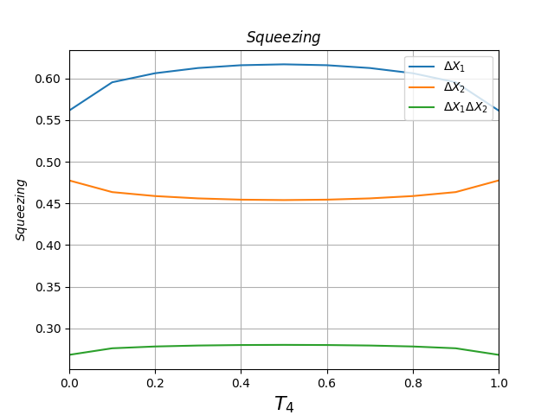
|1> + |alpha=1>, phase = 1.0 pi, detection=FIRST.
|1> + |alpha=1>, phase = 1.25 pi, detection=FIRST.
|1> + |alpha=1>, phase = 1.5 pi, detection=FIRST.
|1> + |alpha=1>, phase = 1.75 pi, detection=FIRST.

Slide 4
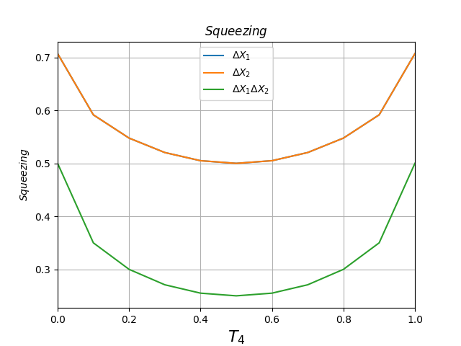
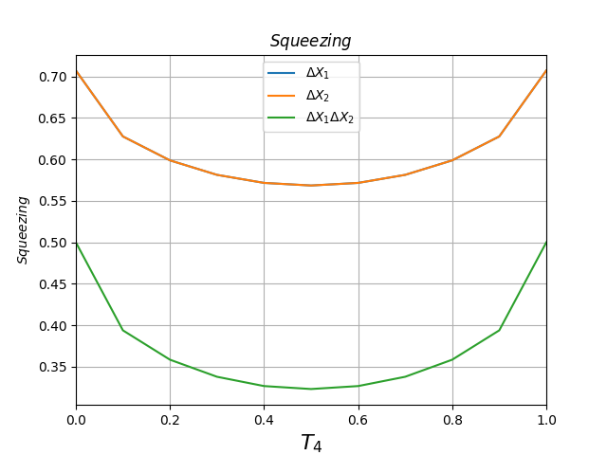
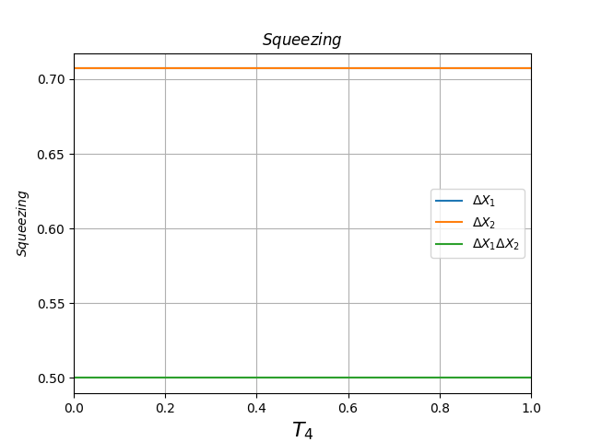
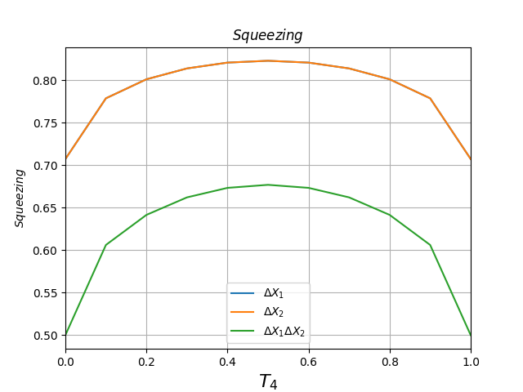
|1> + |alpha=1>, phase = 0 pi, detection=NONE.
|1> + |alpha=1>, phase = 0.25 pi, detection=NONE.
|1> + |alpha=1>, phase = 0.5 pi, detection=NONE.
|1> + |alpha=1>, phase = 0.75 pi, detection=NONE.

Slide 5
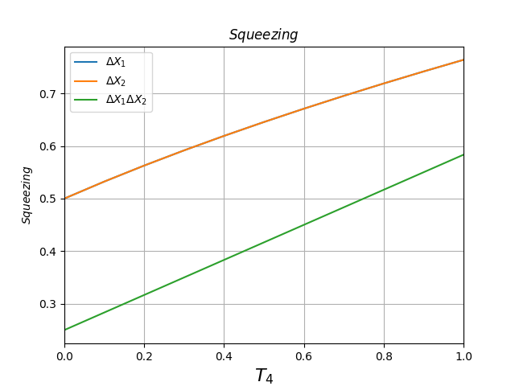
|1> + |1>, phase = 0 pi, detection=FIRST.

