Slide 1
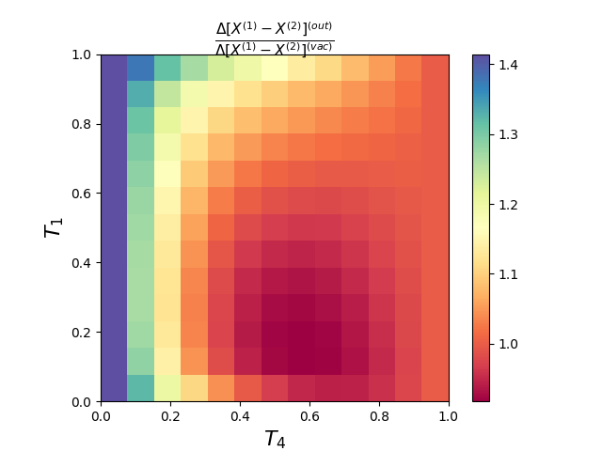
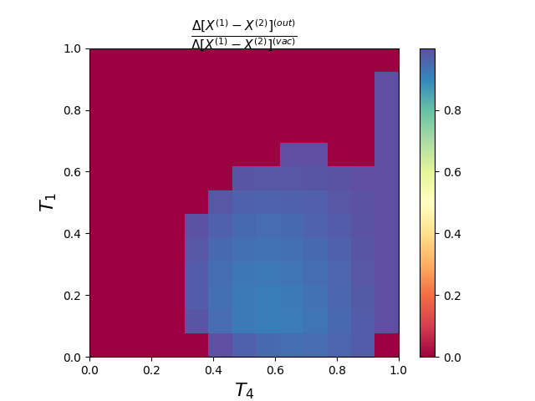
|1>(channel=1) + |alpha=1>(channel2), phase = 0.25 pi, detection=FIRST.

Slide 2
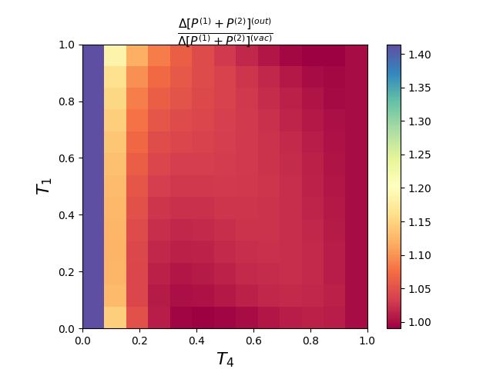
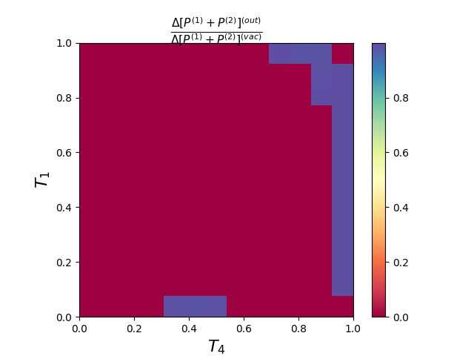

Slide 3
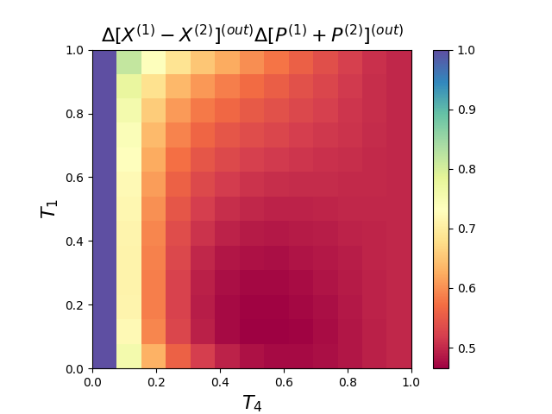

Slide 4
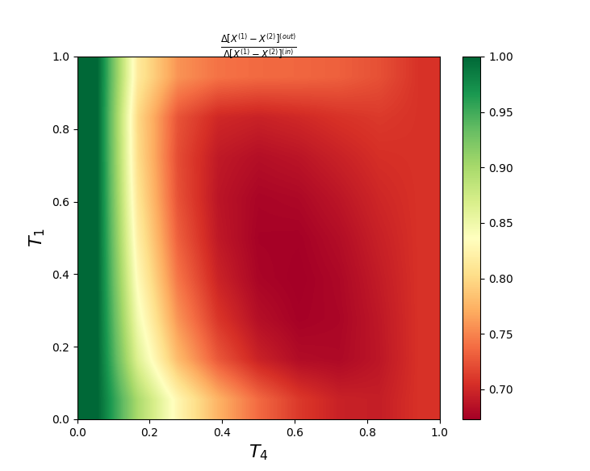
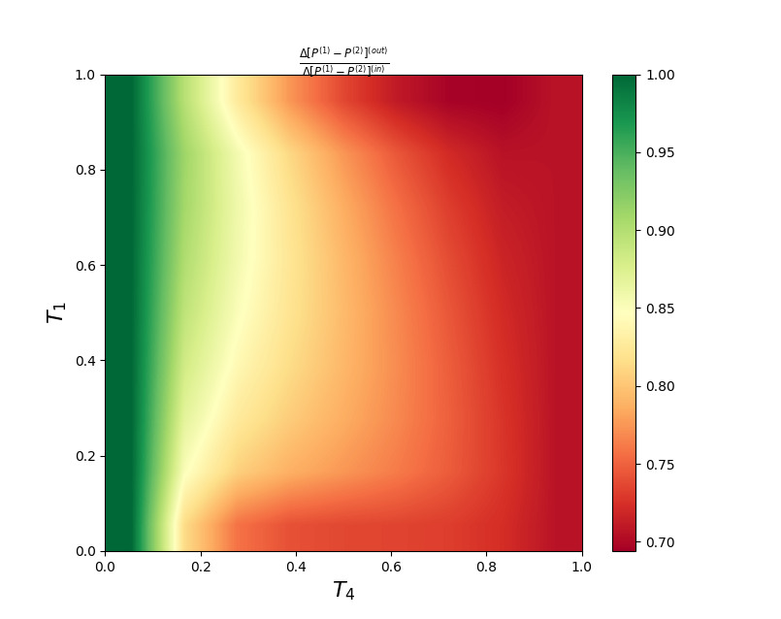
|1> + |alpha=1>, phase = 0 pi, detection=FIRST.

Slide 5
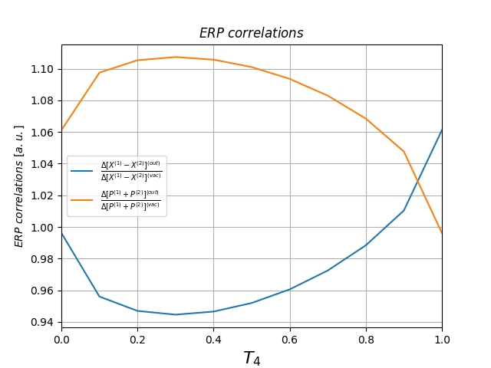
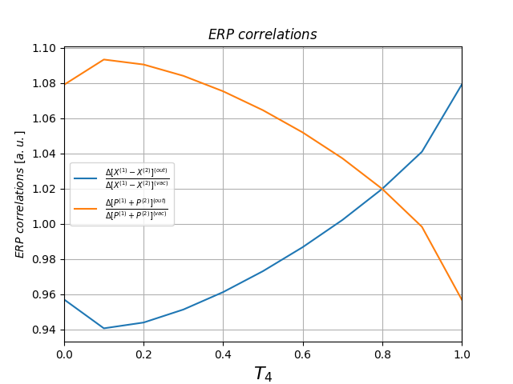
|1>(channel=1) + |alpha=1>(channel2), phase = 0 pi, detection=FIRST.
T2 = 0.7, T3 = 0.3.
T2 = 0.9, T3 = 0.1.

