Slide 1
CSCE 313 LAB session Sec 50x
Wei Zhang

Slide 2
Due date
Nov-6

Slide 3
MP 5: recap
Client creates 3 threads
Generate 3n DATA in the buffer, each thread generate one type of data.
Run in parallel
Feed the data to the buffer, handle race condition!
Then creates w worker threads
Each thread creates its own data channel
Run in parallel
Retrieve data form the buffer
Send the data to the server, handle race condition!

Slide 4
Handle race condition
w worker threads retrieve and send
Data channel 1
3 threads
gen DATA
DATA
DATA
REP
Data channel 2
REP
Client
BUF
Data
Server
DATA
DATA
REP
Data channel w
REP
…
DATA
DATA
Handle race condition
REP
REP

Slide 5
Synchronization
Protect the recourse shared by multiple threads.
E.g. if x++ is shared by two threads, then
pthread_mutex_lock() x++
pthread_mutex_unlock()
pthread_mutex_init() and pthread_mutex_destroy() is also necessary.
http://www.thegeekstuff.com/2012/05/c-mutex-examples/

Slide 6
MP 5 limitations
Limitations of MP5
Fill the buffer first (with 3 threads), then drain the buffer (using w threads)
Can fill and drain happen simultaneously?
Data channel 1
drain
fill
DATA
DATA
REP
Data channel 2
REP
Client
BUF
Data
Server
DATA
DATA
REP
Data channel w
REP
…
DATA
DATA
REP
REP

Slide 7
MP 5 limitations
The buffer can be infinite in MP5
We have no idea how many data a user can generate
Can we limit the size of the buffer?
BUF

Slide 8
MP 6
Logically same as MP5
Eliminate the limitations
Design a bounded buffer
Safe to fill and drain at the same time.
Good synchronization is necessary!
BUF
What are the difficulties?
How to Insert data to a full buffer?
How to retrieve data from an empty buffer?

Slide 9
Semaphore
Another synchronization primitive
A variable that keeps track of how many units of a given resource are available
When a thread needs the resource it decrements the semaphore, and if the semaphore’s count passes below 0 then the process enters a wait queue and sleeps.
When more of the resource becomes available the semaphore count is incremented and, if the count passes from -1 to 0, then the scheduler picks a thread from the semaphore wait queue and wakes it up.

Slide 10
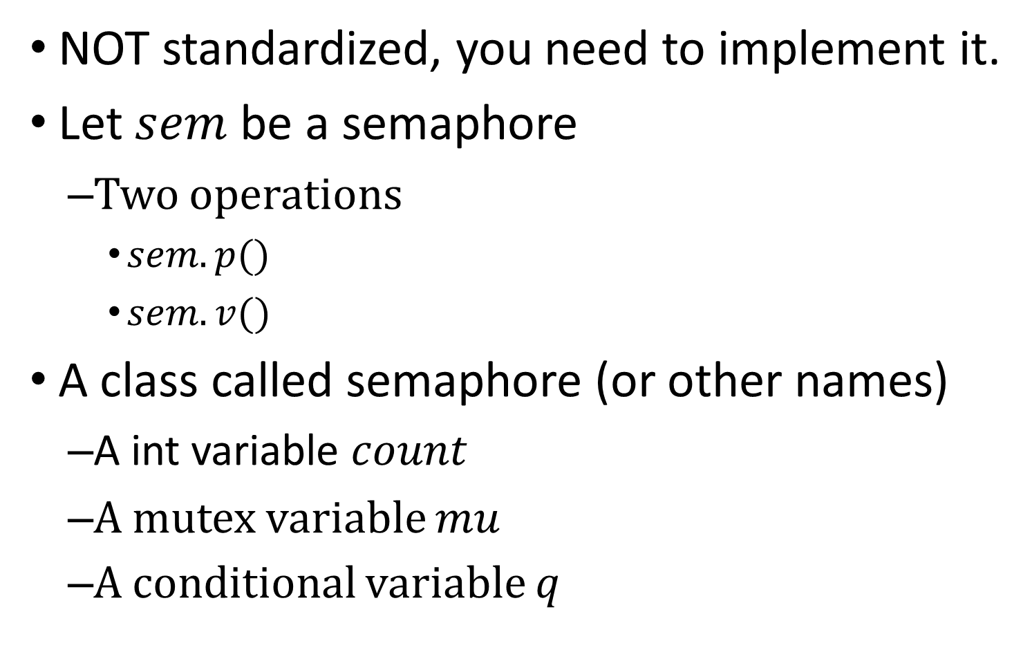
Semaphore
NOT standardized, you need to implement it.
Let $sem$ be a semaphore
Two operations
$sem.p()$
$sem.v()$
A class called semaphore (or other names)
A int variable $count$
A mutex variable $mu$
A conditional variable $q$

Slide 11


$p()$ implementation
$sem.p()$
$mu.lock()$
$count−−$
$mutex.unlock()$
sem.p()
{
mu.lock();
count--;
if (count<0) {
cond_wait(&q,&mu)
}
mu.unlock();
}

Slide 12

$v()$ implementation
$sem.p()$
$mu.lock()$
$count−−$
$mutex.unlock()$
sem.v()
{
mu.lock();
count++;
if (count<=0) {//if Q is empty
cond_signal(&q);
}
mu.unlock();
}

Slide 13
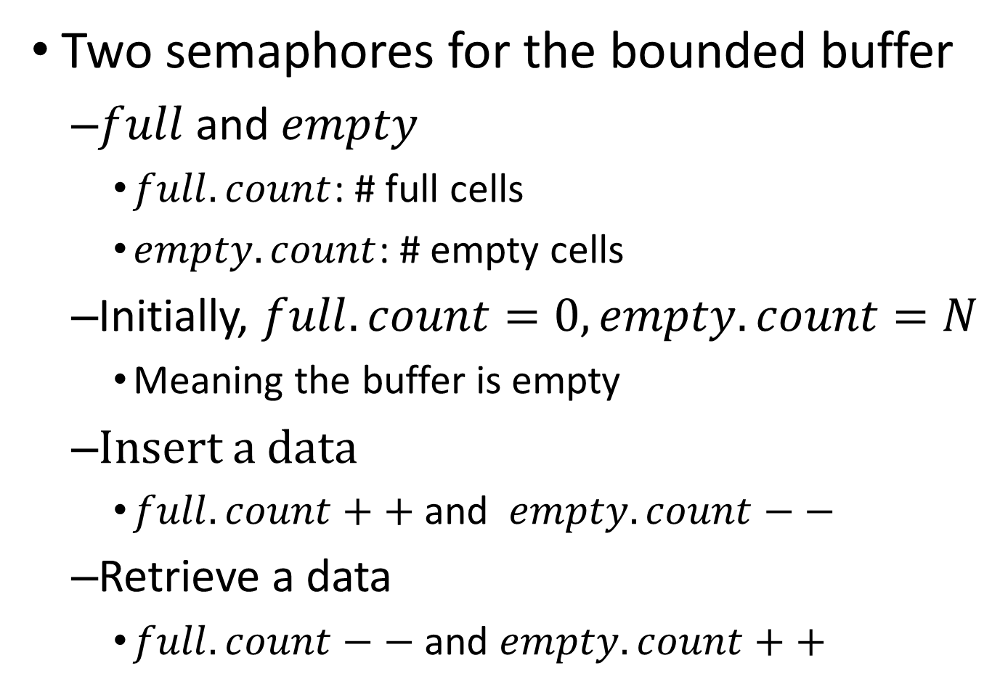
MP 6
Two semaphores for the bounded buffer
$full$and $empty$
$full.count$: # full cells
$empty.count$: # empty cells
Initially, $full.count=0, empty.count=N$
Meaning the buffer is empty
Insert a data
$full.count++$and $empty.count−−$
Retrieve a data
$full.count−−$and $empty.count++$
BUFFER
Thread 1
Thread 2

Slide 14
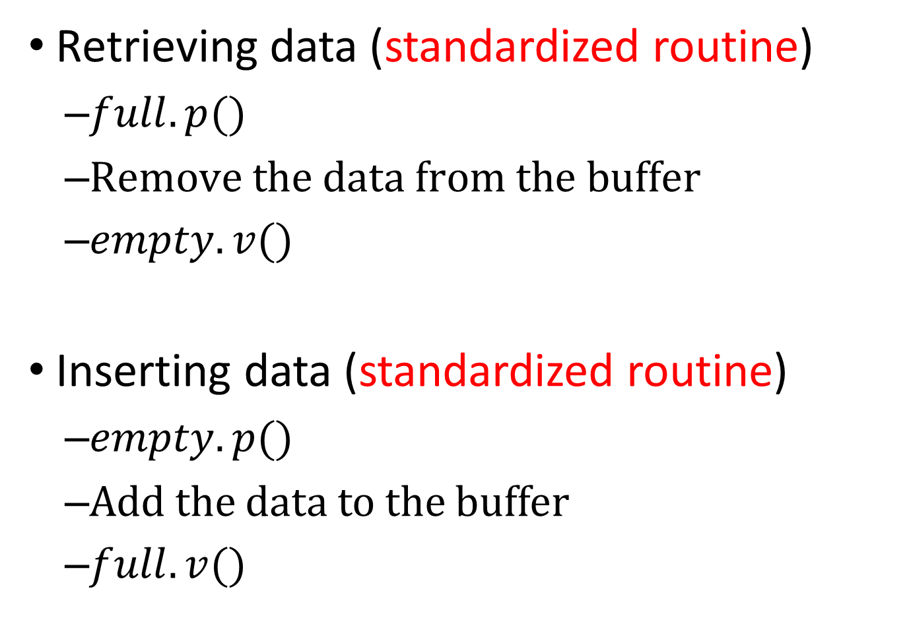
Use semaphore
Retrieving data (standardized routine)
$full.p()$
$\text{Remove} \text{the} \text{data} \text{from} \text{the} \text{buffer}$
$empty.v()$
Inserting data (standardized routine)
$empty.p()$
Add the data to the buffer
$full.v()$

Slide 15
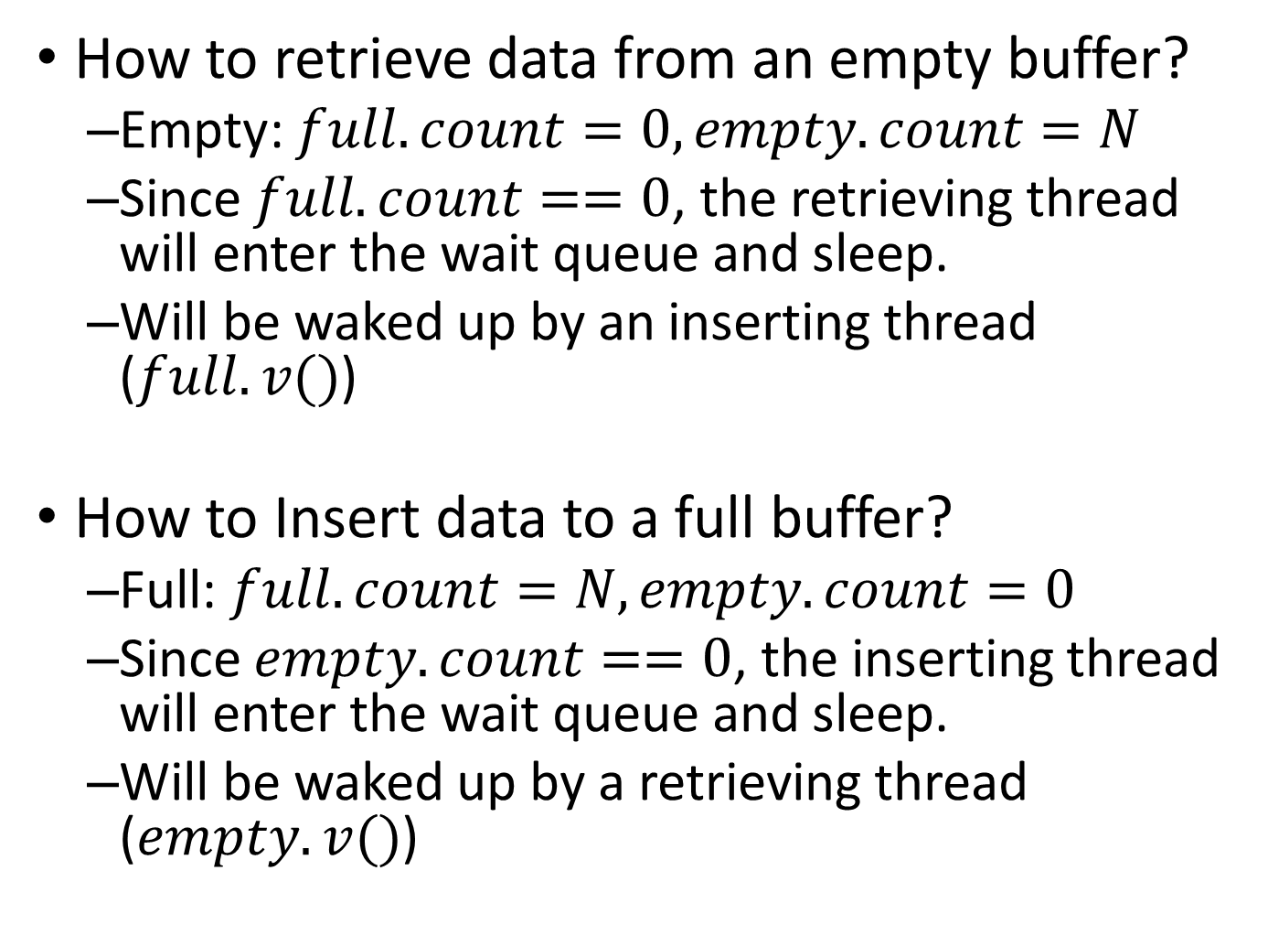
Back to the questions
How to retrieve data from an empty buffer?
Empty: $full.count=0, empty.count=N$
Since $full.count==0$, the retrieving thread will enter the wait queue and sleep.
Will be waked up by an inserting thread ($full.v()$)
How to Insert data to a full buffer?
Full: $full.count=N, empty.count=0$
Since $empty.count==0$, the inserting thread will enter the wait queue and sleep.
Will be waked up by a retrieving thread ($empty.v()$)

Slide 16
Last thing
3 statistics threads
Draw histogram
3 bounded buffers for response reception
The w worker threads put the corresponding responses to the right buffer
3 bounded buffers for response
w worker threads
get the response
Statistics threads = 3
w worker threads
Request threads = 3
Bounded buffer
Data
Server
Data
Server
…
…
Semaphore to sync
Draw histogram

Slide 17

Questions?

Slide 18
Backups

Slide 19
MP 5
Get familiar with UNIX Threads
Four files are given
dataserver.cpp, request_channel.cpp, request_channel.h
client.cpp, (You ONLY need to modify this file)
Generate client and dataserver
./client
The client process calls fork() and runs the dataserver program.

Slide 20
Channel
Not a standard concept!
Pipe
Unidirectional
Channel is bidirectional
Two separate pipes
write
read
A
B
read
write

Slide 21
Client architecture
Create a control channel.
Using RequestChannel()
Create a data channel.
Using the control channel and RequestChannel()
Generate DATA in a buffer.
DATA: 3 different strings, n for each, 3n in total.
Retrived DATA from the buffer, and send them to the server and receive REPLY.

Slide 22
Control channel
Data channel
Client
BUF
CMD
CMD
Data
Server
REP
REP
DATA
DATA
REP
REP

Slide 23
Send DATA & Receive REPLY
Assume dataChannel is the pointer to the data channel.
REPLY= dataChannel->send_request(DATA);

Slide 24
Threads
Lightweight process
Execute a function in parallel with the main process
int pthread_create(
pthread_t * thread,
pthread_attr_t * attr,
void * (*start_routine)(void *),
void * arg);
start_routine is the function
arg is the parameter pointer for start_routine
http://www.amparo.net/ce155/thread-ex.html

Slide 25
The MP 5
Client creates 3 threads
Generate 3n DATA in the buffer, each thread generate one type.
Then creates w worker threads
Each thread creates its own data channel
And does the same thing as the original code
You can reuse most of the code given!
Simply put them in the start_routine of a thread

Slide 26
Data channel 1
3 threads
gen DATA
w worker threads send
DATA
DATA
REP
Data channel 2
REP
Client
BUF
Data
Server
DATA
DATA
REP
Data channel w
REP
…
DATA
DATA
REP
REP

Slide 27
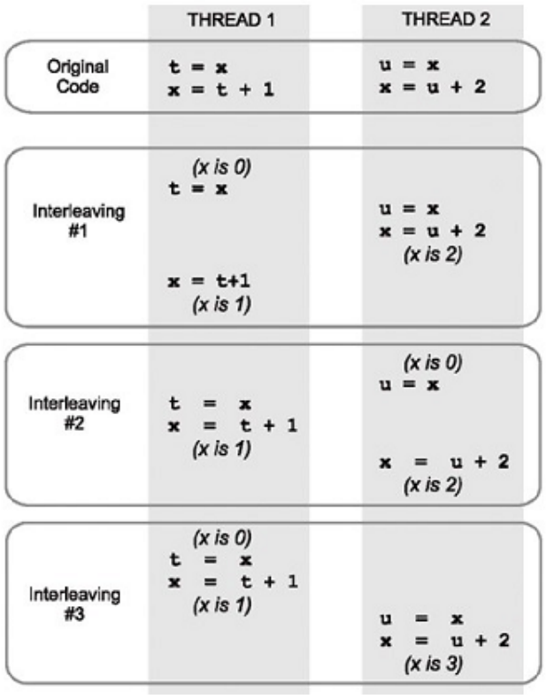
Race condition
Multiple threads access one recourse.
Thread execution can be interrupted at any point of time.

Slide 28
Synchronization
Protect the recourse shared by multiple threads.
E.g. if x++ is shared by two threads, then
pthread_mutex_lock() x++
pthread_mutex_unlock()
pthread_mutex_init() and pthread_mutex_destroy() is also necessary.
http://www.thegeekstuff.com/2012/05/c-mutex-examples/

Slide 29
The MP5 - Details
How do you make sure there 3n requests sent out and in parallel (in w threads)?
First make 3 request threads
Each of them pushes n requests to buffer
All together, so have to handle race conditions
Once the request threads finish working (i.e., you join them in main)
Create w worker threads, each with a dedicated request channel
Pop from the buffer and send the requests to server
Again, have to handle race conditions
After all worker threads finish (i.e., you join them), your program terminates after
printing results in histogram
And, doing clean up (i.e., closing each channel)

