Slide 1
Do explanations drift
before accuracy does?
CS4437 · EXPLAINABLE AI · GROUP 8
Watching a frozen electricity-price model through the 2026 oil shock
Matthew Burke · Holly Best · Tom Byrne · Conor Clancy
Notes:
Do explanations drift before accuracy does? In this presentation we’ll use the 2026 oil shock to test whether a model’s explanations could have warned us before its predictions started going wrong.

Slide 2
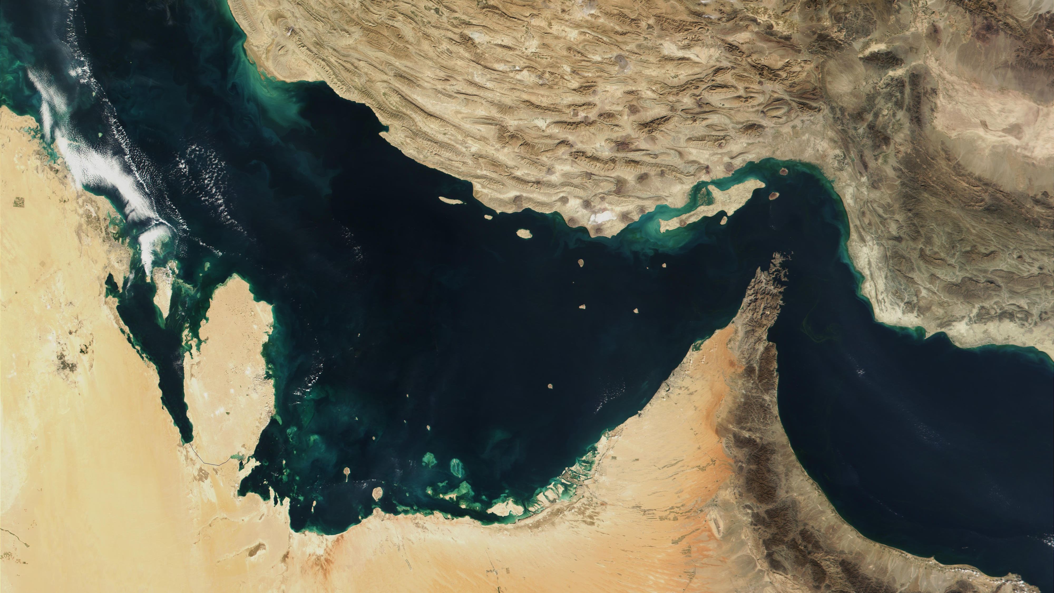

The Strait of Hormuz
IRAN
The only sea route out of the Persian Gulf. About 33 km wide at its narrowest.
Strait of Hormuz
Persian Gulf
Gulf of Oman
ARABIAN PENINSULA
Image: via USNI News, 27 Mar 2026
Notes:
As I am sure we can all remember, earlier in Febuary this year the Strait of Hormuz closed. For anyone unfamiliar, it is this [point] stretch of water between Iran and Oman. It is the only route for ships out of the Persian Gulf, where a huge amount of the world’s oil is produced, and it is only 33km at its narrowest. It is relevant because-

Slide 3






About a fifth of the world's oil goes through one strait. It closed.
28 FEBRUARY 2026
~20%
WHERE THAT OIL GOES
China
~38%
India, Japan, South Korea
~31%
of the world's oil use: about 20 million barrels a day
Rest of Asia
~15%
Europe buys little of it directly. But oil is priced globally, so everyone pays more.
Everyone else, incl. Europe and the US
~16%
US EIA, June 2025. Crude oil through Hormuz: Asia 84%, the four named countries 69% (2024); China's share from Q1 2025. Approximate.
Notes:
-a fifth of the world’s oil goes through it. That’s 20 million barrels, which is over 3 billion litres, every day. As you can see, most of it goes to Asia, and Europe buys very little of it. But oil is priced on a global market, so that kind of block causes price to go up everywhere.

Slide 4
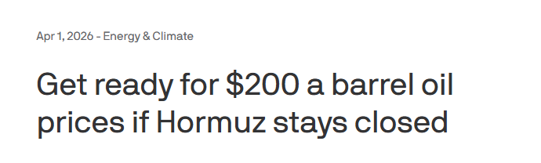
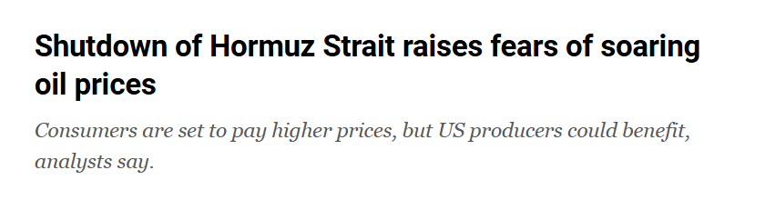
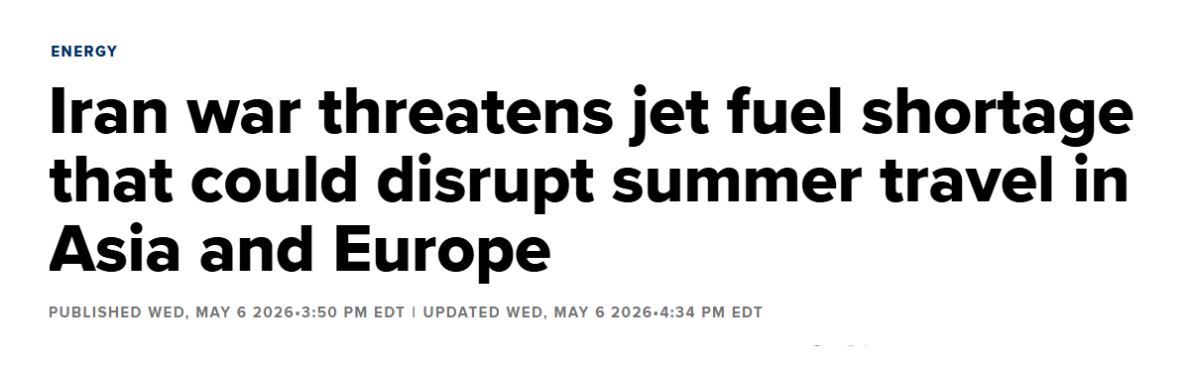
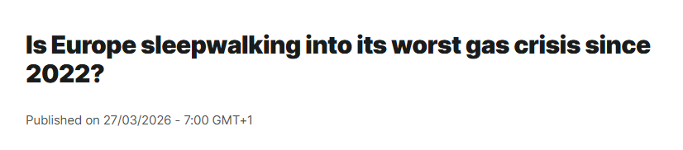
What we were told to expect
Al Jazeera, 3 Mar 2026 · Axios, 1 Apr 2026 · Euronews, 27 Mar 2026 · CNBC, 6 May 2026
Notes:
That’s why the close resulted in headlines like this [point], of “$200 barrels”, and “Europe’s worst gas crisis since 2022,” and “flight cancellations for summer.” But did any of this happen..?

Slide 5
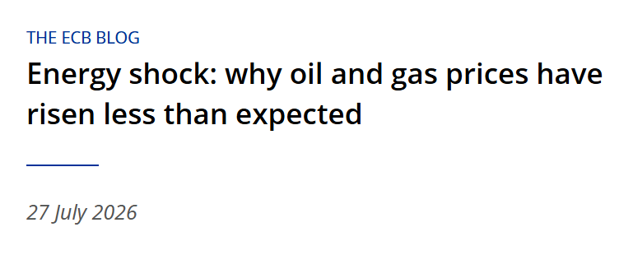
The worst predictions didn't come true.
WHAT ACTUALLY HAPPENED
So what did the forecasting models see?
Did their reasoning shift before their forecasts went wrong?
ECB Blog, 27 Jul 2026: oil peaked at just over +50%, where past shocks this size implied up to +105%
Notes:
No, it didn’t. Oil peaked at about 50% up, not the doubling that past shocks suggested. And that’s the problem with any forecast: you only find out how wrong it was once the real results come in. But what a model is relying on, you can see straight away. So could that reasoning have warned us sooner?

Slide 6








So we built our own model to find out
DATA
PREDICT
EXPLAIN
MEASURE
German electricity
LightGBM
SHAP
Weighted tau
Forecasts tomorrow's 24 hourly prices
Which inputs each forecast relied on
How much that changed, every two weeks
Hourly prices, plus wind, solar and demand forecasts
LightGBM + SHAP on German electricity prices follows Trebbien et al. 2023, so we start from a setup known to work.
Notes:
To find out, we built our own model. [point as you go left to right] First, the data: German electricity prices for every hour, plus forecasts for wind, sun and demand. Next, we predict with a LightGBM model, which forecasts tomorrow’s 24 hourly prices. It’s built from hundreds of decision trees, like the ones we split with Gini impurity in class, so it’s no longer interpretable by design, and we need a post-hoc method to explain it. That’s where SHAP comes in. Finally, every two weeks, we measure how much the model’s reasoning has changed, using a score called weighted tau. We based this setup on a 2023 paper by Trebbien [say: TREB-been] and colleagues, who used LightGBM and SHAP to explain German electricity prices. What’s new in our project is that we watch those explanations change over time.

Slide 7





We modelled electricity prices, not oil. Why?
Oil price: too obvious
The shock is the oil price itself. A model of it would obviously break, and that teaches us nothing.
Plenty of open data
Germany publishes a price for every hour, free to use: 336 prices per fortnight.
Electricity price: one step removed
It feels the shock indirectly, through fuel costs. That's how most real systems get hit.
The link is proven
Fuel prices are among the top drivers of German power prices (Trebbien et al. 2023).
Oil and gas prices rise
Gas power plants cost more to run
The priciest plant needed sets everyone's price
Electricity price rises
Notes:
You might be wondering: why not just predict the oil price? Well, the shock is the oil price, so a model of it would obviously break. Electricity feels the shock indirectly, through fuel costs. Here’s the chain. [point along the arrows] Oil and gas prices go up, so gas power plants cost more to run. The most expensive plant that’s needed sets the price for everyone, so electricity prices go up. And we know this link is real, because Trebbien’s paper found that fuel prices are among the top drivers of German power prices.

Slide 8




What the model relies on
October is autumn. Keep that in mind for the results.
SHAP measures how many €/MWh each input moved each forecast up or down. Averaged over October 2025, our "before" snapshot that every later fortnight is compared against:
Wind forecast
25.3
Yesterday's price
13.9
Solar forecast
11.6
Demand forecast
10.6
Last week's price
5.7
Everything else (temperature, gas power, hour, day, holiday): under 2 each.
One rule: only inputs known before the noon auction the day before, so the model never sees the answer.
Blind model, October 2025 · Data: SMARD, Open-Meteo (CC BY 4.0) · SHAP: Lundberg & Lee 2017; TreeSHAP: Lundberg et al. 2020
Notes:
So what does the model actually rely on? This is SHAP, the post-hoc method we covered in class. For every forecast, SHAP gives a local explanation: how much each input, or feature, pushed the price up or down, in euro. If we average the size of those pushes over October, we get a global ranking. [point at bars] Wind is way out in front: on average it moved the forecast by about 25 euro. Yesterday’s price is next at about 14, then solar and demand. We chose SHAP over permutation feature importance, also from class, because permutation importance needs the true answer, and a model running live doesn’t have that yet. We also had one rule: we only use what’s known before the daily noon auction, like the wind and sun forecasts. This October ranking is our ‘before’ picture. [point at warning] But notice: October is autumn, so it’s windy and not very sunny. That comes back to bite us later.

Slide 9





How we ran the experiment
1
2
3
4
Train
Snapshot
Measure normal wobble
Watch
Jan 2024 – Sep 2025
Oct 2025
Check it's accurate. Record the "before" ranking.
From the shock, 28 Feb 2026
Learns from 21 months of German prices.
Nov 2025 – mid-Feb 2026
No shock yet. How much does the ranking move on its own? That sets the warning line.
Forecast every day. Every 2 weeks: compare the ranking with October, and check the error.
Average gap from the real price:
14.5
€/MWh
vs 43.5 for just copying last week's price
Trained once, then frozen. No retraining, so any change in its reasoning comes from the world changing, not from new training.
Notes:
Here’s how we ran the experiment. [point left to right] Step one, train. The model learns from 21 months of German prices, January 2024 to September 2025. Step two, snapshot, in October 2025. On average the model is 14.5 euro off the real price, versus 43.5 for just copying last week’s price. Step three, measure normal wobble, from November to mid-February, still before the shock. We measure how much the ranking normally moves, and that sets our warning line. Step four, watch. From the 28th of February, the model forecasts tomorrow’s prices every day. Every two weeks we check how far the ranking has moved from October, and how big the error is. [point at bottom] And crucially, the model is trained once, then frozen. So if its reasoning changes, it’s because the world changed, not the model.

Slide 10

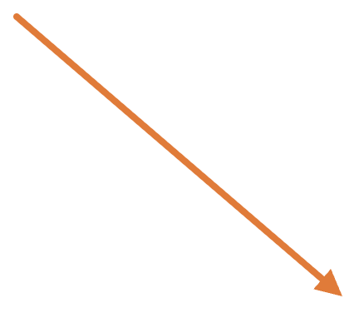
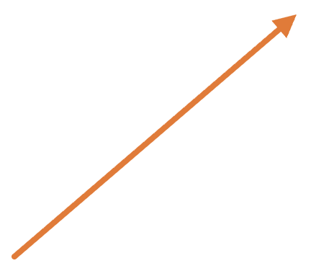

Measuring how far the ranking moves
OCTOBER 2025
EARLY JUNE 2026
MEASURE
1 Wind
1 Solar
Weighted Kendall's tau: 1 = identical ranking. Swaps near the top count more.
2 Yesterday's price
2 Yesterday's price
3 Solar
3 Wind
WARNING
4 Demand
4 Demand
Line at 0.66: 2 SD below tau's pre-crisis normal. June scores 0.72, so no warning.
5 Last week's price
5 Last week's price
Wind and solar swap places at the top. That's summer, not the shock, and it pulls tau down to 0.72.
Example: the blind model's real fortnight from 6 June 2026. Baseline: 8 pre-crisis fortnights. Vigna 2015 (weighted tau).
Notes:
So how do we measure how much the ranking moved? [point at columns] Here’s October’s ranking on the left, and early June’s on the right. We use a score called weighted Kendall’s tau. It checks every pair of inputs and asks: are they in the same order in both rankings? A score of 1 means identical, and 0 means unrelated. ‘Weighted’ means swaps near the top count more. In this example, only wind and solar swapped places at the top. That’s summer, not the shock: the sun really does matter more in June. But because the swap is at the top, tau drops to 0.72. [point at the Warning card] Our warning line is 0.66, two standard deviations below the normal wobble, so there’s no warning. But it shows the season alone moves this score a lot. We use the same rule for the error, so both are judged fairly.

Slide 11
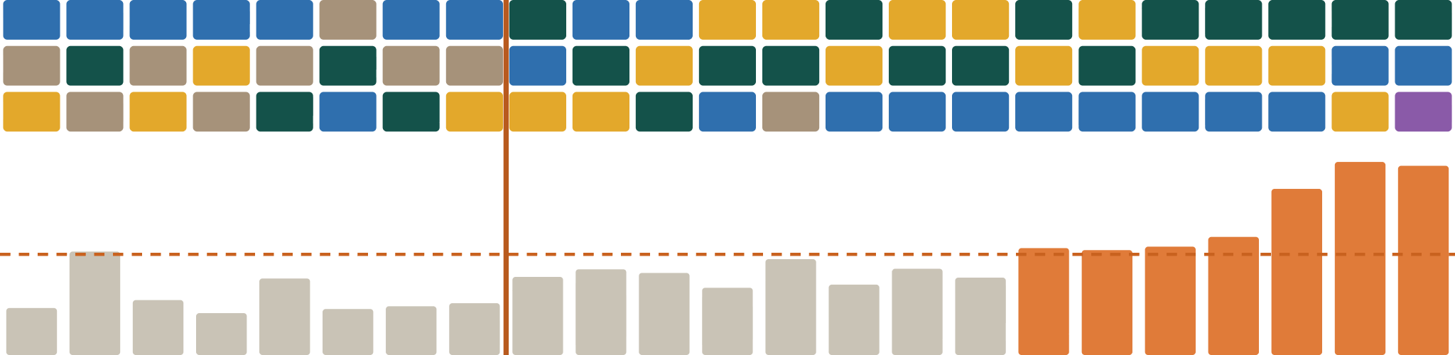
The reasoning follows the calendar, not the shock
Blind model. Each column is one fortnight: its top three inputs, and its forecast error.
Top inputs:
Wind
Solar
Yesterday's price
Demand
Last week's price
Oil shock, 28 Feb
1st
2nd
3rd most used
Error unusual from 20 Jun
normal range ends here
Forecast error
€/MWh
Nov
Dec
Jan
Feb
Mar
Apr
May
Jun
Jul
Aug
Sep
Forecast error:
Normal
Unusual (above the dashed line)
Notes:
This chart shows the whole result. Each column is a fortnight, showing the model’s top three inputs and, underneath, its forecast error. All winter, wind is on top. [point at shock line] But look at yesterday’s price after the shock: it’s suddenly near the top almost every fortnight. In spring, solar takes over, and by late summer yesterday’s price leads. So something did shift. [point at error bars] The error stays normal all through spring, then turns orange from the 20th of June, when the forecasts really went wrong. So the question is: did our measure catch the shift before that?

Slide 12



The ranking moved, but gave no warning
15/15
Yesterday's price took over
In the first fortnight after the shock it was the top input for the first time. From mid-July it led every fortnight.
fortnights after the shock had yesterday's price in the top three
Demand dropped out
In the top three in all 8 fortnights before the shock, but in just 1 of 15 after it.
Before the shock: only 4 of 8.
But no early warning
Wind was back on top the next fortnight. Tau never crossed its warning line before the error did, on 20 June.
16 weeks · ranking shifts, no warning
Nov
28 Feb · oil shock
20 Jun · error unusual
Sep
Wind
Solar
Yesterday's price
Demand
Yesterday's price 2nd
Each block is one fortnight's top input (mean |SHAP|), blind model. Pre-shock windows are all autumn and winter, so season and shock overlap.
Notes:
So, did it catch it? [point at 15/15] After the shock, yesterday’s price was one of the model’s top three inputs in all 15 fortnights. Before the shock, it was only 4 out of 8. [point at second card] Demand went the other way: it was a top-three input in all 8 fortnights before the shock, but only 1 of 15 after. Maybe the model leans on recent prices when something it can’t see, like fuel costs, is driving them. But with one shock, we can’t prove that. [point at dark card] And none of this was an early warning. Tau never crossed its warning line before the error did, on the 20th of June. Why not? Because in October, yesterday’s price was already second. So moving up to first is just one swap, and tau barely notices.

Slide 13


What if the model could see oil?
1 · IT LOOKED LIKE A WIN
2 · BUT IT WASN'T OIL
3 · WHY OIL STAYED QUIET
56
Solar jumped to 1st
Training
+21%
days early
The shock
+78%
Our October snapshot is autumn, so spring alone looks like drift. Oil sat 11th of 13. Compare with spring 2025 instead and the warning disappears.
Its biggest monthly oil rise in training was 21%. Tree models can't go past what they've seen, so a 78% rise looked like 21%.
We added the oil price to the model. Its tau crossed the warning line on 25 April, 56 days before the error did.
What it taught us: check a warning against the season before trusting it, and a model can't explain a shock it never saw.
Oil model = blind model + 30-day Brent change (FRED). Oil rank: mean |SHAP|, fortnight from 25 Apr 2026.
Notes:
So what happens if we give the model the oil price too? We trained a second version that can see it. [point at card 1] Its tau did cross the warning line, on the 25th of April: 56 days before the error did. [point at card 2] But what actually changed that fortnight was solar jumping to first. That’s spring, not oil. And when we compared with spring 2025 instead, the warning disappeared. [point at card 3] So why didn’t oil matter more? The biggest monthly oil rise the model saw in training was 21%. The shock was 78%. Tree models can’t go beyond what they’ve seen, so to this model a 78% rise looked exactly like 21%. [point at bottom bar] So there are two lessons: check any warning against the season, and a model can’t explain a shock it has never seen.

Slide 14


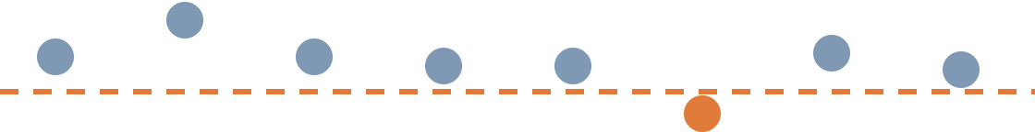


What our setup can't tell us
Rank, not size
A shaky warning line
October
13.9
warning line
September
35.5
Yesterday's price pushed 2.5× harder, but tau only sees it move up one place.
"Normal wobble" comes from just 8 calm fortnights, so the line itself is uncertain. Mid-January, with no crisis, already crossed it: a false alarm.
October did two jobs
One event, one market
When to stop training
+
How accurate it is
1 shock
1 market
2 models
Using one month for both makes our 14.5 €/MWh error slightly optimistic.
No early warning here doesn't rule one out for other shocks, markets or models.
Notes:
We also want to be honest about what our setup can’t tell us. [point top left] First, rank, not size. By September, yesterday’s price’s push had grown from about 14 euro to 35, but tau only sees it move up one place. [point top right] Second, a shaky warning line. It comes from just 8 calm fortnights, and in mid-January, with no crisis at all, tau already crossed it. [point bottom left] Third, October did two jobs: we used it both to decide when to stop training and to measure accuracy, so our 14.5 error is slightly optimistic. [point bottom right] And finally, this is one shock, one market and two models, so it doesn’t prove that explanations never warn early.

Slide 15
Explanation drift isn't a free early warning. Seasons can move it more than a shock.
TAKEAWAY
For monitoring: watch explanations beside error, not instead of it.
Next: same-season baselines, a trend-based detector, more shocks.
Questions?
Lundberg & Lee 2017 · Lundberg et al. 2020 · Ke et al. 2017 · Trebbien et al. 2023 · Mougan et al. 2025 · Vigna 2015 · Code and data: github.com/matthewb62/cs4437-xai-group-project
Notes:
So, back to our question: do explanations drift before accuracy does? For this shock and this model, no. The error moved first, and the biggest shifts in the explanations came from the seasons, not the shock. So if you’re monitoring a model, SHAP is a useful extra signal, but watch it beside the error, not instead of it, and check any shift against the season first. Thank you. Any questions?

