Slide 1
Overview
Determine available bus routes to specified destination
Provide the user with list of nearest bus stops or pick-up points
For each bus stop or pick-up point, tell the user how much slack time they will have between their estimated arrival to the bus stop and the arrival of the bus

Slide 2
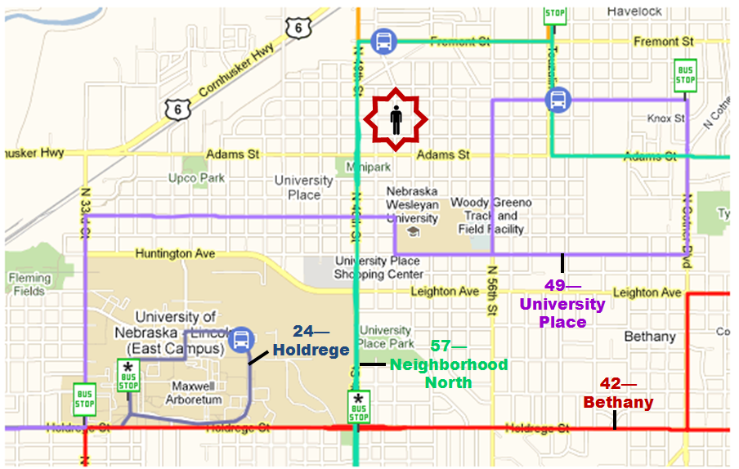
User Input | Back End | Example
Destination | Find bus routes that go to that destination (or as close as possible) | Destination: East Campus Bus routes: 24—Holdrege 42—Bethany 49—University Place 57—Neighborhood North

Slide 3
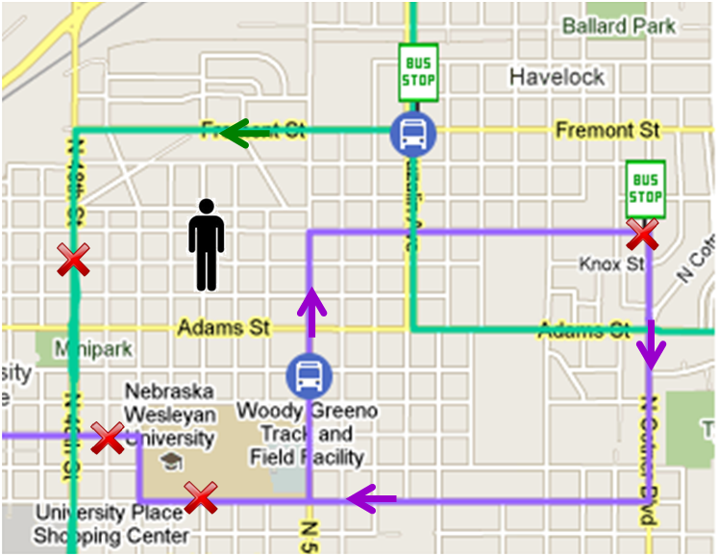
User Input | Back End | Example
Current location (obtained through GPS signal on phone) | Find nearby bus routes On nearby bus routes, find nearby designated bus stops as well as acceptable bus stops | Bus routes: 42—Bethany 49—University Place Bus stops: Marked by X

Slide 4
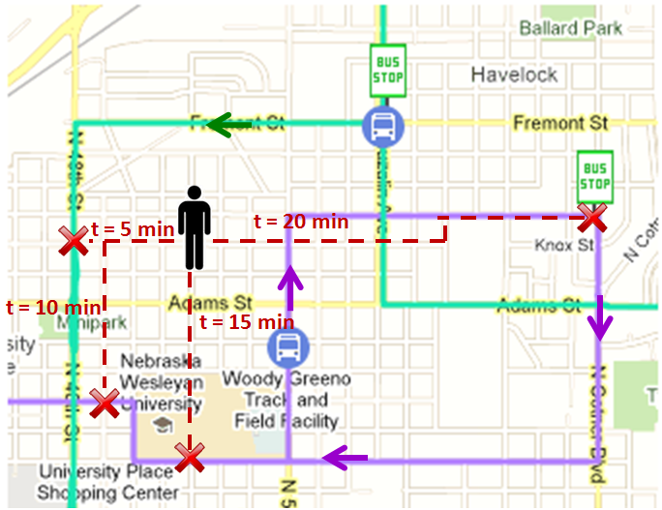
User Input | Back End | Example
Walking, biking, or driving to bus stops | Use Google Maps to calculate a route to each destination marked by X and find the time to reach each destination | Routes marked by dotted line

Slide 5
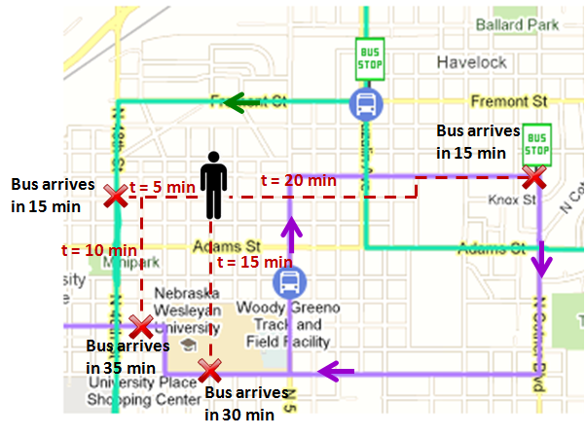
Back End | Example
Calculate the estimated bus arrival time to each destination | Routes marked by dotted line

Slide 6
15 min slack time
Back End | Example
Determine the slack time (time between estimated arrival to bus stop and arrival of bus) | Indicated

Slide 7
10 min slack time
Back End | Example
Determine the slack time (time between estimated arrival to bus stop and arrival of bus) | Indicated

Slide 8
25 min slack time
Back End | Example
Determine the slack time (time between estimated arrival to bus stop and arrival of bus) | Indicated

Slide 9
Not able to reach bus in time
Back End | Example
Determine the slack time (time between estimated arrival to bus stop and arrival of bus) | Indicated

Slide 10
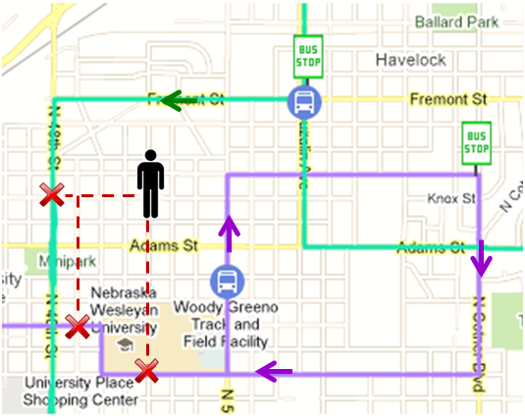
Output
10 min slack time
25 min slack time
15 min slack time

