Slide 1
Advanced Compilers
CMPSCI 710
Spring 2003
Using SSA form
Emery Berger
University of Massachusetts, Amherst

Slide 2
Topics
Last time
  Computing SSA form
This time
  Optimizations using SSA form
    Constant propagation & dead code elimination
    Loop invariant code motion

Slide 3
Constant Propagation
Lattice for integer addition, multiplication, mod, etc.
>
false
…
-1
0
1
…
true
?

Slide 4
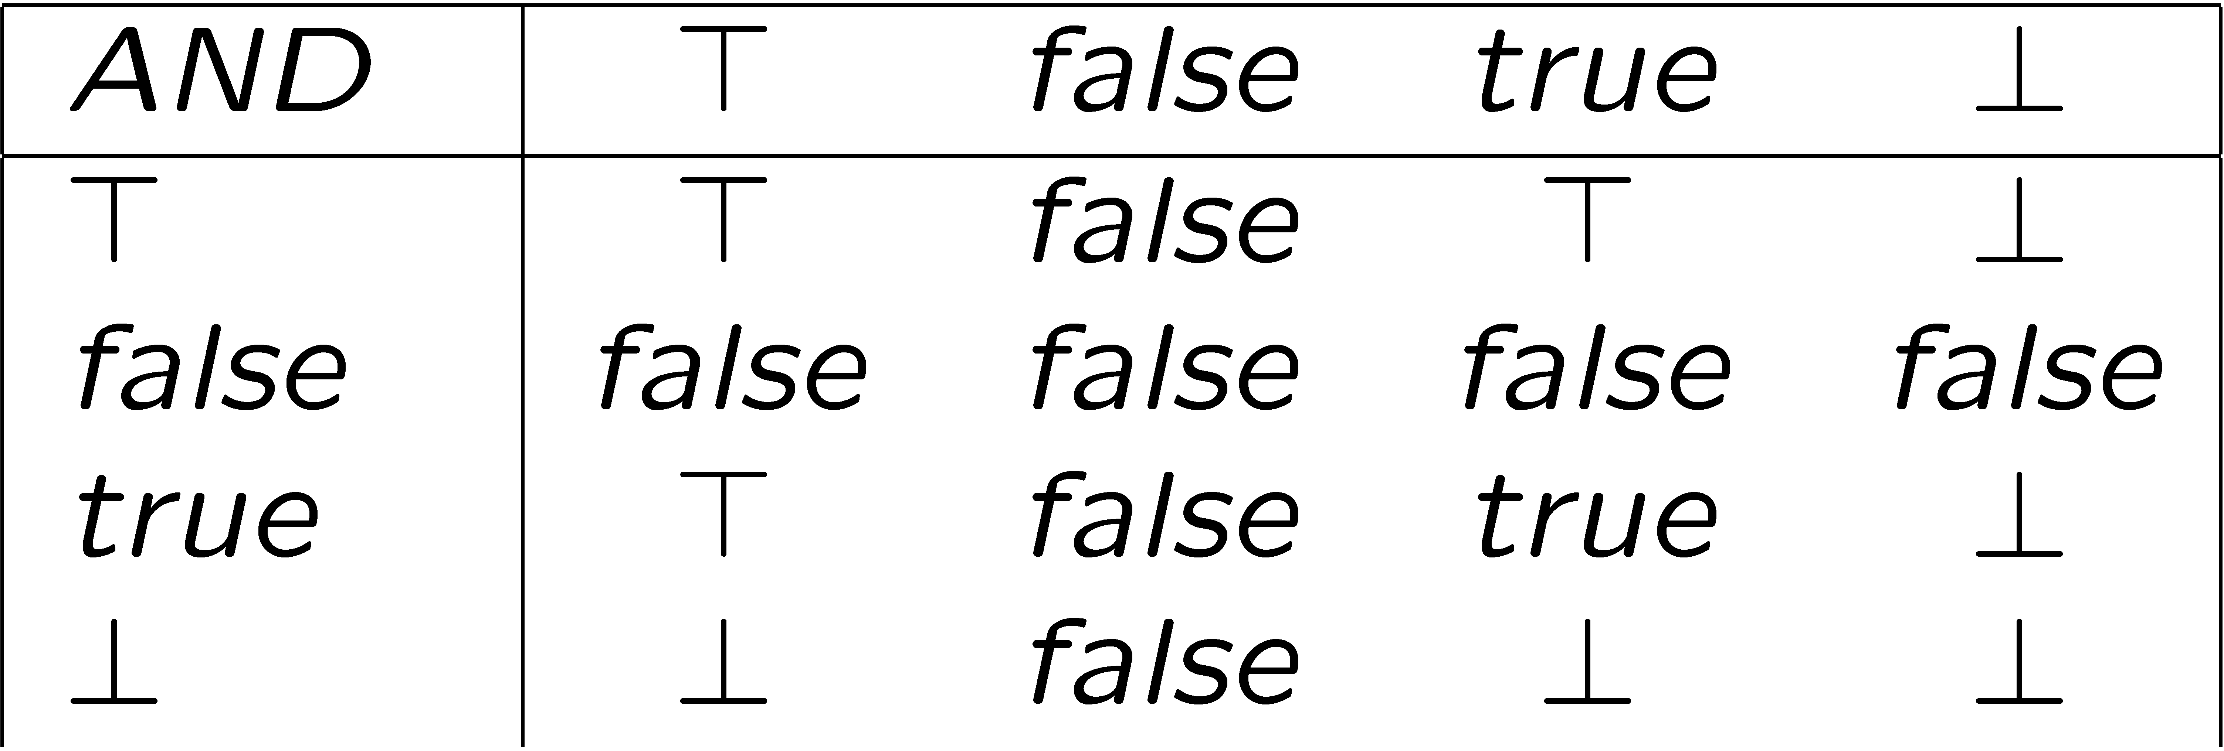
Boolean Lattices, AND
meet functions
example: true AND ?, false AND >

Slide 5
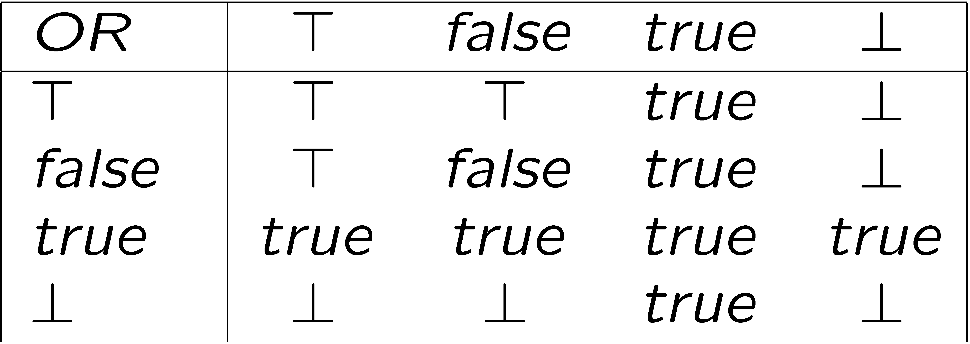
Boolean Lattices, OR
meet functions
example: true OR ?, false OR >

Slide 6
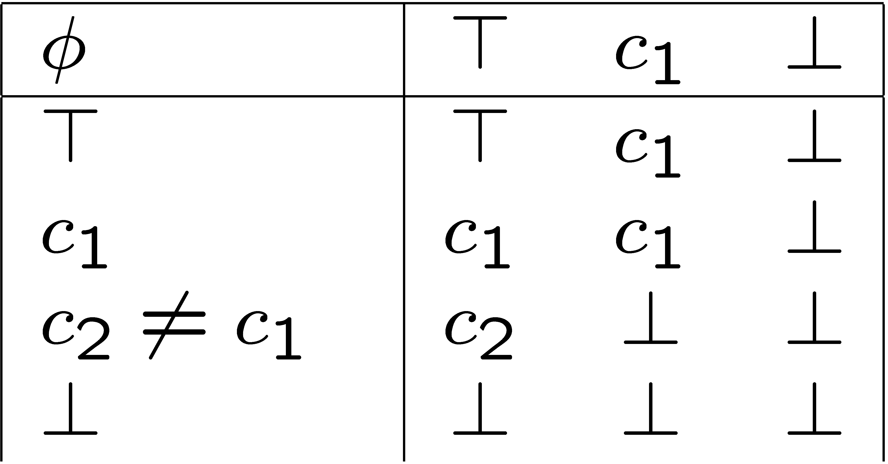
Lattice for Φ-Nodes
To propagate constants:
if constant appears in conditional
  Insert assignment on true branch

Slide 7
Constant Propagation
Using SSA Form
Initialize all expressions to >
Two work lists:
  CFG edges = (entry, x)
    x = first reachable node
  SSA edges = ∅
Pick edge from either list until empty
  Propagate constants when visiting either edge
  When we visit a node:
    φ-node: meet lattice values
    others: add SSA successors, CFG successors

Slide 8
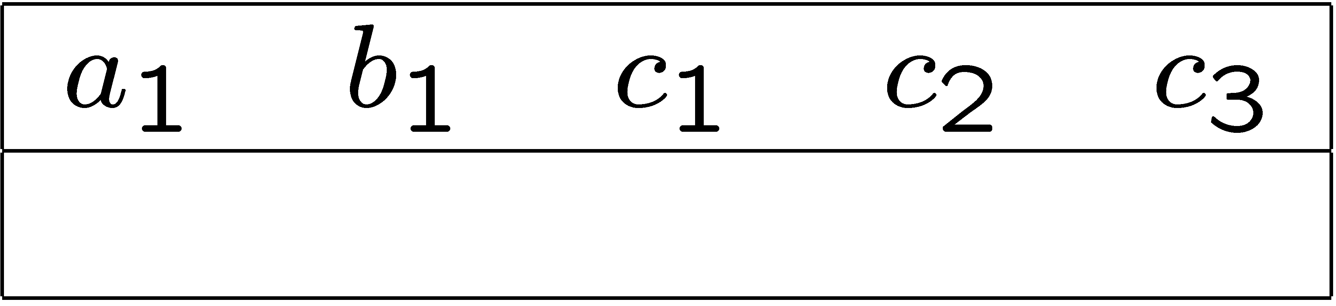

Sparse Conditional
Constant Propagation Example
entry
a₁ Ã 2
B1
b₁ Ã 3
B2
Initialize all expressions to >
Two work lists:
  CFG edges = (entry, x)
  SSA edges = ∅
Pick edge from either list until empty
  Propagate constants when visiting either edge
  When we visit a node:
    φ-node: meet lattice values
    others: add SSA successors, CFG successors
if a₁ < b₁
B3
B4
c₁ Ã 4
c₂ Ã 5
B5
c₃ Ã φ₆(c₁,c₂)
B6
exit

Slide 9
Loop Optimizations
Why optimize loops?
  Loops = frequently-accessed code
    regular patterns – can simplify optimizations
    rule of thumb: loop bodies execute 10^{depth} times
    optimizations pay off
But why do we care if we aren’t using FORTRAN?
  Loops aren’t just over arrays!
    Pointer-based data structures
    Text processing…

Slide 10
Loop Invariant Code Motion
Classical loop optimization
  avoids unnecessary computation
while (z < 1000)
t = a + b
z += t
t = a + b
while (z < 1000)
z += t

Slide 11
Removing Loop Invariant Code
Build SSA graph
Simple test:
  no operands in statement are defined by φ node or have definition inside loop
  if match:
    assign computation new temporary name and move to loop pre-header, and add assignment to temp
    e.g., l = r₁ op r₂ becomes t₁ = r₁ op r₂; l = t₁

Slide 12
Loop Invariant Code Motion Example
Build SSA graph
Simple test:
  no operands in statement are defined by φ node or have definition inside loop
  if match:
    assign computation new temporary name and move to loop pre-header, and add assignment to temp
    e.g., l = r1 op r2 becomes t1 = r1 op r2; l = t1
a₁ Ã 2
b₁ Ã 3
x = a₁ + b₁
y = x + y

Slide 13
Finding More Invariants
Build SSA graph
If operands point to definition inside loop
and definition is function of invariants
(recursively)
  replace as before

Slide 14
Loop Invariant Code Motion Example II
a₁ Ã 2
x Ã q
Build SSA graph
If operands point to definition inside loop
and definition is function of invariants
(recursively)
  replace as before
b₁ Ã 3
y Ã r
x = a₁ + b₁
y = x + y
z = x + a₁

Slide 15
Loop Induction Variables
Loop induction variable:
increases or decreases by constant amount inside loop
  e.g., for (i = 0; i < 100; i++)
Opportunity for:
  strength reduction
    e.g., j = 2 * i becomes j = j + 2
  identifying stride of accesses for prefetching
    e.g.: array accesses

Slide 16
Easy Detection of Loop Induction Variables
Pattern match & check:
  Search for “i = i + b” in loop
  i is induction variable if no other assignment to i in loop
Pros & Cons:
  Easy!
  Does not catch all loop induction variables
  e.g., “i = a * c + 2”

Slide 17
Next Time
Finding loop induction variables
Strength reduction
Read ACDI ch. 12, pp 333-342
Project Design documents due
March 13: project presentations
  5-10 minutes
  3 slides

Slide 18
Taxonomy of Induction Variables
basic induction variable:
  only definition in loop is assignment
  j := j § c, where c is loop invariant
mutual induction variable:
  definition is linear function of other induction variable i‘:
    i = c1 * i‘ § c2
    i = i‘ / c1 § c2
family of basic induction variable j =
set of induction variables i such that i always assigned linear function of j

