Slide 1
Compiler
Abstract Syntax Trees
© Copyright 2005, Matthew B. Dwyer and Robby. The syllabus and lectures for this course are copyrighted
materials and may not be used in other course settings outside University of Nebraska-Lincoln and Kansas
State University in their current form or modified form without express written permission of one of the
copyright holders. During this course, students are prohibited from selling notes to or being paid for taking
notes by any person or commercial firm without the express written permission of one of the copyright holders.

Slide 2
Compiler Architecture
SCAN
PARSE
WEED
RESOURCE
TYPE
SYMBOL
CODE
OPTIMIZE
EMIT

Slide 3
Phases and Passes
A compiler phase is a cohesive functional unit that processes a representation of the source program
A compiler pass is a traversal of the source program representation
Multiple phases can be integrated into a single pass
  e.g., parser-driven scanning

Slide 4
Single Pass Compilation
All processing must happen in a pipelined fashion
  Restricts languages (forward declarations)
  Limits optimization
Used to be popular:
  fast (if your machine is slow); and
  space efficient (if you only have 4K RAM)
A modern compiler uses 5-15 passes

Slide 5
Abstract Syntax Trees
Common representation for program
  Represents all of the semantic entities in the program
  Eliminates irrelevant syntactic details
Can be thought of as a compressed parse tree
  Need extra structure in the grammar during parsing for precedence, etc.
  Don’t need all of that structure subsequently

Slide 6
Parse Tree vs. AST
E
+
E
+
T
id
*
T
T
*
F
id
id
F
F
id
id
id

Slide 7
Intermediate Languages
+
ASTs can be thought of as the input or output language of a phase
  e.g., parser outputs ASTs, code generator takes AST as input
Linear forms for ASTs allow phases to be written as separate programs
  With their own parsers, etc.
id
*
id
id
+(id,*(id,id))

Slide 8
Expression AST
Enhance expression parser to produce ASTs
Need to design
  An in-memory AST data structure
  A linearized external form (for debugging purposes mainly)
We’ll study a small ANTLR example
  Source is online for you to play with

Slide 9
AST Data Structure
ANTLR provides a default AST structure
  Allows arbitrary children using left-most child/right-sibling organization
  Enabled by parser option output
  Will construct something like the parse tree by default
We’ll build an expression AST
  Abstract base type
  Binary operator sub-type
  Operator specific sub-types
  Literal specific leaves

Slide 10
ExprAST
package antlr.explicitast;
public abstract class ExprAST {
public abstract int value();
public abstract String pretty();
}

Slide 11
BinaryOperatorAST
package antlr.explicitast;
public abstract class BinaryOperatorAST extends ExprAST
{
ExprAST left, right;
char operator;
public BinaryOperatorAST(ExprAST l, ExprAST r, char op)
{
left = l; …
}
public ExprAST left()
{
return left;
} …
}

Slide 12
PlusNodeAST
…
public class PlusNodeAST extends BinaryOperatorAST {
public PlusNodeAST(ExprAST l, ExprAST r) {
super(l,r,’+’);
}
public int value() {
return left().value() + right().value();
}
public String pretty() {
return "(" + left().pretty() + " + " +
right().pretty() + ")";
}
…
}

Slide 13
LiteralAST
public class LiteralAST extends ExprAST {
int v = 0;
public LiteralAST(String s) {
v = Integer.parseInt(s);
}
public int value() {
return v;
}
public String pretty() {
return ""+v;
}
…
}

Slide 14
Syntax-directed Translation
We will use the structure of the grammar to define how trees are built up
  The order of rule matching/reduction will determine the sequence of AST constructor calls
Need to declare the AST types in the parser specification in order to
  Pass AST nodes up the parser call stack
  Call AST methods

Slide 15
Builtin vs. External ASTs
We are using external AST support
  like SJC
  antlr.astexamples use builtin AST support
We will use ANTLR notation to indicate
  AST types associated with parse actions
  Which parse nodes should be included in the AST
For SJC we state all of that explicitly

Slide 16
Parse Actions
expr returns [ExprAST e = null;]
@init { boolean isPlus = true; }
: l=mexpr { e = l; }
(
('+' {isPlus=true;} | '-' {isPlus=false;})
r=mexpr
{ e = (isPlus) ?
(new PlusNodeAST(e,r)) :
(new MinusNodeAST(e,r));
}
)*
;

Slide 17
ANTLR Builtin is Compact
…
option { …; output=AST; }
mexpr
: atom ('*'^ atom)*
;
atom
: INT^
| '('! expr ')'!
;
…

Slide 18
ANTLR Rule Directives
The ^ in a rule indicates the token used to determine the AST node that is built
  The logic of the constructor/initializer actually assembles the AST from ASTs of other production elements
The ! In a rule indicates that the token should be ignored for the purpose of ASTs
  We effectively discard () here after using them to enforce parse structure

Slide 19
Enriching ASTs
ASTs can carry lots of information about a program and its sub-parts
  phases/passes may add their own info
Scanner → line numbers
  Useful for error messages
Symbol processing → identifier meaning
Type checker → expression types
Code Generation → assembler code

Slide 20
Enriched AST Data Structure
Trivial to add this to our AST by extending the base type ExprAST with new fields
  Updating the constructor/intializer to, e.g., add line number information collected by the lexer

Slide 21
For You To Do
Extend the lexer to keep track of source line number
Extend AST to record line number information
Extend pretty printer to dump line number information
  NB: this will break the existing unit tests

Slide 22
External Form
Could produce pre-fix representation
We will produce an infix representation that fully-parenthesizes source expression
  i.e., a pretty printer
We exploit AST visitor structure
  Implement pretty() function in each node

Slide 23
Putting it all together
public class ExprTreeTest extends TestCase {
public void testNoParen() {
testPass("1 + 3 * 2", 7, "(1 + (3 * 2))");
}
…
public static void testPass(String i, int r, String p)
{
try {
…
} catch (Exception e) {
e.printStackTrace();
Assert.assertTrue(e.getMessage(), false);
}
}
}

Slide 24
Putting it all together
ANTLRStringStream afs = new ANTLRStringStream(input);
ExplicitExprASTLexer sjl = new ExplicitExprASTLexer(afs);
CommonTokenStream cts = new CommonTokenStream(sjl);
ExplicitExprASTParser eeap = new ExplicitExprASTParser(cts);
ExprAST rootExpr = eeap.expr();
Assert.assertTrue(rootExpr.value() == r);
String s = rootExpr.pretty();
Assert.assertTrue(s.equals(p));
System.out.println(s);

Slide 25
Front-end Testing
Each part of the front-end is a little translator
  Character stream → token stream
  Token stream → AST
  AST → AST’
As long as you have an external form for your data structures you can test them independently or in combination

Slide 26
A Testing Strategy
Let parse be the front-end and pretty be the pretty printing pass discussed earlier
  Does pretty(parse(P)) = P ?

Slide 27
Eliminating
White-space Sensitivity
An application of pretty(parse()) eliminates white-space
  we can just apply it to both sides
pretty(parse(pretty(parse(P)))) = pretty(parse(P))

Slide 28
Eclipse Java Development Tooling (JDT) Domain Object Model (DOM)
set of classes (in the org.eclipse.jdt.core.dom package) that model the source code of a Java program as a structured document
has nodes for each syntactic category in Java
each represented by its own structure
  created by using the AST factory class
  top-level ASTNode class provides utility methods, for exampe, to copy (deep-clone) sub-trees
extensively documented!

Slide 29
StaticJava in JDT DOM
StaticJava | Eclipse JDT DOM Class
<program> | CompilationUnit
<class-declaration> | TypeDeclaration
<main-method-declaration> | MethodDeclaration
<field-declaration> | FieldDeclaration
<method-declaration> | MethodDeclaration
<type> | Type (PrimitiveType)
<param> | SingleVariableDeclaration
<method-body> | Block
<local-declaration> | VariableDeclarationStatement
… | …

Slide 30
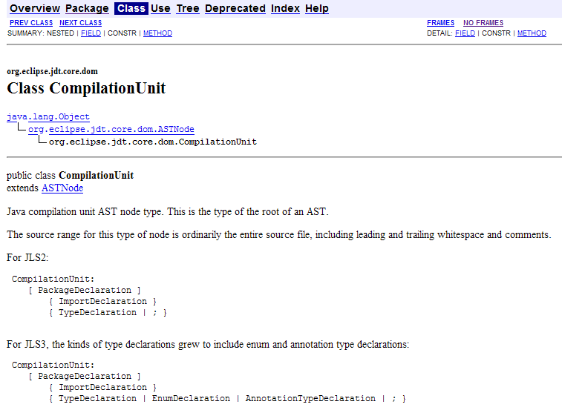
CompilationUnit

Slide 31
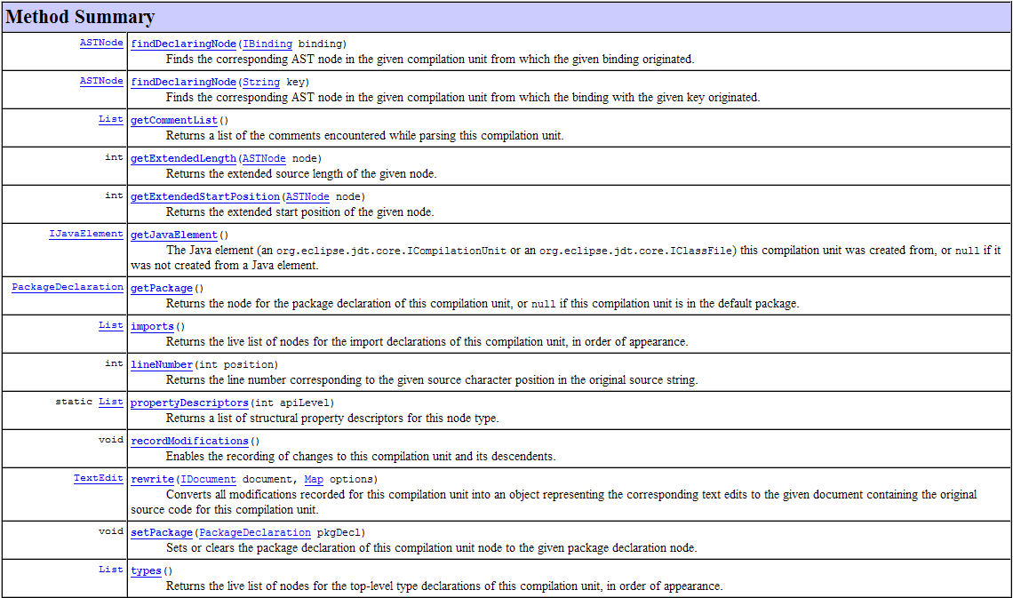
CompilationUnit API

Slide 32
CompilationUnit Example
// create a Java AST factory object (Java Lang Spec 3)
AST ast = AST.newAST(AST.JLS3);
// create a compilation unit
CompilationUnit cu = ast.newCompilationUnit();
// add a new class
{
TypeDeclaration td = ast.newTypeDeclaration();
// unfortunately, JDT DOM doesn't use generic
// i.e., no type check when adding new element
// but runtime check is done by the API
cu.types().add(td); // what is td's class name?
}
// iterate over the types in the compilation unit
for (Object o: cu.types())
{
TypeDeclaration td = (TypeDeclaration) o;
// process td
}

Slide 33
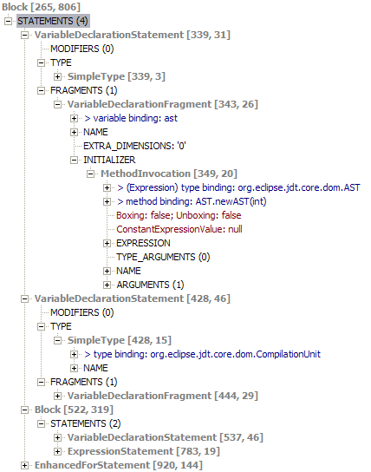
JDT ASTViewer Plugin (Demo)
// create a Java AST factory object (Java Lang Spec 3)
AST ast = AST.newAST(AST.JLS3);
// create a compilation unit
CompilationUnit cu = ast.newCompilationUnit();
// add a new class
{
TypeDeclaration td = ast.newTypeDeclaration();
// unfortunately, JDT DOM doesn't use generic
// i.e., no type check when adding new element
// but runtime check is done by the API
cu.types().add(td); // what is td's class name?
}
// iterate over the types in the compilation unit
for (Object o: cu.types())
{
TypeDeclaration td = (TypeDeclaration) o;
// process td
}

Slide 34
JDT DOM Designs
independent of any JDK version
  i.e., Java generics cannot be leveraged
default values for missing node info
  reduces runtime exception checks
uses the visitor pattern for AST traversal
  separates AST traversal from node processing
  leverages dynamic method dispatch in OOP

Slide 35
Bottom-Up AST Construction in Top-Down Parsing
Top-down parsers perform actions when they recognize terminals or non-terminals
  this makes it natural to construct AST structures bottom-up
    to create AST for A from the rule A ::= B, then we need to construct B first
  in ANTLR we can attach AST construction code in a similar way to the syntax directed evaluation parser example

Slide 36
StaticJava ASTParser ─
Compilation Unit
compilationUnit
returns [CompilationUnit result = ast.newCompilationUnit()]
{
TypeDeclaration td;
}
: td=classDefinition { // add a new class
result.types().add(td);
}
EOF
;

Slide 37
StaticJava ASTParser ─
Class Declaration
classDefinition returns [TypeDeclaration result = ast.newTypeDeclaration()]
{
String className; MethodDeclaration md; FieldDeclaration fd;
}
: "public“ { result.modifiers().add(
ast.newModifier(Modifier.
ModifierKeyword.PUBLIC_KEYWORD));
}
"class" id:IDENT LCURLY { className = id.getText();
result.setName(
ast.newSimpleName(className));
}
md=mainMethodDeclaration { result.bodyDeclarations().add(md); }
(
("static" type IDENT SEMI) =>
fd=fieldDeclaration { result.bodyDeclarations().add(fd); }
| md=methodDeclaration { result.bodyDeclarations().add(md); }
)* RCURLY
;

Slide 38
StaticJava ASTParser ─
If-Else Statement
ifStatement returns [IfStatement result = ast.newIfStatement()]
{
Block thenStatement = ast.newBlock(); result.setThenStatement(thenStatement);
Block elseStatement = ast.newBlock(); result.setElseStatement(elseStatement);
Expression condExp; Statement s;
}
: "if" LPAREN condExp=exp RPAREN { result.setExpression(condExp); }
LCURLY
(
s=statement { thenStatement.statements().add(s); }
)*
RCURLY
( "else" LCURLY
(
s=statement { elseStatement.statements().add(s); }
)*
RCURLY
)?
;

Slide 39
StaticJava ASTParser ─
Multiplicative Expression
multiplicativeExp returns [Expression result = null]
{
Expression e; InfixExpression.Operator op = null;
}
: result=unaryExp
(
(
STAR { op = InfixExpression.Operator.TIMES; }
| DIV { op = InfixExpression.Operator.DIVIDE; }
| MOD { op = InfixExpression.Operator.REMAINDER; }
)
e=unaryExp {
InfixExpression ie = ast.newInfixExpression();
ie.setLeftOperand(result);
ie.setOperator(op);
ie.setRightOperand(e);
result = ie;
}
)*
;

Slide 40
StaticJava ASTParser ─
Invoke Expression
invokeExp returns [MethodInvocation result = ast.newMethodInvocation()]
{ String className = null; String methodName; ArrayList<Expression> es; }
: ( id1:IDENT { className = id1.getText();
result.setExpression(ast.newSimpleName(className));
}
DOT )?
id2:IDENT { methodName = id2.getText();
result.setName(ast.newSimpleName(methodName));
}
LPAREN ( es=args { result.arguments().addAll(es); }
)? RPAREN
;
args returns [ArrayList<Expression> result = new ArrayList<Expression>()]
{ Expression e; }
: e=exp { result.add(e); }
(
COMMA e=exp { result.add(e); }
)*
;

Slide 41
The Visitor Pattern ─
Motivation
Roughly speaking a computation can be broken down into
  Data -- the values being operated on
  Algorithm -- the operations applied to the data
Many software design approaches advocate coupling data and algorithms
  e.g., ADTs usually provide algorithms for encapsulated data behind an opaque interface
Sometimes this is the wrong decision
  e.g., when an algorithm can be applied to a wide variety of data we don’t want to have to implement the common parts of it repeatedly

Slide 42
AST Traversal ─
Collecting Integer Literals
public void collectInt(Expression e) {
if (e instanceof BooleanLiteral) {
// skip
} else if (e instanceof NumberLiteral) {
collectInt((NumberLiteral) e);
} else if (e instanceof PrefixExpression){
collectInt((PrefixExpression) e);
} else if (e instanceof InfixExpression) {
collectInt((InfixExpression) e);
} else if (e instanceof
ParenthesizedExpression) {
collectInt((ParenthesizedExpression) e);
} else if (e instanceof
MethodInvocation) {
collectInt((MethodInvocation) e);
} else if (e instanceof SimpleName) {
// skip
} else { assert false; } }
public void collectInt(NumberLiteral e) {
addInt(Integer.parseInt(e.getToken()));
}
public void collectInt(PrefixExpression e) {
collectInt(e.getOperand());
}
public void collectInt(InfixExpression e) {
collectInt(e.getLeftOperand());
collectInt(e.getRightOperand());
}
public void collectInt(ParenthesizedExpression e)
{
collectInt(e.getExpression());
}
public void collectInt(MethodInvocation e) {
for (Object o : e.arguments()) {
collectInt((Expression) o);
}
}

Slide 43
AST Traversal ─
Collecting Variable Names
public void collectName(Expression e) {
if (e instanceof BooleanLiteral) {
// skip
} else if (e instanceof NumberLiteral) {
// skip
} else if (e instanceof PrefixExpression){
collectName((PrefixExpression) e);
} else if (e instanceof InfixExpression) {
collectName((InfixExpression) e);
} else if (e instanceof
ParenthesizedExpression) {
collectName((ParenthesizedExpression)e);
} else if (e instanceof
MethodInvocation) {
collectName((MethodInvocation) e);
} else if (e instanceof SimpleName) {
collectName((SimpleName) e);
} else { assert false; } }
public void collectName(PrefixExpression e) {
collectName(e.getOperand());
}
public void collectName(InfixExpression e) {
collectName(e.getLeftOperand());
collectName(e.getRightOperand());
}
public void collectName(ParenthesizedExpression e)
{
collectName(e.getExpression());
}
public void collectName(MethodInvocation e) {
for (Object o : e.arguments()) {
collectName((Expression) o);
}
}
public void collectName(SimpleName e) {
addName(e.getIdentifier());
}

Slide 44
Assessment (1)
Each collecting algorithm requires
  The traversal of the sub-structure of expression, e.g., collectX (Expression)
  The part-specific processing, i.e., collectInt(NumberLiteral) and collectName(SimpleName)
Traversing the structure of the data is common to all of the operations
  but it is implemented independently in each algorithm

Slide 45
Assessment (2)
What happens if we add another kind of expression in our AST/language?
  assertion failure happens (if assertion check is enabled, otherwise ?)
  need to add a new if-else case for both code base
    what if we have various algorithms that work on the AST?
    we need to adapt all the (traversal) code
Can we find a way to factor traversal out of an operation?
  we still need to be able to specify the part-specific processing

Slide 46
AST Traversal ─
Visitor Pattern in JDT
public abstract class ASTNode {
abstract void accept0(ASTVisitor visitor);
public void accept(ASTVisitor visitor) {
if (visitor == null) {
throw new IllegalArgumentException();
}
…
accept0(visitor);
…
}
final void acceptChild(ASTVisitor visitor,
ASTNode child) {
if (child == null) { return; }
child.accept(visitor);
}
}
public class InfixExpression extends Expression {
void accept0(ASTVisitor visitor) {
boolean visitChildren = visitor.visit(this);
if (visitChildren) {
acceptChild(visitor, getLeftOperand());
acceptChild(visitor, getRightOperand());
…
}
visitor.endVisit(this);
}
}
public abstract class ASTVisitor {
public boolean visit(InfixExpression node) {
return true;
}
public void endVisit(InfixExpression node) {}
}

Slide 47
Class Interaction
Suppose we have an InfixExpression e, when we invoke e.accept(visitor)
ASTNode
InfixExpression
ASTVisitor
accept (Visitor)
accept0(Visitor)
visit(InfixExpression)
returns true
acceptChild(Expression)
acceptChild(Expression)
endVisit(InfixExpression)

Slide 48
Assessment (4)
ASTNode provides a generic accept method to initiate AST traversal
Each AST node (e.g., InfixExpression) implements the abstract accept0 method that traverse its subnodes
ASTVisitor provides default methods that basically do nothing except instructing that the node traversal should continue to visit subnodes

Slide 49
Assessment (5)
Notice that if-else and type casting to handle different kinds of AST node are not needed
  replaced by dynamic dispatch of accept0
When one overrides the ASTVisitor visit and endVisit methods
  dynamic method dispatch will not call the default methods in ASTVisitor
  it will invoke the overriding methods

Slide 50
AST Traversal ─
Collecting Int Literal Revisited
public abstract class ASTNode {
abstract void accept0(ASTVisitor visitor);
public void accept(ASTVisitor visitor) {
if (visitor == null) {
throw new IllegalArgumentException();
}
…
accept0(visitor);
…
}
final void acceptChild(ASTVisitor visitor,
ASTNode child) {
if (child == null) { return; }
child.accept(visitor);
}
}
public class NumberLiteral extends Expression {
void accept0(ASTVisitor visitor) {
visitor.visit(this);
visitor.endVisit(this);
}
}
public abstract class ASTVisitor {
public boolean visit(NumberLiteral node) {
return true;
}
public void endVisit(NumberLiteral node) {}
}
…
e.accept(new ASTVisitor() {
public boolean visit(NumberLiteral node) {
addInt(Integer.parseInt(node.getToken()));
return false;
}
});

Slide 51
AST Traversal ─
Collecting Var Name Revisited
public abstract class ASTNode {
abstract void accept0(ASTVisitor visitor);
public void accept(ASTVisitor visitor) {
if (visitor == null) {
throw new IllegalArgumentException();
}
…
accept0(visitor);
…
}
final void acceptChild(ASTVisitor visitor,
ASTNode child) {
if (child == null) { return; }
child.accept(visitor);
}
}
public class SimpleName extends Expression {
void accept0(ASTVisitor visitor) {
visitor.visit(this);
visitor.endVisit(this);
}
}
public abstract class ASTVisitor {
public boolean visit(SimpleName node) {
return true;
}
public void endVisit(SimpleName node) {}
}
…
e.accept(new ASTVisitor() {
public boolean visit(SimpleName node) {
addName(node.getIdentifier());
return false;
}
});

Slide 52
For You To Do
Does the code in the previous slide only collect variable names?
  look at the various Expression API in Eclipse JDT DOM and think about what SimpleName are used for
Fix the previous code accordingly
  hint: see the code for collectName(MethodInvocation e)

Slide 53
Assessment (6)
What happens if we add another kind of expression in our AST/language?
  the new node is responsible for its traversal (changes are localized)
  need to add default methods in the AST visitor
Avoiding pitfalls
  notice that if we add another kind of node, then our previous code may not break (as in the assertion failure case)
    however, we still need to make sure that the new node does not require changes in the actual processing algorithm
  we need to keep in mind the context of where the AST node can be traversed from

Slide 54
Weeding-out Divide by Zero
In the grammar, we can prevent the following input: “3 / 0”
  we can use ANTLR semantic predicates in the grammar
  but, we can do a separate check pass
cu.accept(new ASTVisitor() {
public boolean visit(InfixExpression node) {
if (node.getOperator() == InfixExpression.Operator.DIVIDE) {
if ("0".equals(node.getRightOperand().toString().trim())) {
// signal error
}
}
return super.visit(node);
} });

Slide 55
Weeding-out Multi Array Access
In the grammar, we can prevent the following input: “a[0][0]”
  we can use ANTLR semantic predicates in the grammar
  but, we can do a separate check pass
cu.accept(new ASTVisitor() {
public boolean visit(ArrayAccess node) {
if (node.getArray() instanceof ArrayAccess) {
// signal error
}
return super.visit(node);
}
});

