Slide 1
Garbage Collection
Matthew Dwyer
324E Nichols Hall
dwyer@cis.ksu.edu
http://www.cis.ksu.edu/~dwyer

Slide 2
Garbage Collector
is part of the run-time system: it reclaims heap-allocated records that are no longer used.
A garbage collector should:
  reclaim all unused records;
  spend very little time per record;
  not cause significant delays; and
  allow all of memory to be used.
These are difficult and often conflicting requirements.

Slide 3
Without Garbage Collection
unused records must be explicitly deallocated;
superior if done correctly;
but it is easy to miss some records; and
it is dangerous to handle pointers.

Slide 4
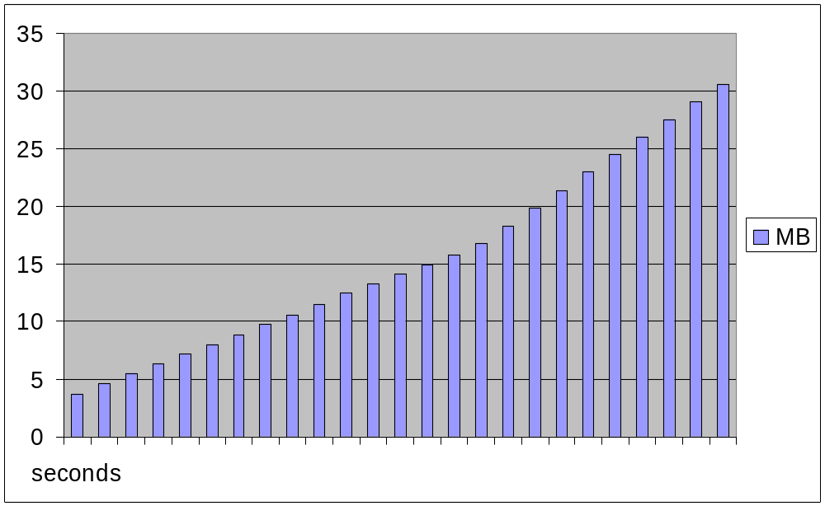
Memory leaks in real life (ical v.2.1)

Slide 5
Which records are in use?
Ideally, records that will never be accessed in the future execution of the program.
  but that is of course undecidable...
Basic conservative assumption:
  A record is live if it is reachable from a stack-based program variable.
Dead records may still be pointed to by other dead records.

Slide 6
Heap with Live and Dead Records
p
37
q
r
12
15
37
59
20
7
9

Slide 7
Mark and Sweep
Algorithm
  explore pointers starting from the program variables, and mark all
  records encountered;
  sweep through all records in the heap and reclaim the unmarked ones; also
  unmark all marked records.
Assumptions:
  we know the size of each record;
  we know which fields are pointers; and
  reclaimed records are kept in a freelist.

Slide 8
Mark-and-sweep Code
function DFS(x)
if x is a pointer into the heap then
if record x is not marked then
mark record x
for i in 1 .. |x| do
DFS(x.f_{i})

Slide 9
Mark-and-sweep Code
function Mark()
for each program variable v do
DFS(v)

Slide 10
Mark-and-sweep Code
function Sweep()
p := first address in heap
while p < last address in heap do
if record p is marked then
unmark record p
else
p.f₁ := freelist
freelist := p
p := p + sizeof(record p)

Slide 11
Example
p
37
q
r
12
15
37
59
20
7
9

Slide 12
Example
p
37
q
r
12
15
37
59
20
7
9

Slide 13
Example
p
37
q
r
12
15
37
59
20
7
9

Slide 14
Example
p
37
q
r
12
15
37
59
20
7
9

Slide 15
Example
p
37
q
r
12
15
37
59
20
7
9

Slide 16
Example
p
37
q
r
12
15
37
59
20
7
9

Slide 17
Example
p
37
q
r
12
15
37
59
20
7
9

Slide 18
Example
p
freelist
37
q
r
12
15
37
59
20
7
9

Slide 19
Example
p
freelist
37
q
r
12
15
37
59
20
7
9

Slide 20
Analysis of Mark-and-Sweep
Assume the heap has R of H words that reachable.
The cost of garbage collection is:
  c₁R + c₂H
Realistic values are:
  10R + 3H
The cost per reclaimed word is:
(c₁R + c₂H)(H-R)
  if R is close to H, then this is expensive;
  the lower bound is c₂;
  increase the heap when R > 0.5H; then
  the cost per word is c₁ + 2c₂ =16.

Slide 21
Other Issues
The DFS recursion stack could have size H (and has at least size log H), which may be too much
  however, the recursion stack can cleverly be embedded in the fields of marked records (pointer reversal).
Records can be kept sorted by sizes in the freelist. Records may be split into smaller pieces if necessary.
The heap may become fragmented: containing many small free records but none that are large enough.

Slide 22
Reference Counting
Algorithm
  maintain a counter of the references to each record;
  for each assignment, update the counters appropriately; and
  a record is dead when its counter is zero.
Advantages:
  is simple and attractive;
  catches dead records immediately; and
  does not cause long pauses.
Disadvantages:
  cannot detect cycles of dead records; and
  is much too expensive.

Slide 23
Reference Counting Code
function Increment(x)
x.count := x.count + 1
function Decrement(x)
x.count := x.count – 1
if x.count == 0 then
PutOnFreeList(x)

Slide 24
Reference Counting Code
function PutOnFreelist(x)
Decrement(x.f₁)
x.f₁ := freelist
freelist := x
function RemoveFromFreelist(x)
for i in 2 … |x| do
Decrement(x.f_{i})

Slide 25
Stop-and-Copy Counting
Algorithm
  divide the heap into two parts;
  only use one part at a time;
  when it runs full, copy live records to the other part; and
  switch the roles of the two parts.
Advantages:
  allows fast allocation (no freelist);
  avoids fragmentation;
  collects in time proportional to R; and
  avoids stack and pointer reversal.
Disadvantage:
  wastes half your memory.

Slide 26
Example Stop-and-copy
next identifies address of a block of free memory
limit is maximum address
next
limit
from-space to-space

Slide 27
Example Stop-and-copy
next
limit
from-space to-space

Slide 28
Example Stop-and-copy
next
limit
from-space to-space

Slide 29
Example Stop-and-copy
Copied records are contiguous in memory
next
limit
to-space from-space

Slide 30
Copy Code
function Copy()
scan := next := start of to-space
for each program variable v do
v := Forward(v)
while scan < next do
for i in 1 .. |scan| do
scan.f_{i} := Forward(scan.f_{i})
scan := scan + sizeof(record scan)

Slide 31
Copy Code
function Forward(p)
if p in from-space then
if p.f₁ in to-space then
return p.f₁
else
for i in 1 .. |p| do
next.f_{i} := p.f_{i}
p.f_{i} := next
next := next + sizeof(record p)
return p.f₁
else return p

Slide 32
Analysis of Stop-and-Copy
Assume the heap has R of H words that reachable.
The cost of garbage collection is:
  c₃R
Realistic values are:
  10R
The cost per reclaimed word is:
(c₃R)(H/2 - R)
  no lower bound as H grows;
  If H = 4R then the cost is constant at approximately 10

Slide 33
Earlier Assumptions
We assumed
  we know the size of each record; and
  we know which fields are pointers.
For object-oriented languages, each record already contains a pointer to a class descriptor.
For general languages, we must sacrifice a few bytes per record.

Slide 34
For You To Do
What algorithm should we use?
Under what conditions?

Slide 35
Common Algorithms
Mark-and-sweep or stop-and-copy
Garbage collection is expensive
  ~100 instructions for a small object
Extensions
  Generational and Region-based Collection
    Identify objects that die around same time and collect them at once -- faster
  Incremental and partial collection
    Reclaim only a part of the heap at a time -- smoother

Slide 36
Generational Collection
observation: the young die quickly;
hence the collector should focus on young records;
divide the heap into generations: G₀, G₁, G₂, …;
all records in G_{i} are younger than records in G_{i+1};
collect G₀ often, G₁ less often, and so on; and
promote a record from G_{i} to G_{i+1} when it survives several collections.

Slide 37
Generational Collection
How to collect the G₀ generation:
  roots are no longer just program variables but also pointers from G₁, G₂, …;
  it might be very expensive to find those pointers;
  fortunately, they are rare; so we can try to remember them.
Ways to remember:
  maintain a list of all updated records (use marks to make this a set);
  mark pages of memory that contain updated records (in hardware or software);
  Syntactic extensions (e.g., RTJava scoped memory)

Slide 38
Incremental Collection
Garbage collection may cause long pauses
  this is undesirable for interactive or real-time programs; so
  try to interleave the garbage collection with the program execution.
Two players access the heap:
  the mutator: creates records and moves pointers around; and
  the collector: tries to collect garbage.
Some invariants are clearly required to make this work.
  The mutator will suffer some slowdown to maintain these invariants.

