Slide 1
Native Code Generation
Matthew Dwyer
324E Nichols Hall
dwyer@cis.ksu.edu
http://www.cis.ksu.edu/~dwyer

Slide 2
Compile Time
JOOS programs are compiled into bytecode.
This bytecode can be executed using:
  an interpreter;
  an Ahead-Of-Time (AOT) compiler; or
  a Just-In-Time (JIT) compiler.
Bytecode is compiled into native code.

Slide 3
Interpreters
are easier to implement than compilers;
can be very portable; but
suffer an inherent inefficiency

Slide 4
Interpreters
pc = code.start;
while(true)
{ npc = pc + instruction_length(code[pc]);
switch (opcode(code[pc]))
{ ILOAD_1: push(local[1]); break;
ILOAD: push(local[code[pc+1]]); break;
ISTORE: t = pop();
local[code[pc+1]] = t; break;
IADD: t1 = pop(); t2 = pop();
push(t1 + t2); break;
IFEQ: t = pop();
if (t == 0) npc = code[pc+1]; break;
...
}
pc = npc;
}

Slide 5
Ahead-of-Time Compilers
translate the low-level intermediate form into native code;
create all object files, which are then linked, and finally executed.
This is not so useful for Java and JOOS:
  method code is fetched as it is needed;
  from across the internet; and
  from multiple hosts with different native code sets.

Slide 6
Just-in-Time Compilers
merge interpreting with traditional compilation;
have the overall structure of an interpreter; but
method code is handled differently.
When a method is invoked for the first time:
  the bytecode is fetched;
  it is translated into native code; and
  control is given to the newly generated native code.
When a method is invoked subsequently:
  control is simply given to the previously generated native code.

Slide 7
Features of a JIT Compiler
it must be fast, because the compilation occurs at run-time;
  Just-In-Time is really Just-Too-Late
it does not generate optimized code;
it does not compile every instruction into native code, but relies on the runtime library for complex instructions;
it need not compile every method; and
it may concurrently interpret and compile a method
  Better-Late-Than-Never

Slide 8
Generating Native Code
instruction selection
  choose the correct instructions based on the native code instruction set
memory modelling
  decide where to store variables and how to allocate registers
method calls
  determine calling conventions
branch handling
  allocate branch targets

Slide 9
JVM to VirtualRISC
map the Java local stack into registers and memory;
do instruction selection on the fly;
allocate registers on the fly; and
allocate branch targets on the fly.
Several real JITs do this (e.g., Kaffe)

Slide 10
CodeGen Algorithm
determine number of slots in frame:
  locals limit + stack limit + # temps
find starts of basic blocks;
find local stack height for each bytecode;
emit prologue;
emit native code for each bytecode; and
fix up branches.

Slide 11
Naïve Approach
each local and stack location is mapped to an offset in the native frame;
each bytecode is translated into a series of native instructions, which
constantly move locations between memory and registers.
This is similar to the native code generated by a non-optimizing compiler.

Slide 12
Example : Source
public void foo() {
int a,b,c;
a = 1;
b = 13;
c = a + b;
}

Slide 13
Example : Generated Bytecode
.method public foo()V
.limit locals 4
.limit stack 2
iconst_1 ; 1
istore_1 ; 0
ldc 13 ; 1
istore_2 ; 0
iload_1 ; 1
iload_2 ; 2
iadd ; 1
istore_3 ; 0
return ; 0
compute frame size
  4 + 2 + 0 = 6;
find stack height for each
bytecode;
emit prologue; and
emit native code for each
bytecode.

Slide 14
Example : Frame Slot Assignments
name offset location
a 1 [fp-32]
b 2 [fp-36]
c 3 [fp-40]
stack 0 [fp-44]
stack 1 [fp-48]

Slide 15
save sp,-136,sp
a = 1; iconst_1 mov 1,R1
st R1,[fp-44]
istore_1 ld [fp-44],R1
st R1,[fp-32]
b = 13; ldc 13 mov 13, R1
st R1,[fp-44]
istore_2 ld [fp-44], R1
st R1,[fp-36]
c = a + b; iload_1 ld [fp-32],R1
st R1,[fp-44]
iload_2 ld [fp-36],R1
st R1,[fp-48]
iadd ld [fp-48],R1
ld [fp-44],R2
add R2,R1,R1
st R1,[fp-44]
istore_3 ld [fp-44],R1
st R1,[fp-40]
return restore
ret

Slide 16
Naïve Code is Slow
Many unnecessary loads and stores
  Which are the most expensive operations
We would like to replace load/store operations with register operations
  Requires that we assign registers to JVM local stack locations

Slide 17
Naïve Code is Slow
c = a + b; iload_1 ld [fp-32],R1
st R1,[fp-44]
iload_2 ld [fp-36],R1
st R1,[fp-48]
iadd ld [fp-48],R1
ld [fp-44],R2
add R2,R1,R1
st R1,[fp-44]
istore_3 ld [fp-44],R1
st R1,[fp-40]
Becomes
c = a + b; iload_1 ld [fp-32],R1
iload_2 ld [fp-36],R2
iadd add R1,R2,R1
istore_3 st R1,[fp-40]

Slide 18
Register Allocation
A fixed register allocation scheme:
  assign m registers to the first m locals;
  assign n registers to the first n stack locations;
  assign k scratch registers; and
  spill remaining locals and locations into memory.
Example for 6 registers (m=n=k=2):
name offset location register
a 1 R1
b 2 R2
c 3 [fp-40]
stack 0 R3
stack 1 R4
scratch 0 R5
scratch 1 R6

Slide 19
Register Allocation Improves Code
save sp,-136,sp
a = 1; iconst_1 mov 1,R3
istore_1 mov R3,R1
b = 13; ldc 13 mov 13,R3
istore_2 mov R3,R2
c = a + b; iload_1 mov R1,R3
iload_2 mov R2,R4
iadd add R3,R4,R3
istore_3 st R3,[fp-40]
return restore
ret

Slide 20
Register Allocation Improves Code
This works quite well if:
  the architecture has a large register set;
  the stack is small most of the time; and
  the first locals are used most frequently.

Slide 21
Summary of Fixed Register Allocation
registers are allocated once; and
the allocation does not change within a method.
Advantages:
  it's simple to do the allocation; and
  no problems with different control flow paths.
Disadvantages:
  assumes the first locals and stack locations are most important; and
  may waste registers within a region of a method.

Slide 22
Basic Block Register Allocation
The basic block register allocation scheme:
  assign frame slots to registers on demand within a basic block; and
  update descriptors at each bytecode.
The descriptor maps a slot to an element of the set
                 

Slide 23
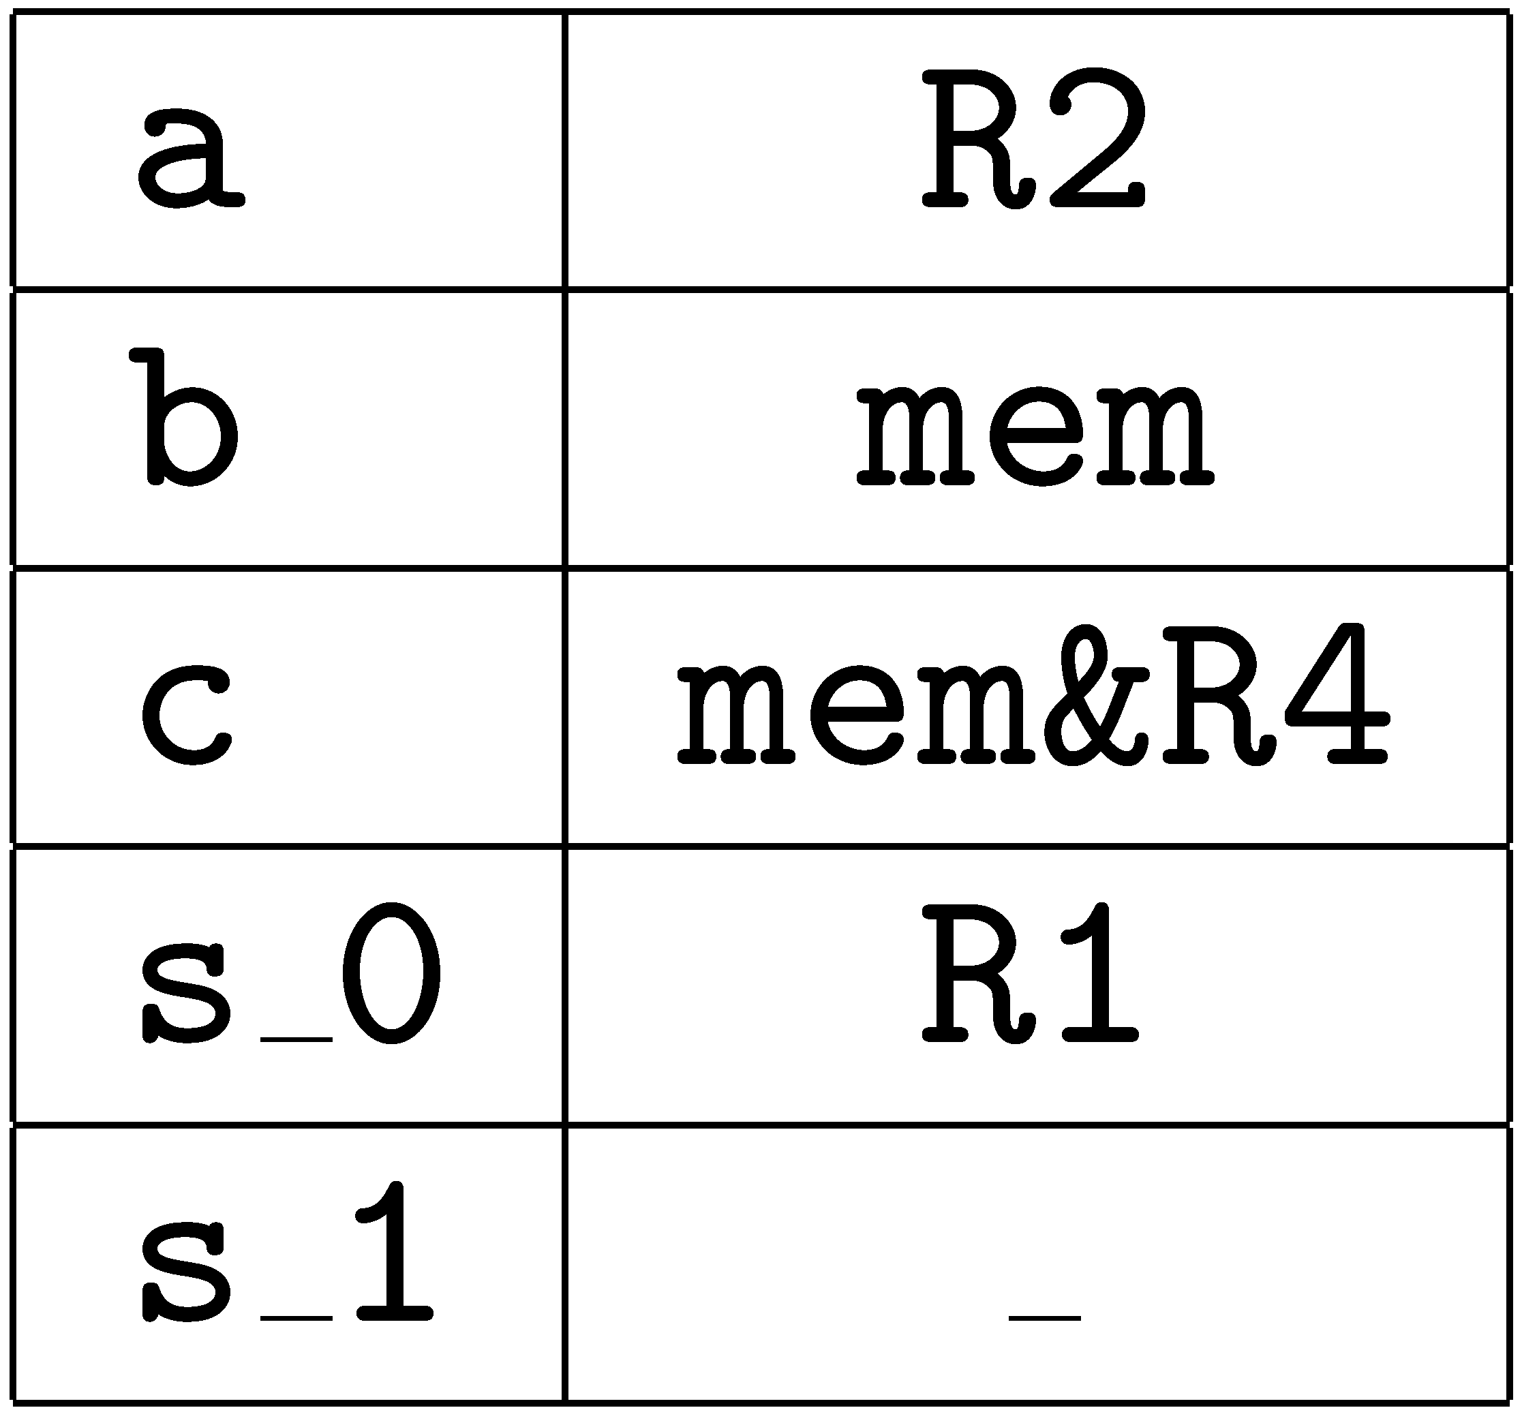
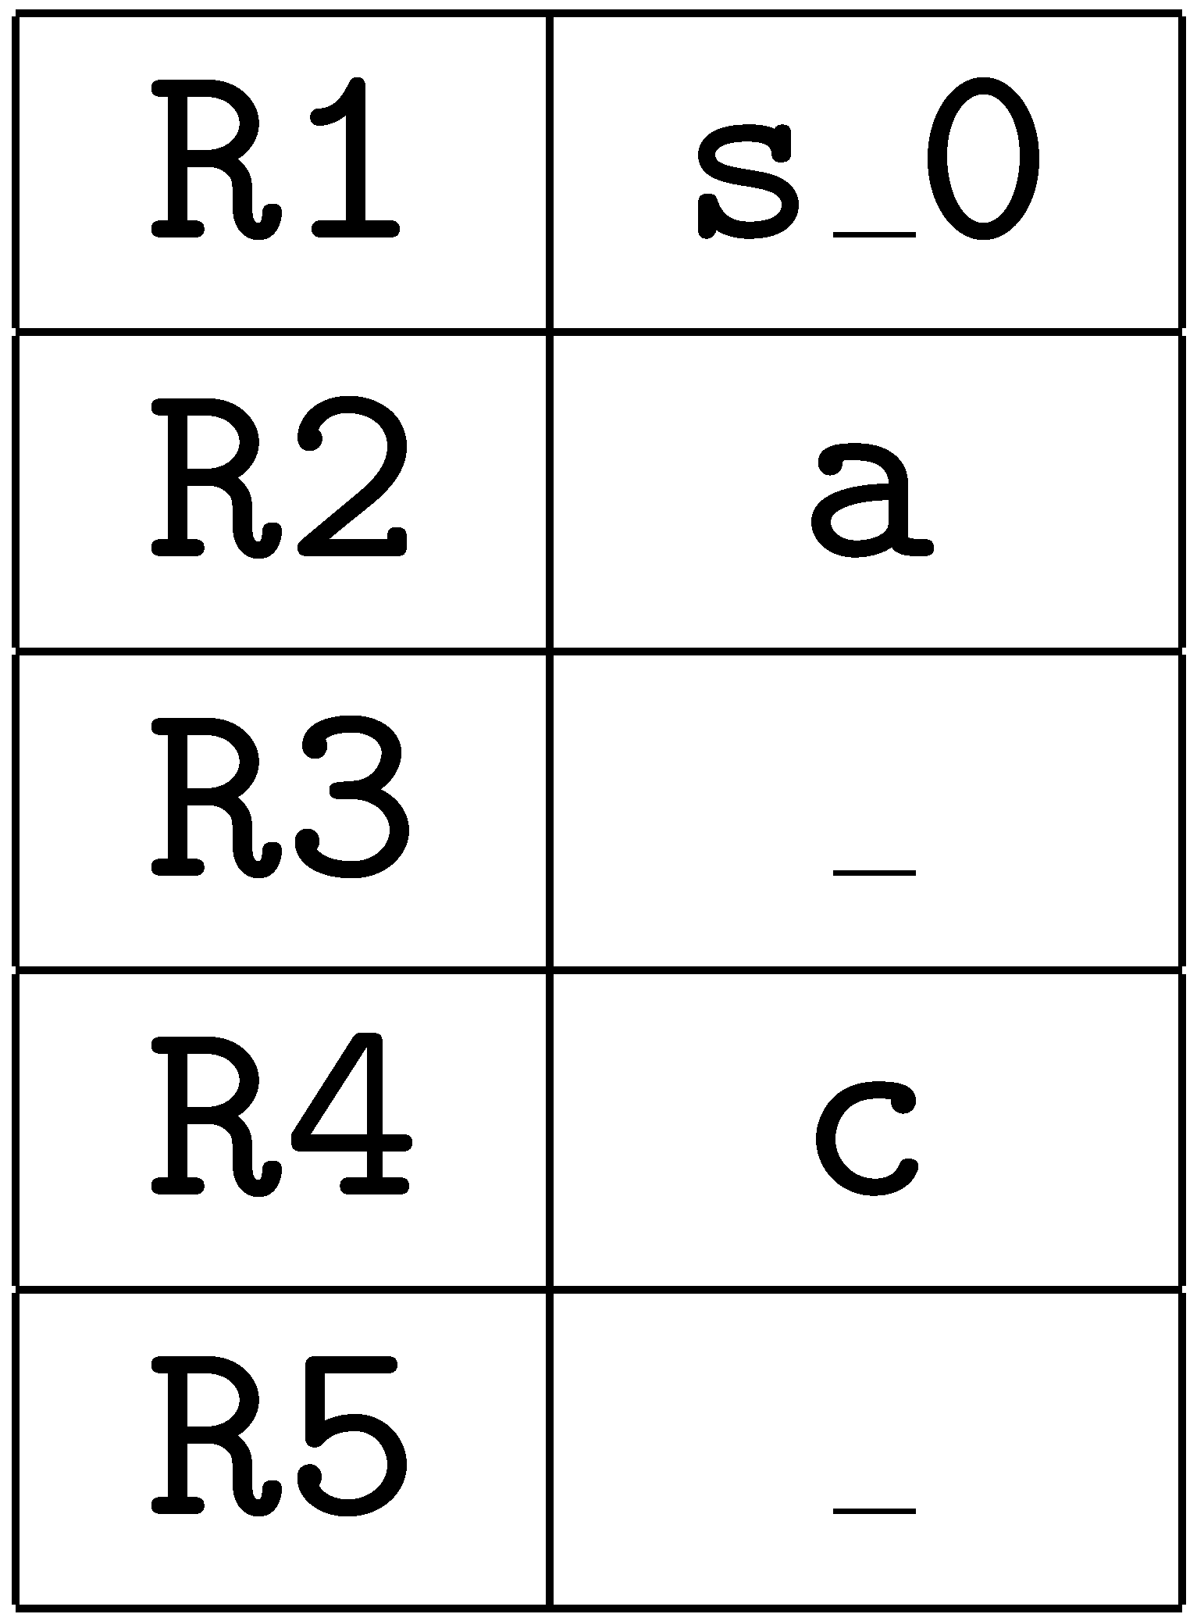
Basic Block Register Allocation
For our example:
We also keep the
inverse register map:

Slide 24
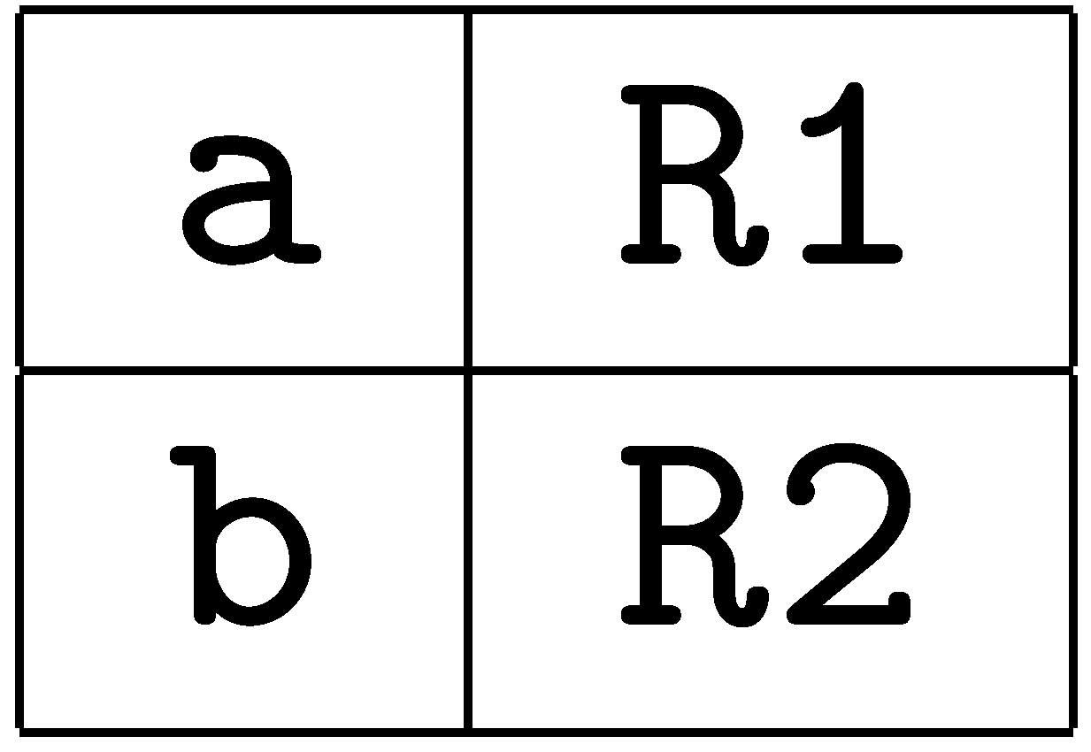
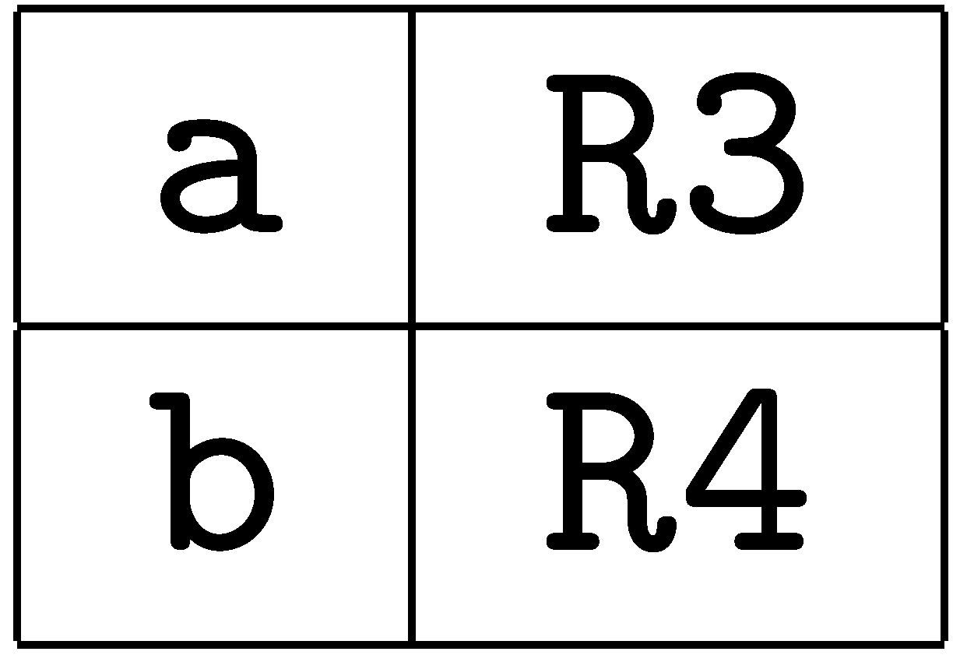

Treating Control Flow
At the beginning of a block, all slots are in memory.
Basic blocks are merged by control paths:

Slide 25
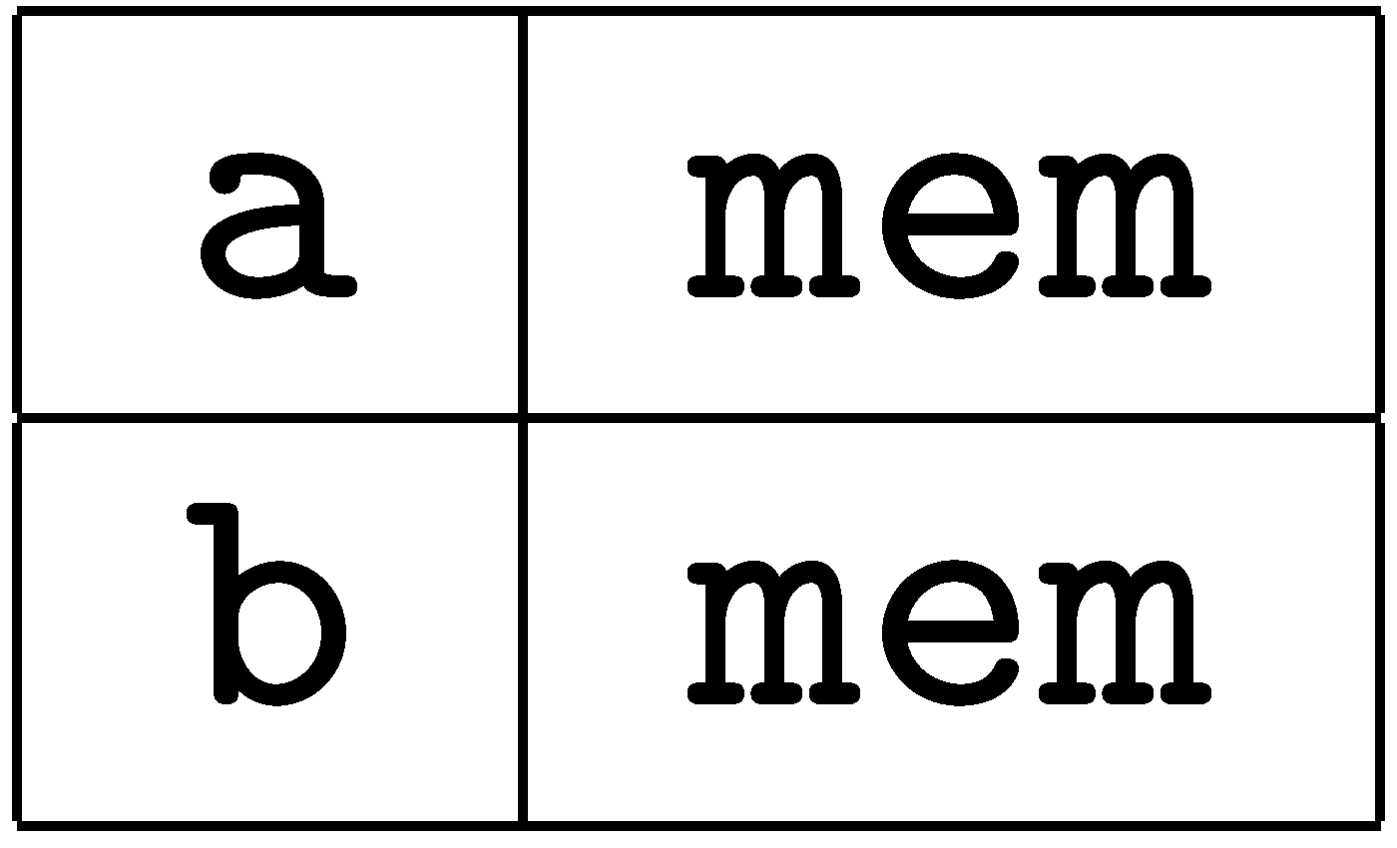
Treating Control Flow
Registers must be spilled after basic blocks:
st R1, [fp-32]
st R2,[fp-36]
st R3, [fp-32]
st R4,[fp-36]

Slide 26
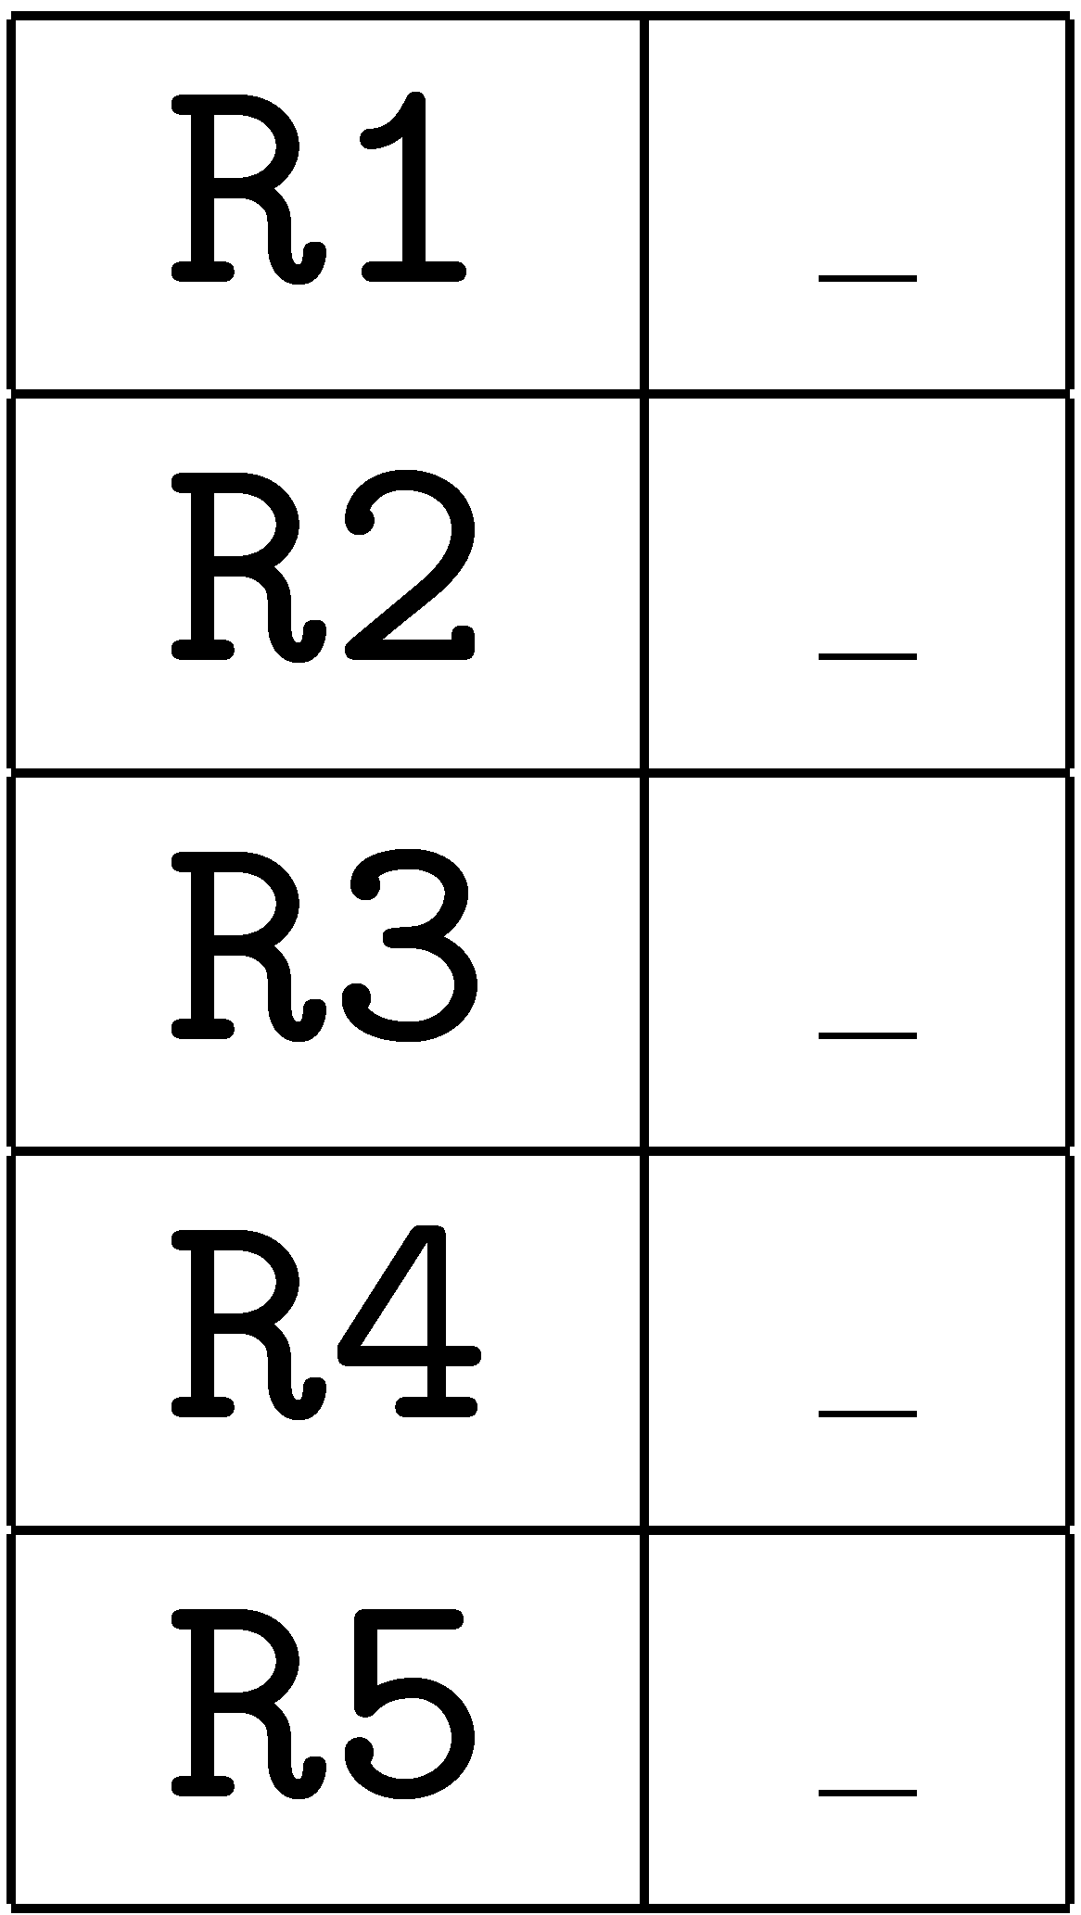
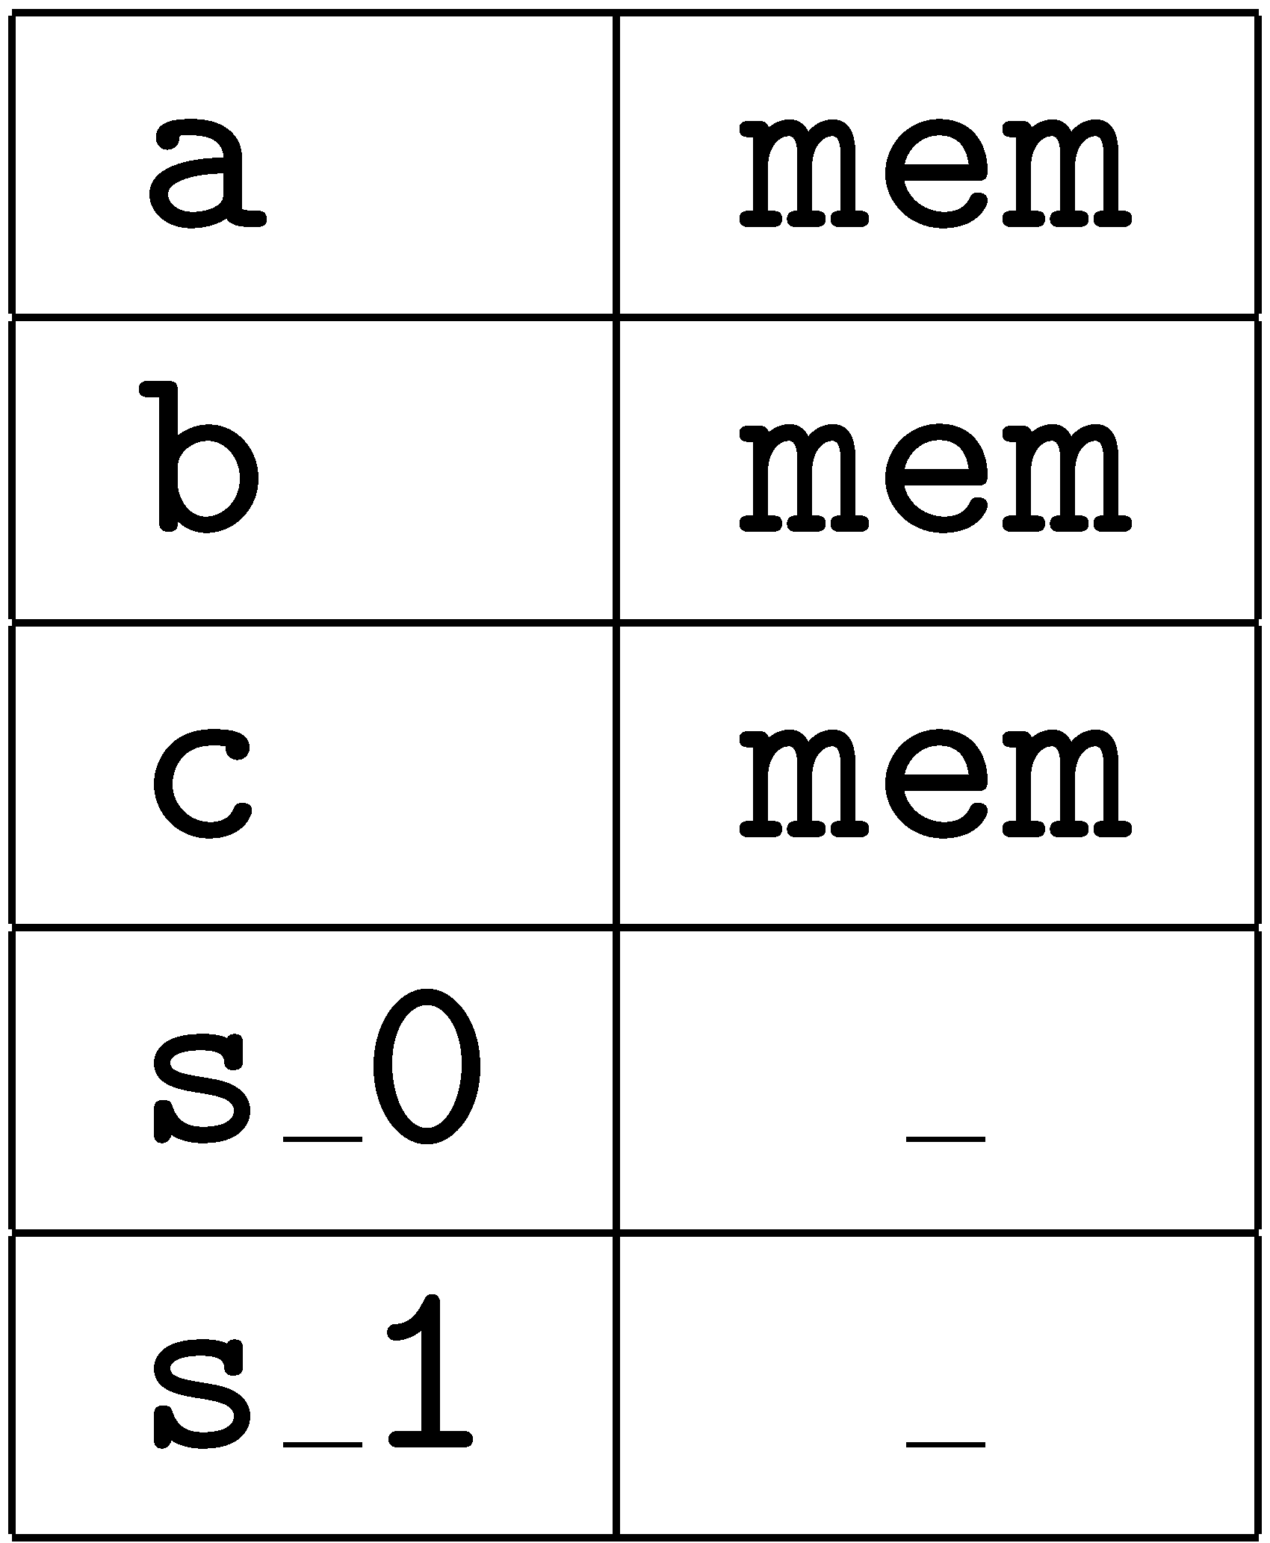
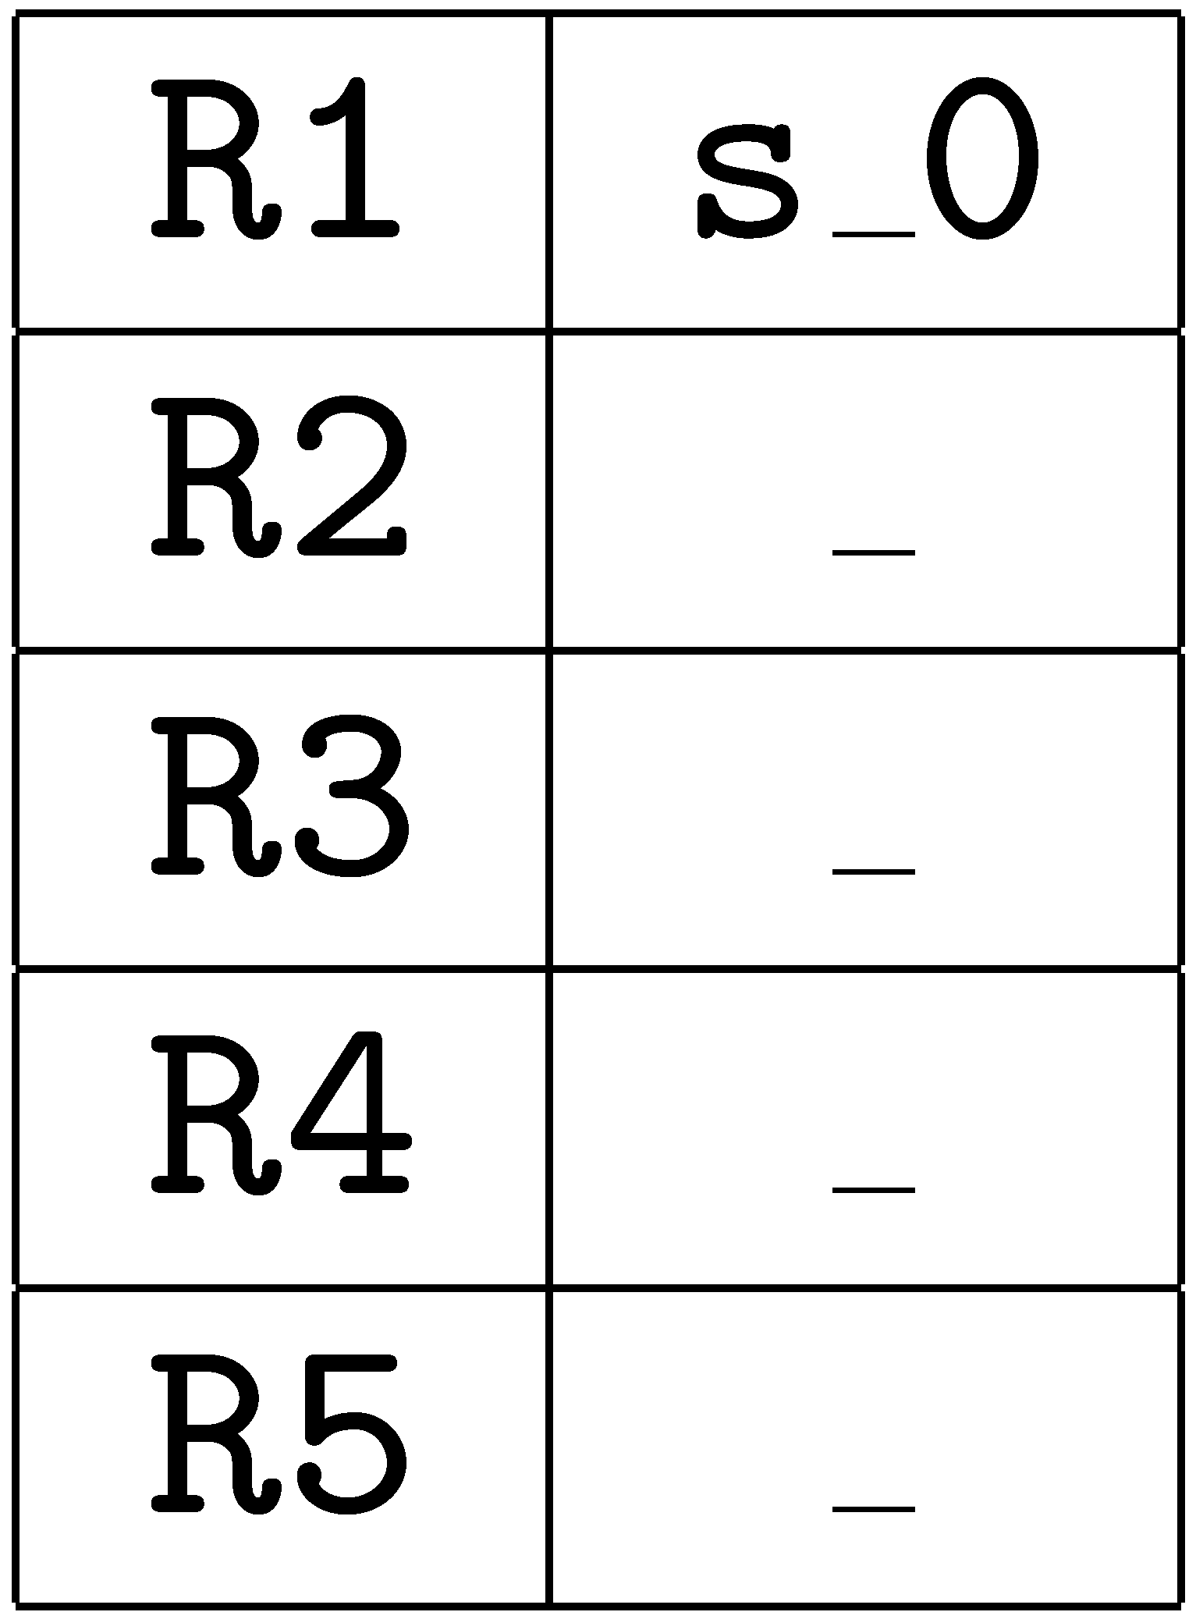
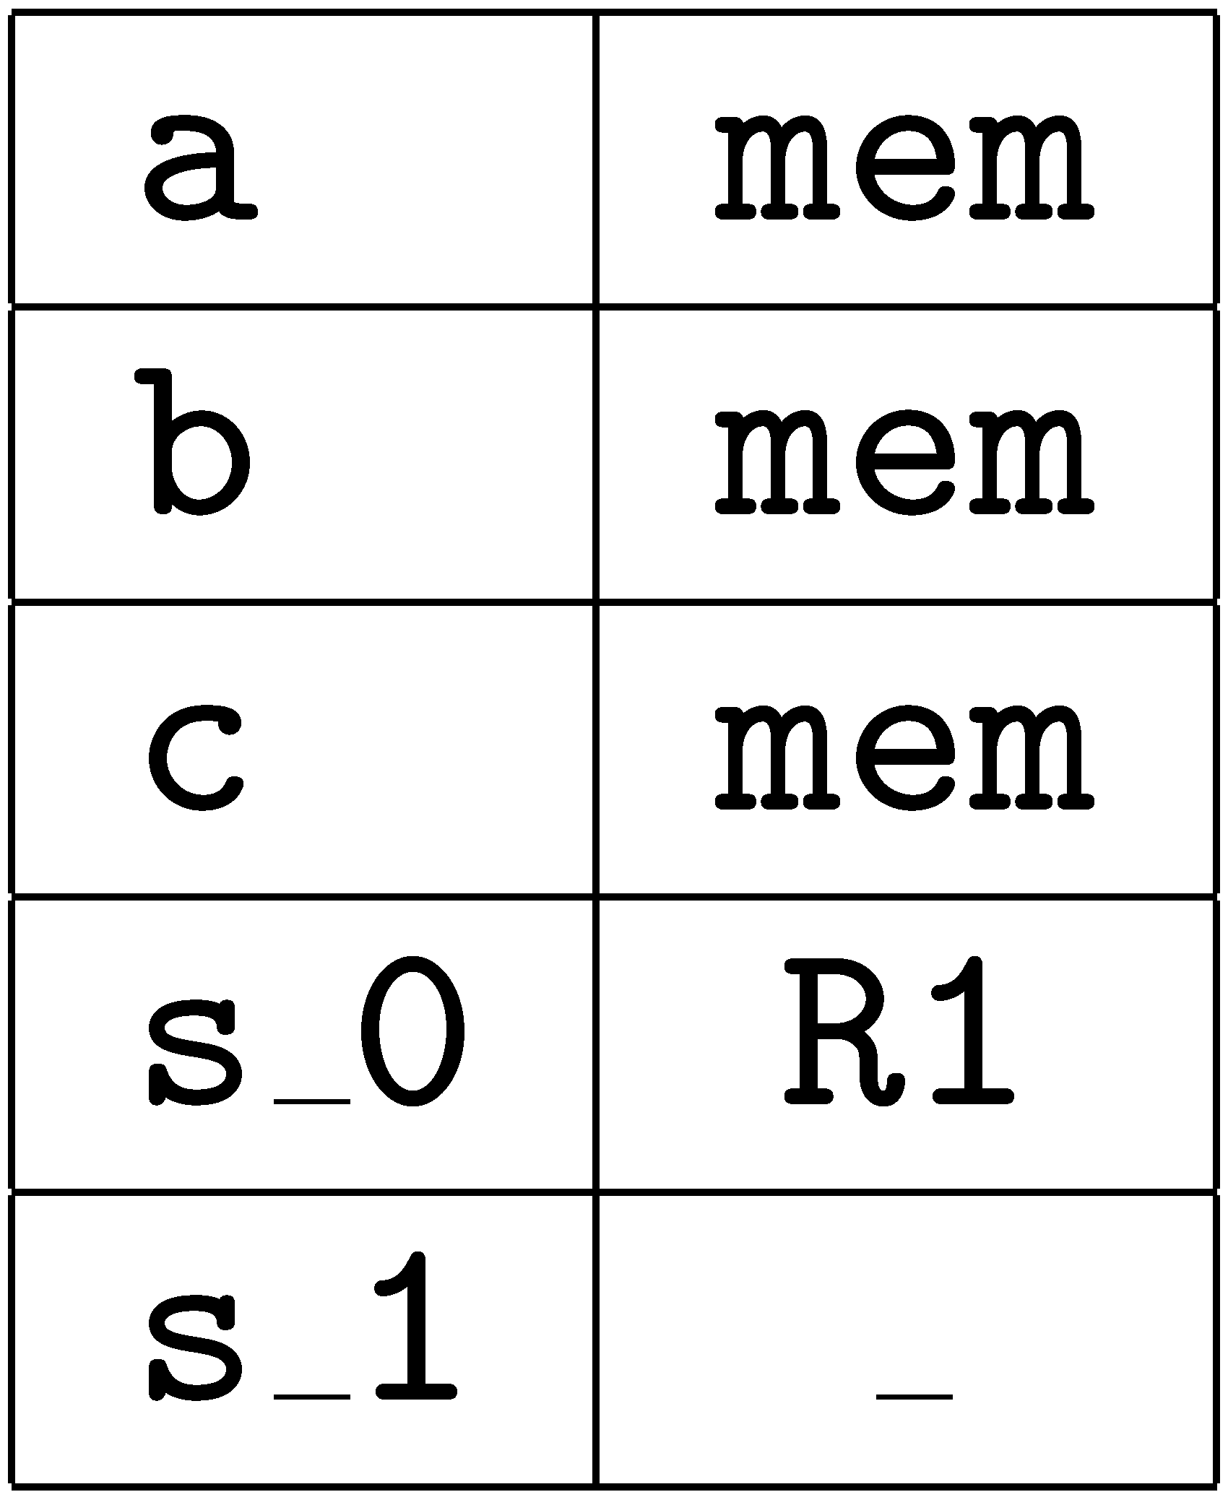
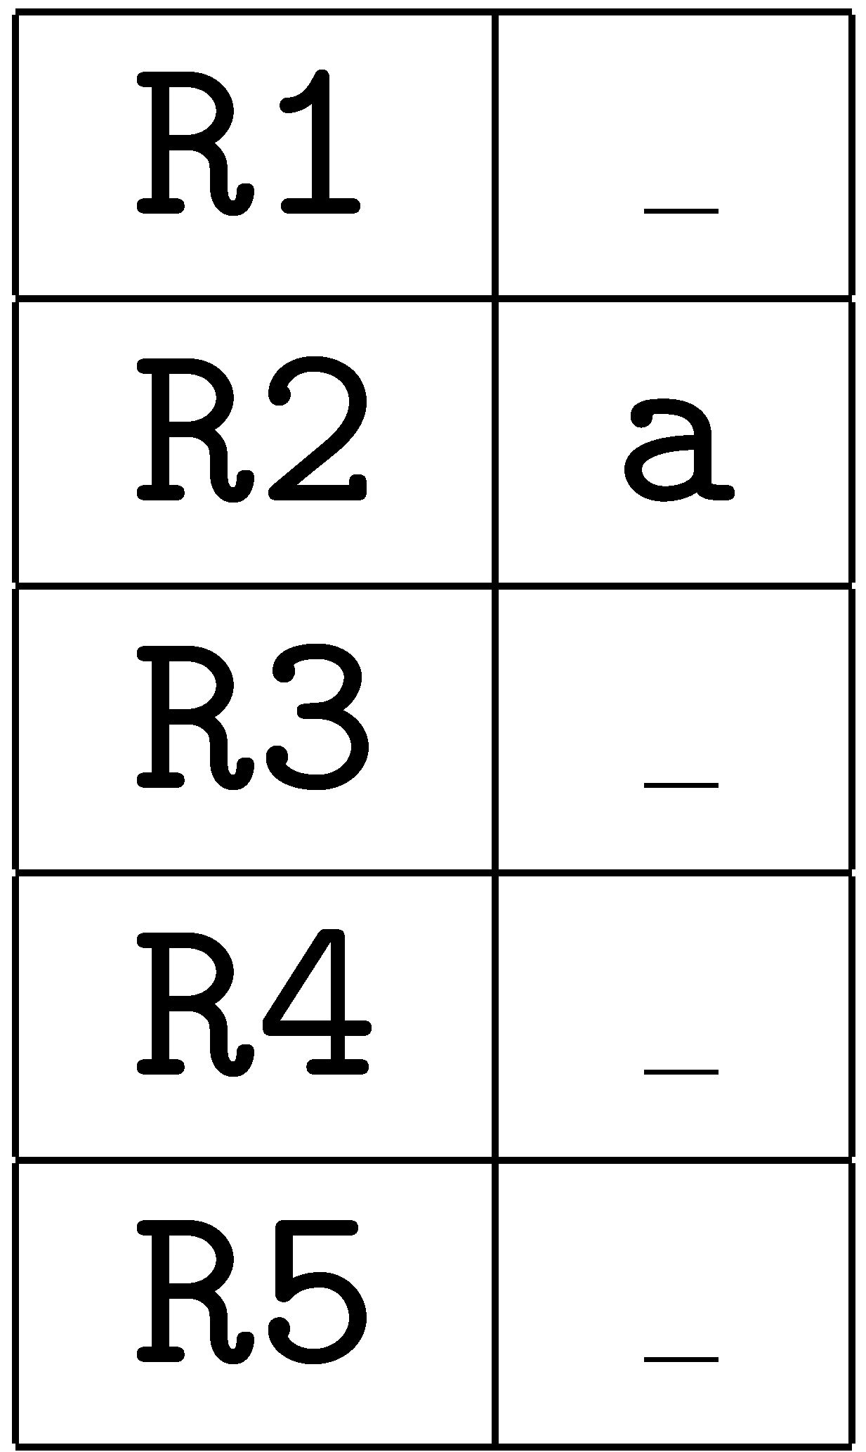
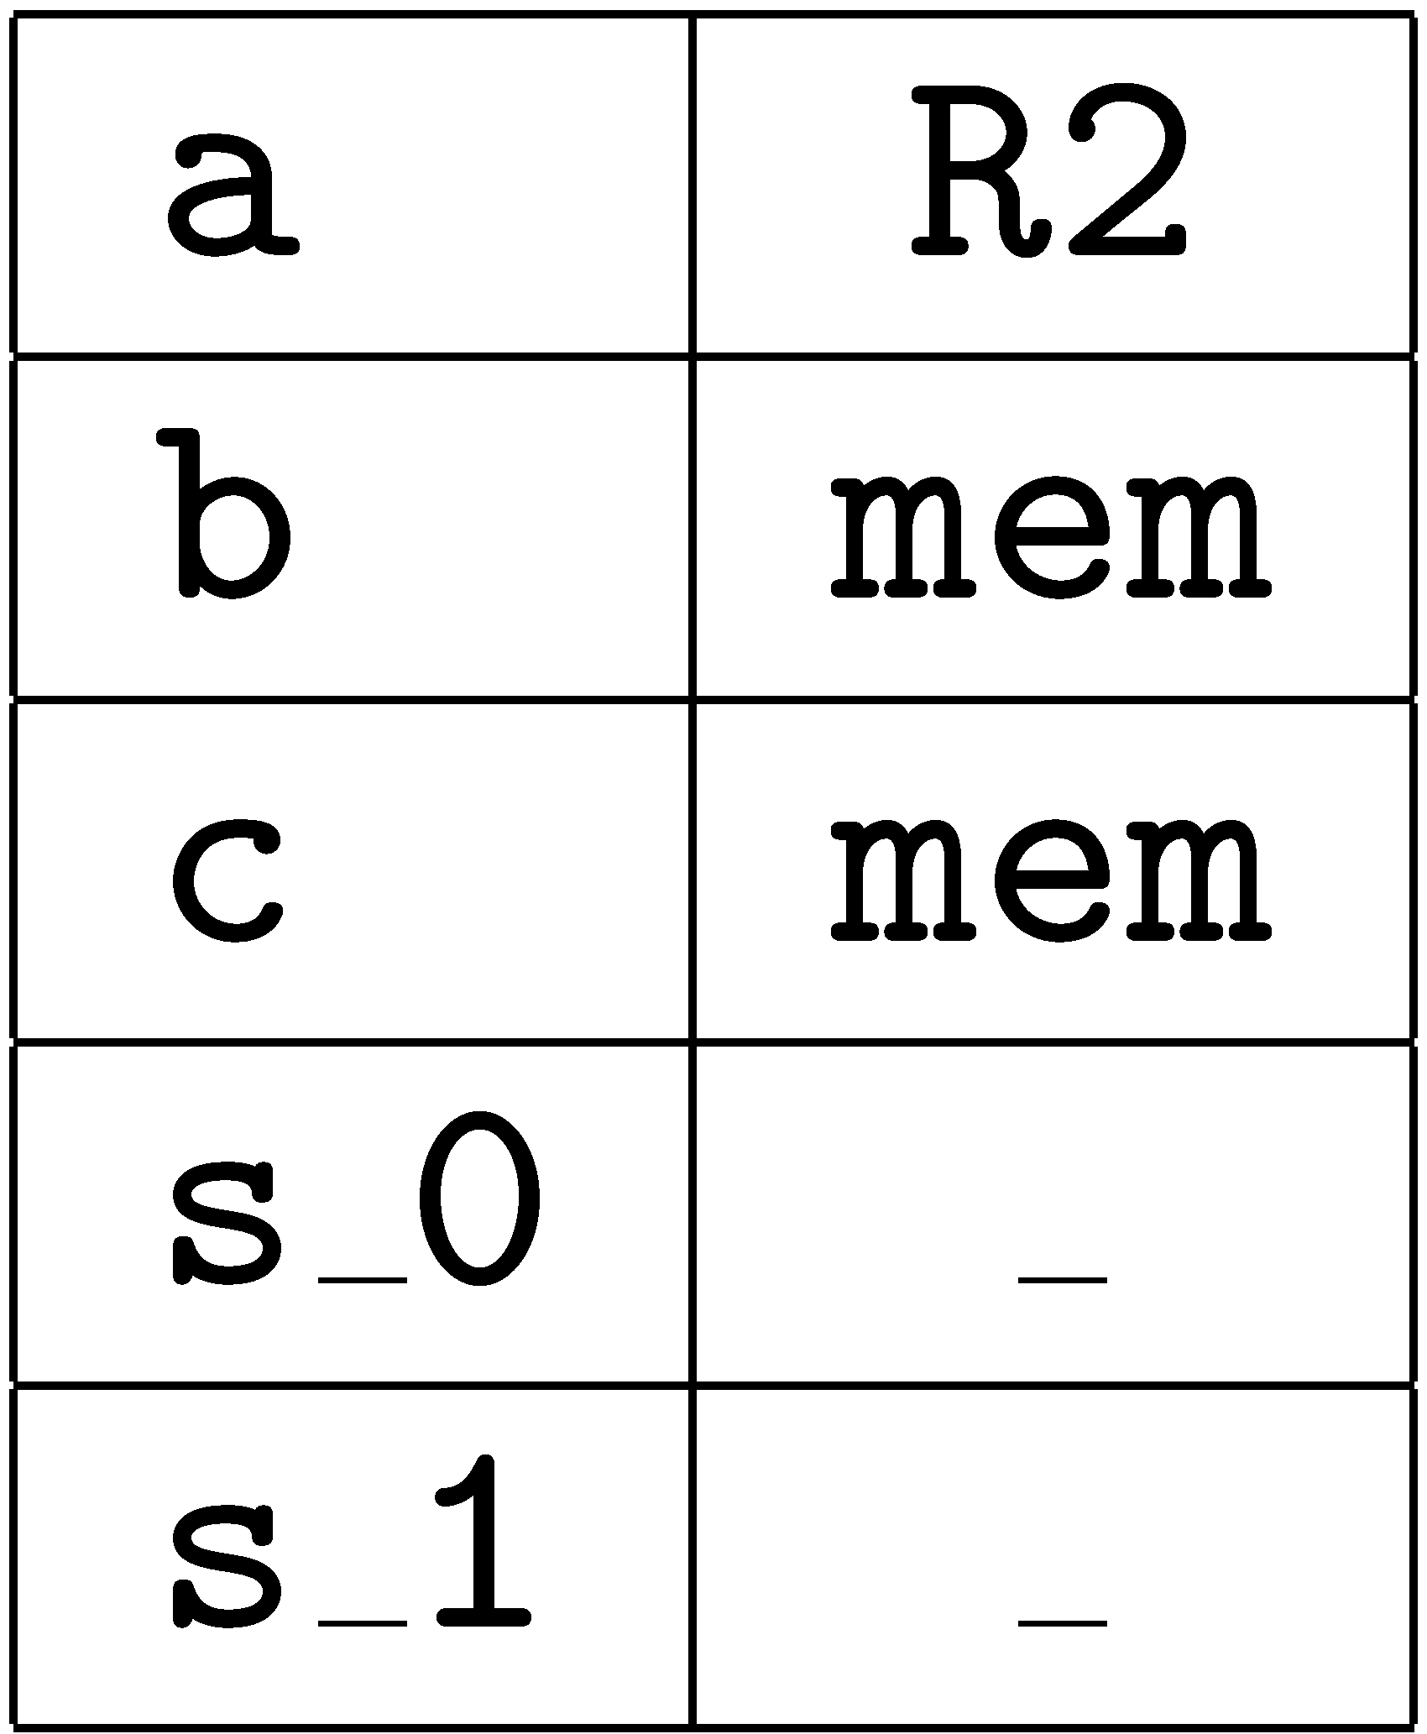
Example : BB Register Allocation
save sp,-136,sp
iconst_1 mov 1,R1
istore_1 mov R1,R2

Slide 27
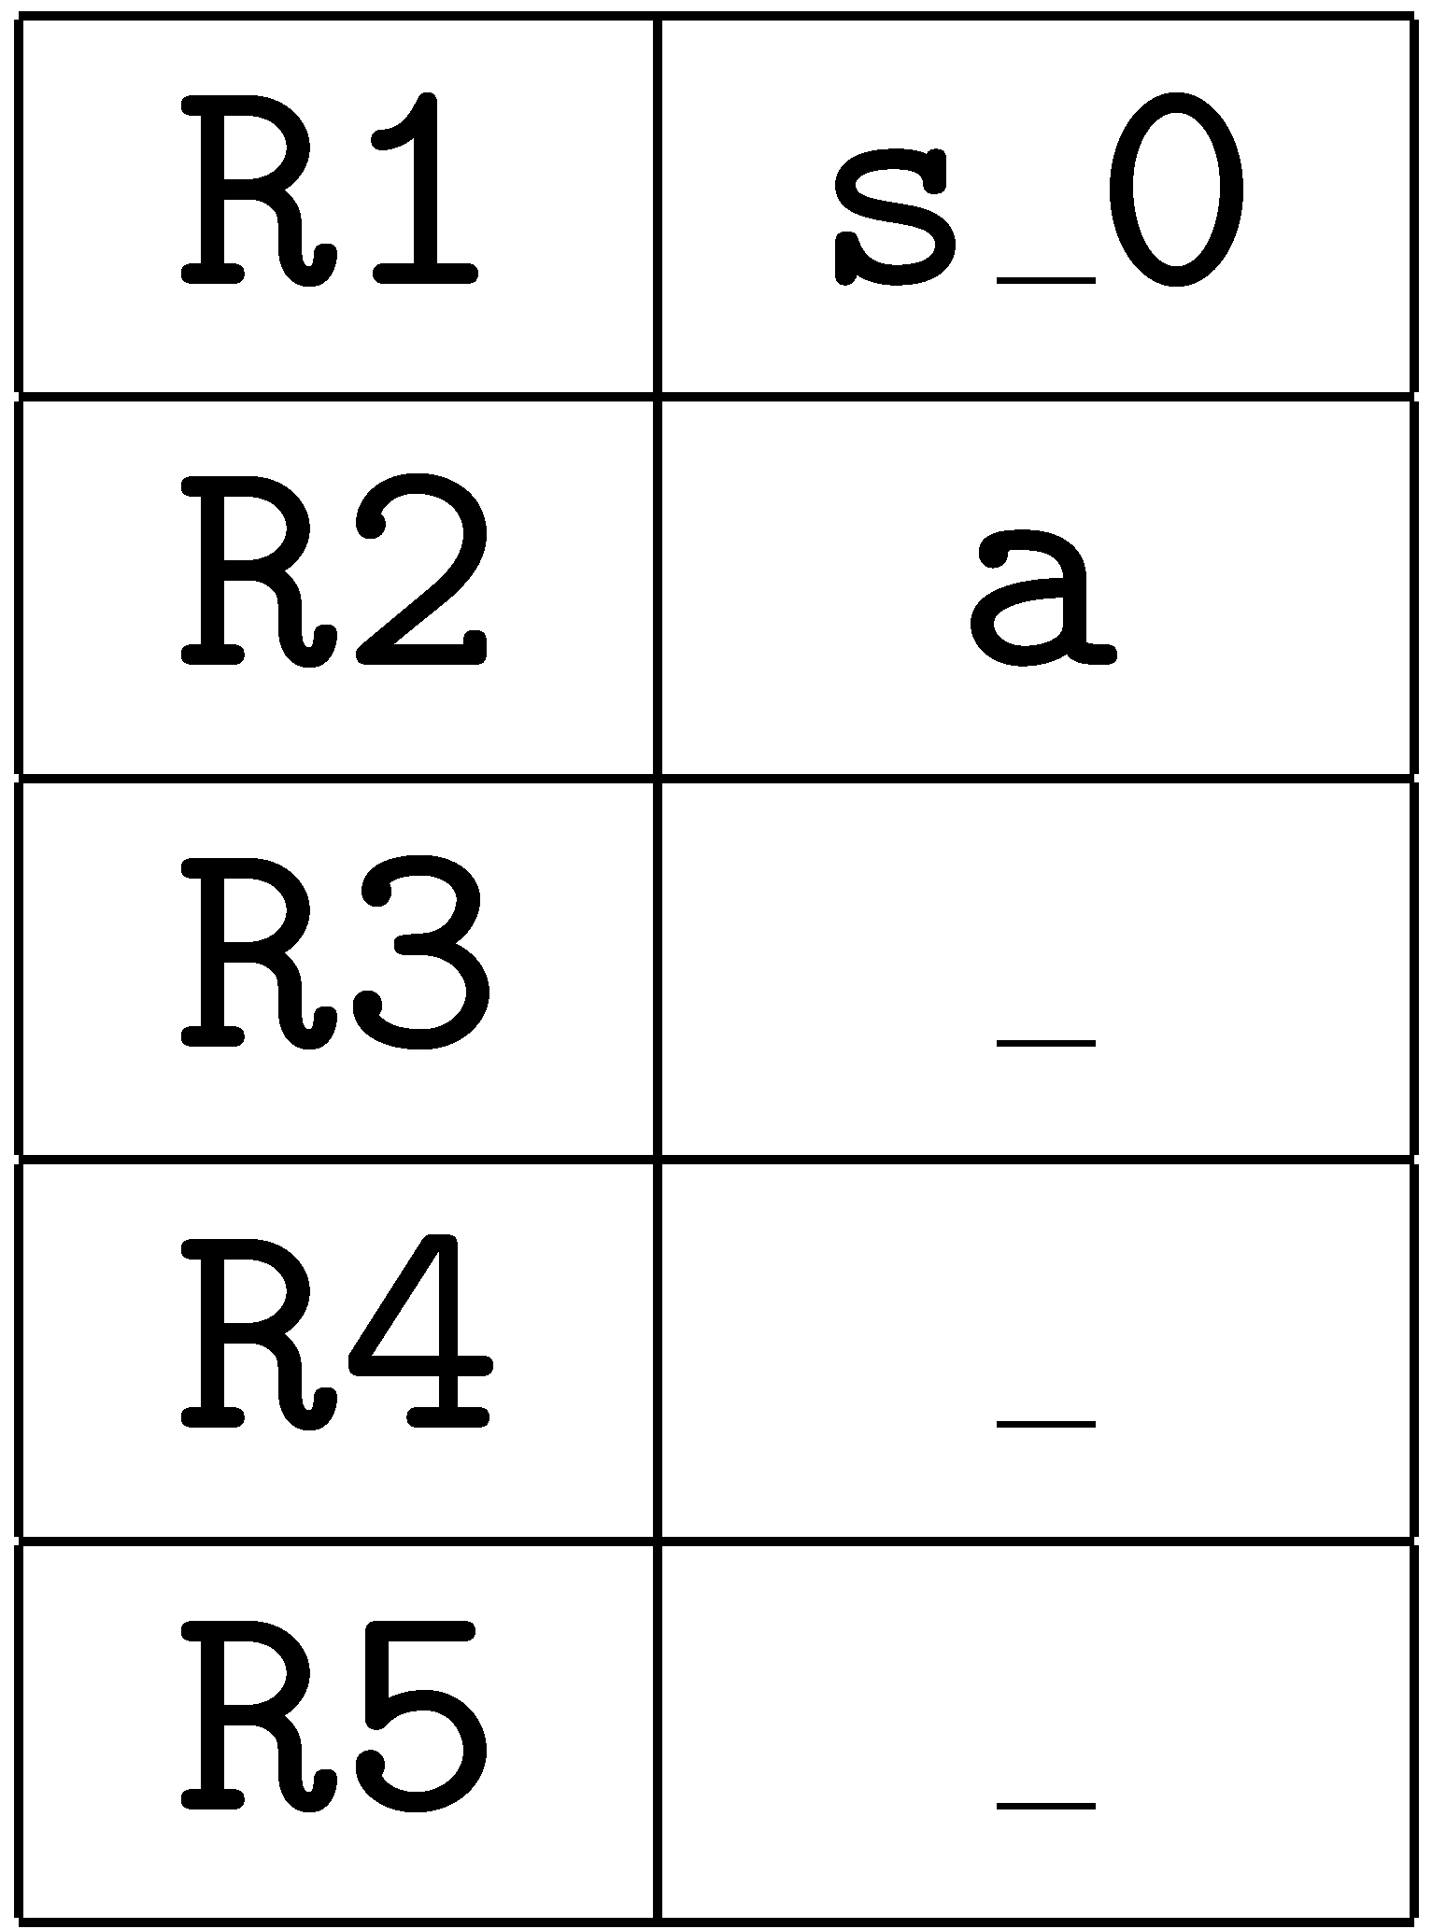
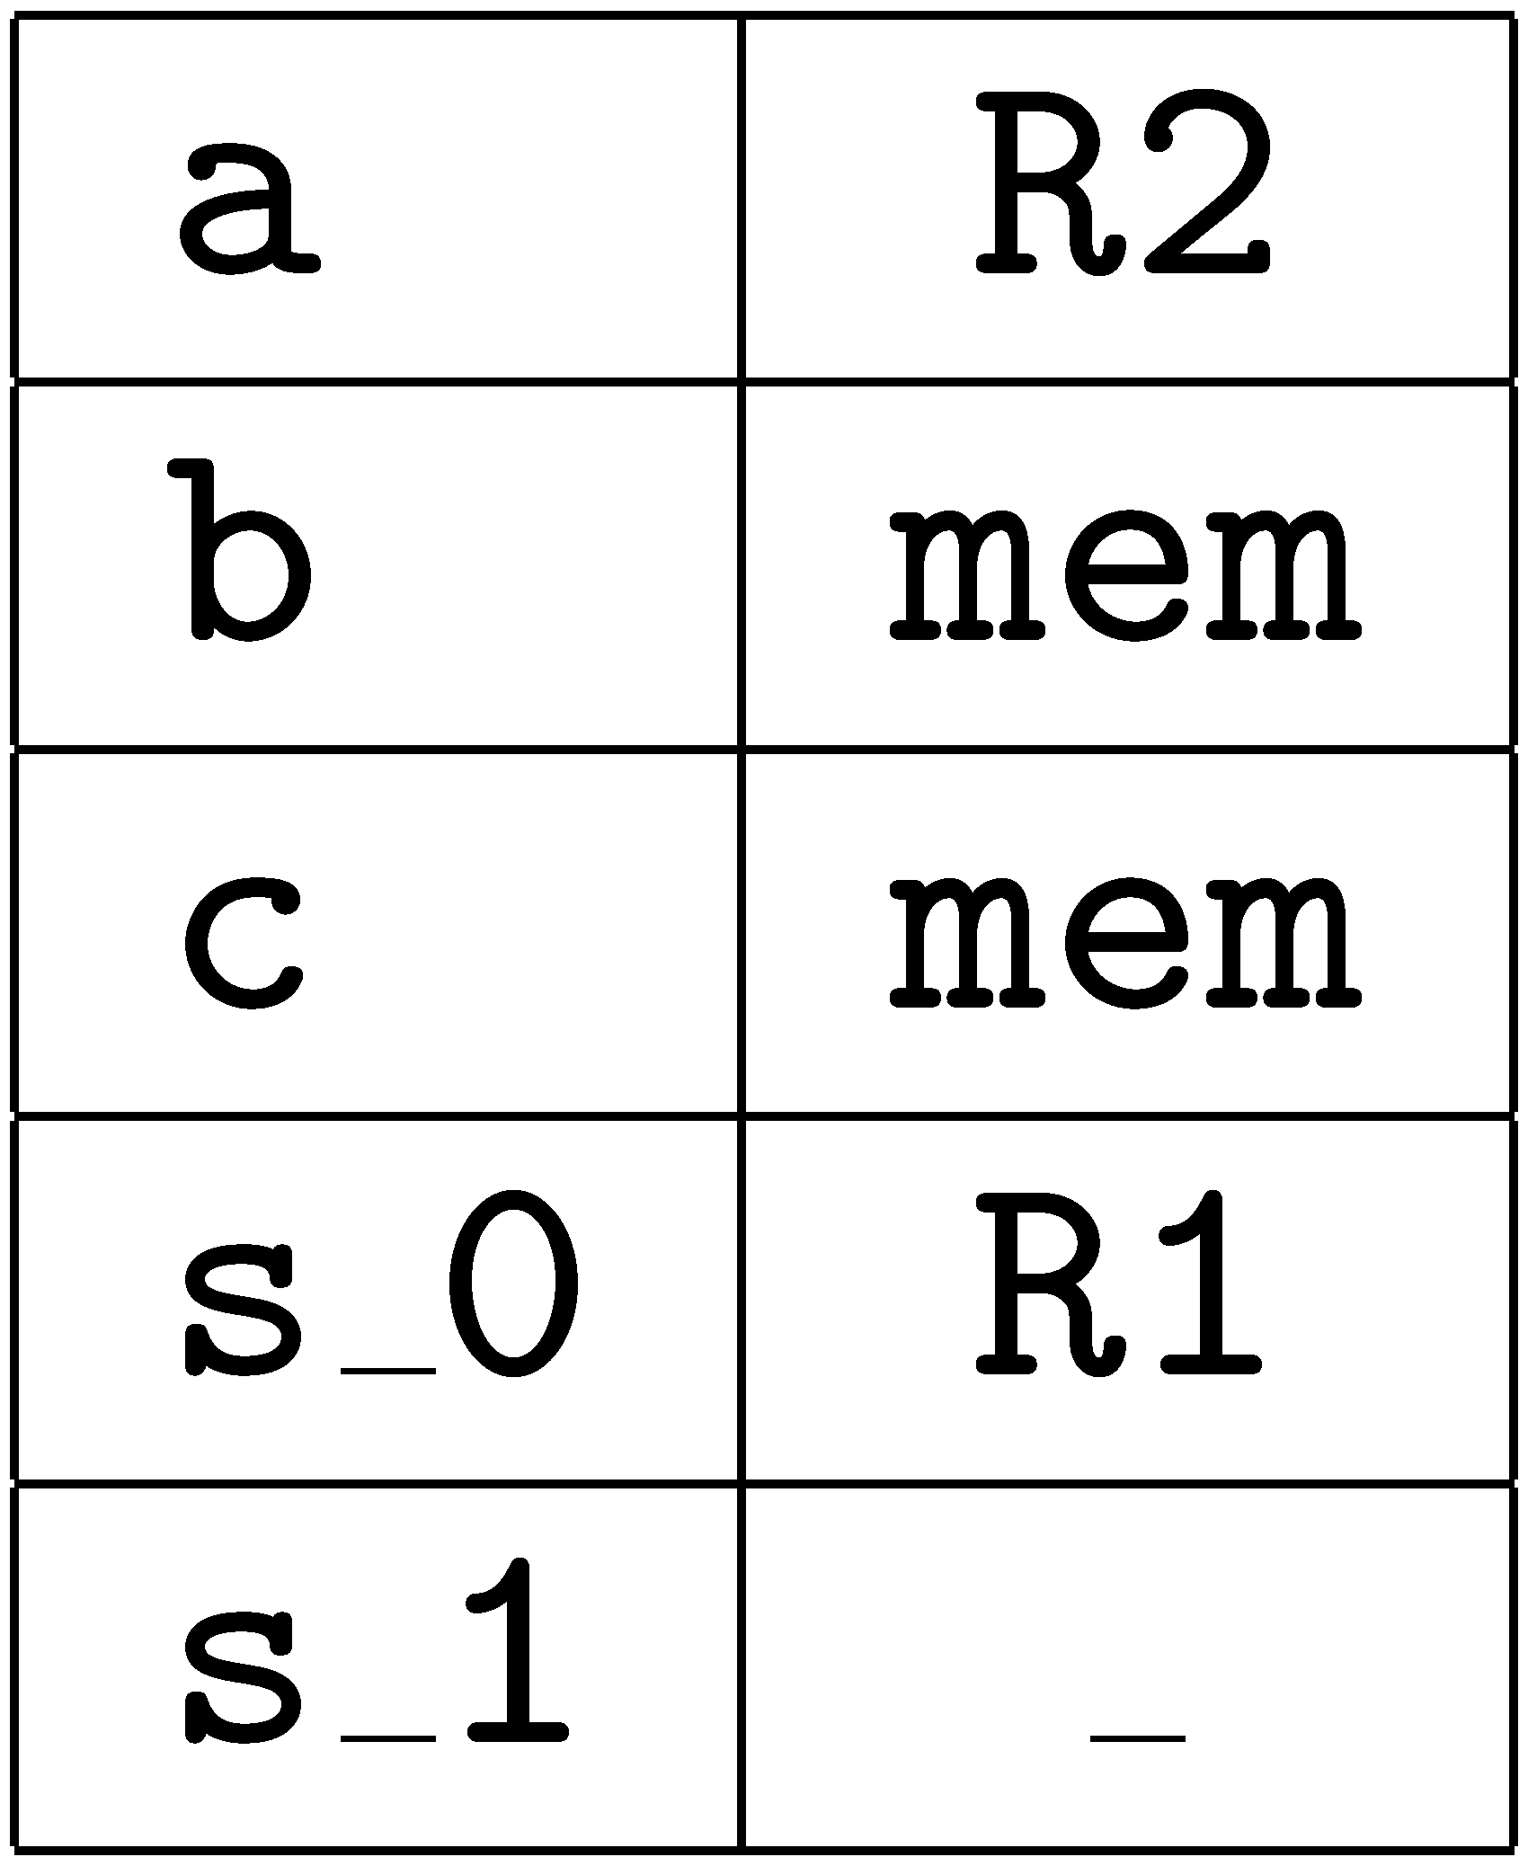
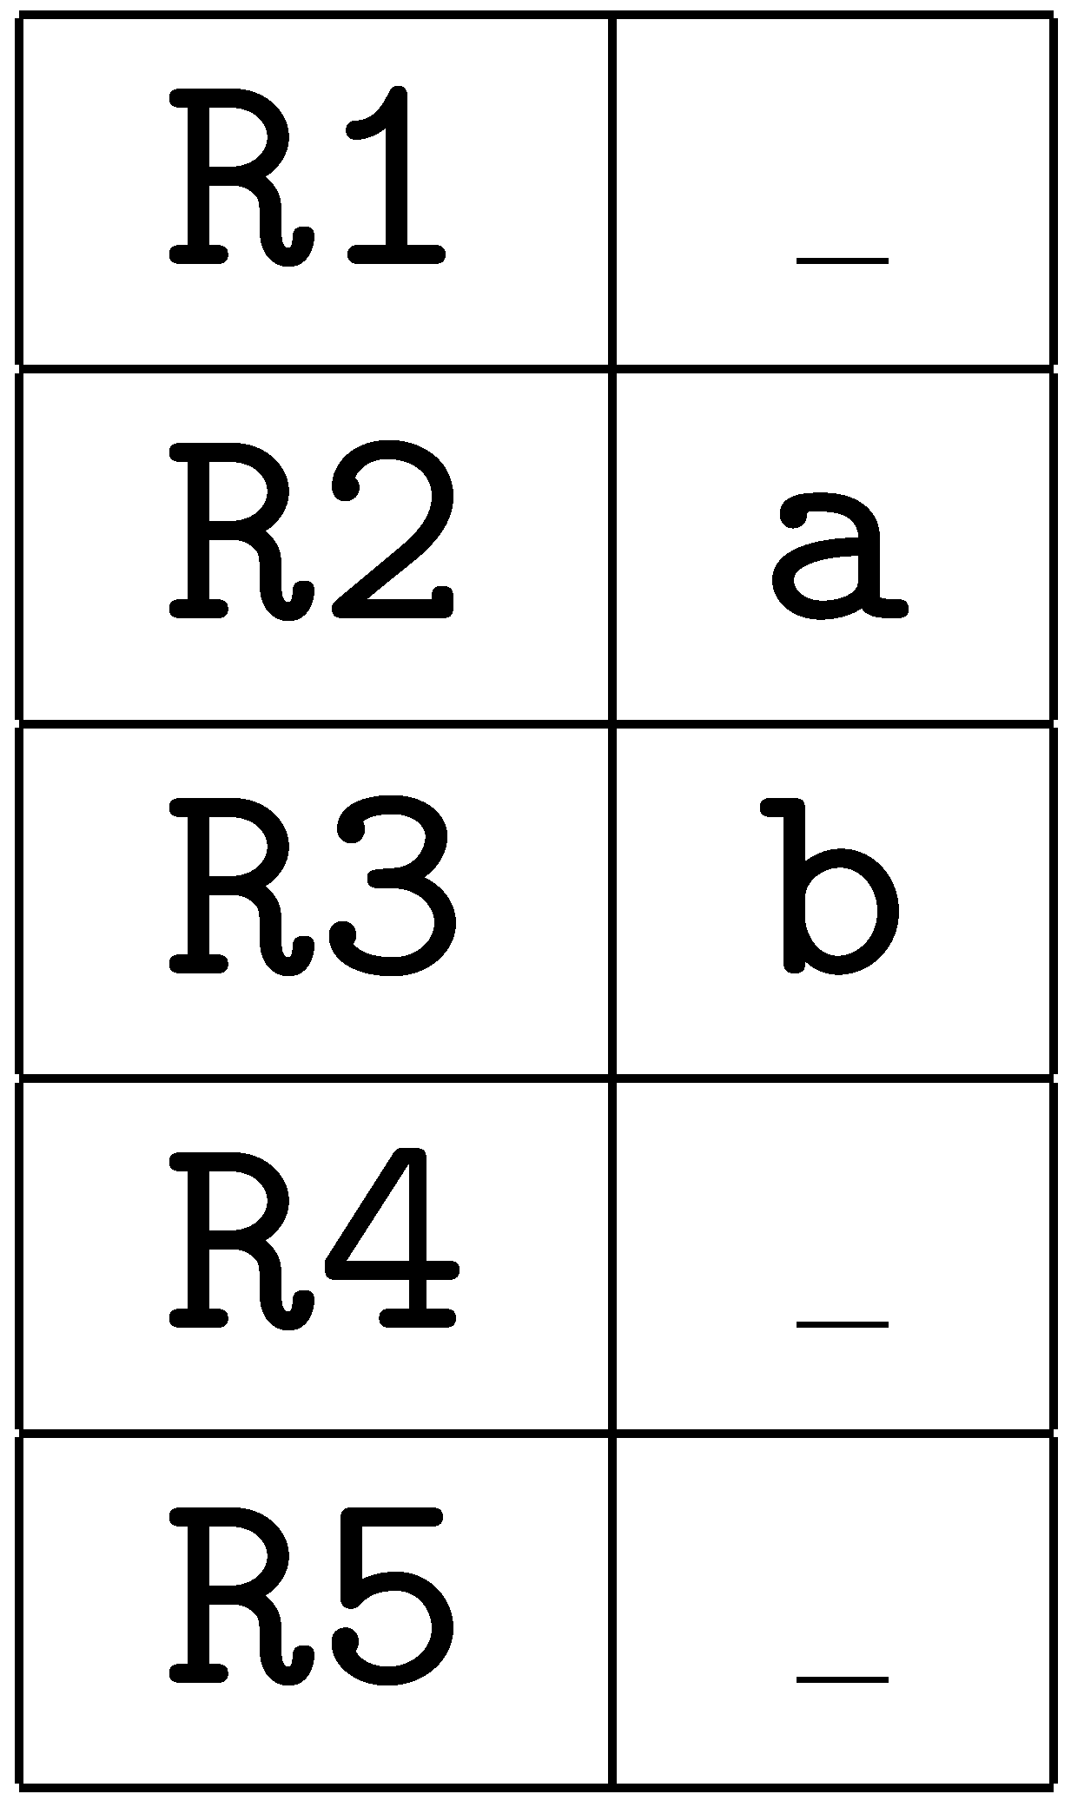
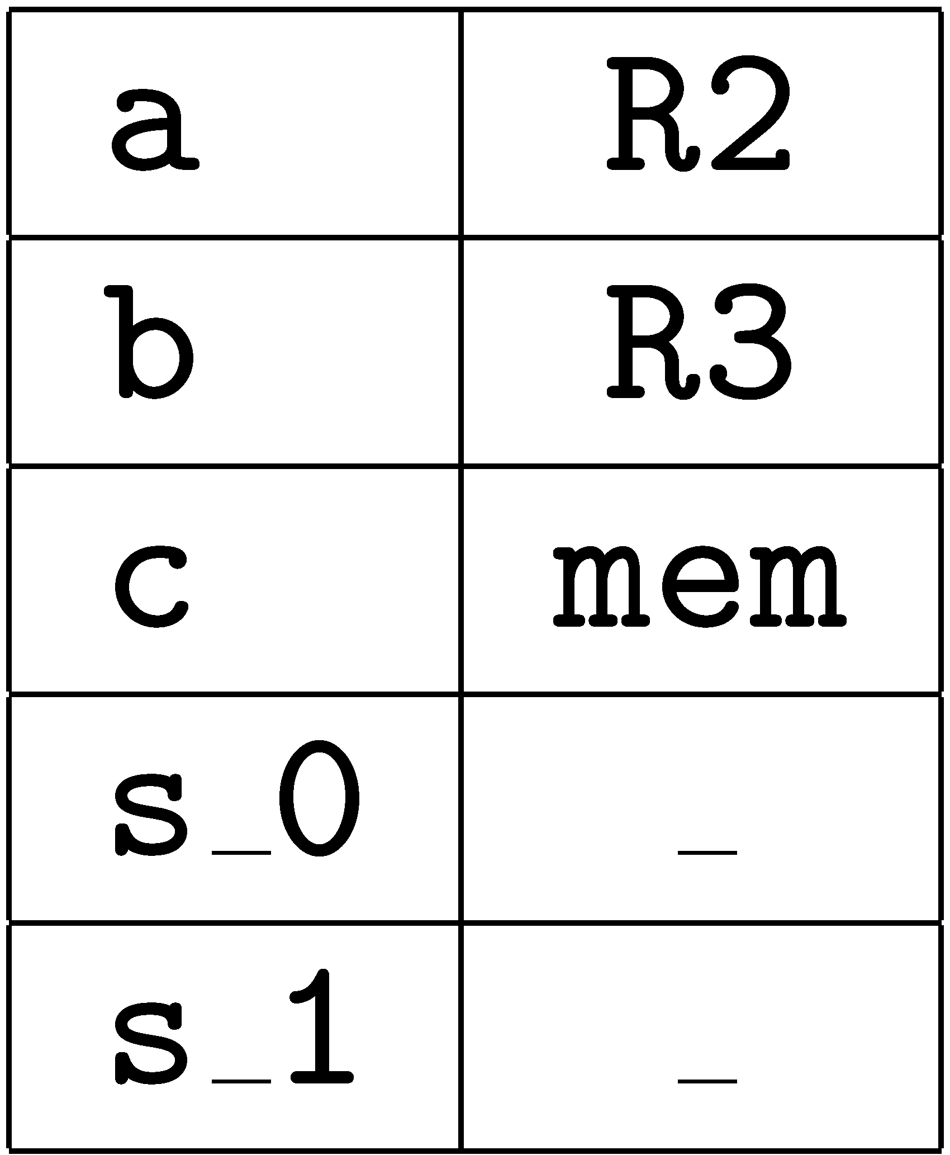
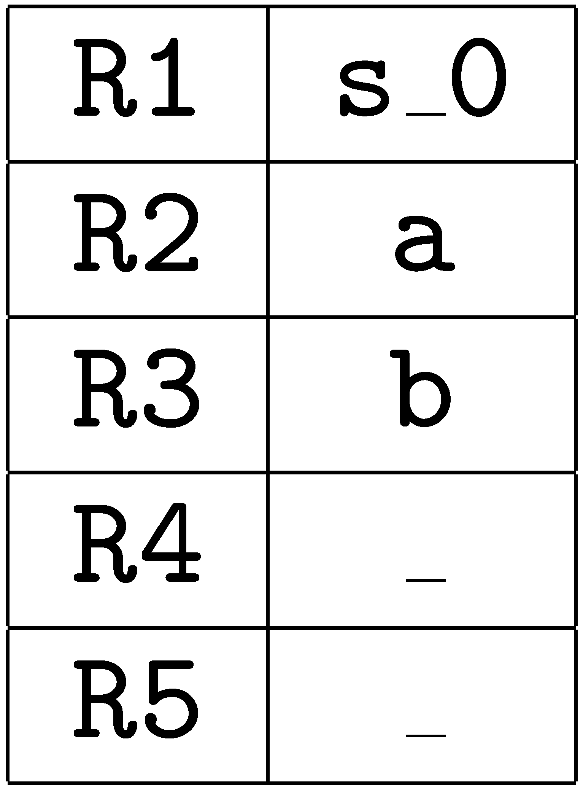
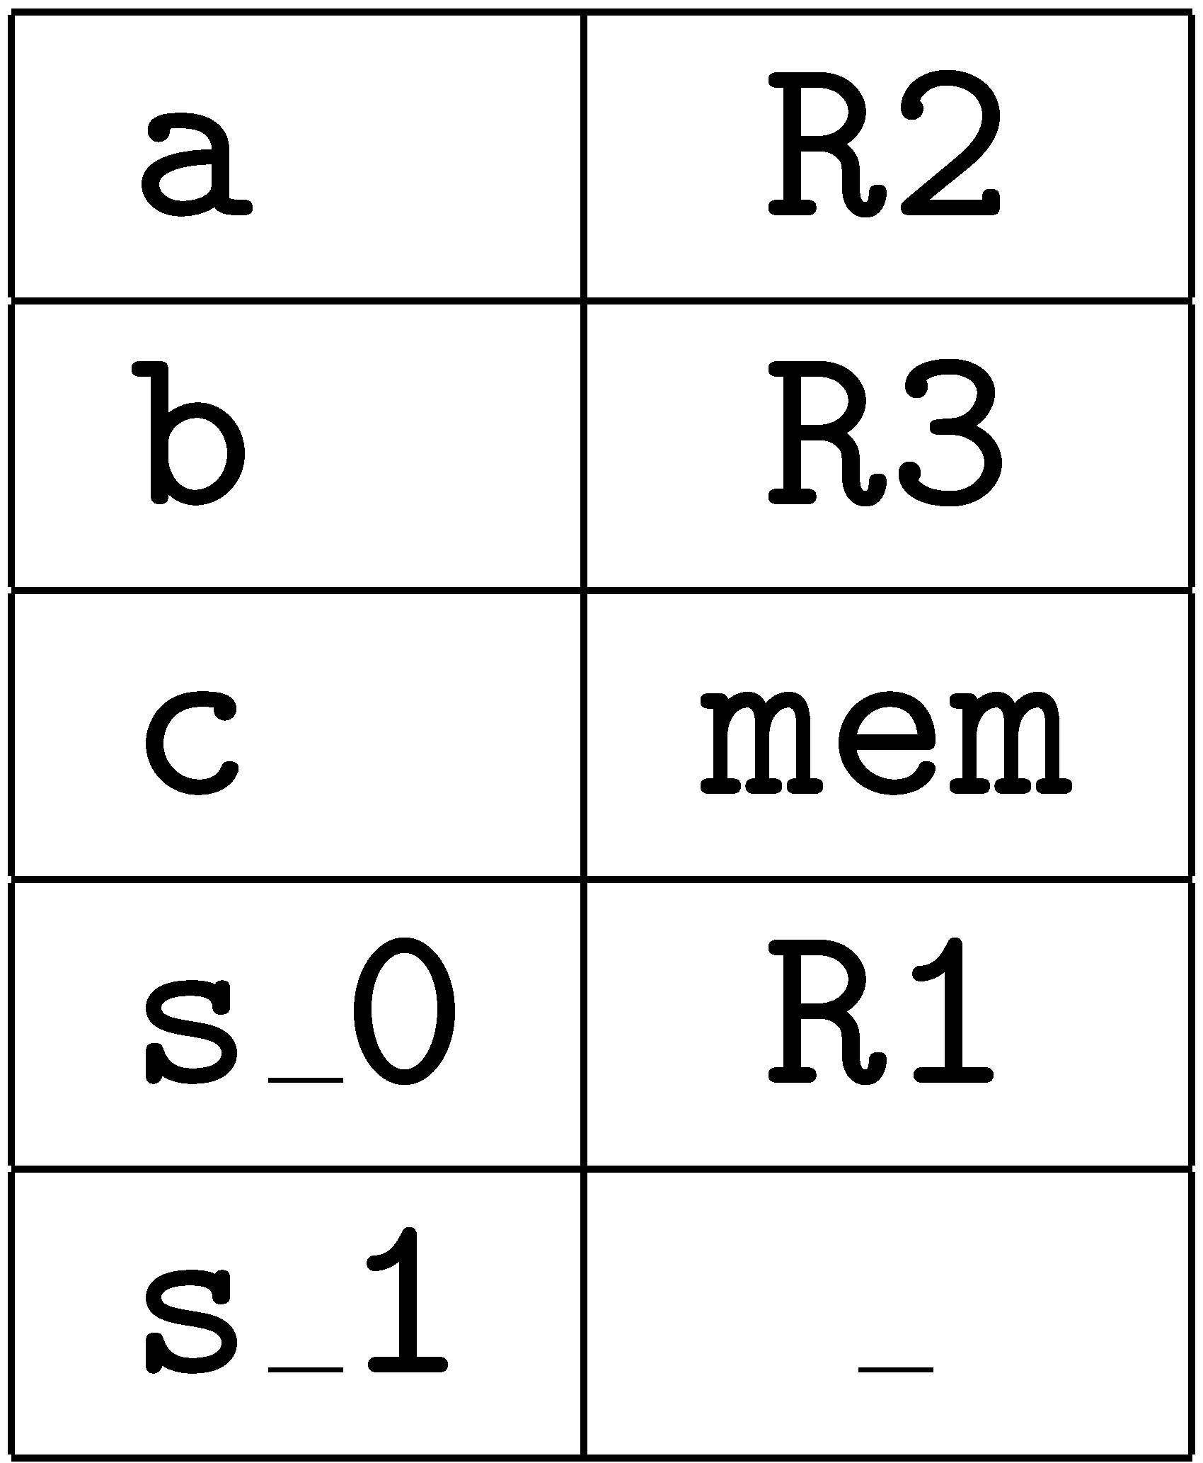
Example : BB Register Allocation
ldc 13 mov 13,R1
istore_2 mov R1,R3
iload_1 mov R2,R1

Slide 28
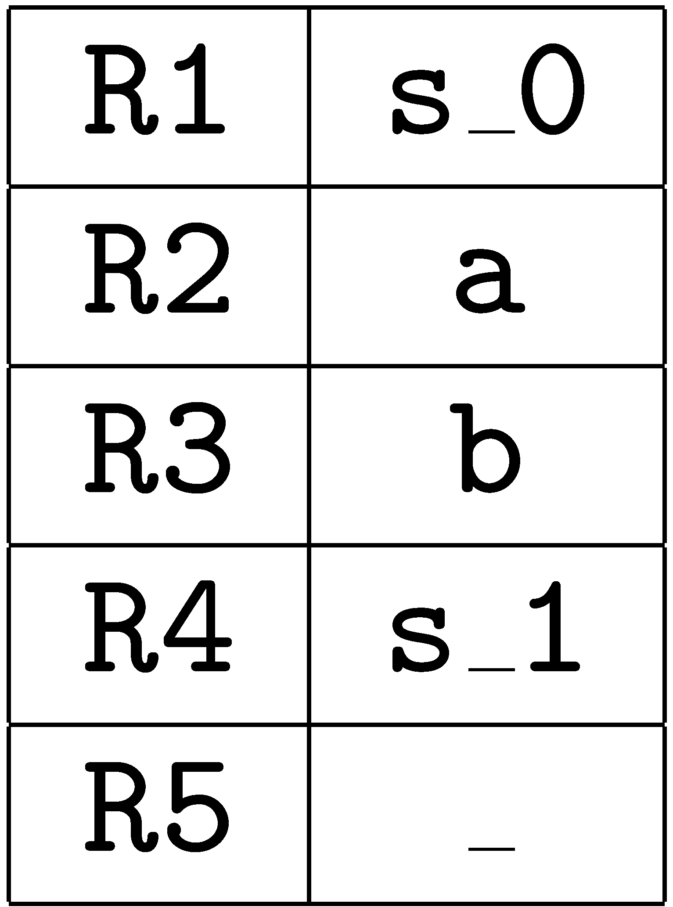
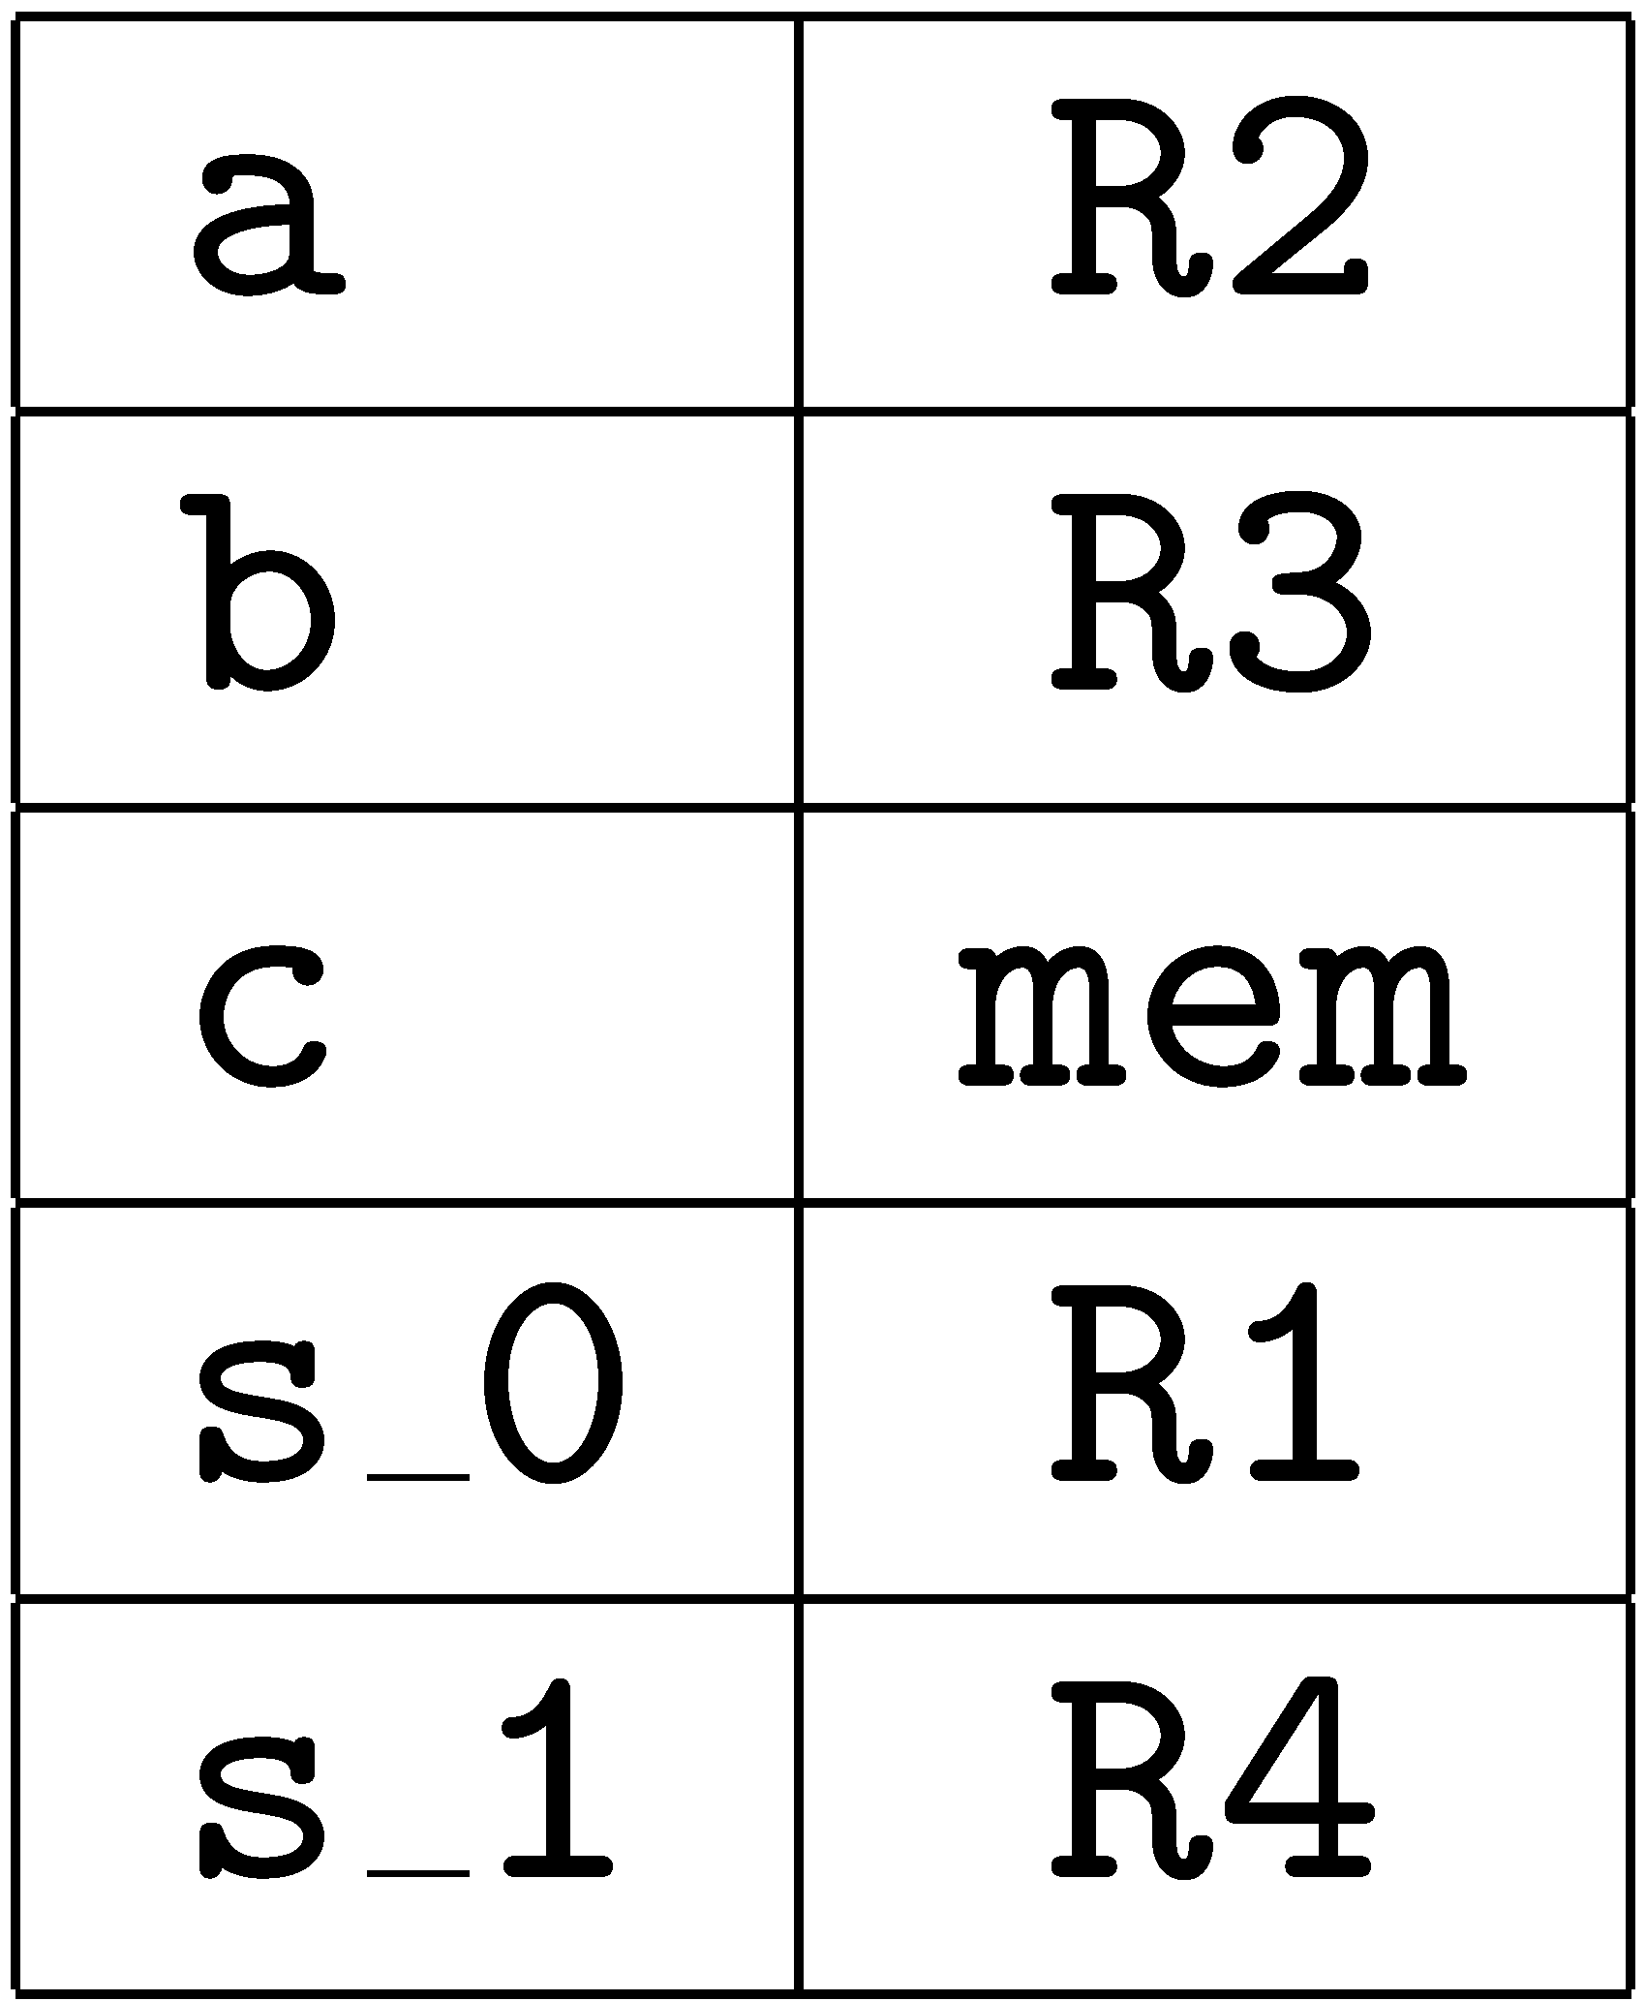
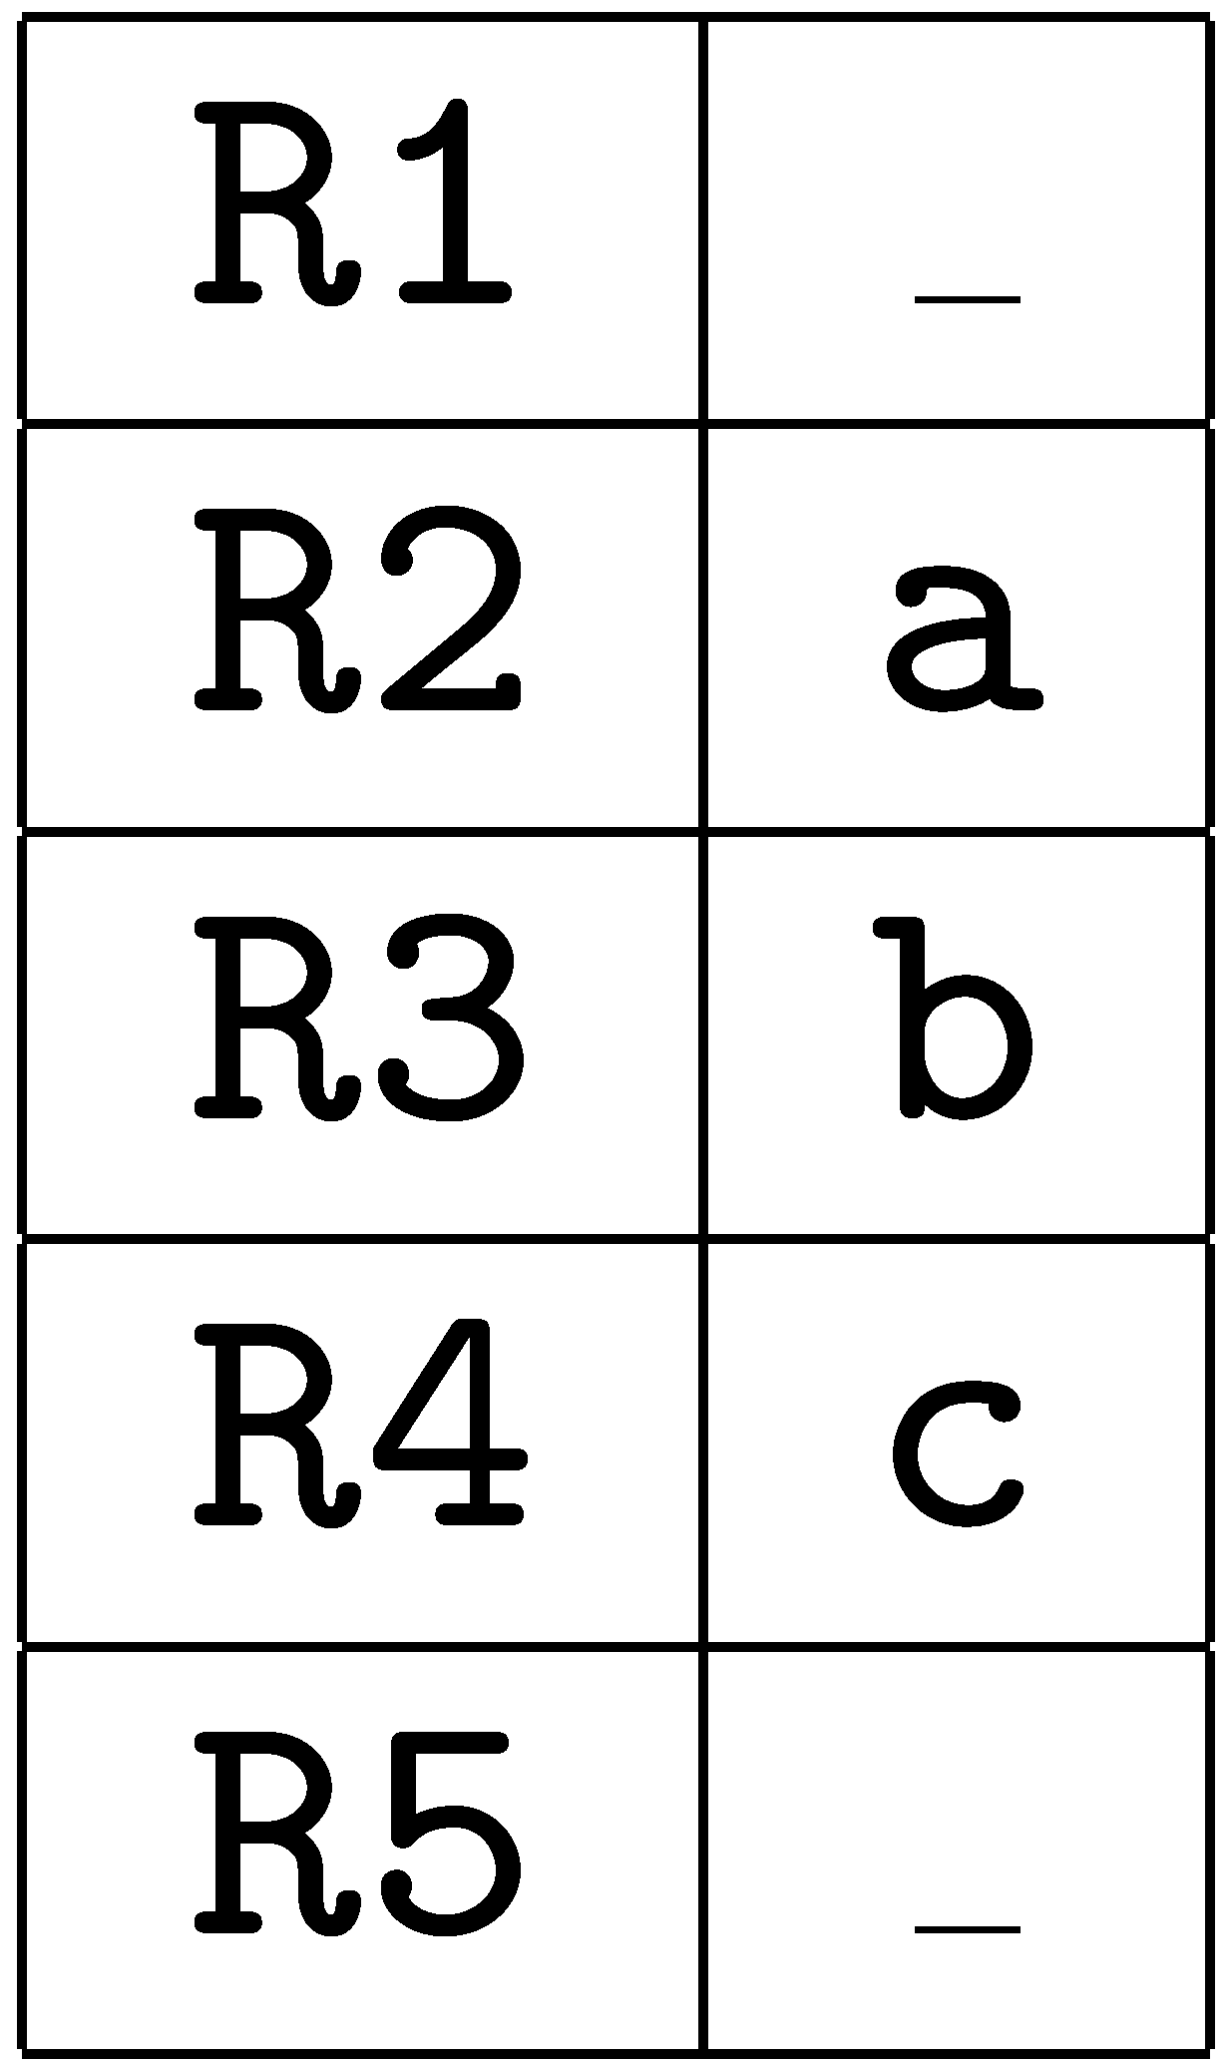
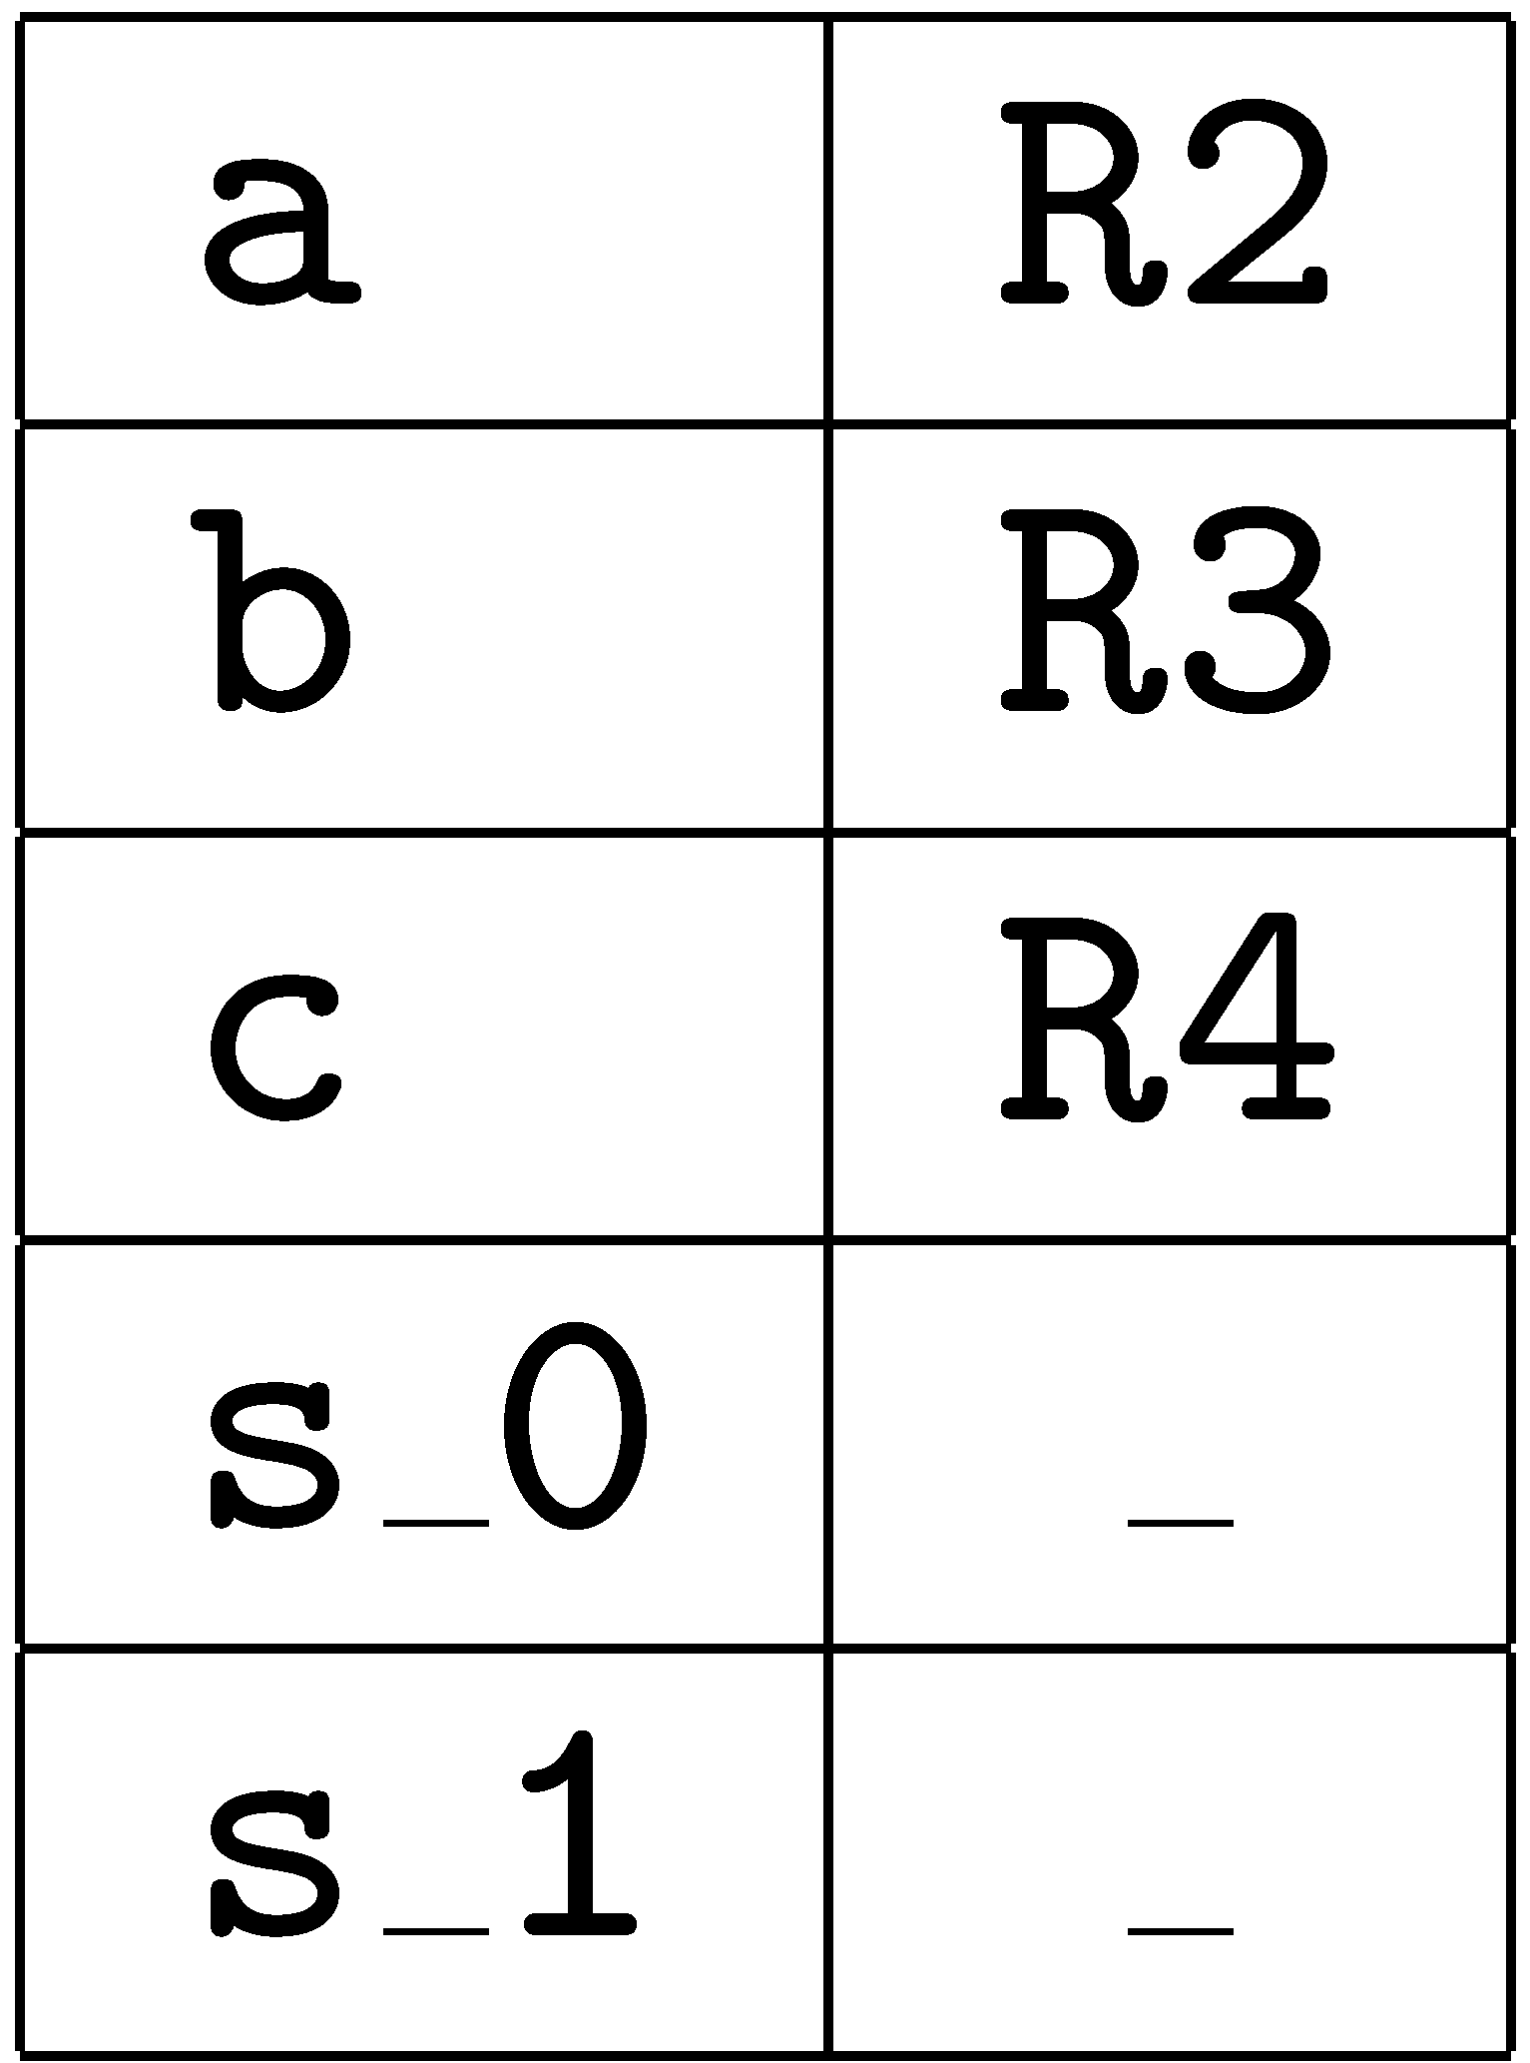
Example : BB Register Allocation
iload_2 mov R3,R4
iadd add R1,R4,R1
istore_3 mov R1,R4

Slide 29
Example : BB Register Allocation
st R2,[fp-32]
st R3,[fp-36]
st R4,[fp-40]
return restore
ret

Slide 30
No Improvement
But if we add the statement:
c = c * c + c;
then the fixed scheme generates:
ld [fp-40],R3
ld [fp-40],R4
mul R3,R4,R3
ld [fp-40],R4
add R3,R4,R3
st R3,[fp-40]
whereas the basic block scheme continues:
mul R4,R4,R1
add R1,R4,R1
st R1,R4
which is vastly better.

Slide 31
Summary of BB Register Allocation
registers are allocated on demand; and
slots are kept in registers within a basic block.
Advantages:
  registers are not wasted on unused slots; and
  less spill code within a basic block.
Disadvantages:
  much more complex than the fixed register allocation scheme;
  registers must be spilled at the end of a basic block; and
  we may spill locals that are never needed.

Slide 32
Further Optimization
If we skip modeling the local stack
save sp,-136,sp save sp,-136,sp
mov 1,R1 mov 1,R2
mov R1,R2
mov 13,R1 mov 13,R3
mov R1,R3
mov R2,R1
mov R3,R4
add R1,R4,R1 add R2,R3,R1
st R1,[fp-40] st R1,[fp-40]
restore restore
ret ret

Slide 33
Optimization
Unfortunately, this cannot be done safely on the fly by a peephole optimizer.
The optimization:
mov 1,R3 mov 1,R1
mov R3,R1
is unsound if R3 is used in a later instruction:
mov 1,R3 mov 1,R1
mov R3,R1
… …
mov R3,R4 mov R3,R4
Such optimizations require dataflow analysis.

Slide 34
Method Invocation
Invoking methods in bytecode:
  evaluate each argument leaving results on the stack; and
  emit invokevirtual instruction.
Invoking methods in native code:
  call library routine soft_get_method_code to perform the method lookup;
  generate code to load arguments into registers; and
  branch to the resolved address.

Slide 35
Example
Consider a method invocation
c = t.foo(a,b);
where the memory map is:
name offset location register
a 1 [fp-60] R3
b 2 [fp-56] R4
c 3 [fp-52]
t 4 [fp-48] R2
stack 0 [fp-36] R1
stack 1 [fp-40] R5
stack 2 [fp-44] R6
scratch 0 [fp-32] R7
scratch 1 [fp-28] R8

Slide 36
aload_4 mov R2,R1
iload_1 mov R3,R5
iload_2 mov R4,R6
invokevirtual foo // soft call to get address
ld R7,[R2+4]
ld R8,[R7+52]
// spill all registers
st R3,[fp-60]
st R4,[fp-56]
st R2,[fp-48]
st R6,[fp-44]
st R5,[fp-40]
st R1,[fp-36]
st R7,[fp-32]
st R8,[fp-28]
// make call
mov R8,R0
call soft_get_method_code // result in R0
// put args in R2, R1, and R0
ld R2,[fp-44] \\ R2 := stack_2
ld R1,[fp-40] \\ R1 := stack_1
st R0,[fp-32] \\ spill result
ld R0,[fp-36] \\ R0 := stack\_0
ld R4,[fp-32] \\ reload result
jmp [R4] \\ call method

Slide 37
Innefficient
This is long and costly; and
The lack of dataflow analysis causes massive spills within the basic blocks.

Slide 38
Handling Branches
the only problem is that the target address is not known;
assemblers normally handle this; but
the JIT compiler produces binary code directly in memory.
Generating native code:
if (a < b) iload_1 ld R1,[fp-44]
iload_2 ld R2,[fp-48]
if_icmpge 17 sub R1,R2,R3
bge ??
How to compute the branch targets:
  previously encountered branch targets are already known;
  keep unresolved branches in a table; and
  patch targets when the bytecode is eventually reached.

