Slide 1
Symbol Processing
Matthew Dwyer
324E Nichols Hall
dwyer@cis.ksu.edu
http://www.cis.ksu.edu/~dwyer

Slide 2
Compiler Architecture
SCAN
PARSE
WEED
RESOURCE
TYPE
SYMBOL
CODE
OPTIMIZE
EMIT

Slide 3
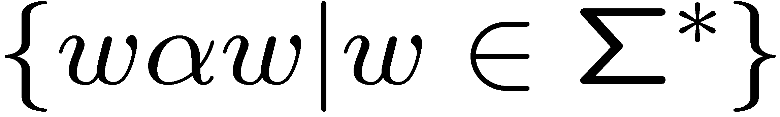
Analyzing Identifiers
Lexical analysis defines form of identifiers
Syntactic analysis defines where identifiers can appear
Symbol analysis defines correlation of definition and uses of identifiers
Grammars are too weak for this
  is not context-free

Slide 4
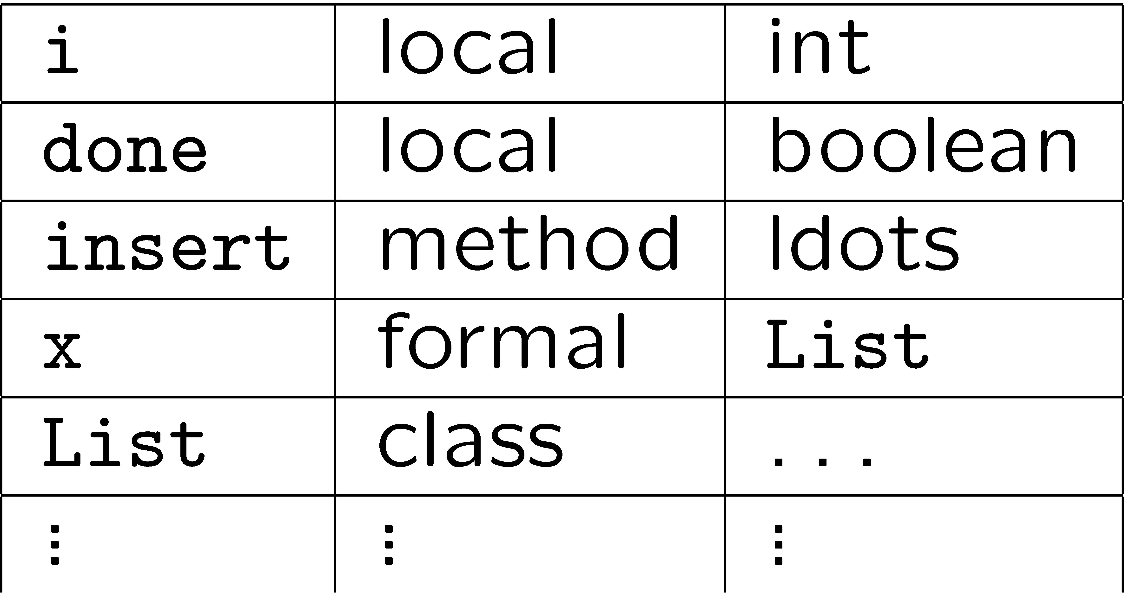
Symbol Table
Maps identifiers to their meaning (i.e., definition)

Slide 5
JOOS Symbol Table Uses
Which classes are defined;
what is the inheritance hierarchy;
is the hierarchy well-formed;
which fields are defined;
which methods are defined;
what are the signatures of methods;
are identifiers defined twice;
are identifiers defined when used; and
are identifiers used properly?

Slide 6
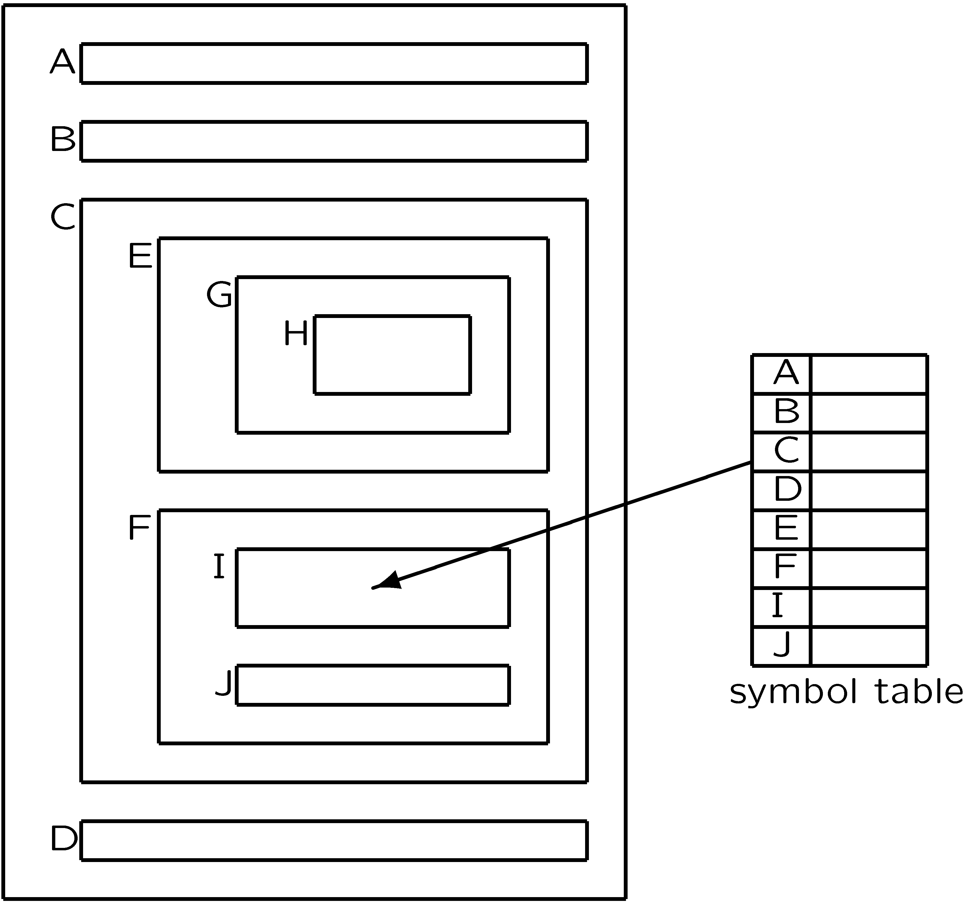
Static Nested Scope Rules

Slide 7
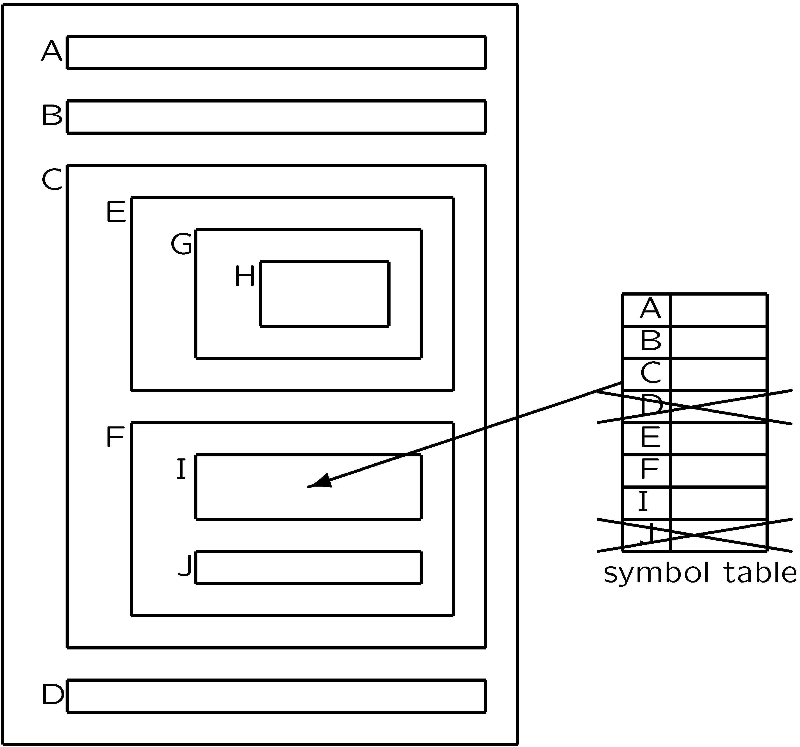
Nesting vs. Ordering
Multiple passes are required to eliminate the need for forward declarations

Slide 8
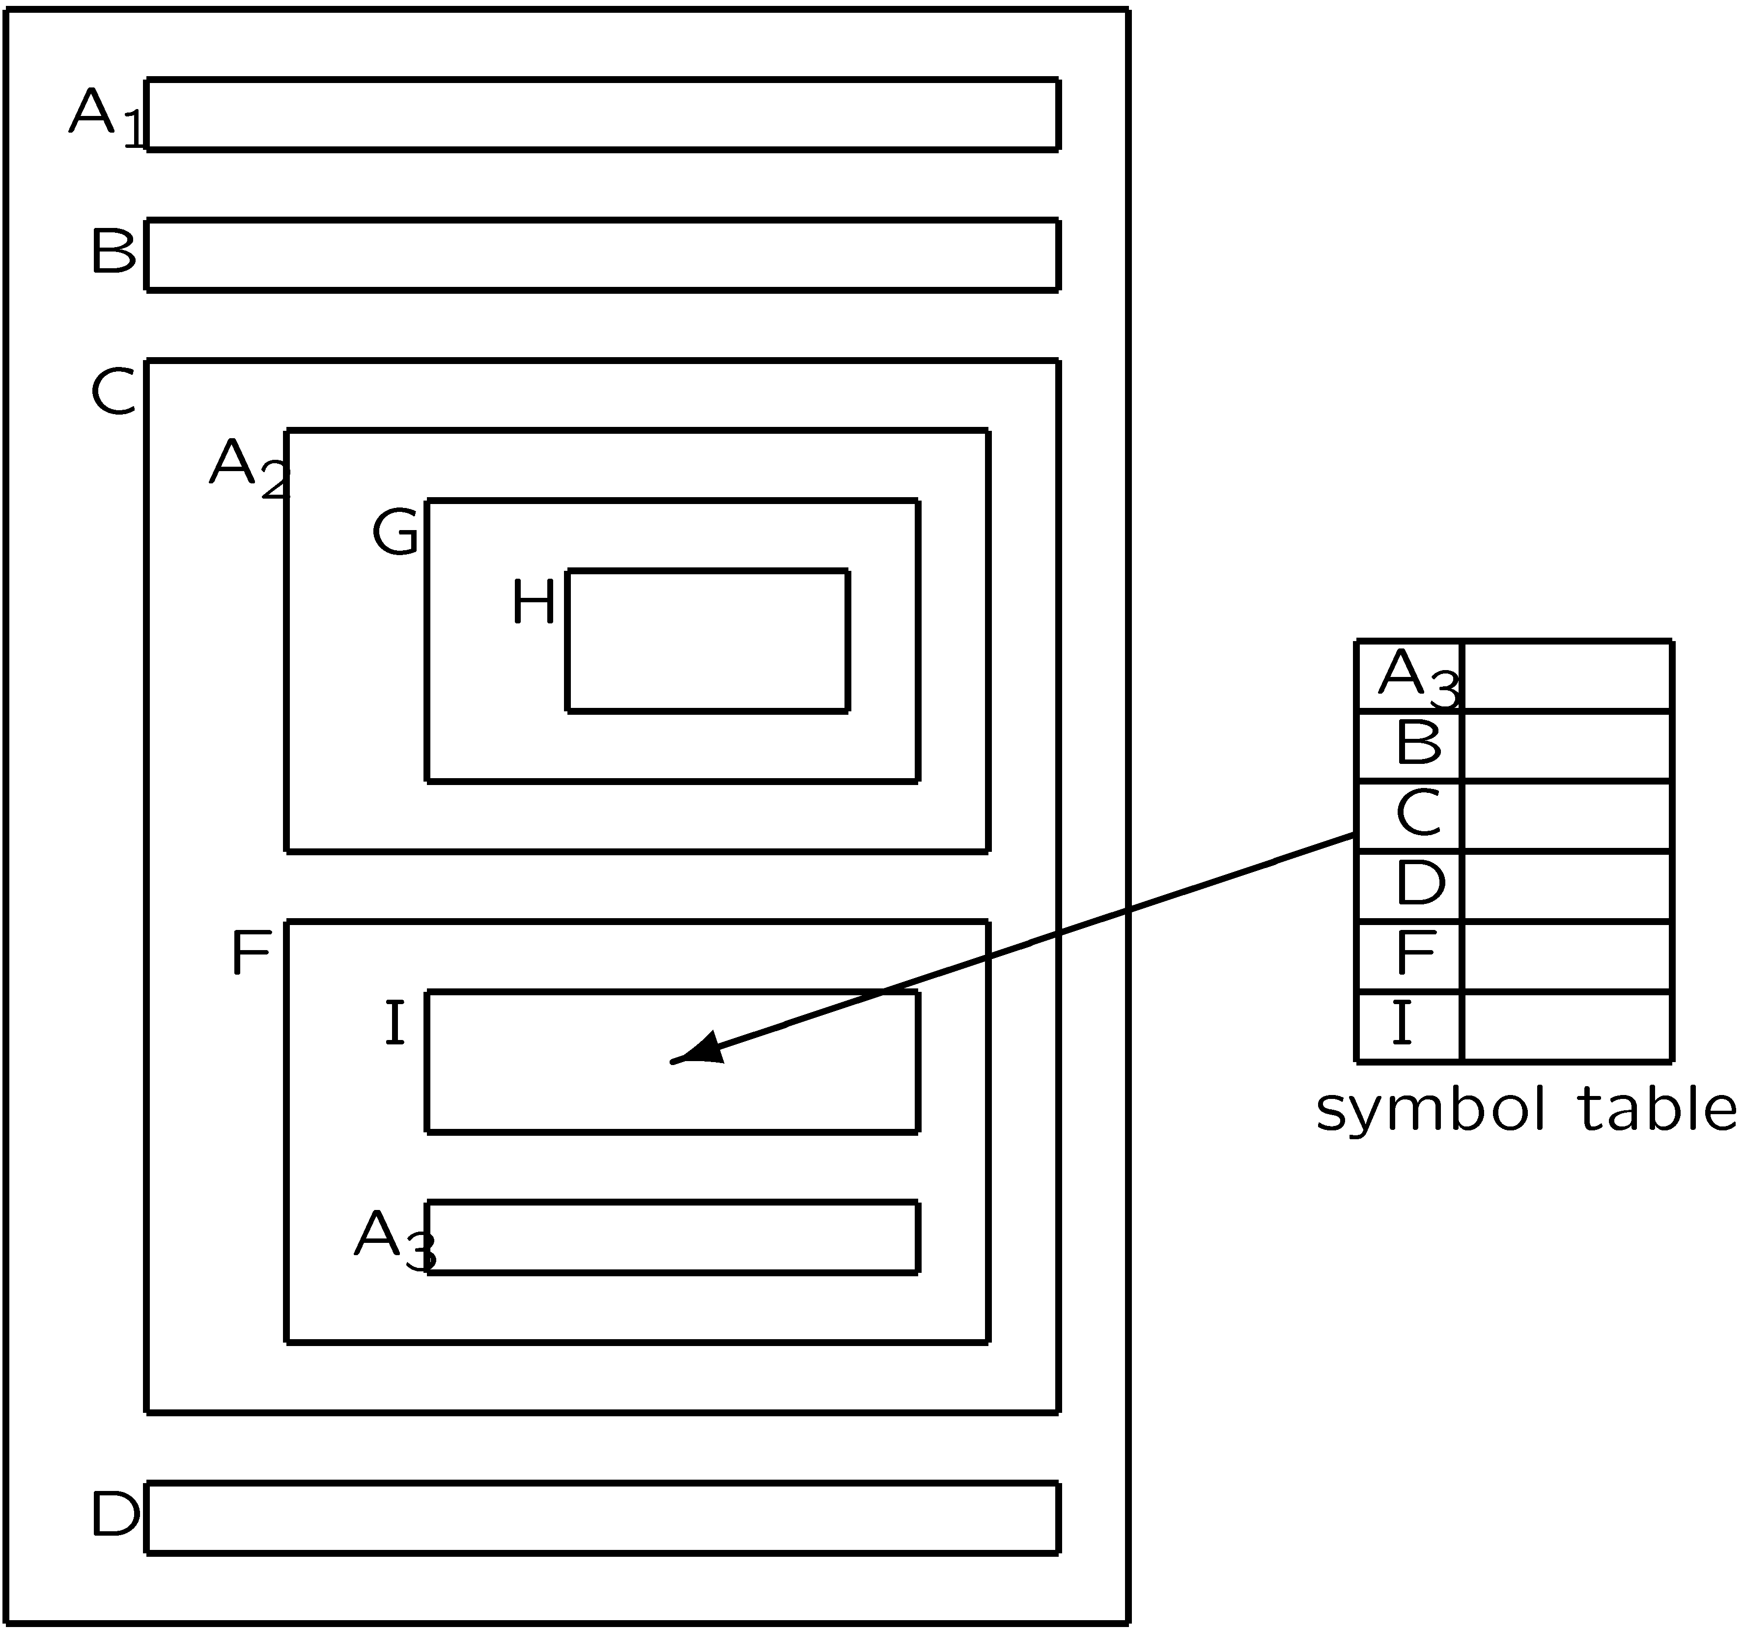
Most Closely Nested Definition
A2 shadows A1
A3 shadows A2, A1
Identifiers at same level must be unique

Slide 9
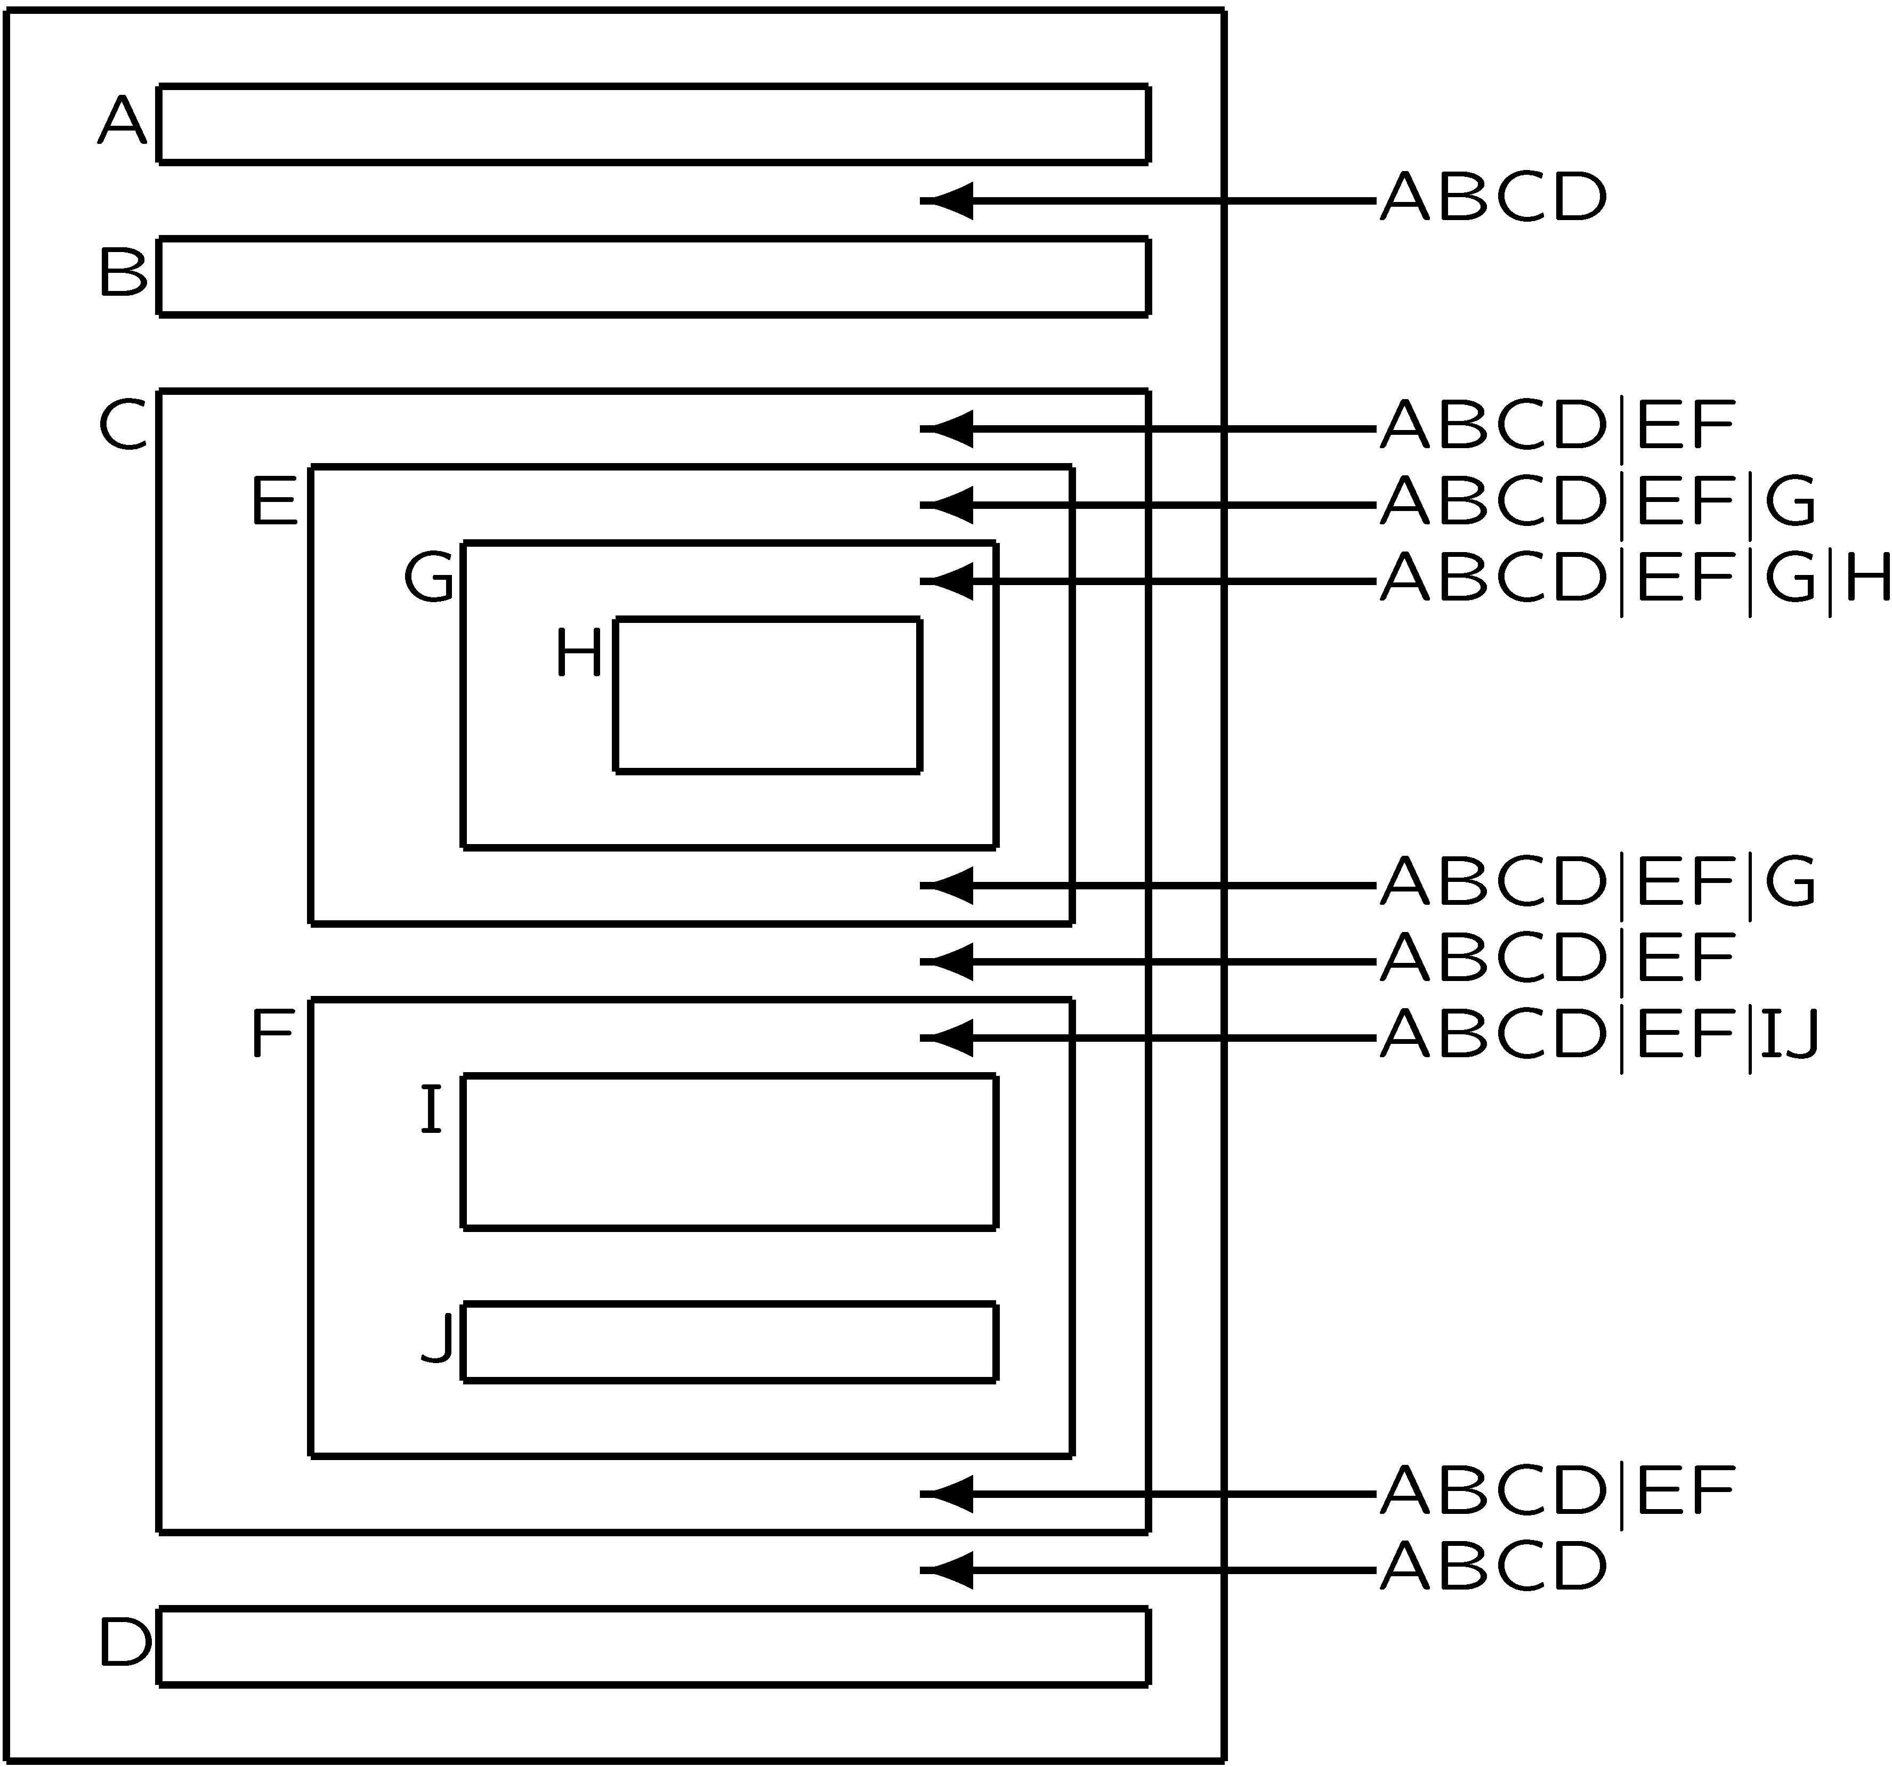
Symbol Table acts like a Stack

Slide 10
Symbol Table as Stack
The symbol table can be implemented as a simple stack:
  pushSymbol(SymbolTable *t, char *name, ...)
  popSymbol(SymbolTable *t)
  getSymbol(SymbolTable *t, char *name)
But how do we detect multiple definitions of an identifier at the same level?
Use bookmarks:
  scopeSymbolTable(SymbolTable *t)
  putSymbol(SymbolTable *t, char *name, ...)
  unscopeSymbolTable(SymbolTable *t)
  getSymbol(SymbolTable *t, char *name)

Slide 11
Implementation
Symbol table is stack of hash tables
  each hash table contains the identifiers in a level;
  push a new hash table when a level is entered;
  each identifier is entered in the top hash table;
  it is an error if it is already there;
  a use of an identifier is looked up in the hash tables from top to bottom;
  it is en error if it is not found;
  pop a hash table when a level is left.

Slide 12
Hash Functions for IDs
Initial letter (or prefix)
  codePROGRAM, codeMETHOD, codeEXP, …
Sum of ASCII encoding of letters
  the_int = tenth_i
Shifted sum of letters
  “j” = 106 = 0000000001101010
  = 0000000011010100
  + “o” = 111 = 0000000001101111
  = 0000000101000011
  + “o” = 111 = 0000000001101111
  = 0000000101000011
  + “s” = 115 = 0000000001110011
  = 0000000001110011
  = 1629

Slide 13
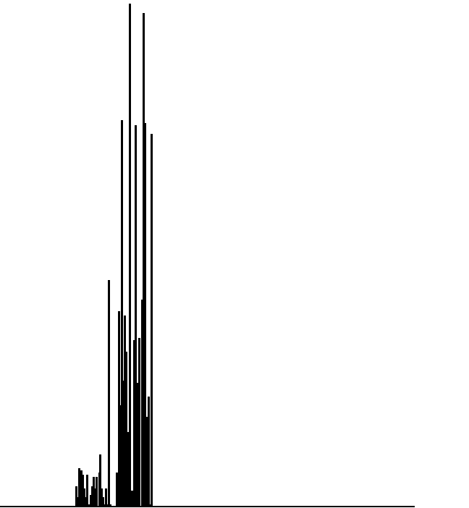
Initial letter
hash = *str;

Slide 14
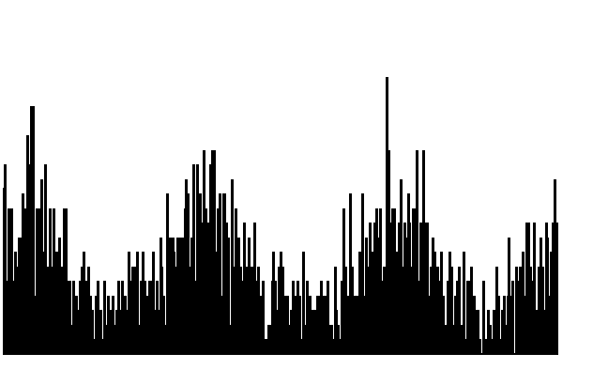
Sum of letters
while (*str)
hash = hash + *str++;

Slide 15
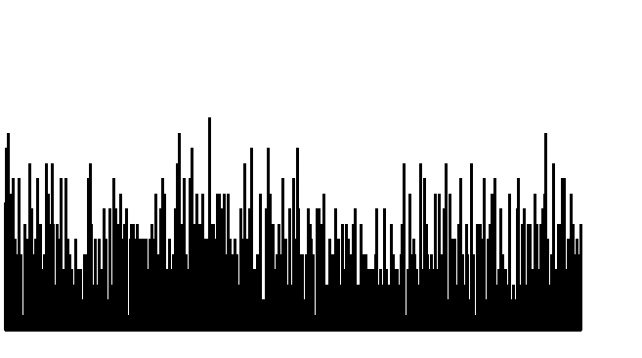
Shifted sum of letters
while (*str)
hash = (hash << 1)+ *str++;

Slide 16
Symbol Table Code
#define HashSize 317
typedef struct SymbolTable {
SYMBOL *table[HashSize];
struct SymbolTable *next;
} SymbolTable;
int Hash(char *str)
{ unsigned int hash = 0;
while (*str) hash = (hash << 1) + *str++;
return hash % HashSize;
}

Slide 17
Symbol Table Code (cont)
SymbolTable *initSymbolTable()
{ SymbolTable *t;
int i;
t = NEW(SymbolTable);
for (i=0; i < HashSize; i++) t->table[i] = NULL;
t->next = NULL;
return t;
}
SymbolTable *scopeSymbolTable(SymbolTable *s)
{ SymbolTable *t;
t = initSymbolTable();
t->next = s;
return t;
}

Slide 18
Insert Symbol
SYMBOL *putSymbol(SymbolTable *t, char *name,
SymbolKind kind)
{ int i = Hash(name);
SYMBOL *s;
for (s = t->table[i]; s; s = s->next) {
if (strcmp(s->name,name)==0) return s;
}
s = NEW(SYMBOL);
s->name = name;
s->kind = kind;
s->next = t->table[i];
t->table[i] = s;
return s;
}

Slide 19
Lookup Symbol
SYMBOL *getSymbol(SymbolTable *t, char *name)
{ int i = Hash(name);
SYMBOL *s;
for (s = t->table[i]; s; s = s->next)
if (strcmp(s->name,name)==0) return s;
if (t->next==NULL) return NULL;
return getSymbol(t->next,name);
}
int defSymbol(SymbolTable *t, char *name)
{ int i = Hash(name);
SYMBOL *s;
for (s = t->table[i]; s; s = s->next)
if (strcmp(s->name,name)==0) return 1;
return 0;
}

Slide 20
Mutually Recursive Definitions
A single traversal of the parse tree is not enough.
Make two traversals:
  collect definitions of identifiers; and
  analyze uses of identifiers.
In cases like recursive types, the definition is not completed before the second traversal.

Slide 21
JOOS Symbol Data
typedef enum{classSym,fieldSym,constructorSym,methodSym,
formalSym,localSym} SymbolKind;
typedef struct SYMBOL {
char *name;
SymbolKind kind;
union {
struct {struct SYMBOL *parent;
struct CLASS *source;
struct SymbolTable *csym;} classS;
struct TYPE *fieldS;
struct {struct FORMAL *formals;} constructorS;
struct {struct FORMAL *formals;
struct TYPE *returntype;
ModifierKind modifier;} methodS;
struct FORMAL *formalS;
struct {struct ID *id; struct TYPE *type;} localS;
} val;
struct SYMBOL *next;
} SYMBOL;

Slide 22
Notes
Each class has a local symbol table
  fields, methods, …
Meaning of symbol is defined by reference to AST nodes
  e.g., the type definition for an attribute

Slide 23
AST and Symbol Table
Are closely inter-related
  AST points to symbol entry for an ID
  Symbol points to AST node for definitions
  public class B extends A {
  protected A a;
  protected B b;
  public void m(A x, B y) {
  this.m(a,b);
  }
  }

Slide 24
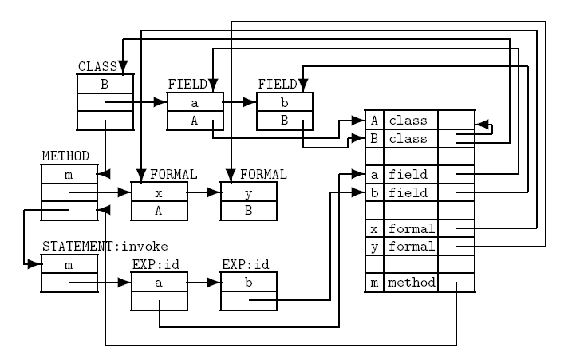
Cross-referencing

Slide 25
Recursion
Complex recursion
  e.g., between type definitions, method signatures, and method bodies
is resolved via multiple passes
void symPROGRAM(PROGRAM *p)
{ classlib = initSymbolTable();
symInterfacePROGRAM(p,classlib);
symInterfaceTypesPROGRAM(p,classlib);
symImplementationPROGRAM(p);
}

Slide 26
Symbol Passes
symInterfacePROGRAM
  define classes and their interfaces;
symInterfaceTypesPROGRAM
  build hierarchy and analyze interface types; and
symImplementationPROGRAM
  define locals and analyze method bodies.

Slide 27
Defining a Class
void symInterfaceCLASS(CLASS *c, SymbolTable *sym)
{ SymbolTable *csym;
if (defSymbol(sym,c->name)) {
reportStrError("class name %s already defined",
c->name,c->lineno);
c->thissym = NULL;
} else {
c->thissym = putSymbol(sym,c->name,classSym);
csym = initSymbolTable();
symInterfaceFIELD(c->fields,csym);
symInterfaceCONSTRUCTOR(c->constructor,c->name,csym);
symInterfaceMETHOD(c->methods,csym);
c->thissym->val.classS.csym = csym;
c->thissym->val.classS.source = c;
}
}

Slide 28
Defining a Method
void symInterfaceMETHOD(METHOD *m, SymbolTable *sym)
{ SYMBOL *s;
if (m!=NULL) {
symInterfaceMETHOD(m->next,sym);
if (defSymbol(sym,m->name)) {
reportStrError("method name %s already defined",
m->name,m->lineno);
} else {
s = putSymbol(sym,m->name,methodSym);
s->val.methodS.formals = m->formals;
s->val.methodS.returntype = m->returntype;
s->val.methodS.modifier = m->modifier;
}
}
}

Slide 29
and its Signature
void symInterfaceTypesMETHOD(METHOD *m, SymbolTable *sym)
{ if (m!=NULL) {
symInterfaceTypesMETHOD(m->next,sym);
symTYPE(m->returntype,sym);
symInterfaceTypesFORMAL(m->formals,sym);
}
}

Slide 30
Analyzing a JOOS Class
void symImplementationCLASS(CLASS *c)
{ SymbolTable *sym;
sym = scopeSymbolTable(classlib);
symImplementationFIELD(c->fields,sym);
symImplementationCONSTRUCTOR(c->constructor,
c->thissym,sym);
symImplementationMETHOD(c->methods,
c->thissym,sym);
}

Slide 31
Analyzing a JOOS Method Body
void symImplementationMETHOD(METHOD *m,
SYMBOL *this,
SymbolTable *sym)
{ SymbolTable *msym;
if (m!=NULL) {
symImplementationMETHOD(m->next,this,sym);
msym = scopeSymbolTable(sym);
symImplementationFORMAL(m->formals,msym);
symImplementationSTATEMENT(
m->statements,this,msym);
}
}

Slide 32
Analyzing local Declarations
In symImplementationSTATEMENT():
case localK:
symTYPE(s->val.localS.type,sym);
symImplementationIDlocal(s->val.localS.names,
s->val.localS.type,sym);
break;
.
.
.

Slide 33
Analyzing local Declarations
void symImplementationIDlocal(ID *i, TYPE *t,
SymbolTable *sym)
{ SYMBOL *s;
if (i!=NULL) {
symImplementationIDlocal(i->next,t,sym);
if (defSymbol(sym,i->name)) {
reportStrError("local name %s already declared",
i->name,i->lineno);
} else {
s = putSymbol(sym,i->name,localSym);
s->val.localS.id = i;
s->val.localS.type = t;
}
}
}

Slide 34
Lookup in Class Hierarchy
SYMBOL *lookupHierarchy(char *name, SYMBOL *start)
{ SYMBOL *s;
if (start==NULL) return NULL;
s = getSymbol(start->val.classS.csym,name);
if (s!=NULL) return s;
return lookupHierarchy(name,
start->val.classS.parent);
}
SYMBOL *lookupHierarchyClass(char *name, SYMBOL *start)
{ SYMBOL *s;
if (start==NULL) return NULL;
s = getSymbol(start->val.classS.csym,name);
if (s!=NULL) return start;
return lookupHierarchyClass(name,
start->val.classS.parent);
}

Slide 35
Analyzing JOOS Identifier
In symImplementationExp():
case idK:
e->val.idE.idsym =
symVar(e->val.idE.name,sym,
this,e->lineno);
break;
.
.
.

Slide 36
Analyzing JOOS Identifier
SYMBOL *symVar(char *name, SymbolTable *sym,
SYMBOL *this, int lineno)
{ SYMBOL *s;
s = getSymbol(sym,name);
if (s==NULL) {
s = lookupHierarchy(name,this);
if (s==NULL)
reportStrError("id %s not declared", name,lineno);
else
if (s->kind!=fieldSym)
reportStrError("%s not a var", name,lineno);
} else {
if ((s->kind!=fieldSym) && (… formalSym) && (… localSym))
reportStrError("%s not a var", name,lineno);
}
return s;
}

Slide 37
Testing Strategy
The testing strategy for the symbol tables involves an extension of the pretty printer.
A textual representation of the symbol table is printed once for every scope area.
These tables are then compared to a corresponding manual construction for a sufficient collection of programs.
Furthermore, every error message should be provoked by some test program.

