Slide 1
Code Optimization
Matthew Dwyer
324E Nichols Hall
dwyer@cis.ksu.edu
http://www.cis.ksu.edu/~dwyer

Slide 2
Compiler Architecture
SCAN
PARSE
WEED
RESOURCE
TYPE
SYMBOL
CODE
OPTIMIZE
EMIT

Slide 3
Optimizer
Focuses on
  Reducing run-time cost
  Reducing code size
  Reducing power consumption
Goals often conflict
  Usually cannot find an optimal solution
  Code improver is a more accurate term

Slide 4
Optimizing Space
Optimizations are driven by economics!
historically very important, because memory was small and expensive;
when memory became large and cheap, optimizing compilers traded space for speed; but
now Internet bandwidth is small and expensive, so Java compilers optimize for space.

Slide 5
Optimizing Time
historically very important to gain acceptance for high-level languages;
still important, since software features are constantly expanding to strain the limits of hardware;
are challenged by ever higher level abstractions in language;
must constantly adapt to changing micro-processor architectures.

Slide 6
Optimizing Power
historically these weren’t an issue, since computers were plugged into the wall;
mobile devices like laptops, PDAs and cell-phones are full-blown computing platforms;
power consumption is the dominant issue in compiling for mobile platforms today.

Slide 7
Where to Optimize?
Source code level
Intermediate representation (e.g., AST)
Virtual machine code (e.g., JVM)
Binary machine code level
During run-time (e.g., JIT compilers)
Aggressive optimization requires lots of small contributions at all levels.

Slide 8
For You To Do: Optimizing JOOS
c = a*b+c;
if (c<a) a=a+b*113;
while (b>0) {
a=a*c;
b=b-1;
}

Slide 9
JOOS Optimization
iload_1
iload_2
imul
iload_3
iadd
dup
istore_3
pop
iload_3
iload_1
if_icmplt true_1
iconst_0
goto stop_2
true_1:
iconst_1
stop_2:
ifeq stop_0
iload_1
iload_2
ldc 113
imul
iadd
dup
istore_1
pop
stop_0:
start_3:
iload_2
iconst_0
if_icmpgt true_5
iconst_0
goto stop_6
true_5:
iconst_1
stop_6:
ifeq stop_4
iload_1
iload_3
imul
dup
istore_1
pop
iload_2
iconst_1
isub
dup
istore_2
pop
goto start_3
stop_4:
iload_1
iload_2
imul
iload_3
iadd
istore_3
iload_3
iload_1
if_icmpge stop_0
iload_1
iload_2
ldc 113
imul
iadd
istore_1
stop_0:
start_3:
iload_2
iconst_0
if_icmple stop_4
iload_1
iload_3
imul
istore_1
iinc 2 -1
goto start_3
stop_4:
From 50 to 27 instructions

Slide 10
JOOS Optimizer
Remove unnecessary operations
  especially those at the boundaries of templates
Simplify control structures
Replace complex operators by simpler ones
Later on we will look at:
  JIT compilers
  More powerful “global” optimizations

Slide 11
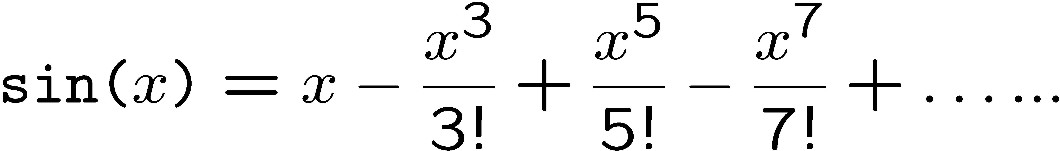
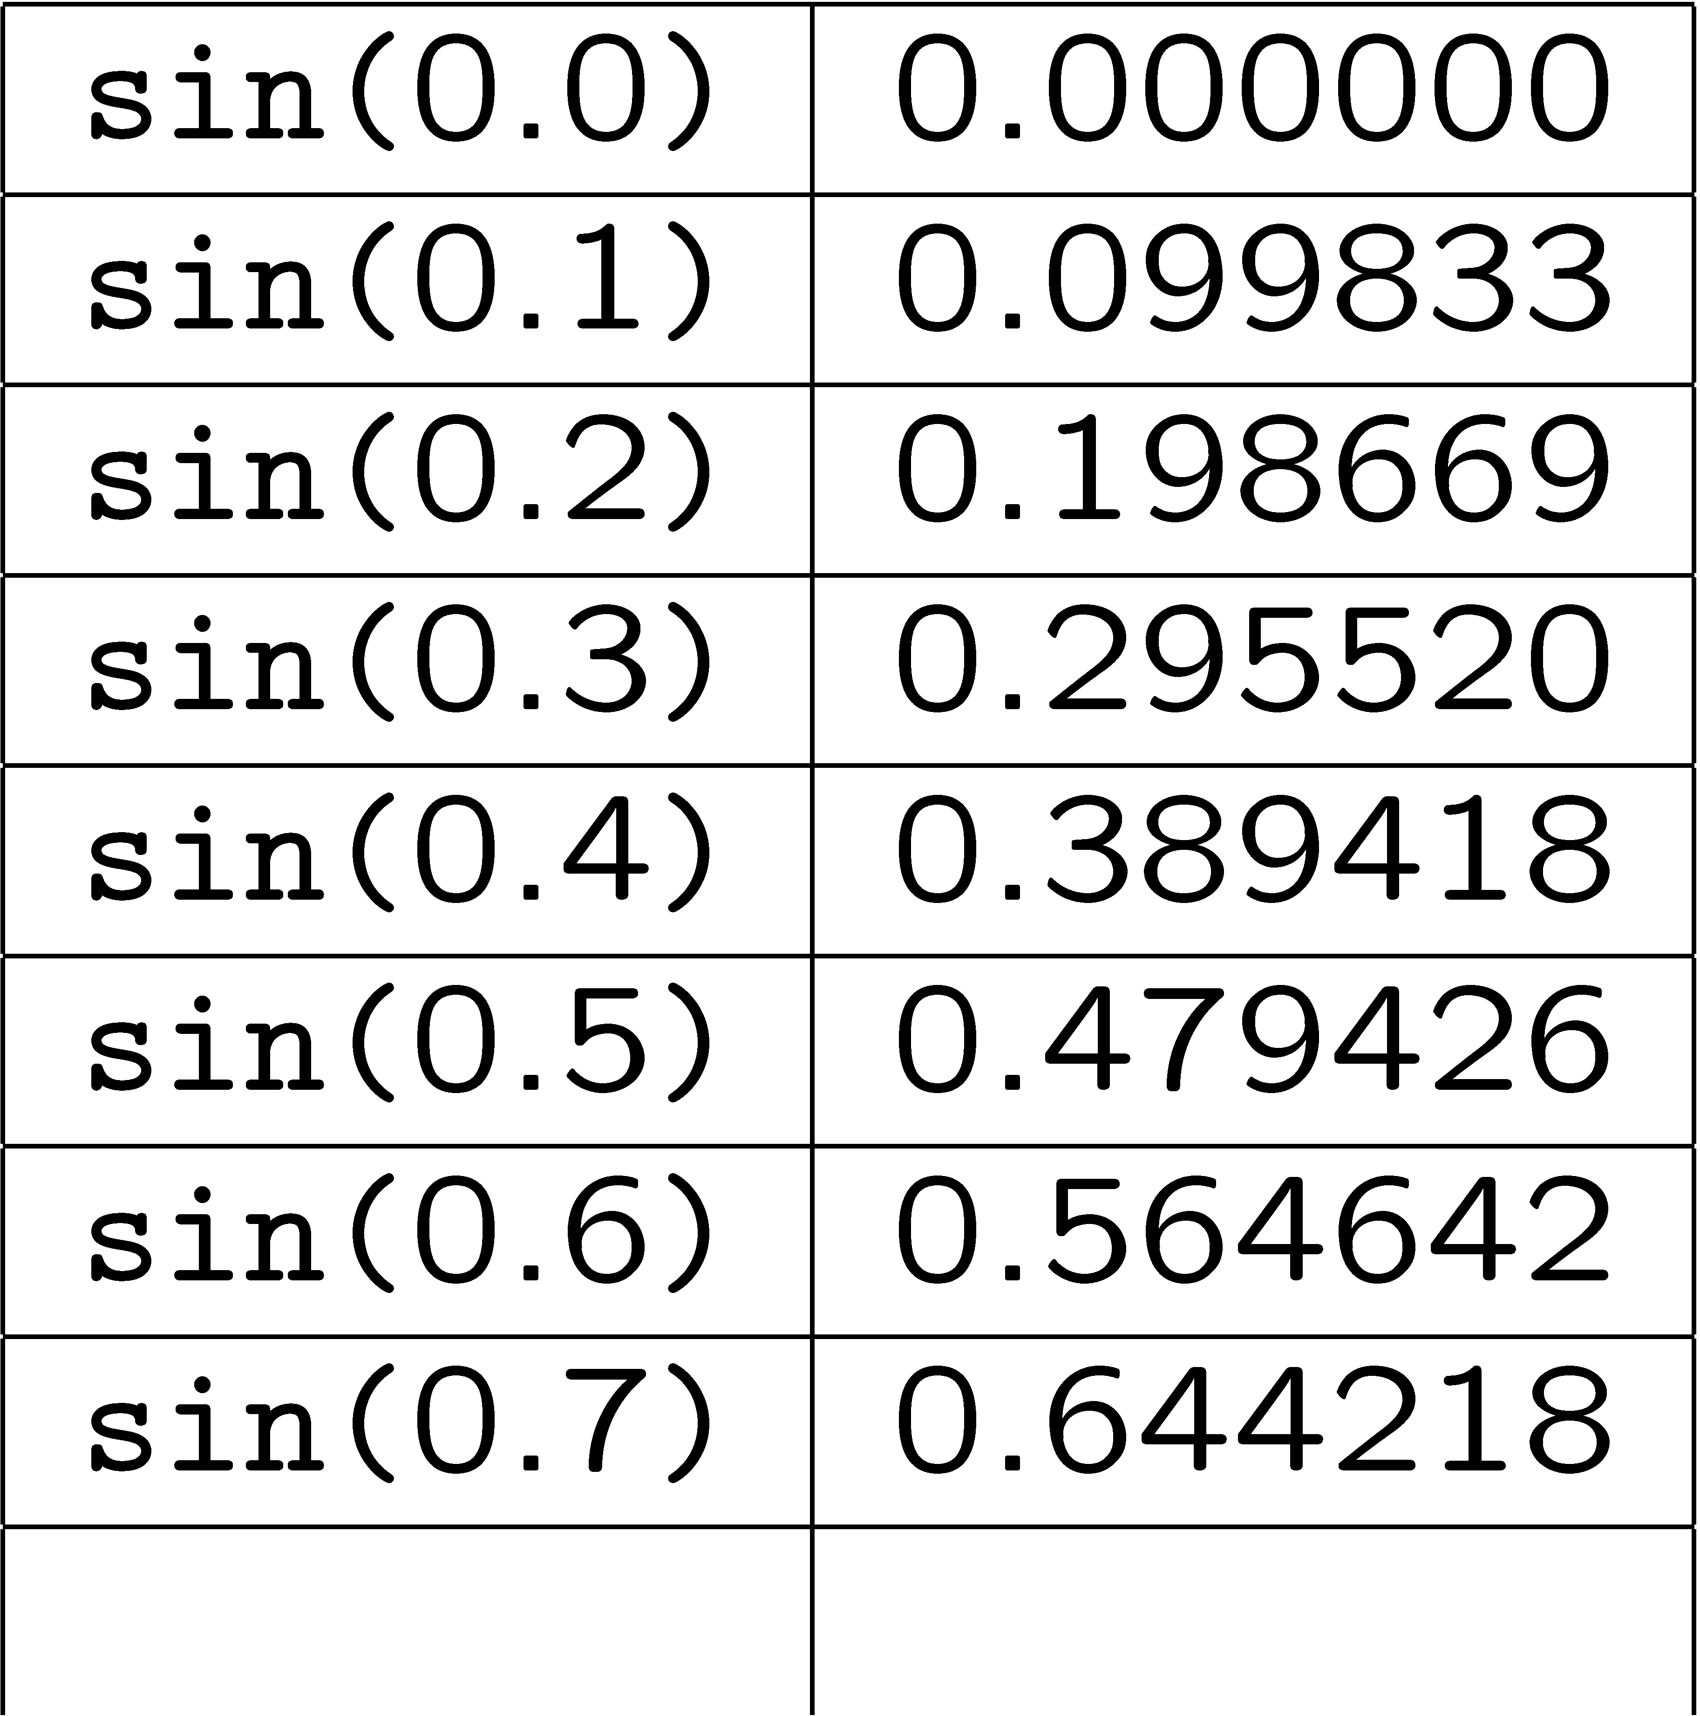
Tabulation
Sometimes we can trade space for time
Consider the sine function computed as:
Alternatively we could use:

Slide 12
Loop Unrolling
The loop
  for (i=0; i<2*N; i++) {
  a[i] = a[i] + b[i];
  }
is changed into:
  for (i=0; i<2*N; i=i+2) {
  j = i+1;
  a[i] = a[i] + b[i];
  a[j] = a[j] + b[j];
  }
which reduces the overhead and may give a 10 to 20% speedup.

Slide 13
Issues
The optimizer must undo fancy language abstractions, e.g.:
  variables abstract away from registers, so the optimizer must find an efficient mapping;
  control structures abstract away from gotos, so the optimizer must construct and simplify a goto graph;
  data structures abstract away from memory, so the optimizer must find an efficient layout;
  method lookups abstract away from procedure calls, so the optimizer must efficiently determine the intended implementations.

Slide 14
Compromises
a high abstraction level makes the development time cheaper, but the run-time more expensive;
an optimizing compiler makes run-time more efficient, but compile-time less efficient;
optimizations for speed and size may conflict; and
different applications may require different optimizations.

Slide 15
JOOS Peephole Optimizer
works at the bytecode level;
looks only at peepholes, which are sliding windows on the code sequence;
uses patterns to identify and replace inefficient constructions;
continues until a global fixed point is reached; and
optimizes both speed and space.

Slide 16
Peephole Optimizer
Uses a program representation called the goto graph
  Explicitly connects branches to labels
For example
  while (a>0) {
  if (b==c) a=a-1; else c=c+1;
  }

Slide 17
start_0:
iload_1
iconst_0
if_icmpgt true_2
iconst_0
goto stop_3
true_2:
iconst_1
stop_3:
ifeq stop_1
iload_2
iload_3
if_icmpeq true_6
iconst_0
goto_ stop_7
true_6:
iconst_1
stop_7:
ifeq else_4:
iload_1
iconst_1
isub
dup
istore_1
pop
goto stop_5
else_4
iload_3
iconst_1
iadd
dup
istore_3
pop
stop_5:
goto start_0
stop_1:

Slide 18
Goto Graph
Represent labels for a code block as an array of
        typedef struct LABEL {
        char *name;
        int sources;
        struct CODE *position;
        } LABEL;
  where
  the array index is the label's number;
  the field name is the textual part of the label;
  the field sources indicates the in-degree of the label; and
  the field position points to the location of the label in the code sequence.

Slide 19
Goto Graph Operations
inspect a given bytecode;
find the next bytecode in the sequence;
find the destination of a label;
create a new reference to a label;
drop a reference to a label;
ask if a label is dead (in-degree 0);
ask if a label is unique (in-degree 1); and
replace a sequence of bytecodes by another.

Slide 20
Bytecode Inspection
int is_istore(CODE *c, int *arg)
{ if (c==NULL) return 0;
if (c->kind == istoreCK) {
(*arg) = c->val.istoreC;
return 1;
} else {
return 0;
}
}

Slide 21
Search Operations
Find the next bytecode in the sequence:
    CODE *next(CODE *c)
    { if (c==NULL) return NULL;
    return c->next;
    }
    }
Find the destination of a label:
    CODE *destination(int label)
    { return currentlabels[label].position;
    }

Slide 22
Label Operations
Create a new reference to a label:
    int copylabel(int label)
    { currentlabels[label].sources++;
    return label;
    }
Drop a reference to a label:
    void droplabel(int label)
    { currentlabels[label].sources--;
    }

Slide 23
In-degree Operations
Ask if a label is dead (indegree 0):
    int deadlabel(int label)
    { return currentlabels[label].sources==0;
    }
Ask if a label is unique (indegree 1):
    int uniquelabel(int label)
    { return currentlabels[label].sources==1;
    }

Slide 24
Replacement Operation
Replace a sequence of bytecodes by another:
  int replace(CODE **c, int k, CODE *r)
  { CODE *p;
  int i;
  p = *c;
  for (i=0; i<k; i++) p=p->next;
  if (r==NULL) {
  *c = p;
  } else {
  *c = r;
  while (r->next!=NULL) r=r->next;
  r->next = p;
  }
  return 1;
  }

Slide 25
Generic JOOS Peephole Pattern
Takes a pointer to a sequence of bytecodes
Tests a condition on some part of that sequence, e.g., the first few bytecodes
If test passes, implements a transformation of the bytecodes
Returns 1 if transformation is made and 0 otherwise

Slide 26
Increment Identification
The expression: x = x + k
may be simplified to an increment operation, if 0 <= k <= 255
Corresponding JOOS peephole pattern:
    int positive_increment(CODE **c)
    { int x,y,k;
    if (is_iload(*c,&x) &&
    is_ldc_int(next(*c),&k) &&
    is_iadd(next(next(*c))) &&
    is_istore(next(next(next(*c))),&y) &&
    x==y && k<=255) {
    return replace(c,4,makeCODEiinc(x,k,NULL));
    }
    return 0;
    }
We may attempt to apply this pattern anywhere in the code sequence.

Slide 27
Algebraic Simplifications
Exploit arithmetic properties x * 0 = 0
      x * 1 = x
      x * 2 = x + x
Corresponding JOOS peephole pattern
int simplify_multiplication_right(CODE **c) {
int x,k;
if (is_iload(*c,&x) && is_ldc_int(next(*c),&k) && is_imul(next(next(*c)))) {
if (k==0) return replace(c,3,makeCODEldc_int(0,NULL));
else if (k==1) return replace(c,3,makeCODEiload(x,NULL));
else if (k==2) return replace(c,3,makeCODEiload(x,
  makeCODEdup(
  makeCODEiadd(NULL))));
  return 0;
}
return 0;
}

Slide 28
Jump Optimizations
Short-circuit chains of jumps, e.g.,
goto L1 goto L7
…
L1:
goto L7
…
L7:

Slide 29
Jump Optimizations
int simplify_goto_goto(CODE **c)
{ int l1,l2;
if (is_goto(*c,&l1) &&
is_goto(next(destination(l1)),&l2) && l1<l2) {
droplabel(l1);
copylabel(l2);
return replace(c,1,makeCODEgoto(l2,NULL));
}
return 0;
}

Slide 30
For You To Do
Is the following pattern useful?
    int simplify_astore(CODE **c)
    { int x;
    if (is_dup(*c) &&
    is_astore(next(*c),&x) &&
    is_pop(next(next(*c)))) {
    return replace(c,3,makeCODEastore(x,NULL));
    }
    return 0;
    }

Slide 31
Statement Expressions
The assignment statement:
    a = b;
generates the code:
    aload_2
    dup
    astore_1
    pop
because of our simpleminded strategy.

Slide 32
Assignments
  case formalSym:
  codeEXP(e->val.assignE.right);
  code_dup();
  if (e->val.assignE.leftsym->
  val.formalS->type->kind==refK) {
  code_astore(e->val.assignE.leftsym->
  val.formalS->offset);
  } else {
  code_istore(e->val.assignE.leftsym->
  val.formalS->offset);
  }
  break;

Slide 33
Assignments
To avoid the dup, we must know if the assigned value is needed later; this information must then flow back to the code gen for the expression:
    case expK:
    codeEXP(s->val.expS);
    if (s->val.expS->type->kind!=voidK) {
    code_pop();
    }
    break;
to decide whether to pop or not. A peephole pattern is simpler and more modular.

Slide 34
Peephole Optimizer Engine
Any collection of peephole patterns:
  typedef int(*OPTI)(CODE **);
  #define OPTS 4
  OPTI optimization[OPTS] = {simplify_multiplication_right,
  simplify_astore,
  positive_increment,
  simplify_goto_goto};
can be applied to a goto graph in a fixed point process:
    repeat
    for each bytecode in succession do
    for each peephole pattern in succession do
    repeat
    apply the peephole pattern to the bytecode
    until the goto graph doesn't change
    end
    end
    until the goto graph doesn't change

Slide 35
JOOS Fixed-point Engine
void optiCODE(CODE **c)
{ optiCHANGE = 1;
while (optiCHANGE) {
optiCHANGE = 0;
optiCODEtraverse(c);
}
}
int optiCHANGE;
void optiCODEtraverse(CODE **c)
{ int i,change;
change = 1;
if (*c!=NULL) {
while (change) {
change = 0;
for (i=0; i<OPTS; i++) {
change = change | optimization[i](c);
}
optiCHANGE = optiCHANGE || change;
}
if (*c!=NULL) optiCODEtraverse(&((*c)->next));
}
}

Slide 36
For You To Do
Does this process terminate?
Does it depend on the peephole patterns?
If so, what characteristics should the peephole patterns have to ensure termination?
If not, what characteristic of the driver assures termination?

Slide 37
Monotonicity
Termination is a property of the monotonicity of the peephole pattern transformations
  i.e., they always make some measure smaller
Some patterns do not make the code shorter, e.g., jump chaining
What is the measure?

Slide 38
Lexicographic Measure
The measure has three components
  Total number of bytecodes
  Number of imul bytecodes
  Sum of the length of all goto chains
Seems kind of cooked up to account for the work that our patterns do in simplifying the program
  Nature of measure is unimportant, it’s existence is all that matters
  If you define new patterns make sure the are monotone with respect to this or an extended measure

Slide 39
For You to Do
Does the order of pattern application affect the resultant program?
Note that the patterns are applied in the order in which you define them in the optimizations array

Slide 40
Order Matters (potentially)
For the example patterns, order doesn’t matter, but consider the following patterns:
A
B
C
A
B
D
A
B
D
P₁
A
B
P₂
P₁
A
B
C
D
C
D
D
E
A
B
D
E
A
B
D
E
P₂
P₂
P₁

Slide 41
JOOS Optimizer (35 patterns)

Slide 42
“Optimizer”
Suppose OPM(G) is the shortest goto graph equivalent to G.
The shortest diverging goto graph, D, is:
    L:
    goto L
We can decide the Halting problem on an arbitrary goto graph G as:
      OPM(G) = D
hence, the program OPM cannot exist.

Slide 43
Testing the Optimizer
Carefully argue that each peephole pattern is sound, i.e., it preserves the semantics of the original bytecodes
Demonstrate that each peephole pattern is coded correctly
Show statistics that illustrate the improvements possible using your optimizer.

