Slide 1
Parsing
Matthew Dwyer
324E Nichols Hall
dwyer@cis.ksu.edu
http://www.cis.ksu.edu/~dwyer

Slide 2
Compiler Architecture
SCAN
PARSE
WEED
RESOURCE
TYPE
SYMBOL
CODE
OPTIMIZE
EMIT

Slide 3
Compiler Architecture
SCAN
Token stream
PARSE
Parse tree
WEED
nextToken()

Slide 4
The Functionality of the Parser
Input: sequence of tokens from lexer
Output: parse tree of the program
  parse tree is generated if the input is a legal program
  if input is an illegal program, syntax errors are issued
Note: Instead of parse tree, some parsers produce:
  abstract syntax tree (AST) + symbol table
In the following, we’ll assume that parse tree is generated.

Slide 5
Comparison with Scanner
Phase | Input | Output
Scanner | String of characters | String of tokens
Parser | String of tokens | Parse tree

Slide 6
Example
The program:
  x * y + z
Input to parser:
  ID TIMES ID PLUS ID
  we’ll write tokens as follows:
  id * id + id
Output of parser:
  the parse tree →
E
E
+
E
E
*
E
id
id
id

Slide 7
Can we use REs?
Write an automaton that accepts strings
  {“a”,“(a)”,“((a))”,“(((a)))”}
  {“a”,“(a)”,“((a))”,“(((a)))”,…“(^{k}a)^{k}”}
    where a^{k} means a a a …. a
{
k times

Slide 8
Can we use REs?
What programs are generated by?
  digit+ ( ( “+” | “-” | “*” | “/” ) digit+ )*
What important properties does this RE fail to express?

Slide 9
Parser : Overview
Parser plays two important roles
Recognizer: not all strings of tokens are programs
  must distinguish between valid and invalid strings of tokens
Translator: must expose program structure
  e.g., associativity and precedence
  hence must return the parse tree

Slide 10
Parser : Overview
Similar requirements as for scanner, we need:
A language for describing valid strings of tokens
  To function like REs in scanner
  Context-free Grammars (CFG)
A method for distinguishing valid from invalid strings of tokens
  To function like the DFA and algorithm in scanner
  Push-down Automata (PDA)

Slide 11
Context-free Grammar
In English:
  An integer is an arithmetic expression.
  If exp₁ and exp₂ are arithmetic expressions,
  then so are the following:
    exp₁ - exp₂
    exp₁ / exp₂
    ( exp₁ )
As a CFG:
  E → intlit
  E → E - E
  E → E / E
  E → ( E )

Slide 12
Reading the CFG
The grammar has five terminal symbols: intlit, -, /, (, )
  terminals are tokens returned by the scanner.
The grammar has one non-terminal symbol: E
  non-terminals describe valid (sub)sequences of tokens
The grammar has four productions or rules
  each of the form: E → α
  left-hand side is a single non-terminal
  right-hand side (α ) is either
    a sequence of one or more terminals and/or non-terminals
    ε (an empty production)

Slide 13
Example, revisited
A more compact way to write previous grammar:
  E → intlit | E - E | E / E | ( E )
or
    E → intlit
    | E - E
    | E / E
    | ( E )

Slide 14
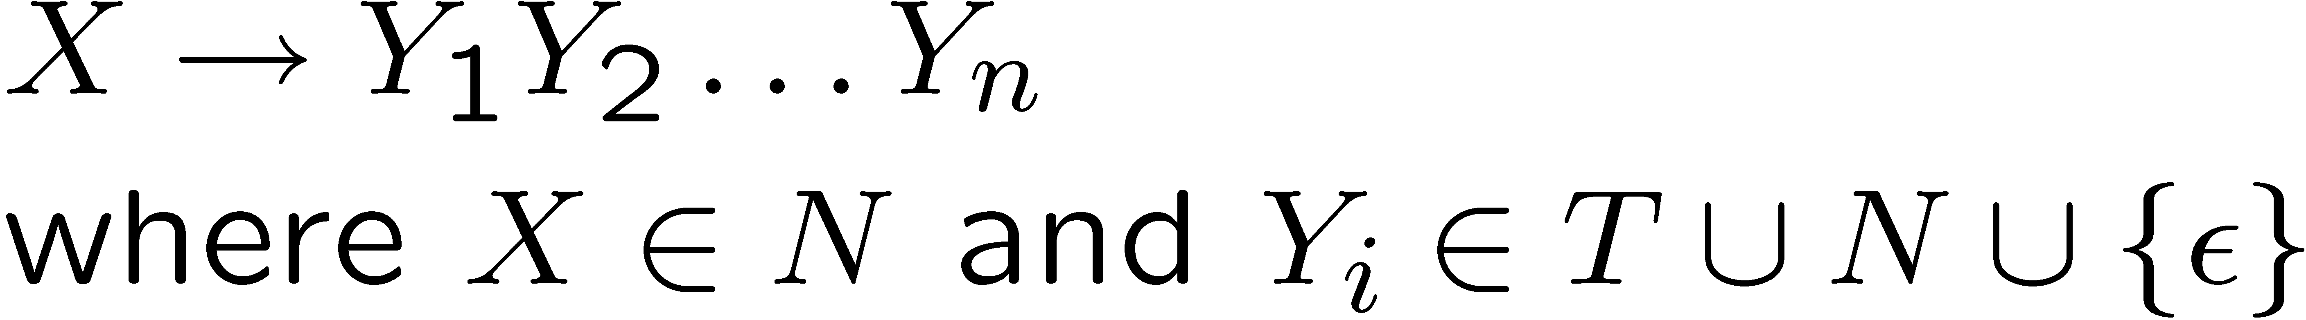
A formal definition of CFGs
A CFG consists of
  A set of terminals T
  A set of non-terminals N
  A start symbol S (a non-terminal)
  A set of productions:
Notes:
If not specified, then S is the nonterminal that appears on the left-hand side of the first production.

Slide 15
Notational Conventions
In these lecture notes
  Non-terminals are written upper-case
  Terminals are written lower-case
  The start symbol is the left-hand side of the first production

Slide 16
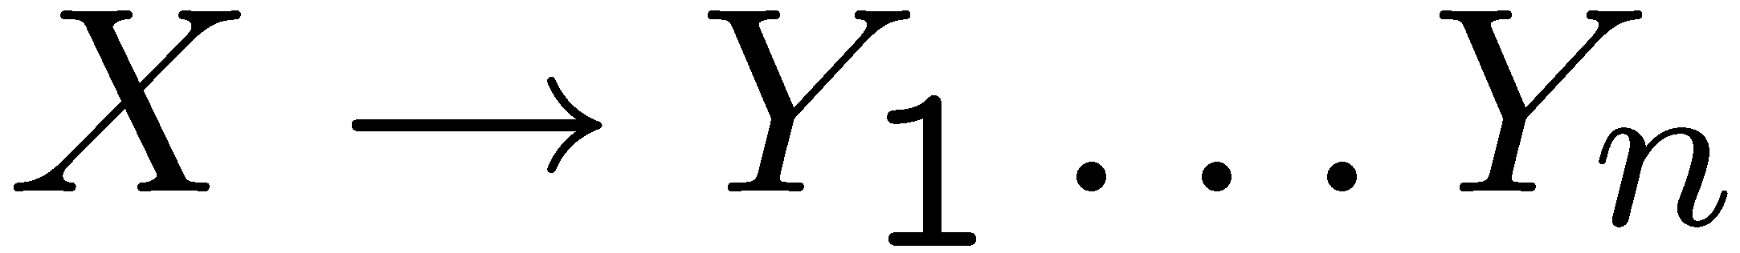
The Language of a CFG
The language defined by a CFG is the set of terminal strings that can be derived from the start symbol of the grammar.
Derivation: Read productions as rules:
Means X can be replaced by Y₁ … Y_{n}

Slide 17
Derivation
A sequence of grammar rule applications leading from the start symbol
Basic Idea
Begin with a string consisting of the start symbol “S”
Replace any non-terminal X in the string by a the right-hand side of some production
  X → Y₁ .. Y_{n}
Repeat (2) until there are no non-terminals in the string

Slide 18
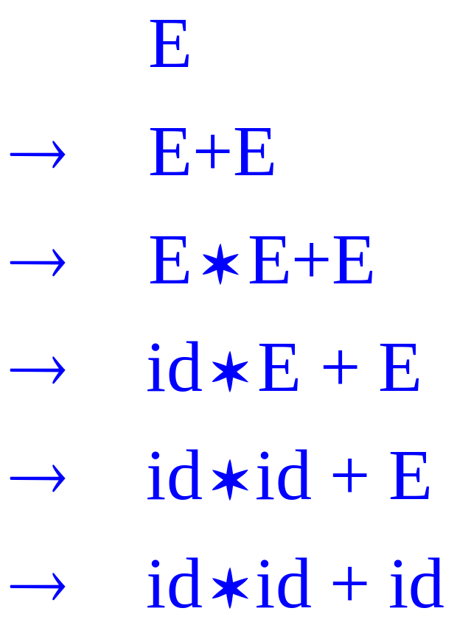
Derivation: an example
CFG:
  E → id
  E → E + E
  E → E * E
  E → ( E )
Is string id * id + id in the
language defined by the grammar?
derivation:

Slide 19
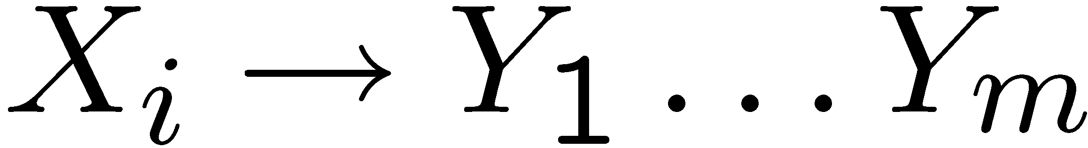
The Language of a CFG
More formally, write
if there is a production
A sentential form is a sequence of terminals and non-terminals

Slide 20
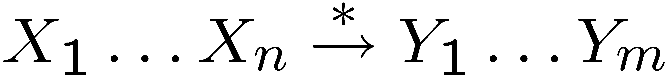
The Language of a CFG (Cont.)
Write
if
in 0 or more steps

Slide 21
The Language of a CFG
Let G be a context-free grammar with start symbol S. Then the language of G is:

Slide 22
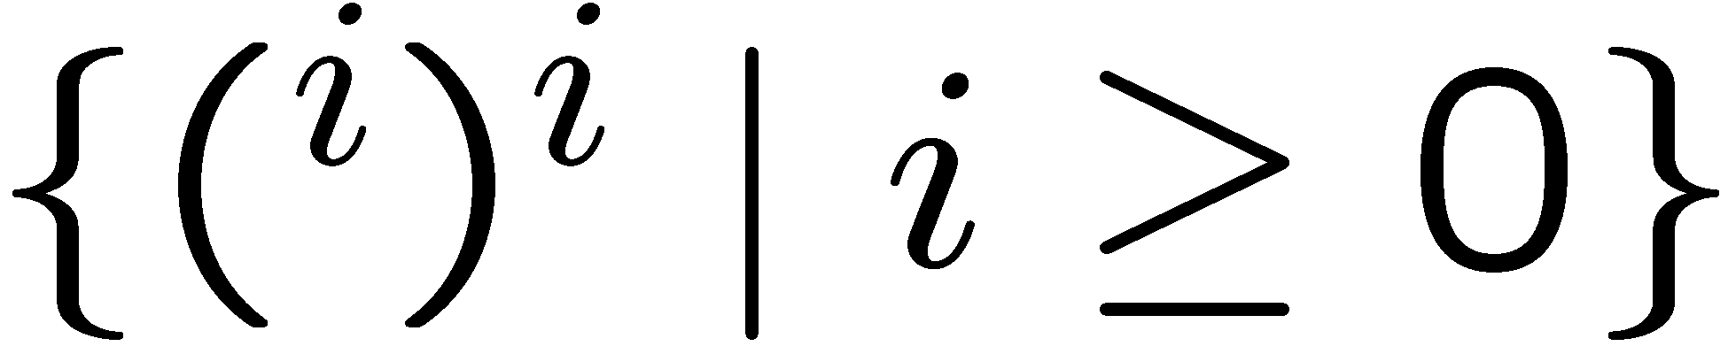
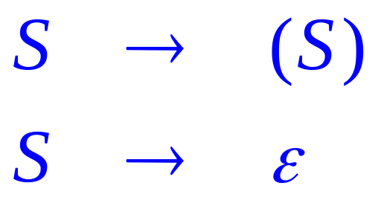
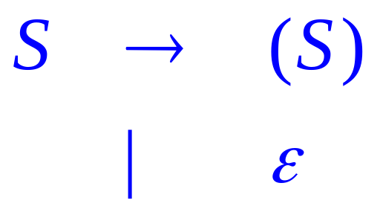
Examples
Strings of balanced parentheses
The grammar:
same
as

Slide 23
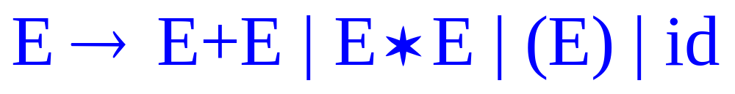
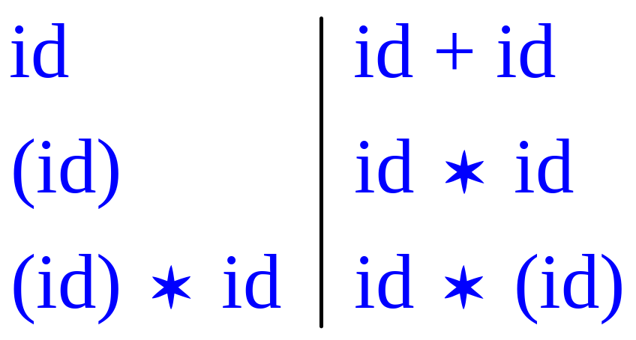
Arithmetic Example
Simple arithmetic expressions:
Some elements of the language:

Slide 24
Notes on CFGs
Membership in a language is “yes” or “no”
  we also need parse tree of the input!
  furthermore, we must handle errors gracefully
Need an “implementation” of CFG’s,
  i.e. the parser
Form of the grammar is important for generating a parser

Slide 25
Derivations and Parse Trees
A derivation is a sequence of productions
A derivation can be drawn as a tree
  Start symbol is the tree’s root
  For a production X → Y₁ … Y_{n}
  add children Y₁ … Y_{n} to node X

Slide 26

Derivation Example
Grammar
String

Slide 27
Derivation Example (Cont.)
E
E
+
E

Slide 28
Derivation Example (Cont.)
E
E
+
E
E
*
E

Slide 29
Derivation Example (Cont.)
E
E
+
E
E
*
E
id

Slide 30
Derivation Example (Cont.)
E
E
+
E
E
*
E
id
id

Slide 31
Derivation Example (Cont.)
E
E
+
E
E
*
E
id
id
id

Slide 32
Derivation Example (Cont.)
E
E
+
E
E
*
E
id
id
id

Slide 33
Notes on Derivations
A parse tree has
  Terminals at the leaves
  Non-terminals at the interior nodes
An in-order traversal of the leaves is the original input
The parse tree shows the association of operations, the input string does not

Slide 34
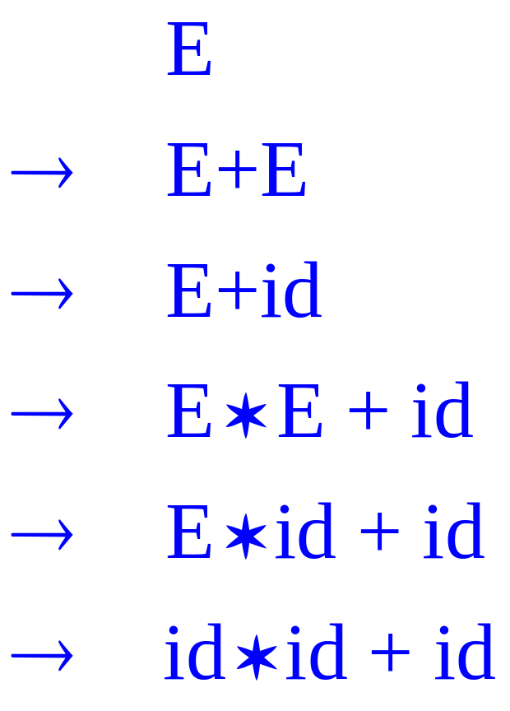
Left-most and Right-most Derivations
The example is a left-most derivation
  At each step, replace the left-most non-terminal
There is an equivalent notion of a right-most derivation

Slide 35
Derivation Example (Cont.)
E
E
+
E

Slide 36
Derivation Example (Cont.)
E
E
+
E
id

Slide 37
Derivation Example (Cont.)
E
E
+
E
E
*
E
id

Slide 38
Derivation Example (Cont.)
E
E
+
E
E
*
E
id
id

Slide 39
Derivation Example (Cont.)
E
E
+
E
E
*
E
id
id
id

Slide 40
Derivations and Parse Trees
Note that right-most and left-most derivations have the same parse tree
The difference is the order in which branches are added

Slide 41
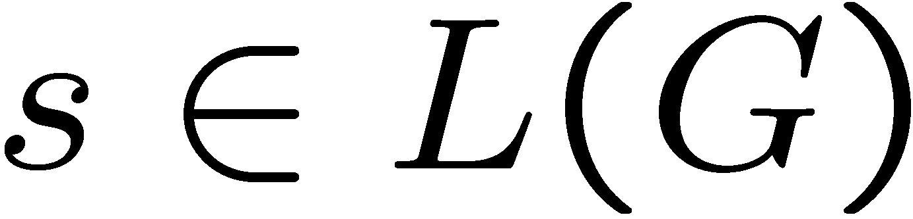
Summary of Derivations
We are not just interested in whether
  we need a parse tree for s
A derivation defines a parse tree
  but one parse tree may have many derivations
Left-most and right-most derivations are important in parser implementation

Slide 42
Multiple Parse Trees
The string “id * id + id” has two parse trees
E
E
E
+
E
E
*
E
E
*
E
id
id
E
+
E
id
id
id
id

Slide 43
For You To Do
for each of the two parse trees, find the corresponding left-most derivation
for each of the two parse trees, find the corresponding right-most derivation

Slide 44
Ambiguity
A grammar is ambiguous if for some string
(the following three conditions are equivalent)
  it has more than one parse tree
  if there is more than one right-most derivation
  if there is more than one left-most derivation
Ambiguity is BAD
  Want operator precedence enforced!

Slide 45
Resolving Ambiguity
Rewrite the grammar
  use a different nonterminal for each precedence level
  start with the lowest precedence (MINUS)
  E → E - E | E / E | ( E ) | id
rewrite to
  E → E - E | T
  T → T / T | F
  F → id | ( E )

Slide 46
For You To Do
Attempt to construct a parse tree for
“id – id / id”
that shows the wrong precedence.

Slide 47
Associativity
The grammar captures operator precedence, but it is still does not capture the proper meaning
Fails to express that both subtraction and division are left associative;
  5-3-2 = ((5-3)-2) and not (5-(3-2))

Slide 48
For You To Do
Draw two parse trees for the expression
    5-3-2
using the grammar given above;
  one that correctly groups 5-3
  one that incorrectly groups 3-2

Slide 49
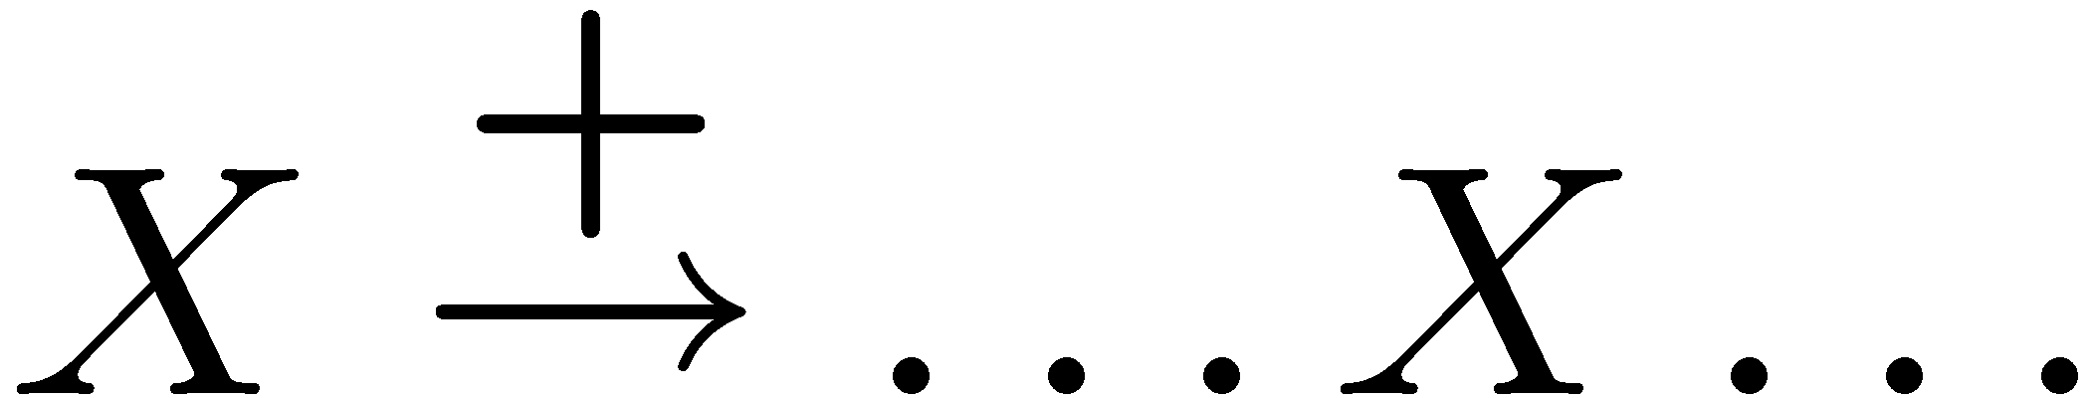
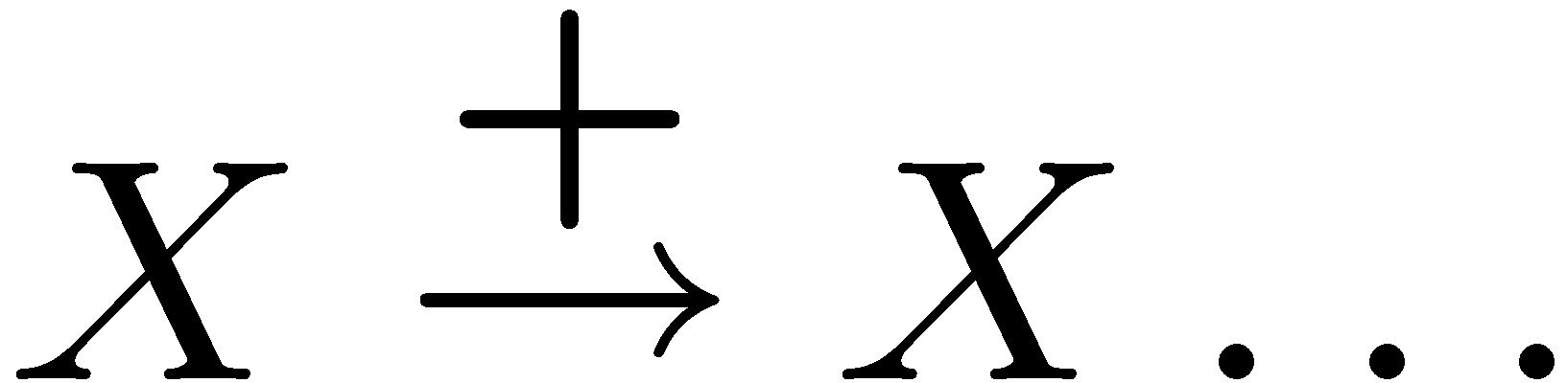
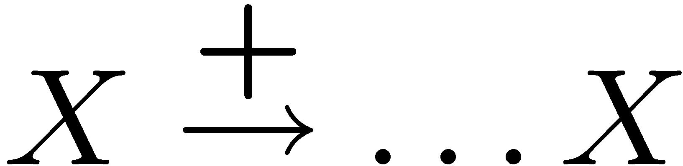
Recursion
A grammar is recursive in nonterminal X if
  in one or more steps, X derives a sequence of symbols that includes an X
A grammar is left recursive in X if
  in one or more steps, X derives a sequence of symbols that starts with an X
A grammar is right recursive in X if
  in one or more steps, X derives a sequence of symbols that ends with an X

Slide 50
Resolving Associativity
The grammar given above is both left and right recursive in nonterminals E and T
To correctly expresses operator associativity:
  For left associativity, use left recursion.
  For right associativity, use right recursion.
Here's the correct grammar:
  E → E – T | T
  T → T / F | F
  F → id | ( E )

Slide 51
Ambiguity: The Dangling Else
Consider the grammar
  E → if E then E
  | if E then E else E
  | print
This grammar is also ambiguous

Slide 52
The Dangling Else: Example
The expression
  if E₁ then if E₂ then E₃ else E₄
has two parse trees
if
if
E₁
if
E₁
if
E₄
E₂
E₃
E₄
E₂
E₃

Slide 53
The Dangling Else: A Fix
else matches the closest unmatched then
We can describe this in the grammar
E → MIF /* all then are matched */
  | UIF /* some then are unmatched */
  MIF → if E then MIF else MIF
  | print
  UIF → if E then E
  | if E then MIF else UIF

Slide 54
The Dangling Else: Example Revisited
The expression if E₁ then if E₂ then E₃ else E₄
if
if
E₁
if
E₁
if
E₄
E₂
E₃
E₄
E₂
E₃
A valid parse tree (for a UIF)
Not valid because the then expression is not a MIF

Slide 55
Precedence and Associativity Declarations
Instead of rewriting the grammar
  Use the more natural (ambiguous) grammar
  Along with disambiguating declarations
Most parser generators allow precedence and associativity declarations to disambiguate grammars

