Slide 1
Scanning
Matthew Dwyer
324E Nichols Hall
dwyer@cis.ksu.edu
http://www.cis.ksu.edu/~dwyer

Slide 2
Compiler Architecture
SCAN
PARSE
WEED
RESOURCE
TYPE
SYMBOL
CODE
OPTIMIZE
EMIT

Slide 3
Compiler Architecture
Source Code
Character stream
SCAN
Token stream
PARSE

Slide 4
Scanner : Overview
A scanner transforms a string of characters into a string of symbols:
  it corresponds to a finite-state machine (FSM);
  plus some C code to make it work;
  which is generated by Flex.
Symbols (aka tokens, lexemes) are the indivisible units of a languages syntax
  words, punctuation symbols, …
A FSM recognizes the structure of a symbol
  that structure is specified as a regular expression

Slide 5
Token Definitions
Described in language specification:
  “An identifier is an unlimited-length sequence of Java letters and Java digits, the first of which must be a Java letter.
  An identifier cannot have the same spelling (Unicode character sequence) as a keyword (§3.9), Boolean literal (§3.10.3), or the null literal (§3.10.7).”
  http://java.sun.com/docs/books/jls/html/3.doc.html#40625

Slide 6
Finite State Machine
A FSM is similar to a compiler in that:
  A compiler recognizes legal programs
  in some (source) language.
  A finite-state machine recognizes legal strings
  in some language.
Example: Pascal Identifiers
  sequences of one or more letters or digits,
  starting with a letter:
letter | digit
letter
S
A

Slide 7
FSM Graphs
A state
The start state
An accepting state
a
A transition
Notes:
Nodes are states.
Edges (arrows) are transitions.
Each edge labeled with a single character.
a single edge labeled "letter" stands for 52 edges labeled 'a', 'b', ..., 'z', 'A', ..., 'Z'.
the label "letter,digit" stands for 62 edges labeled 'a',...'Z','0',...'9'.
S is the start state
every FSM has exactly one (labeled with "S"),
A is a final state
drawn using a double circle, and non-final states are drawn using single circles.
A FSM may have more than one final state.

Slide 8
FSM Interpretation
Transition: s₁ →ª s₂
Is read: In state s₁ on input “a” go to state s₂
At end of input
  if in accepting state => accept
  otherwise => reject
If no transition possible => reject

Slide 9
Language defined by FSM
The language defined by a FSM is the set of strings accepted by the FSM.
  in the language of the FSM shown above:
    x, tmp2, XyZzy, position27.
  not in the language of the FSM shown above:
    123, a?, 13apples.

Slide 10
For You To Do
Write an automaton that accepts Java identifiers
  one or more letters, digits, or underscores, starting with a letter or an underscore.
Write a finite-state machine that accepts only Java identifiers that do not end with an underscore

Slide 11
Example: Integer Literals
FSM that accepts integer literals with an optional + or - sign:
digit
B
digit
digit
+
S
A
-

Slide 12
Two kinds of FSM
Deterministic (DFA):
  No state has more than one outgoing edge with the same label.
Non-Deterministic (NFA):
  States may have more than one outgoing edge with same label.
  Edges may be labeled with ε (epsilon), the empty string.
  The automaton can take an ε epsilon transition without looking at the current input character.

Slide 13
Example of NFA
integer-literal example:
digit
B
ε
digit
+
S
A
-

Slide 14
NFA
sometimes simpler than DFA
can be in multiple states at the same time
NFA accepts a string if
  there exists a sequence of moves
  starting in the start state,
  ending in a final state,
  that consumes the entire string.
Example:
  the integer-literal NFA on input "+75":
Notes:
After scanning Can be in these States
-------------- ----------------------
(nothing) S A
+ A -stuck-
+7 B -stuck-
+75 B -stuck-
There is one sequence of moves that consumes the entire input and ends in a final state (state B), so this input is accepted by his machine.

Slide 15
Equivalence of DFA and NFA
Theorem:
  For every non-deterministic finite-state machine M, there exists a deterministic machine M' such that M and M' accept the same language.
DFA are easy to implement
NFA are easy to generate from specifications
Algorithms exist to convert NFA to DFA

Slide 16
Regular Expressions (RE)
Automaton is a good “visual” aid
  but is not suitable as a specification
regular expressions are a suitable specification
  a compact way to define a language that can be accepted by an automaton.
used as the input to a scanner generator
  define each token, and also
  define white-space, comments, etc
    these do not correspond to tokens,
    but must be recognized and ignored.

Slide 17
Example: Pascal identifier
Lexical specification (in English):
  a letter, followed by zero or more letters or digits.
Lexical specification (as a regular expression):
  letter (letter | digit)*
|
means "or"
means "followed by"
*
means zero or more instances of
()
are used for grouping
Notes:
Often, the "followed by" dot is omitted, and just writing two things next to each other means that one follows the other. For example:
letter (letter | digit)*

Slide 18
Operands of RE Operators
Operands are same as labels on the edges of an FSM
  single characters or ε
"letter" is a shorthand for
  a | b | c | ... | z | A | ... | Z
"digit“ is a shorthand for
  0 | 1 | … | 9
sometimes we put the characters in quotes
  necessary when denoting | *

Slide 19
Operator Precedence
Regular Expression Operator | Analogous Arithmetic Operator | Precedence
| | plus | lowest
 | times | middle
* | exponentiation | highest
Consider regular expressions:
  letter letter | digit*
  letter (letter | digit)*
Notes:
does not define the same language as the expression given above. Since the dot operator has higher precedence than the | operator (and the * operator has the highest precedence of all), this expression is the same as:
(letter.letter) | (digit*)
and it means "either two letters, or zero or more digits".

Slide 20
For You To Do
Describe (in English) the language defined by each of the following regular expressions:
  letter (letter | digit*)
  digit digit* "." digit digit*

Slide 21
Example: Integer Literals
An integer literal with an optional sign can be defined in English as:
  “(nothing or + or -) followed by one or more digits”
The corresponding regular expression is:
  (+|-| ε) (digit.digit*)
Convenience operators
  a+ is the same as a (a)*
  a? is the same as (a | ε )
  (+|a)? digit+
Notes:
so “integer literals with optional sign is” can be written as
(+|-|epsilon).digit+

Slide 22
Language Defined by RE
Recall: language = set of strings
Language defined by an automaton
  the set of strings accepted by the automaton
Launguage defined by a regular expression
  the set of strings that match the expression.
Regular Exp.
Corresponding Set of Strings
ε
{""}
a
{"a"}
a b c
{"abc"}
a | b | c
{"a", "b", "c"}
(a | b | c)*
{"", "a", "b", "c", "aa", "ab", ..., "bccabb" ...}

Slide 23
The Role of Regular Expressions
Theorem:
  for every regular expression, there is a deterministic finite-state machine that defines the same language, and vice versa.
Q: Why is the theorem important for scanner generation?
A:
Q: Theorem is not enough: what do we need for automatic scanner generation?
A:

Slide 24
Regular Expressions to NFA (1)
For each kind of RE, define an NFA
  Notation: NFA for RE M
M
  ε
ε
  a
a

Slide 25
Regular Expressions to NFA (2)
A B
ε
A
B
A | B
B
ε
ε
ε
ε
A

Slide 26
Regular Expressions to NFA (3)
A*
ε
A
ε
ε
ε

Slide 27
Example : RE to NFA
Consider the regular expression
  (1|0)*1
The NFA is
ε
1
ε
ε
C
E
A
B
1
ε
0
G
ε
H
ε
I
J
ε
D
F
ε
ε

Slide 28
Putting It All Together
Specify regular expression for each token
  Generate NFA and convert to DFA
Define appropriate action for each token
  ignore comments and whitespace
  return string for identifier or numeric constant
  indicate keyword or operator
Associate patterns and actions
Integrate matching of all possible patterns

Slide 29
Example : Expressions
  operators: "*", "/", "+", "-"
  parentheses: "(", ")"
  integer constants: 0|([1-9][0-9]*)
  identifiers: [a-zA-Z_][a-zA-Z0-9_]*
  white space: [ \t\n]+
  where: [abc] = (a|b|c]

Slide 30
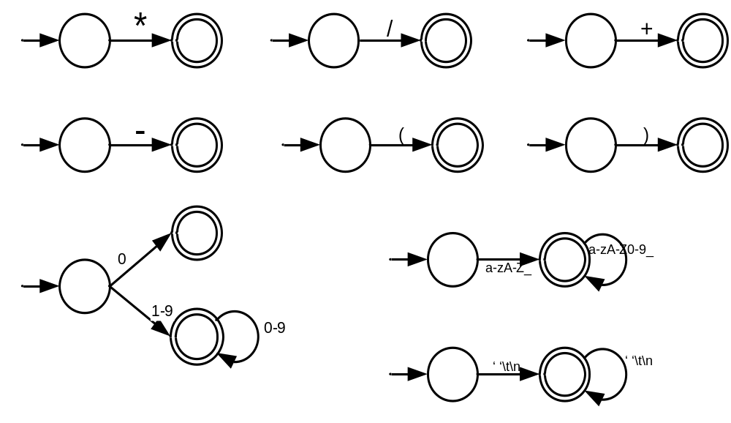
Symbol DFAs

Slide 31
Scanner Algorithm
Given DFA D₁, …, D_{n}
while input is not empty do
s_{i} := the longest prefix that D_{i} accepts;
k := max{ |s_{i}| };
if k > 0 then
j := min { i: |s_{i}|=k };
remove s_{j} from input;
perform the j^{th} action
else
move one character from input to output
end
end

Slide 32
For You To Do
What if more than one string matches a pattern?
  Which string is used?
What if a string matches more than one pattern?
  Which pattern is used?
What happens if a string matches no patterns?
  Are there “implicit” patterns?

