Slide 1
Static Analysis
Matthew Dwyer
324E Nichols Hall
dwyer@cis.ksu.edu
http://www.cis.ksu.edu/~dwyer

Slide 2
Static Analysis
Static
  performed at compile time, i.e., without executing the program
Analysis
  Determination of interesting properties of the run-time behavior of the program
The goal is to enable optimizations
  Can also be used for bug finding, testing, debugging, ...

Slide 3
Interesting Program Properties
are nearly all undecidable, so the analysis computes a conservative approximation:
  if we say yes, then the property definitely holds;
  if we say no, then the property may or may not hold;
  only the yes answer will help us to perform the optimization;
  a trivial analysis will say no always; so
  the art is to say yes as often as possible.
Properties need not be simply yes or no, in which case the notion of approximation is more subtle.

Slide 4
When is Analysis Performed?
Static analysis may take place:
  at the source code level;
  at some intermediate level; or
  at the machine code level.
Static analysis may look at:
  basic blocks only;
  an entire function (intraprocedural); or
  the whole program (interprocedural).
In each case, we are maximally pessimistic at the boundaries.
The precision and cost of an analysis rises as we include more information.

Slide 5
Register Optimization in JITs
The optimization:
mov 1,R3 mov 1,R1
mov R3,R1
is unsound if R3 is used in a later instruction:
mov 1,R3 mov 1,R1
mov R3,R1
… …
mov R3,R4 mov R3,R4

Slide 6
Register Allocation
For basic block register allocation, which variables need to be written back to memory?
The naive scheme:
  must write all those variables that are only in registers.
A better scheme:
  write all those variables that are only in registers and whose values might be used later on.
This could avoid many useless spills.

Slide 7
Predicting the Future
In both examples, we need to know if some R_{i} might be used later on.
  If so, it is called live;
  otherwise, it is called dead.
A static analysis can conservatively approximate liveness at each program point.
  exact liveness is of course undecidable.
  a trivial analysis will call everything live, which precludes all optimizations.
  a superior analysis will identify more dead variables.

Slide 8
Liveness Analysis for VirtualRISC
build a control flow graph (goto graph);
define dataflow equations for each node;
compute the least solution of these equations.
For basic blocks the computation is trivial.
For intra-procedural analysis we must compute a minimal fixed point in a lattice

Slide 9
Example
Consider a simple basic block:
        mov 3,R1
        mov 4,R2
        add R1,R2,R3
        mov R3,R0
        return
The \underlined registers are written (defined),
the others are merely read(used).

Slide 10
Example
The control flow graph is:
        S1: mov 3,R1
        S2: mov 4,R2
        S3: add R1,R2,R3
        S4: mov R3,R0
        S5: return

Slide 11
Example : Defs and Uses
        uses(Si) defs(Si)
S1: mov 3,R1 {} {R1}
S2: mov 4,R2 {} {R2}
S3: add R1,R2,R3 {R1,R2} {R3}
S4: mov R3,R0 {R3} {R0}
S5: return {R0} {}
R0 is used for method return values

Slide 12
Dataflow Equations
Let :
out(Si) be the variables that are live just after Si and
in(Si) those that are live just before Si
in(Si)
Si: op X,Y,Z
out(si)

Slide 13
Dataflow Equations
A dataflow equations defines the facts before (in) in terms of the facts after (out) and the meaning of the statement
in(Si) = uses(Si) U (out(Si) – defines(Si))
out(Si) = in(Si-1)
Add registers that are used in the current instruction and delete those that are defined

Slide 14
N equations and unknowns
Where N is the number of statements
Solve by substitution:
out(S5) = {}
in(S5) = uses(S5) = {R0}
out(S4) = in(S5) = {R0}
in(S4) = uses(S4) U (out(S4) – defs(S4))
= {R3} U ({R0} – {R0}) = {R3}
…

Slide 15
Solution
        uses(Si) defs(Si) in(Si)
S1: mov 3,R1 {} {R1} {}
S2: mov 4,R2 {} {R2} {R1}
S3: add R1,R2,R3 {R1,R2} {R3} {R1,R2}
S4: mov R3,R0 {R3} {R0} {R3}
S5: return {R0} {} {R0}

Slide 16
Treating Control Flow
Within basic blocks the output of a block is the input of the next block
  out(Si) = in(Si+1)
If there is branching, then there may be multiple successors and we accumulate all of their inputs
out(Si) = U in(x)
x in succ(Si)
Branching leads to cyclic equations which cannot be solved by simple substitution

Slide 17
Example : Source
{ int i, sum_even, sum_odd, sum;
i = 1;
sum_even = 0;
sum_odd = 0;
sum = 0;
while (i < 10)
{ if (i%2 == 0) sum_even = sum_even + i;
else sum_odd = sum_odd + i;
sum = sum + i;
i++;
}
}

Slide 18
Example : VirtualRISC
mov 1,R1 // R1 is i
mov 0,R2 // R2 is sum_even
mov 0,R3 // R3 is sum_odd
mov 0,R4 // R4 is sum
loop:
andcc R1,1,R5 // R5 = R1 & 1
cmp R5,0
bne else // if R5 != 0 goto else
add R2,R1,R2 // R2 = R2 + R1; even case
b endif
else:
add R3,R1,R3 // R3 = R3 + R1; odd case
endif:
add R4,R1,R4 // R4 = R4 + R1; update sum
add R1,1,R1 // R1 = R1 + 1; increment i
cmp R1,9
ble loop // if i <= 9 goto loop

Slide 19
S1: mov 1,R1
S2: mov 0,R2
S3: mov 0,R3
S4: mov 0,R4
S5: andcc R1,1,R5
S6: cmp R5,0
S7: bne else
S8: add R2,R1,R2 S9: add R3,R1,R3
S10: add R4,R1,R4
S11: add R1,1,R1
S12: cmp R1,9
S13: ble loop

Slide 20
Try Substitution
To perform substitution, we should start with
  out(S13) = in(S5)
but we have not computed in(S5) yet!
Idea:
If we have values for in(S1), …, in(S13), then we can unravel the code and calculate new values for in(S1), …, in(S13)
These form successive approximations of their values

Slide 21
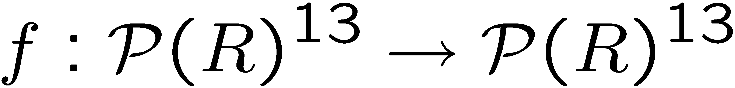
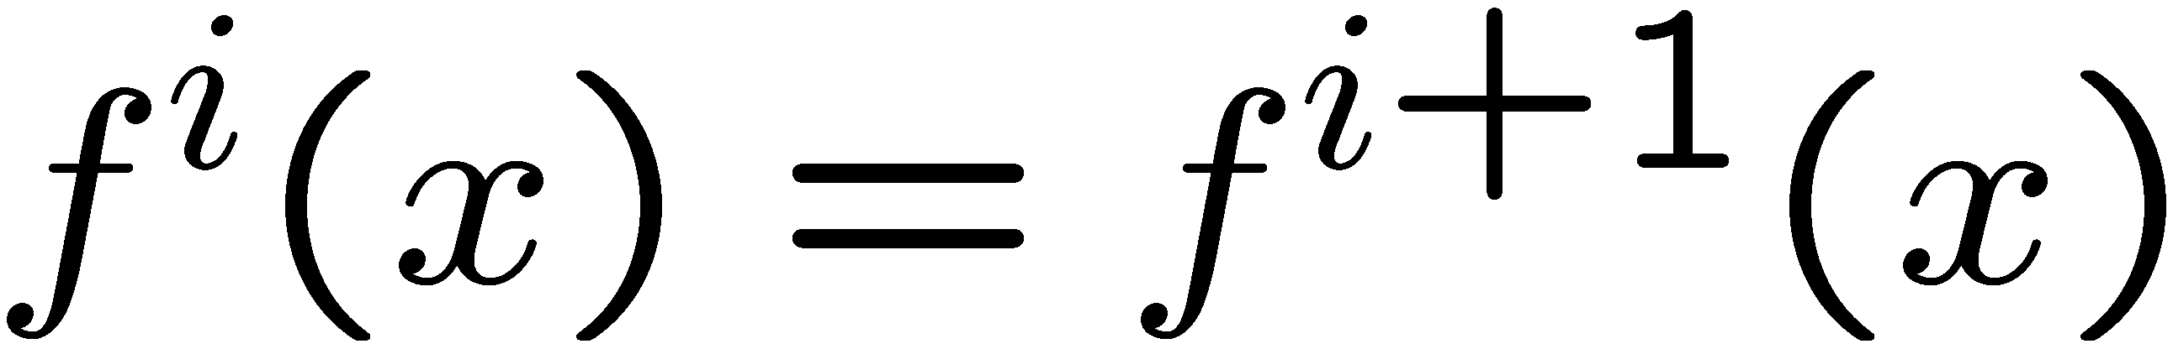
Substitution as a Function
This means that substitution is a function defined over the 13 in(Si) that can be repeatedly applied
where  = {R1, R2, …, R5}.
A solution is a fixed point
we want the smallest such solution.

Slide 22


Fundamental Observations
The set
is a finite lattice
where is point-wise set inclusion
{a,b,c}
{a,b} {a,c} {b,c}
{a} {b} {c}
{}

Slide 23
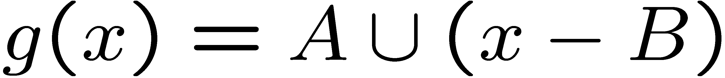
Fundamental Observations
The one step substitution function is monotone
since

Slide 24

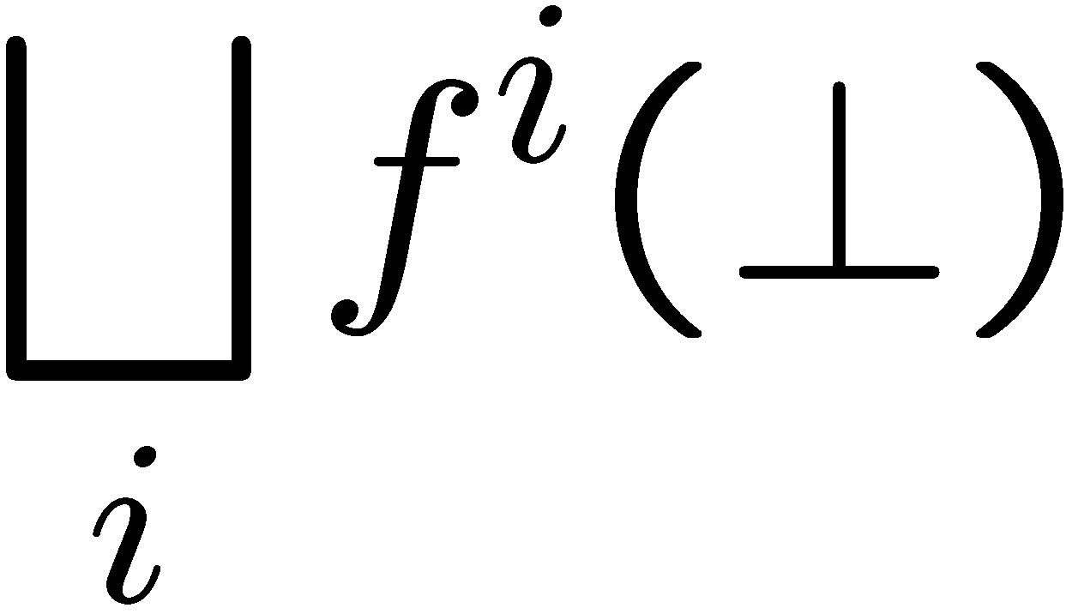
The Fixed Point Theorem
Any monotone function on a finite lattice D has the unique minimal fixed point of:
which is always obtained after finitely many iterations (i.e., substitutions)

Slide 25


Liveness Analysis
For
we have that
so we start with sets in(Si) = {} and keep substituting until the no longer change.
Note that:
Is always the maximal fixed point, which corresponds to a useless and pessimistic analysis result (i.e., all registers have subsequent uses)

Slide 26
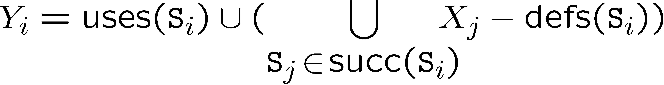
Liveness Analysis
The function is:
where:

Slide 30
Liveness Analysis
Liveness analysis is used for register allocation in optimizing compilers.
In the basic block case, reduce spills to those variables that are only in registers and live.
In the intraprocedural case, construct a graph whose nodes are variables and where edges connect nodes that are live at the same time.

Slide 31
Interference Graph
d
b
f
a
e
c
Register allocation is now reduced to finding a minimal graph coloring

Slide 32
Interference Graph
d
b
f
a
e
c
Let red be the color for R1

Slide 33
Interference Graph
d
b
f
a
e
c
Let red be the color for R1
green be the color for R2

Slide 34
Interference Graph
d
b
f
a
e
c
R1 = {a,d,f}
R2 = {b,e}
R3 = {c}
Let red be the color for R1
green be the color for R2
blue be the color for R3

Slide 35
Other Analyses
Liveness is a backwards analysis
  Calculates input in terms of output of a statement
Constant propogation is a forwards analysis
    S1: mov 3, R1
    S2: mov 4, R2
    S3: add R1,R2,R3
    S4: mov R3, R0
    S5: return
    {(R0,?),(R1,?),(R2,?),(R3,?)}
    {(R0,?),(R1,3),(R2,?),(R3,?)}
    {(R0,?),(R1,3),(R2,4),(R3,?)}
    {(R0,?),(R1,3),(R2,4),(R3,7)}
    {(R0,7),(R1,3),(R2,4),(R3,7)}

Slide 36
Analysis and Transformation
Improving analyses by transformations:
  let P be our set of programs;
  let Ideal: P → D be an ideal static analysis (uncomputable); and
  let Trans: P → P be a program transformation that preserves the semantics.
Since Ideal gives the ideal information, clearly
Ideal(Trans(p)) = Ideal(p)
for all p in P
If Approx: P → D is a conservative approximation to Ideal, then Approx(Trans(p)) may be different from Approx(p), perhaps even better.

Slide 37
Transformations
A transformation may
  Unfold the program to make it more explicit, e.g., unroll program loops to eliminate branching
  Itself be an optimization, e.g., the application of a peephole pattern
As long as they are semantics preserving then we can apply them at will
  As long as there is some advantage

Slide 38


Transformations Boost Analyses
Approx
Ideal

Slide 39
Transformations Boost Analyses
Approx
Trans
Ideal

Slide 40
Transformations Boost Analyses
Approx
Trans
Ideal
Trans

