Slide 1
Virtual Machines
Matthew Dwyer
324E Nichols Hall
dwyer@cis.ksu.edu
http://www.cis.ksu.edu/~dwyer

Slide 2
Compiler Architecture
SCAN
PARSE
WEED
RESOURCE
TYPE
SYMBOL
CODE
OPTIMIZE
EMIT

Slide 3
Virtual Machines
Abstract Syntax Trees
compile
Virtual Machine Code
P-code, JVM
Interpret, compile
pentium, itanium
Native binary code

Slide 4
Compiling to VM Code
Example:
  gcc translates into RTL, optimizes RTL, and then compiles RTL into native code.
Advantages:
  exposes many details of the underlying architecture; and
  facilitates production of code generators for many target architectures.
Disadvantage:
  a code generator must be built for each target architecture.

Slide 5
Interpreting VM Code
Examples:
  P-code for early Pascal interpreters;
  Postscript for display devices; and
  Java bytecode for the Java Virtual Machine.
Advantages:
  easy to generate the code;
  the code is architecture independent; and
  bytecode can be more compact.
Disadvantage:
  poor performance due to interpretative overhead (typically 5-20 times slower).

Slide 6
A Model RISC Machine
VirtualRISC is a simple RISC machine with:
  memory;
  registers;
  condition codes; and
  execution unit.
In this model we ignore:
  caches;
  pipelines;
  branch prediction units; and
  advanced features.

Slide 7
VirtualRISC Memory
a stack
  used for function call frames;
a heap
  used for dynamically allocated memory;
a global pool
  used to store global variables; and
a code segment
  used to store VirtualRISC instructions.

Slide 8
VirtualRISC Registers
unbounded number of general purpose registers;
the stack pointer (sp) which points to the top of the stack;
the frame pointer (fp) which points to the current stack frame; and
the program counter (pc) which points to the current instruction.

Slide 9
VirtualRISC Condition Codes
stores the result of last instruction that can set condition codes (used for branching).

Slide 10
VirtualRISC Execution Unit
reads the VirtualRISC instruction at the current pc, decodes the instruction and executes it;
this may change the state of the machine (memory, registers, condition codes);
the pc is automatically incremented after executing an instruction; but
function calls and branches explicitly change the pc.

Slide 11
Memory/Register Instructions
st Ri,[Rj] [Rj] := Ri
st Ri,[Rj+C] [Rj+C] := Ri
ld [Ri],Rj Rj := [Ri]
ld [Ri+C],Rj Rj := [Ri+C]

Slide 12
Register/Register Instructions
mov Ri,Rj Rj := Ri
add Ri,Rj,Rk Rk := Ri + Rj
sub Ri,Rj,Rk Rk := Ri - Rj
mul Ri,Rj,Rk Rk := Ri * Rj
div Ri,Rj,Rk Rk := Ri / Rj
Constants may be used in place of register values: mov 5,R1

Slide 13
Condition Instructions
Instructions that set the condition codes:
  cmp Ri,Rj
Instructions to branch:
  b L
  bg L
  bge L
  bl L
  ble L
  bne L
To express: if R1 <= 9 goto L1
we code: cmp R1,9
  ble L1

Slide 14
Call Related Functions
save sp,-C,sp save registers,
allocating C bytes
on the stack
call L R15:=pc; pc:=L
restore restore registers
ret pc:=R15+8
nop do nothing

Slide 15
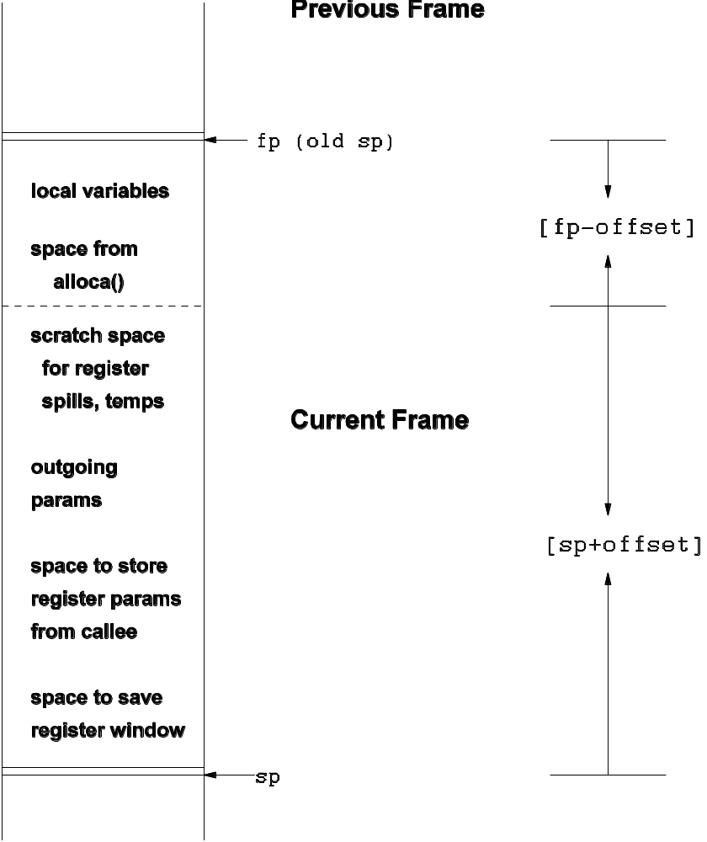

Slide 16
Stack Frames
stores function activations;
sp and fp point to stack frames;
when a function is called a new stack frame is created:
  push fp; fp := sp; sp := sp + C;
when a function returns, the top stack frame is popped:
  sp := fp; fp = pop;
local variables are stored relative to fp
the figure shows additional features of the SPARC architecture.

Slide 17
Example C Code
int fact(int n) {
int i, sum;
sum = 1;
i = 2;
while (i <= n){
sum = sum * i;
i = i + 1;
}
return sum;
}

Slide 18
Example VirtualRISC Code
_fact:
save sp,-112,sp // save stack frame
st R0,[fp+68] // save arg n in caller frame
mov 1,R0 // R0 := 1
st R0,[fp-16] // sum is in [fp-16]
mov 2,R0 // RO := 2
st RO,[%fp-12] // i is in [fp-12]
L3:
ld [fp-12],R0 // load i into R0
ld [fp+68],R1 // load n into R1
cmp R0,R1 // compare R0 to R1
ble L5 // if R0 <= R1 goto L5
b L4 // goto L4

Slide 19
Example VirtualRISC Code
L5:
ld [fp-16],R0 // load sum into R0
ld [fp-12],R1 // load i into R1
mul R0,R1,R0 // R0 := R0 * R1
st R0,[fp-16] // store R0 into sum
ld [fp-12],R0 // load i into R0
add R0,1,R1 // R1 := R0 + 1
st R1,[fp-12] // store R1 into i
b L3 // goto L3
L4:
ld [fp-16],R0 // put return value into R0
restore // restore register window
ret // return from function

Slide 20
Java Virtual Machine
memory;
registers;
condition codes; and
execution unit.

Slide 21
JVM Memory
a stack
  used for function call frames;
a heap
  used for dynamically allocated memory;
a constant pool
  used for constant data that can be shared; and
a code segment
  used to store JVM instructions of currently loaded class files.

Slide 22
JVM Registers
no general purpose registers;
the stack pointer (sp) which points to the top of the stack;
the local stack pointer (lsp) which points to a location in the current stack frame; and
the program counter (pc) which points to the current instruction.

Slide 23
JVM Condition Codes
stores the result of last instruction that can set condition codes (used for branching).

Slide 24
JVM Execution Unit
reads the Java Virtual Machine instruction at the current pc, decodes the instruction and executes it;
this may change the state of the machine (memory, registers, condition codes);
the pc is automatically incremented after executing an instruction; but
method calls and branches explicitly change the pc.

Slide 25
JVM Stack Frames
Have space for:
  a reference to the current object (this);
  the method arguments;
  the local variables; and
  a local stack used for intermediate results.
The number of local slots and the maximum size of the local stack are fixed at compile-time.

Slide 26
Java Compilation
Java compilers translate source code to class files.
Class files include the bytecode instructions for each method.
Magic number
Version number
Constant pool
Access flags
this class
super class
Interfaces
Fields
Methods
Attributes
a.java
javac
a.class

Slide 27
Example Java Method
public int Abs(int x) {
if (x < 0)
return(x * -1);
else
return(x);
}

Slide 28
Example JVM Bytecodes
.method public Abs(I)I // one int argument, returns an int
.limit stack 2 // has stack with 2 locations
.limit locals 2 // has space for 2 locals
// --locals-- --stack---
iload_1 // [ o -3 ] [ * * ]
ifge Label1
iload_1 // [ o -3 ] [ -3 * ]
iconst_m1 // [ o -3 ] [ -3 -1 ]
imul // [ o -3 ] [ 3 * ]
ireturn // [ o -3 ] [ * * ]
Label1:
iload_1
ireturn
.end method

Slide 29
Bytecode Interpreter
pc = code.start;
while(true)
{ npc = pc + inst_length(code[pc]);
switch (opcode(code[pc]))
{ ILOAD_1: push(local[1]);
break;
ILOAD: push(local[code[pc+1]]);
break;
...
}
pc = npc;
}

Slide 30
Bytecode Interpreter
pc = code.start;
while(true){ …
ISTORE: t = pop();
local[code[pc+1]] = t;
break;
IADD: t1 = pop(); t2 = pop();
push(t1 + t2);
break;
IFEQ: t = pop();
if (t == 0) npc = code[pc+1];
break;
}

Slide 31
JVM Arithmetic Operators
ineg [...:i] -> [...:-i]
iadd [...:i1:i2] -> [...:i1+i2]
isub [...:i1:i2] -> [...:i1-i2]
imul [...:i1:i2] -> [...:i1*i2]
idiv [...:i1:i2] -> [...:i1/i2]
irem [...:i1:t2] -> [...:i1\%i2]
iinc k a [...] -> [...]
local[k]=local[k]+a

Slide 32
JVM Branch Operations
goto L [...] -> [...]
branch always
ifeq L [...:i] -> [...]
branch if i == 0
ifne L [...:i] -> [...]
branch if i != 0
ifnull L [...:o] -> [...]
branch if o == null
ifnonnull L [...:o] -> [...]
branch if o != null

Slide 33
More Branches
if_icmpeq L [...:i1:i2] -> [...]
branch if i1 == i2
if_icmpne L [...:i1:i2] -> [...]
branch if i1 != i2
if_icmpgt L [...:i1:i2] -> [...]
branch if i1 > i2
if_icmplt L [...:i1:i2] -> [...]
branch if i1 < i2

Slide 34
More Branches
if_icmple L [...:i1:i2] -> [...]
branch if i1 <= i2
if_icmpge L [...:i1:i2] -> [...]
branch if i1 >= i2
if_acmpeq L [...:o1:o2] -> [...]
branch if o1 == o2
if_acmpne L [...:o1:o2] -> [...]
branch if o1 != o2

Slide 35
Loading Constants
iconst_0 [...] -> [...:0]
iconst_1 [...] -> [...:1]
iconst_2 [...] -> [...:2]
iconst_3 [...] -> [...:3]
iconst_4 [...] -> [...:4]
iconst_5 [...] -> [...:5]
aconst_null [...] -> [...:null]
ldc i [...] -> [...:i]
ldc s [...] -> [...:String(s)]

Slide 36
Memory Access
iload k [...] -> [...:local[k]]
istore k [...:i] -> [...]
local[k]=i
aload k [...] -> [...:local[k]]
astore k [...:o] -> [...]
local[k]=o
getfield f sig [...:o] -> [...:o.f]
putfield f sig [...:o:v] -> [...]
o.f=v

Slide 37
Stack Operations
dup [...:v1] -> [...:v1:v1]
pop [...:v1] -> [...]
swap [...:v1:v2] -> [...:v2:v1]
nop [...] -> [...]

Slide 38
Class Operations
new C [...] -> [...:o]
instance_of C [...:o] -> [...:i]
if (o==null) i=0
else i=(C<=type(o))
checkcast C [...:o] -> [...:o]
if (o!=null && !C<=type(o))
throw ClassCastException

Slide 39
Method Operations
invokevirtual m sig [...:o:a_1:...:a_n] -> [...]
entry=lookup(m,sig,o.methods);
block=select(entry,type(o));
push frame of size block.locals+block.stacksize;
local[0]=o;
local[1]=a_1;
...
local[n]=a_n;
pc=block.code;

Slide 40
Method Operations
invokenonvirtual m sig
[...:o:a_1:...:a_n] -> [...]
block=lookup(m,sig,o.methods);
push stack frame of size
block.locals+block.stacksize;
local[0]=o;
local[1]=a_1;
...
local[n]=a_n;
pc=block.code;

Slide 41
Method Operations
ireturn [...:i] -> [...]
return i and pop stack frame
areturn [...:o] -> [...]
return o and pop stack frame
return [...] -> [...]
pop stack frame

Slide 42
A Java Method
public boolean member(Object item)
{ if (first.equals(item))
return true;
else if (rest == null)
return false;
else
return rest.member(item);
}

Slide 43
Corresponding Bytecode
.method public member(Ljava/lang/Object;)Z
.limit locals 2 // local[0] = o
// local[1] = item
.limit stack 2 // initial stack [ * * ]
aload_0 // [ o * ]
getfield Cons/first Ljava/lang/Object;
// [ o.first *]
aload_1 // [ o.first item]
invokevirtual java/lang/Object/equals(Ljava/lang/Object;)Z
// [bool *]

Slide 44
Corresponding Bytecode
ifeq else_0 // [ * * ]
iconst_1 // [ 1 * ]
ireturn // [ * * ]
else_1:
aload_0 // [ o * ]
getfield Cons/rest LCons; // [ o.rest * ]
aconst_null // [ o.rest null]
if_acmpne else_2 // [ * * ]
iconst_0 // [ 0 * ]
ireturn // [ * * ]

Slide 45
Corresponding Bytecode
else_2:
aload_0 // [ o * ]
getfield Cons/rest LCons; // [ o.rest * ]
aload_1 // [ o.rest item ]
Invokevirtual Cons/member(Ljava/lang/Object;)Z
// [ bool * ]
ireturn // [ * * ]
.end method

Slide 46
Bytecode Verification
bytecode cannot be trusted to be well-formed and well-behaved;
before executing any bytecode that is received over the network, it should be verified;
verification is performed partly at class loading time, and partly at run-time; and
at load time, dataflow analysis is used to approximate the number and type of values in locals and on the stack.

Slide 47
Properties of Verified Bytecode
each instruction must be executed with the correct number and types of arguments on the stack, and in locals (on all execution paths);
at any program point, the stack is the same size along all execution paths; and
no local variable can be accessed before it has been assigned a value.

Slide 48
Interpreting Java
when a method is invoked, a classloader finds the correct class and checks that it contains an appropriate method;
if the method has not yet been loaded, then it may be verified (remote classes);
after loading and verification, the method body is interpreted; or
the bytecode for the method is translated to native code (only for the first invocation).

Slide 49
How we will use JVM and VirtualRISC
Future use of Java bytecode:
  the JOOS compiler will produce Java bytecode in Jasmin format; and
  the JOOS peephole optimizer transforms bytecode into more efficient bytecode.
Future use of VirtualRISC:
  Java bytecode can be converted into machine code at run-time using a JIT (Just-In-Time) compiler;
  we will study some examples of converting Java bytecode into a language similar to VirtualRISC;
  we will study some simple, standard optimizations on VirtualRISC.

