Slide 1
The WIG Project
Matthew Dwyer
324E Nichols Hall
dwyer@cis.ksu.edu
http://www.cis.ksu.edu/~dwyer

Slide 2

Course Project:
Web Interface Generator;
compiled into C-based CGI-scripts;
illustrates a domain-specific language;
shows server-side web programming;
used to get hands-on experience;
and you will implement the language from scratch in C or Java.

Slide 3
Uses of WWW
Static documents
  Supported by HTML
Dynamic documents
  Supported by HTML and CGI
Interactive services
  Supported by CGI, …
Distributed programming
  Aglets, …

Slide 4
Web Content
Static documents
  lots of individual files needed
  the documents are rarely updated; and
  the documents are not customized.
Dynamic documents:
  there are fewer documents;
  the documents are always updated; and
  the documents are customized.

Slide 5
Standard Web Interaction
HTML
Client
Server

Slide 6
Common Gateway Interface
fill-out form
HTML
form data
script
dynamic
document
Client
Server

Slide 7
Fill-out Forms
An extension to HTML
The <form ...> tag contains:
  transmission method (POST or GET);
  URL of the script; and
  a query string.
Extra tags for input fields:
  simple text fields;
  radio buttons;
  menus; and
  submit buttons.

Slide 8
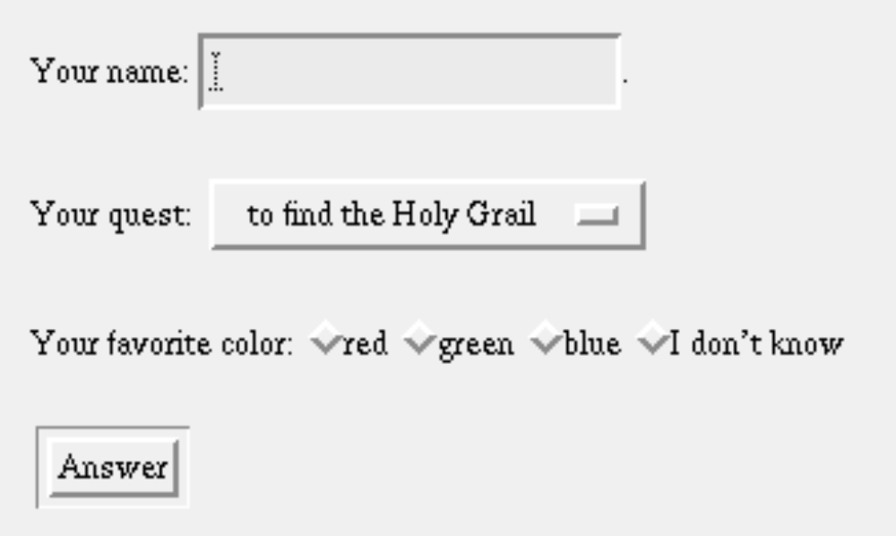
A Simple Fill-out Form

Slide 9
HTML for Form (part 1)
<form
method="POST"
action="http://www.brics.dk/cgi-mis/Python?Questions"
>
Your name:
<input name="name" type="text" size=20>.
<p>
Your quest:
<select name="quest">
<option value="grail">to find the Holy Grail
<option value="wig">to write a WIG compiler
</select>

Slide 10
HTML for Form (part 2)
<p>
Your favorite color:
<input name="color" type="radio" value="red">red
<input name="color" type="radio" value="green">green
<input name="color" type="radio" value="blue">blue
<input name="color" type="radio" value="argh">I don't know
<p>
<input name="submit" type="submit" value="Answer">
</form>

Slide 11
CGI Script
The script may be written in any programming or scripting language
The form data appears on standard input as:
  name=Michael&quest=wig&color=blue&submit=Answer
but must first be decoded:
  change '+' into a space character; and
  replace %xy by the ASCII character with hex value xy
Reserved symbols in data, e.g., '=' and '&‘, must be encoded.

Slide 12
Script Environment Variables
SERVER_SOFTWARE = NCSA/1.5.2
SERVER_NAME = www,cis.ksu.edu
GATEWAY_INTERFACE = CGI/1.1
SERVER_PROTOCOL = HTTP/1.0
SERVER_PORT = 80
REQUEST_METHOD = POST
SCRIPT_NAME = /cgi-bin/python
QUERY_STRING = Questions
REMOTE_HOST = sarin
REMOTE_ADDR = 130.225.16.12
REMOTE_USER =
CONTENT_TYPE = application/x-www-form-urlencoded
CONTENT_LENGTH = 47
USER = dwyer

Slide 13
Dynamic Document
Scripts produce dynamic web-page on standard output
  Content-type: text/html
  Hello Matt,
  <p>
  Good luck on writing a green WIG compiler!
Or redirect pages from an existing file
  Location: URL
  Content-type: text/html

Slide 14
CGI Protocol is State-less
Client-server (script) exchanges
  Happen in isolation;
  No information remains on the server;
  Different users cannot communicate through a service.
We would like to program services with
  Global state;
  Per user sessions;
  Threads; and
  Local state.

Slide 15
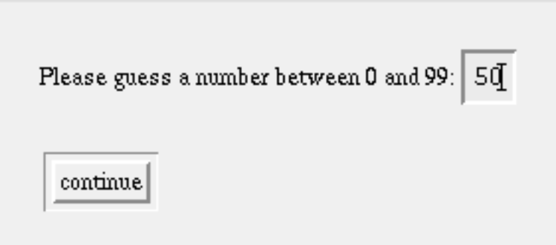
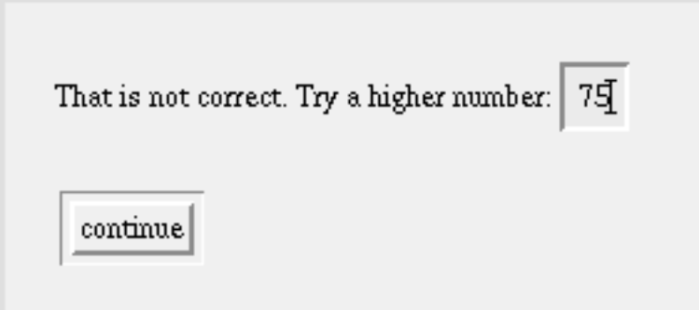
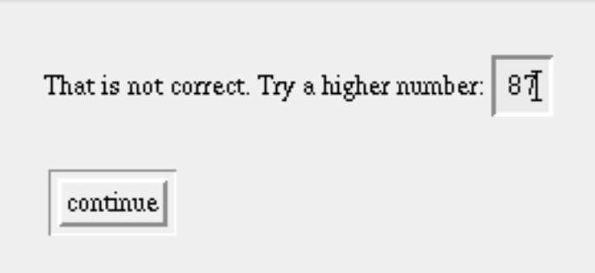
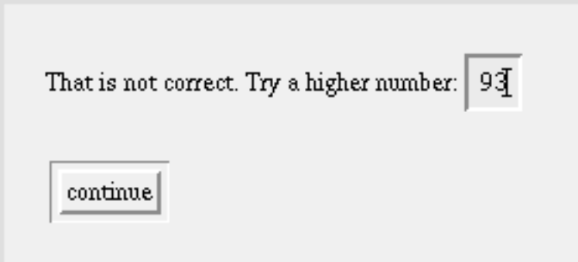
Guessing Game

Slide 16

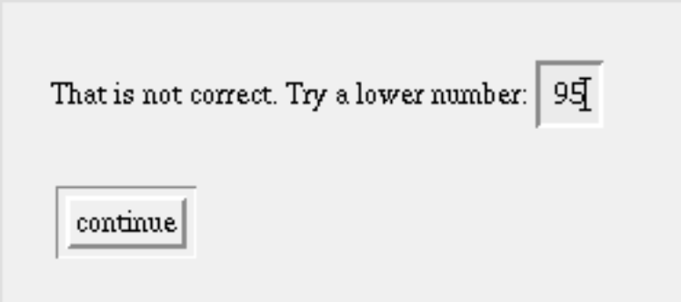
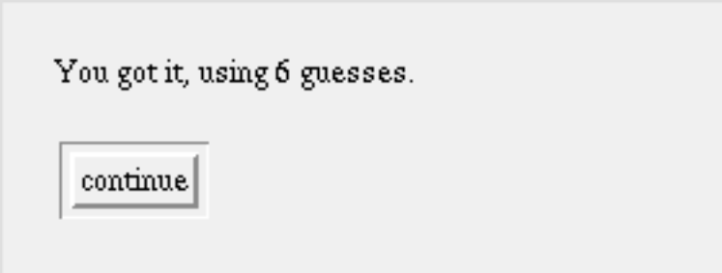
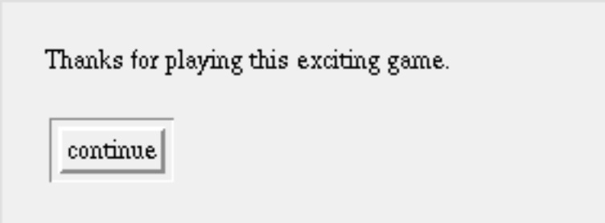
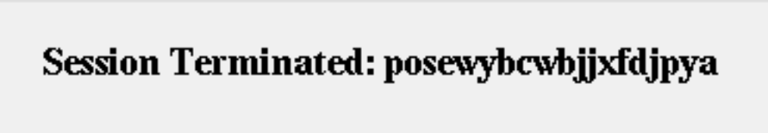
Guessing Game

Slide 17
WIG
Language for developing interactive services that provides
  Global state;
  Safe, dynamic documents;
  Sequential sessions;
  Multiple threads;
  Local state within a session; and
  Simple concurrency control.
WIG programs are compiled to CGI-scripts

Slide 18
Nikolaj’s Counter
service {
global counter: int = 0;
document Nikolaj {
<img src="http://www.brics.dk/~mis/babybath.jpg">
<p>
<i>You are visitor number <var name="no"></i>
}
session Access {
counter:=counter+1;
show Nikolaj[no<-counter]
}
}

Slide 19
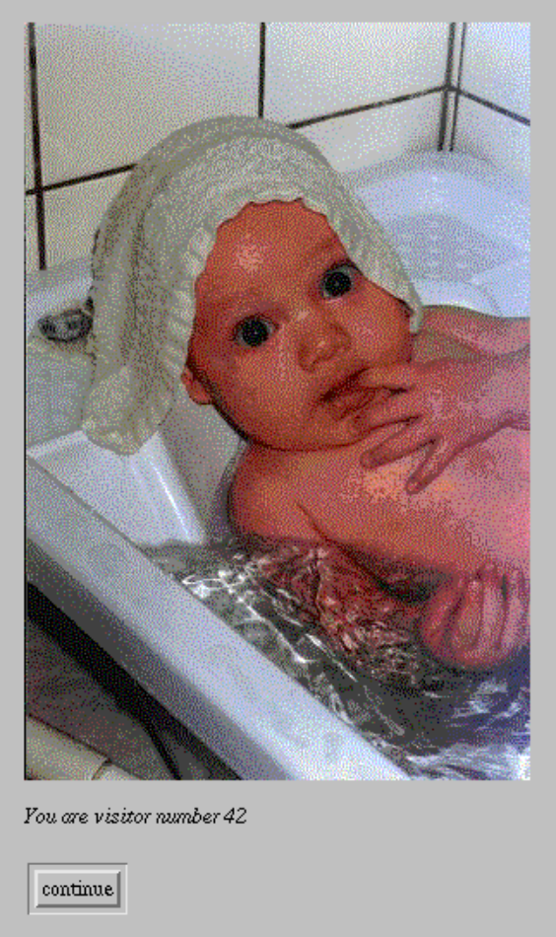
Generated Web-page

Slide 20
Guessing Game WIG
service {
global plays: int;
global record: int;
global holder: text;
document Init { ... }
document Retry { ... }
document Again { ... }
document Done { ... }
document Record { ... }
document Finish { ... }
document List { ... }
session Play { ... }
session HiScore { ... }
}

Slide 21
Play Session (part 1)
session Play {
local number: int;
local guesses: int;
local guess: int;
number:=random(100);
plays:=plays+1;
guesses:=1;
show Init[guess->guess];
while guess>99 { show Retry[guess->guess] };

Slide 22
Play Session (part 2)
while not (guess=number) {
guesses:=guesses+1;
if guess>number {
show Again[correction<-"lower",guess->guess]
} else {
show Again[correction<-"higher",guess->guess]
};
while guess>99 { show Retry[guess->guess] }
};

Slide 23
Play Session (part 3)
show Done[trys<-guesses];
if (record = 0) or (record > guesses) {
show Record[old<-record,name->holder];
record:=guesses
};
show Finish
}

Slide 24
Documents
document Init {
Please guess a number between 0 and 99:
<input name="guess" type="text" size=2>
}
document Retry {
That number is too large!
<p>
Please keep your guess between 0 and 99:
<input name="guess" type="text" size=2>
}

Slide 25
Documents
document Again {
That is not correct.
Try a <var name="correction"> number:
<input name="guess" type="text" size=2>
}
document Done {
You got it, using <var name="trys"> guesses.
}

Slide 26
Documents
document Record {
That makes you the new record holder,
beating the old record of <var name="old"> guesses.
<p>
Please enter your name for the hi-score list
<input name="name" type="text" size=20>
}
document Finish {
Thanks for playing this exciting game.
}

Slide 27
WIG Documents
documents : document | documents document ;
document : "document" identifier title "{" html "}" ;
title : /* empty */ | "(" string ")" ;
html : entity | html entity ;
entity : literal
| "<b>" html "</b>"
| "<i>" html "</i>"
| "<h1>" html "</h1>"
| "<h2>" html "</h2>"
| "<p>"
| "<br>"
| "<hr>“
| …

Slide 28
WIG Syntax
entity : …
| "<img" "src" "=" string ">"
| "<include" "file" "=" string ">"
| "<a" "href" "=" string ">" html "</a>"
| "<ul>" items "</ul>"
| "<table>" rows "</table>"
| "<var" "name" "=" string ">"
| "<select" "name" "=" string ">" options "</select>"
| "<input" "name" "=" string "type" "=" ""text"" "size" "=" intconst ">"
| "<input" "name" "=" string "type" "=" ""radio"" "value" "=" string ">"
| "<applet" "codebase" "=" string "code" "=" string
"width" "=" intconst "height" "=" intconst ">"
arguments "</applet>"
;

Slide 29
WIG Documents
Every document is implicitly a form;
The <var …> tag defines holes to be filled in dynamically; and
The <include …> tag allows static sub-documents

Slide 30
WIG Statements
statement : /* empty */
| "stop"
| identifier ":=" exp
| "take" identifier "{" statement "}"
| statement ";" statement
| "show" identifier parameters
| "if" exp "{" statement "}"
| "if" exp "{" statement "}" "else" "{" statement "}"
| "while" exp "{" statement "}"
;
parameters : /* empty */ | "[" "]" | "[" neparlist "]" ;
neparlist : parameter | neparlist "," parameter ;
parameter : identifier "<-" exp
| identifier "->" identifier
;

Slide 31
Comments on WIG Statements
there are write locks on global variables;
the take statement defines a critical region; and
the show statement displays a dynamic document.
There are two kinds of parameters for show:
  identifier <- exp fills in a hole with some text; and
  identifier -> identifier reads the value of an input field.

Slide 32
WIG Expressions
exp : intconst
| "true" | false
| string
| identifier
| exp "=" exp | exp ">" exp
| exp "and" exp | exp "or" exp
| "not" exp
| exp "+" exp | exp "-" exp | exp "*" exp
| exp "/" exp | exp "%" exp
| exp "++" exp
| exp "(" exp ".." exp ")"
| "|" exp "|"
| "random" "(" exp ")"
| "system" "(" exp ")"
| "(" exp ")"
;

Slide 33
For You To Do
Consider these questions about show
  what happens if not all holes are filled in?
  what happens if not all input fields are read?
  what happens if a hole is filled in with an integer?
  what happens if a hole is filled in twice?
There are many similar questions about the rest of the WIG language.
  You will need to resolve them to implement your compiler

Slide 34
Session Execution
Client
Server
init
browse
show
browse
show
browse
show
stop

Slide 35
CGI-thread Realization
Client
Server
init
save local state and stop
browse and submit form
restore local state and resume
save local state and stop
browse and submit form
restore local state and resume
save local state and stop
browse and submit form
restore local state and resume
stop

Slide 36
Security Issues
Tampering with service state
  Keep all state on the server side
Hijacking a session
  Use randomly generated keys as session id
Saving the state of a thread
  Server makes control state explicit

Slide 37
An Example WIG Service
service {
global x: int = 87;
document Add {
How much do you want to add?
<input name="addition" type="text" size=4>
}
document Total { The total is now <var name="total">. }
session Contribute {
local i: int;
show Add[addition->i];
take x { x:=x+i };
show Total[total<-x]
}
}

Slide 38
Generated CGI Script
#include "runwig.h"
char *sessionid, *sessionkey, *password;
void output_Add() { ... }
void output_Total(char *var_total) { ... }
int PC, tempInt;
char *tempText;
int local_tiny_Contribute_i;
void save_Contribute_state(char *state,int pc) {
FILE *f;
f = fopen(state,"w");
fprintf(f,"%i\n",pc);
fprintf(f,"%i\n",local_tiny_Contribute_i);
fclose(f);
}

Slide 39
Generated CGI Script
void output_Total(char *var_total) {
printf("Content-type: text/html\n\n");
printf("<form method=\"POST\" ");
printf("action=\"/cgi-mis/tiny?%s\">\n",sessionid);
printf("The\n");
printf("total\n");
printf("is\n");
printf("now\n");
printf("%s\n",var_total);
printf(".\n");
printf("<p><input name=\"submit\"
type=\"submit\" value=\"continue\">");
}

Slide 40
Generated CGI Script
void main() {
sessionid = getenv("QUERY_STRING");
parseFields();
if (strcmp(sessionid,"Contribute")==0) goto start_Contribute;
if (strncmp(sessionid,"Contribute",10)==0) goto restart_Contribute;
illegalRequest(sessionid);
.
.
.

Slide 41
Contribute
session Contribute {
local i: int;
show Add[addition->i];
take x { x:=x+i };
show Total[total<-x]
}
start_Contribute:
local_tiny_Contribute_i = 0;
sessionid = randomString("Contribute",20);
sessionkey = sessionid+11;
save_Contribute_state(sessionkey,1);
output_Add();
exit(0);

Slide 42
Contribute
session Contribute {
local i: int;
show Add[addition->i];
take x { x:=x+i };
show Total[total<-x]
}
Contribute_2:
lock("global_tiny_x");
tempInt = getGlobalInt("global_tiny_x") + local_tiny_Contribute_i;
putGlobalInt("global_tiny_x",tempInt);
unlock();
save_Contribute_state(sessionkey,3);
output_Total(itoa(getGlobalInt("global_tiny_x")));
exit(0);

Slide 43
Contribute
session Contribute {
local i: int;
show Add[addition->i];
take x { x:=x+i };
show Total[total<-x]
}
Contribute_3:
terminateSession(sessionkey,NULL);

Slide 44
Restarting A Session
restart_Contribute:
sessionkey = sessionid+11;
if (freopen(sessionkey,"r",stdin)==NULL) illegalSession(sessionkey);
scanf("%i\n",&PC);
scanf("%i\n",&local_tiny_Contribute_i);
if (PC==1) goto Contribute_1;
if (PC==2) goto Contribute_2;
if (PC==3) goto Contribute_3;
}

