Slide 1


BBC Audience
BBC Audience Reach and Profiles
All BBC (All Audiences)

Slide 2
Audience Reach
Monthly Digital Reach
(N16)M
BBC News
Monthly Cross Platform Reach
Monthly TV Reach
(S16)M
BBC Reach a large audience across markets
 | Reach (Vol) | Reach (%)
Cross Platform | (I16)M | (L16)%
Digital | (N16)M | (Q16)%
TV | (S16)M | (V16)%
(I16)M
Audience: (All Audiences)
Audience Affinity: (M16)

Slide 3

Reach by Region
Reach by Region & Platform
BBC Reach (All Audience) across Global Regions through Digital and TV Platforms
(I16)M
Cross Platform
Digital
TV
 | Reach (Vol) | Reach (%)
North America | (I33)M | (L33)%
Latin America | (I34)M | (L34)%
Europe | (I35)M | (L35)%
Middle East | (I36)M | (L36)%
Africa | (I37)M | (L37)%
South Asia | (I38)M | (L38)%
APAC | (I39)M | (L39)%
Reach (Vol) | Reach (%)
(N33)M | (Q33)%
(N34)M | (Q34)%
(N35)M | (Q35)%
(N36)M | (Q36)%
(N37)M | (Q37)%
(N38)M | (Q38)%
(N39)M | (Q39)%
Reach (Vol) | Reach (%)
(S33)M | (V33)%
(S34)M | (V34)%
(S35)M | (V35)%
(S36)M | (V36)%
(S37)M | (V37)%
(S38)M | (V38)%
(S39)M | (V39)%
Total Cross Platform Reach
(L16)% Global Reach
1750 Interviews • 12 Markets in 6 continents • TV & Digital Campaigns • 3 Bespoke Questions • £25k Added Value • Campaign Benchmarking

Slide 4
Competitive Reach
Audience Reach by Organisation
BBC Achieves Strong Global reach to (All Audience) Audiences
Cross Platform Reach
Digital Reach
TV Reach
BBC Cross Platform audience ranks #2 amongst competitive set.
(30-day Digital + TV Reach)
BBC Cross Platform audience ranks #2 amongst competitive set.
(30-day Digital Reach)
BBC Cross Platform audience ranks #2 amongst competitive set.
(30-day TV Reach)
1750 Interviews • 12 Markets in 6 continents • TV & Digital Campaigns • 3 Bespoke Questions • £25k Added Value • Campaign Benchmarking

Slide 5





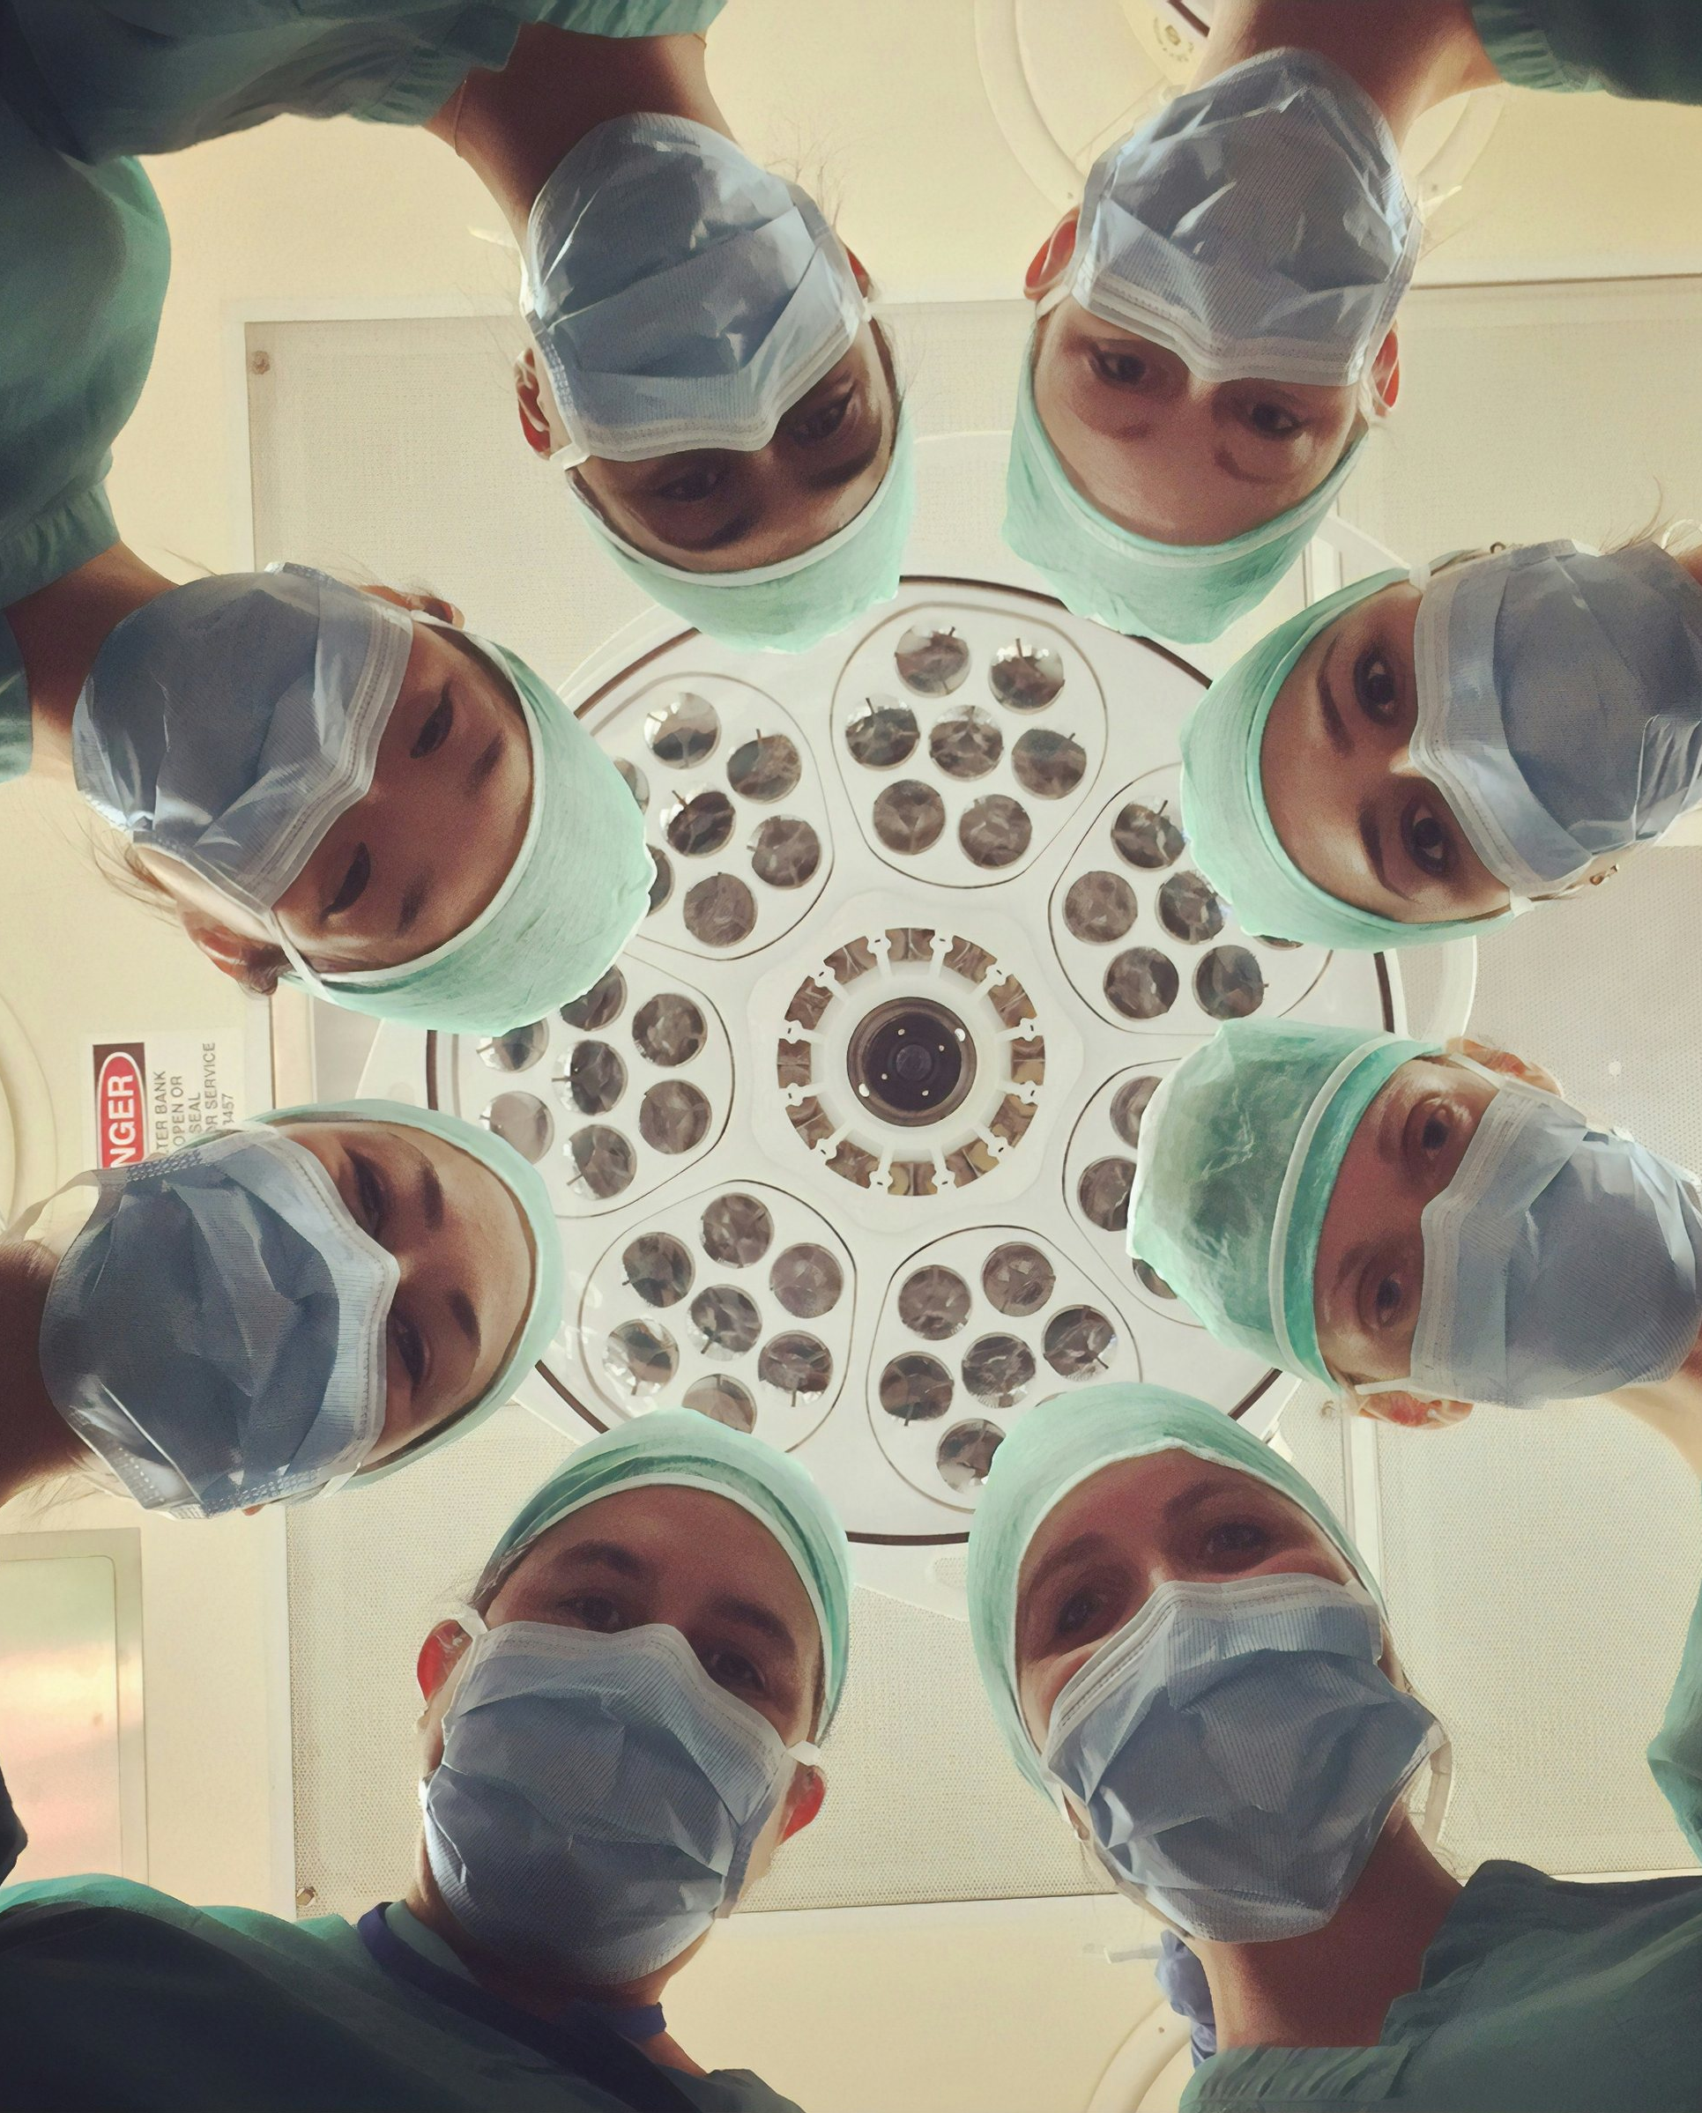
Pillar Alignment
BBC Pillar Alignment
(All Audience) Audience engage strongly across each of BBC content pillar areas
Business
Travel
Technology
Arts & Culture
Sports
Health
Business
Travel
Technology
Arts & Culture
Sports
Health
(K58)%
Are interested in Business
(K59)%
Are interested in Economics, Enterprise or Investment
(K60)%
Like to explore the world
(K61)%
Are international travellers
(K62)%
Follow the latest Tech Trends
(K63)%
Buy new tech as soon as its available
(K64)%
Interested in other cultures
(K65)%
Interested in Film or Theatre
(K66)%
Follow 3+ Sports
(K67)%
Interested playing or watching sport
(K68)%
Are interested in Healthcare
(K69)%
Are interested in Nutrition and Health Foods

Slide 6

Platform Consumption
Platform Consumption
BBC’s (All Audience) Audience regularly engage across a variety of platforms
XX Audiences over indexing on a range of platforms vs. avg. BBC audience
 | Composition | Audience Affinity
Social Media | (K70)% | (K70)
Short Form Videos | (K71)% | (K71)
Longer Videos (e.g. Vlogs) | (K72)% | (K72)
Online Articles | (K73)% | (K73)
Television | (K74)% | (K74)
Streaming Services | (K75)% | (K75)
Podcast | (K76)% | (K76)
Audience Affinity = Likelihood of (All Audience) Audience to regularly consume platform vs. avg. BBC Audience

Slide 7

Demographics
Audience Demographics – (All Audience) Audience
BBC Reach a number of (All Audience) Audience across a range of Demographics
BBCs (All Audience) Audience more likely to be younger and affluence vs. avg. online audience
 | Reach | Composition | BBC Audience Affinity
Male | (I77)M | (K77)% | (M77)
Female | (I78)M | (K78)% | (M78)
Degree Holders | (I79)M | (K79)% | (M79)
Gen-Z | (I80)M | (K80)% | (M80)
Millennials | (I81)M | (K81)% | (M81)
Boomers | (I82)M | (K82)% | (M82)
Baby Boomers + | (I83)M | (K83)% | (M83)
Kids in HH | (I84)M | (K84)% | (M84)
High Income Earners | (I85)M | (K85)% | (M85)
International Travellers | (I86)M | (K86)% | (M86)
BBC Audience Affinity = Likelihood of BBC’s (All Audience) Audience to be within a Demographic group vs. avg. (All Audience) Audience

Slide 8

Employment Profile
Employment Profile
BBC’s (All Audience) Audience regularly engage across a variety of platforms
BBC’s (All Audience) Audiences are more likely to hold a number of senior business positions
 | Composition | BBC Audience Affinity
SMEs | (K87)% | (M87)
Large Business Employees | (K88)% | (M88)
Business Decision Makers (BDMs) | (K89)% | (M89)
Financial Business Decision Makers (FBDMs) | (K90)% | (M90)
IT Decision Makers (IT-BDMs) | (K91)% | (M91)
Senior Management+ | (K92)% | (M92)
C-Suites | (K93)% | (M93)
Strategy Managers | (K94)% | (M94)
Recruitment Responsibilities | (K95)% | (M95)
Business Sustainability Responsibilities | (K96)% | (M96)
BBC Audience Affinity = Likelihood of BBC’s (All Audience) Audience to hold business trait vs. avg. (All Audience) Audience

Slide 9
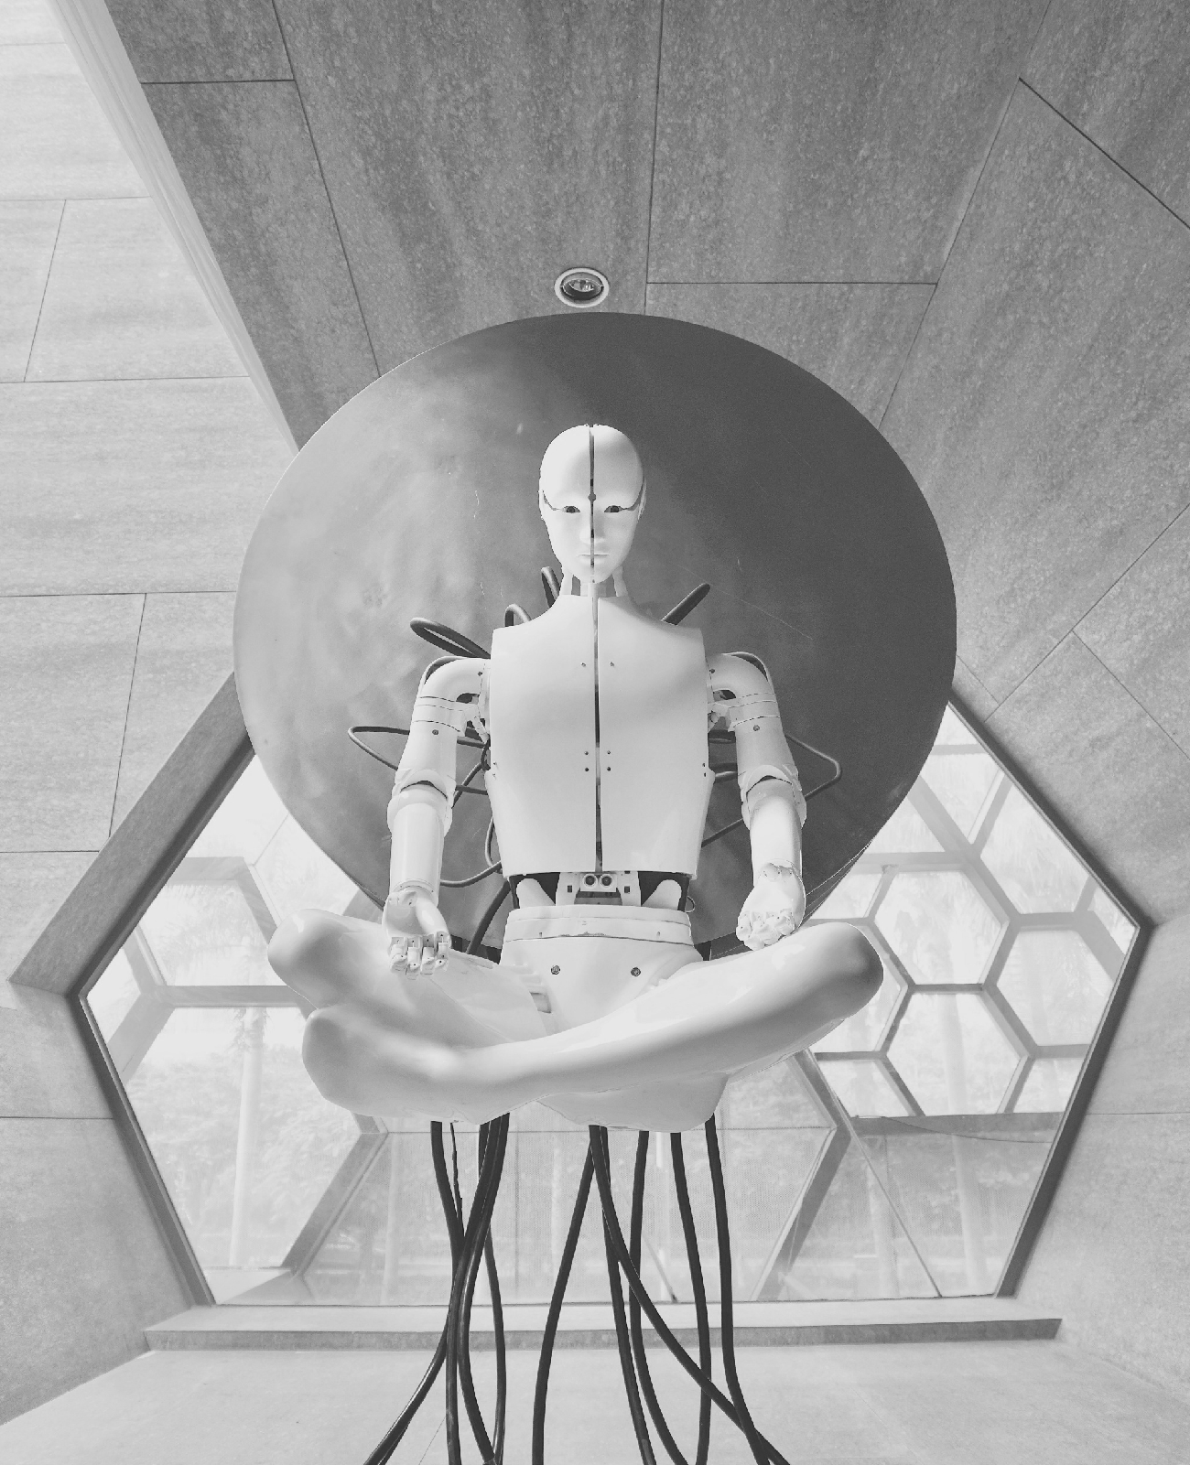
AI Attitudes
(All Audience) Audience AI Attitudes
BBC’s (All Audience) Audience are more likely to hold positive attitudes towards AI implementation
BBC (All Audience) Audiences more likely to agree..
(M97)%
(M98)%
AI Benefits Society
AI Enhances my daily life
(M99)%
(M100)%
Feel AI can answer the worlds biggest problems
AI Can create more job opportunities
BBC Audience Affinity = Likelihood of BBC’s (All Audience) Audience to hold Attitude vs. avg. (All Audience) Audience

