Slide 1


BBC Audience
BBC Audience Reach and Profiles
Total BBC Audience

Slide 2
Regional Reach
Reaching global [AUDIENCE] audiences at scale
(I16) [PLATFORM] reach
Europe | Reach (Vol) | Reach (%)
[PLATFORM] | (I35) | (L35)%
North America | Reach (Vol) | Reach (%)
[PLATFORM] | (I33) | (L33)%
APAC | Reach (Vol) | Reach (%)
[PLATFORM] | (I39) | (L39)%
Africa | Reach (Vol) | Reach (%)
[PLATFORM] | (I37) | (L37)%
Latin America | Reach (Vol) | Reach (%)
[PLATFORM] | (I34) | (L34)%
Middle East | Reach (Vol) | Reach (%)
[PLATFORM] | (I36) | (L36)%
(I16)
South Asia | Reach (Vol) | Reach (%)
[PLATFORM] | (I38) | (L38)%
[AUDIENCE] audiences reached globally each month
(L16)% monthly global reach to [AUDIENCE] audiences
(M16) : BBC Affinity Index to [AUDIENCE] Audiences
Base: All Audiences (2374M) // BBC All Audiences (514M)
Source: GWI Core Survey — Waves: Q1 2026, Q2 2026, Q3 2025, Q4 2025
Markets: 51 Global Markets (Excl. China, Russia, UK)
Platform: BBC Cross Platform, Digital + TV (30 Day Reach)

Slide 3

Competitive Reach
Audience Reach by Organisation
BBC Achieves Strong Competitive Reach to Audiences
Cross Platform Reach
Digital Reach
TV Reach
*Available GWI International Brands inc. Both Digital + TV Reach
Base: All Audiences (2374M) // BBC All Audiences (514M)
Source: GWI Core Survey — Waves: Q1 2026, Q2 2026, Q3 2025, Q4 2025
Markets: 51 Global Markets (Excl. China, Russia, UK)
Platform: BBC Cross Platform, Digital + TV (30 Day Reach)

Slide 4


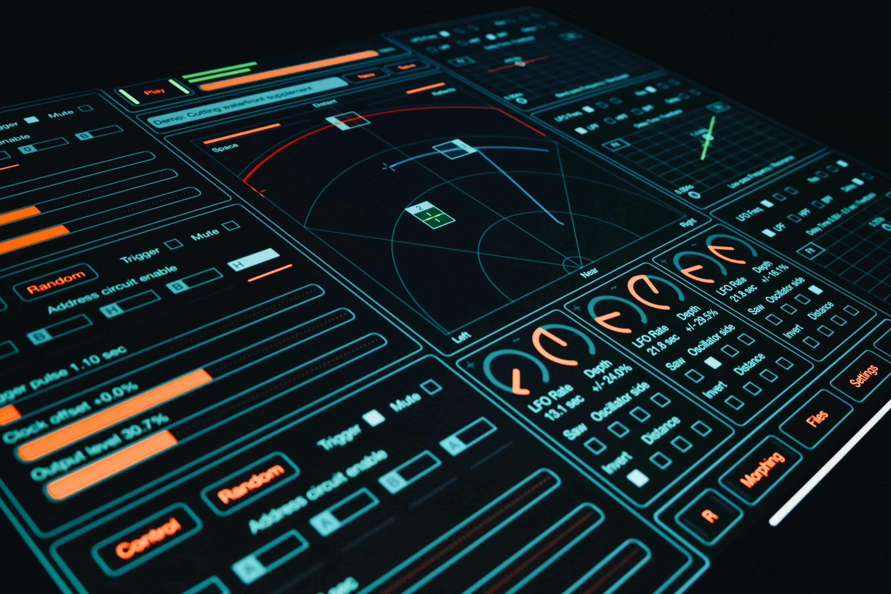


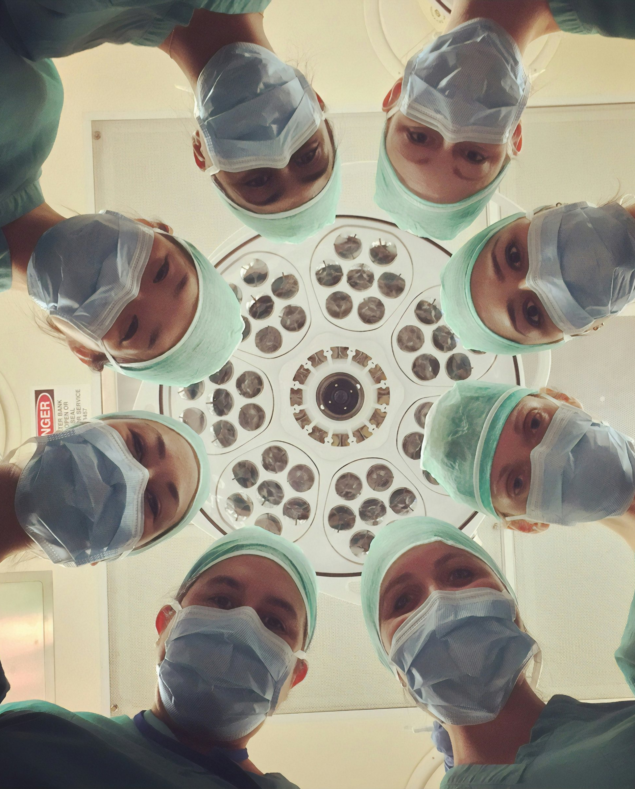
Pillar Alignment
BBC Pillar Alignment
Audiences engage strongly across each of the BBC content pillar areas
Business
Travel
Technology
Arts & Culture
Sports
Health
Business
Travel
Technology
Arts & Culture
Sports
Health
(K69)%
Are interested in Business
(K70)%
Are interested in Economics, Enterprise or Investment
(K71)%
Like to explore the world
(K72)%
Are international travellers
(K73)%
Follow the latest Tech Trends
(K74)%
Buy new tech as soon as its available
(K75)%
Interested in other cultures
(K76)%
Interested in Film or Theatre
(K77)%
Follow 3+ Sports
(K78)%
Interested playing or watching sport
(K79)%
Are interested in Healthcare
(K80)%
Are interested in Nutrition and Health Foods
Base: All Audiences (2374M) // BBC All Audiences (514M)
Source: GWI Core Survey — Waves: Q1 2026, Q2 2026, Q3 2025, Q4 2025
Markets: 51 Global Markets (Excl. China, Russia, UK)
Platform: BBC TV (30 Day TV Reach)

Slide 5

Demographics
Audience Demographics
BBC Reaches Audiences across a Range of Demographics
BBC Audiences span a broad range of demographic groups
 | Reach | Composition | BBC Audience Affinity
Male | (I88) | (K88)% | (M88)
Female | (I89) | (K89)% | (M89)
Degree Holders | (I90) | (K90)% | (M90)
Gen-Z | (I91) | (K91)% | (M91)
Millennials | (I92) | (K92)% | (M92)
Boomers | (I93) | (K93)% | (M93)
Baby Boomers + | (I94) | (K94)% | (M94)
Kids in HH | (I95) | (K95)% | (M95)
High Income Earners | (I96) | (K96)% | (M96)
International Travellers | (I97) | (K97)% | (M97)
BBC Audience Affinity = Likelihood of BBC’s All Audiences Audience to be within a Demographic group vs. avg. All Audiences Audience
Base: All Audiences (2374M) // BBC All Audiences (514M)
Source: GWI Core Survey — Waves: Q1 2026, Q2 2026, Q3 2025, Q4 2025
Markets: 51 Global Markets (Excl. China, Russia, UK)
Platform: BBC TV (30 Day TV Reach)

Slide 6

Employment Profile
Employment Profile
BBC Audiences Work Across a Range of Organisations
BBC Audiences include senior decision-makers and business leaders
 | Reach | Composition | BBC Audience Affinity
Firmographics
SMEs | (I98) | (K98)% | (M98)
Large Business Employees | (I99) | (K99)% | (M99)
Business Title
Business Decision Makers (BDMs) | (I100) | (K100)% | (M100)
Financial Business Decision Makers (FBDMs) | (I101) | (K101)% | (M101)
IT Decision Makers (IT-BDMs) | (I102) | (K102)% | (M102)
Senior Management+ | (I103) | (K103)% | (M103)
C-Suites | (I104) | (K104)% | (M104)
Role Responsibilities
Strategy Managers | (I105) | (K105)% | (M105)
Recruitment Responsibilities | (I106) | (K106)% | (M106)
Business Sustainability Responsibilities | (I107) | (K107)% | (M107)
BBC Audience Affinity = Likelihood of BBC’s All Audiences Audience to hold business trait vs. avg. All Audiences Audience
Base: All Audiences (2374M) // BBC All Audiences (514M)
Source: GWI Core Survey — Waves: Q1 2026, Q2 2026, Q3 2025, Q4 2025
Markets: 51 Global Markets (Excl. China, Russia, UK)
Platform: BBC TV (30 Day TV Reach)

Slide 7
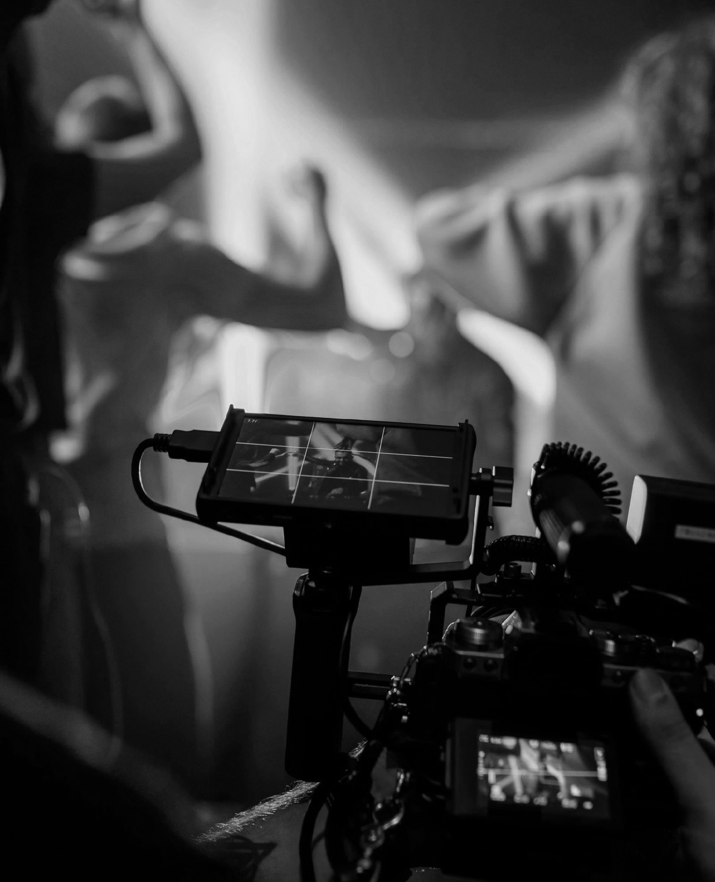
Platform Consumption
Platform Consumption
BBC Audiences are more likely to engage across a range of platforms
BBC Audiences are more likely to engage across a range of platforms
Platform: Daily Consumption | Composition | Audience Affinity
Social Media | (K81)% | (M81)
Short Form Videos | (K82)% | (M82)
Longer Videos (e.g. Vlogs) | (K83)% | (M83)
Online Articles | (K84)% | (M84)
Television | (K85)% | (M85)
Streaming Services | (K86)% | (M86)
Podcast | (K87)% | (M87)
Audience Affinity – Likelihood of BBC audiences to regularly consume a platform vs. the average audience
Base: All Audiences (2374M) // BBC All Audiences (514M)
Source: GWI Core Survey — Waves: Q1 2026, Q2 2026, Q3 2025, Q4 2025
Markets: 51 Global Markets (Excl. China, Russia, UK)
Platform: BBC TV (30 Day TV Reach)

Slide 8

Brand Discovery
Brand Discovery
BBC [AUDIENCE] are more likely to discover brands across a variety of platforms
All Audience Average
BBC Audience Affinity = Likelihood of BBC’s All Audiences to Discover a brand through platform vs. avg. All Audiences
Base: All Audiences (2374M) // BBC All Audiences (514M)
Source: GWI Core Survey — Waves: Q1 2026, Q2 2026, Q3 2025, Q4 2025
Markets: 51 Global Markets (Excl. China, Russia, UK)
Platform: BBC Cross Platform, Digital + TV (30 Day Reach)

Slide 9

AI Attitudes
Impact Audience
BBC’s [AUDIENCE] are more likely to be influenced by advertising and try new premium options
BBC Audiences are more likely to agree
(M119)
To be the first to try new things
(M120)
To purchase from brands that they have seen advertised
(M121)
Buy the premium versions of products
BBC Audience Affinity = Likelihood of BBC’s All Audiences Audience to hold Attitude vs. avg. All Audiences Audience
Base: All Audiences (2374M) // BBC All Audiences (514M)
Source: GWI Core Survey — Waves: Q1 2026, Q2 2026, Q3 2025, Q4 2025
Markets: 51 Global Markets (Excl. China, Russia, UK)
Platform: BBC Cross Platform, Digital + TV (30 Day Reach)

Slide 10
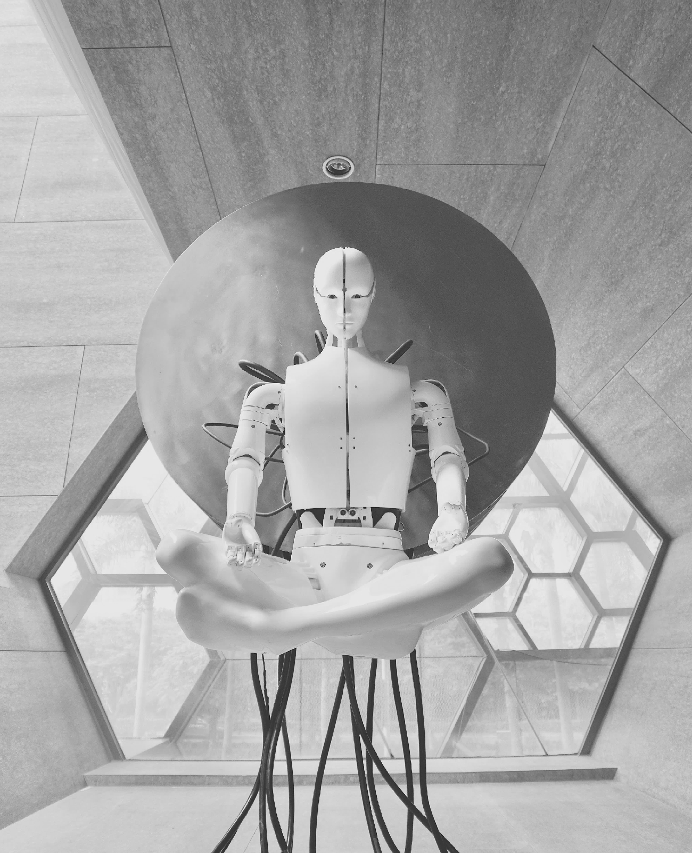
AI Attitudes
BBC Audience AI Attitudes
BBC Audiences Hold Positive Attitudes Towards AI
BBC Audiences are more likely to agree
(M108)
(M109)
AI Benefits Society
AI Enhances my daily life
(M110)
(M111)
Feel AI can answer the worlds biggest problems
AI Can create more job opportunities
BBC Audience Affinity = Likelihood of BBC’s All Audiences Audience to hold Attitude vs. avg. All Audiences Audience
Base: All Audiences (2374M) // BBC All Audiences (514M)
Source: GWI Core Survey — Waves: Q1 2026, Q2 2026, Q3 2025, Q4 2025
Markets: 51 Global Markets (Excl. China, Russia, UK)
Platform: BBC Cross Platform, Digital + TV (30 Day Reach)

