Slide 1
BIAS-VARIANCE TRADEOFF
TROY HEPPER

Slide 2
AGENDA
Review of Linear Regression
Defining Bias and Variance
Visualizing Bias and Variance
How Bias and Variance relate to over- and under-fitting
Takeaways
Notes:
What bias and variance are, where it applies

Slide 3
LINEAR REGRESSION
Linear regression is an approach for modeling the relationship between a dependent variable y and one or more independent variables denoted X.
Main concerns when building linear regression models:
Overfitting
Underfitting

Slide 4
TYPES OF ERROR
In terms of a prediction model, prediction error can be categorized into two main areas: error due to bias and error due to variance

Slide 5
WHY IS BIAS-VARIANCE TRADEOFF IMPORTANT?
Understanding how different sources of error lead to bias and variance helps us improve the data fitting process resulting in more accurate models.
Notes:
Well we have all learned about linear regression models and know that building a good model means minimizing error
So, understanding what bias and variance are and what leads to these two types of error can help us build more accurate models

Slide 6
DEFINING BIAS AND VARIANCE
Error due to Bias: the difference between the prediction of our model and the correct value which we are trying to predict
Error due to Variance: the variability of a model prediction for a given data point
Notes:
How much our predicted value changes between models

Slide 7
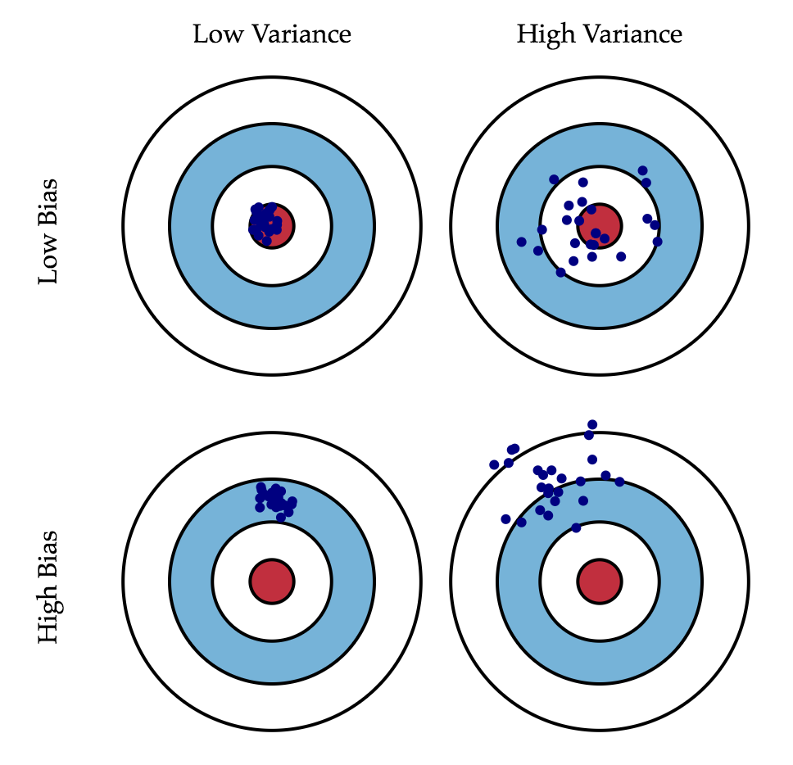
GRAPHICAL VISUALIZATION
Each blue dot on the target represents the predicted value from a different model

Slide 8
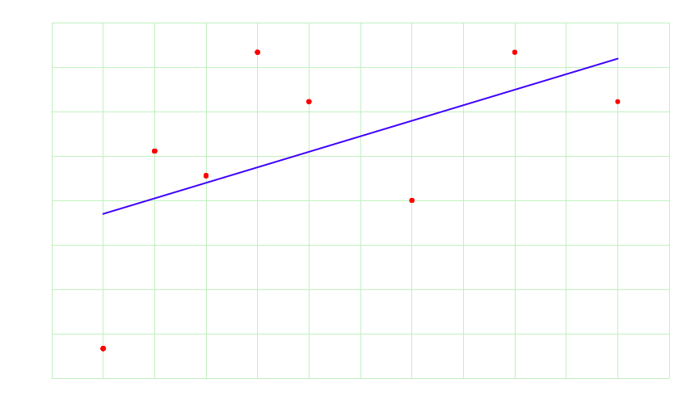
BIAS RESULTS FROM UNDERFITTING
Notes:
Underfitting is when the model does not fit the data well enough

Slide 9
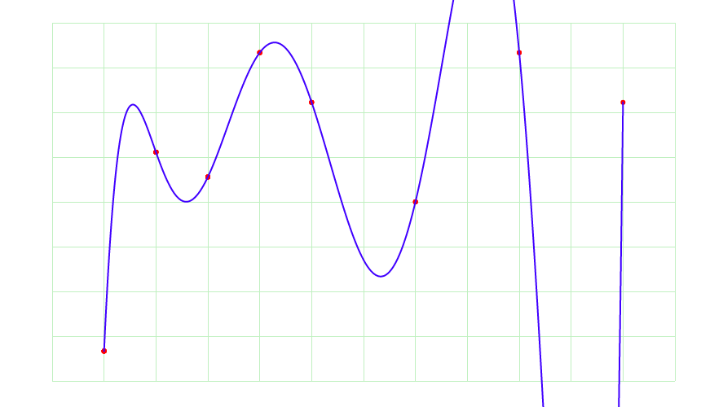
VARIANCE RESULTS FROM OVERFITTING

Slide 10
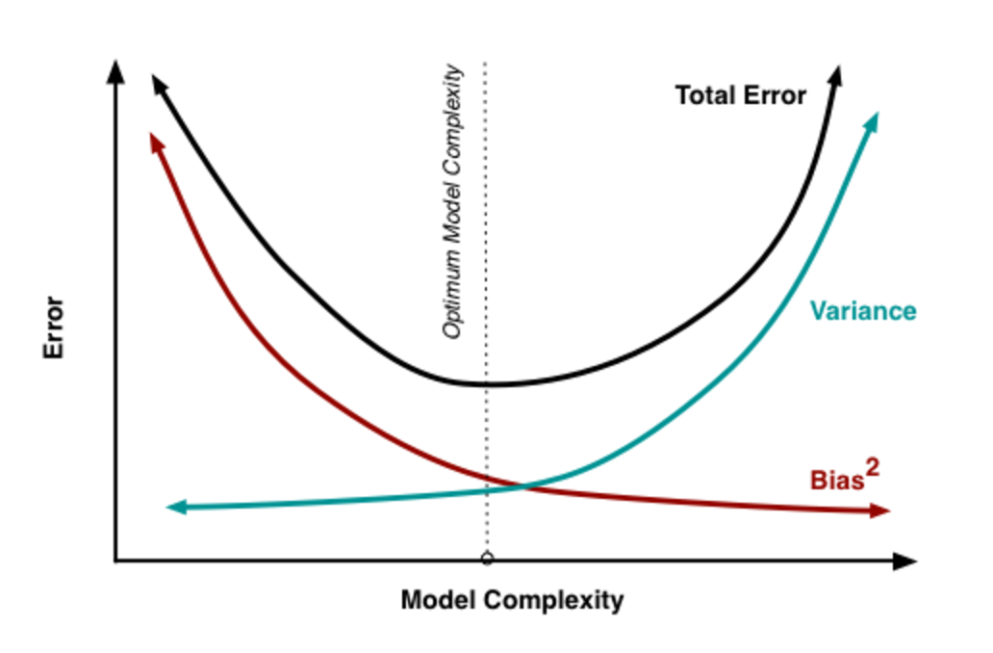
MODEL COMPLEXITY
As more and more parameters are added to a model, the complexity of the model rises and variance becomes our primary concern while bias steadily falls.

Slide 11
QUESTIONS?

